Slide 1

Predicting Car Values on Craigslist
Michigan Technological University
Michael Nicodemus

Slide 2
Introduction
Goal: People often sell items on Craigslist far under market value with the goal of selling it quickly. This research looks at vehicle data posted to the site.
Develop a model that can recognize when a vehicle is undervalued.
Interpret online automobile market trends.
Data Source: https://www.kaggle.com/austinreese/craigslist-carstrucks-data

Slide 3
Challenges
There is no required fields when posting on Craigslist, resulting in extremely messy data.
Majority of Preprocessing tasks were Imputation, Centering, and Scaling
Data size:
>400,000 observations
26 fields.
3 continuous
23 categorical
The relatively few continuous variables make it hard to produce a model that is easily interpretable.

Slide 4
Exploring the data

Slide 5
Data
Variable | Type | Definition
Price (Response) | Continuous | Listing price in US Dollars
Year | Continuous | Year the vehicle was manufactured
Odometer | Continuous | Number of miles driven on the vehicle
Manufacturer | Categorical | Manufacturing company
Model | Categorical | Name of vehicle
Fuel | Categorical | Type of fuel used (gas/diesel)
Cylinders | Categorical | Number of cylinders in engine
Drive | Categorical | Front wheel drive, Four wheel drive etc.
Condition | Categorical | Description of maintenance level
Transmission | Categorical | Automatic/Manual
Type | Categorical | Type of car. SUV, Sedan etc.

Slide 6
Non-Predictive data
Variable | Type | Definition
Latitude/Longitude | Categorical | GPS coordinates of where the vehicle is located
State/County/Region | Categorical | Geographical information
URL/Image URL | Categorical | Web addresses
VIN | Categorical | Unique identifying number of vehicle
Some of this data may have some predictive power but to improve interpretability we exclude these for now.

Slide 7
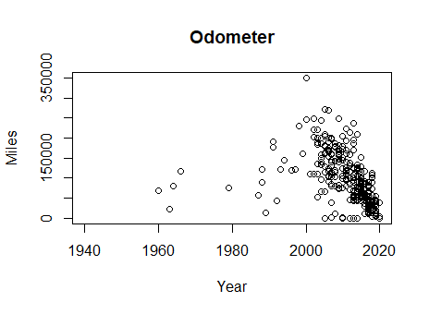
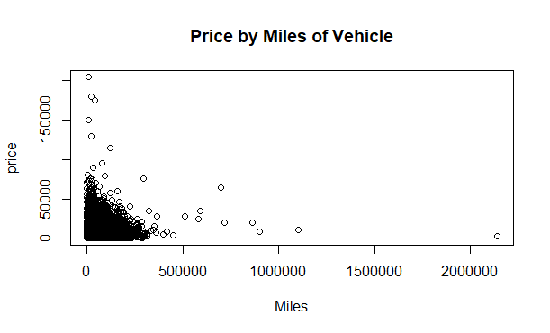
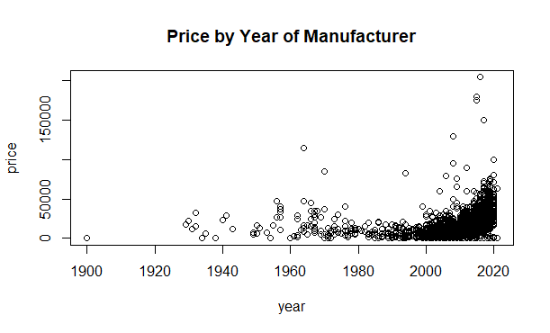
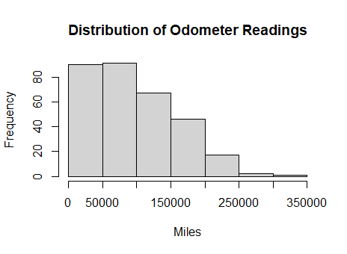
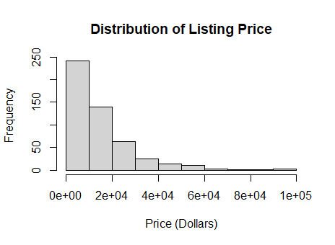
Random sample of 500 accounts shows how odometer and price are distributed as well as how the mileage relates to the year and the price.
Both predictors are heavily skewed.

Slide 8
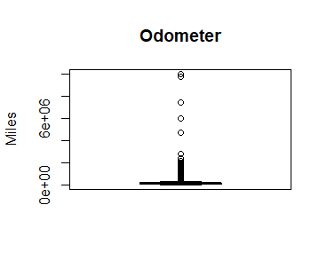
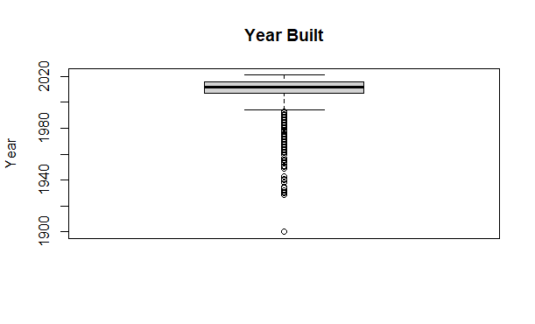
Single Variable Boxplots
Several outliers lead us to use the spatial sign transformation on the two quantitative predictors.

Slide 9
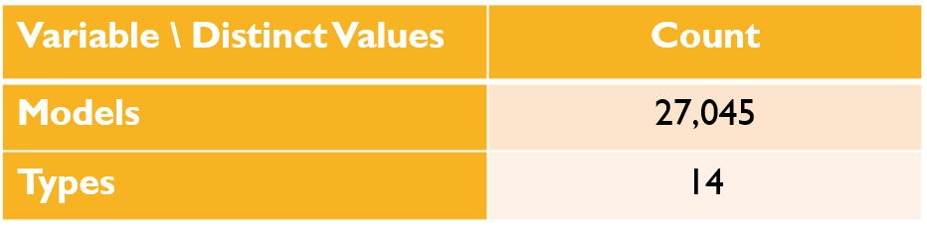
Models (of cars) and Types (also cars)
The model of a car is important in predicting it’s asking price. Since both Camaros and Ferraris are of the same type (sports car), clearly the model would be a better predictor. However, there are simply too many models to be able to incorporate into a model (model model).

Slide 10
preprocessing

Slide 11
Preprocessing Tasks
Categorical Predictors coded as dummy variables.
Find near zero variance of categorical variables.
Imputation of missing values.
Used KNN imputation.
Transform, center and scale quantitative values.
Used Box Cox transformation
Then Spatial sign.
Principal component analysis on quantitative variables.

Slide 12
Preprocessing
Most important task was to impute data into missing fields such as odometer readings. Approximately 25% did not have a valid response.
First attempt involved developing a linear model to predict mileage based on year, price and various categorical variables. The model did not perform well and returned an adjusted R squared score of 0.41
Used KNN to impute missing values.
Used spatial scaling to account for odometer and price outliers. This seemed valid since there is a population of vehicles in both high mileage and high price categories. There is no reason to think that these observations are anomalies or errors.
Conducted PCA to test for strong correlations

Slide 13
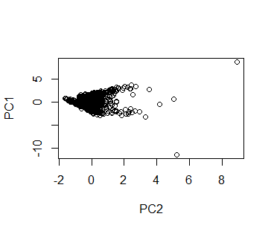
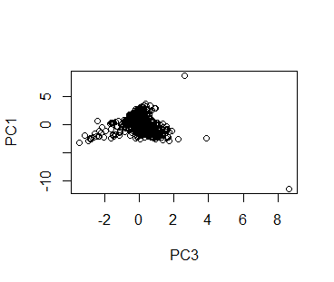
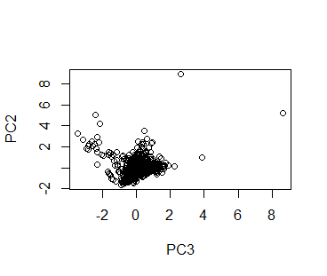
Principal Component Analysis
Principal components plotted against each other. No strong correlations appear to exist.

Slide 14
Model Building

Slide 15
Regression Models
Linear Model
Ridge Regression
LASSO
Elastic Net
Neural Network
MARS
Support Vector Machine

Slide 16
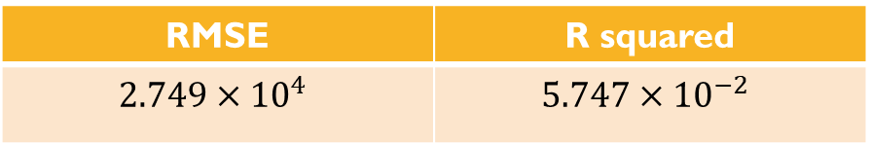
Linear Model
RMSE | R squared
$$2.749×{10}^{4}$$ | $$5.747×{10}^{−2}$$
Clearly a bad model.

Slide 17
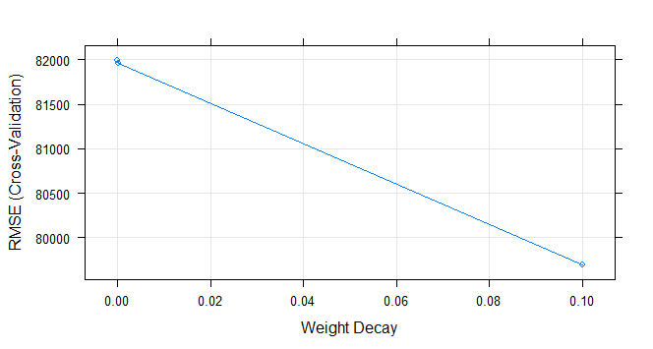
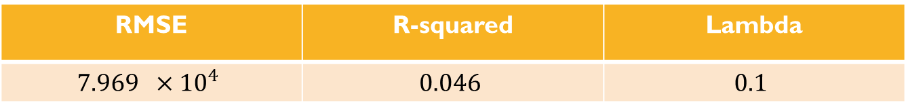
Ridge Regression
RMSE | R-squared | Lambda
$$7.969 ×{10}^{4}$$ | $$0.046$$ | $$0.1$$

Slide 18
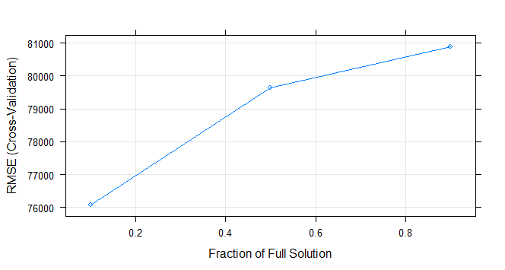
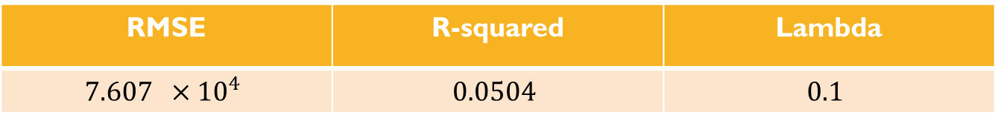
LASSO
RMSE | R-squared | Lambda
$$7.607 ×{10}^{4}$$ | $$0.0504$$ | $$0.1$$

Slide 19
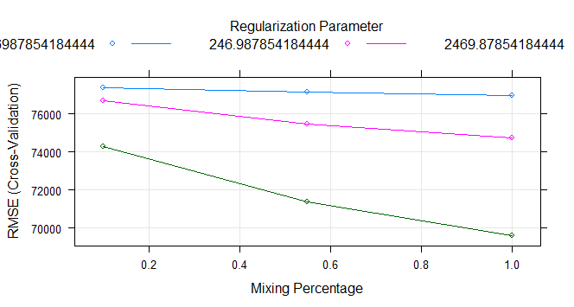
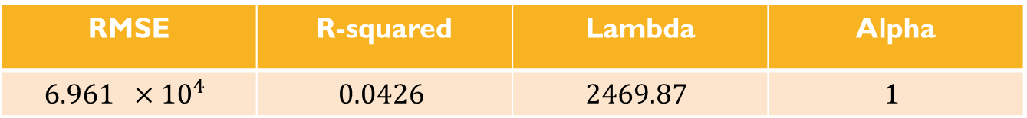
Elastic net
RMSE | R-squared | Lambda | Alpha
$$6.961 ×{10}^{4}$$ | $$0.0426$$ | $$2469.87$$ | $$1$$

