Slide 1

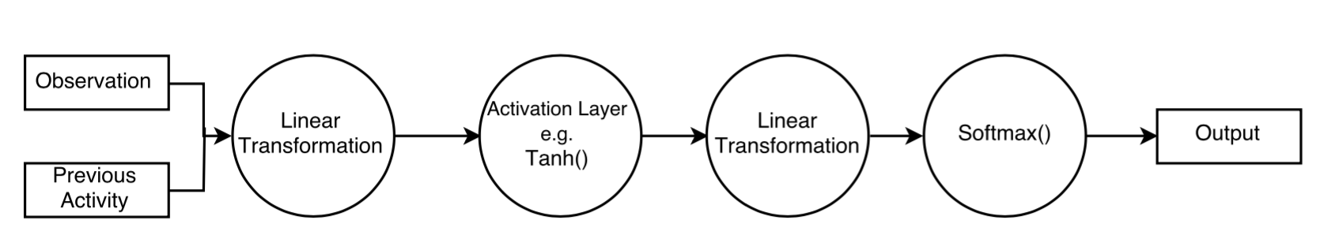
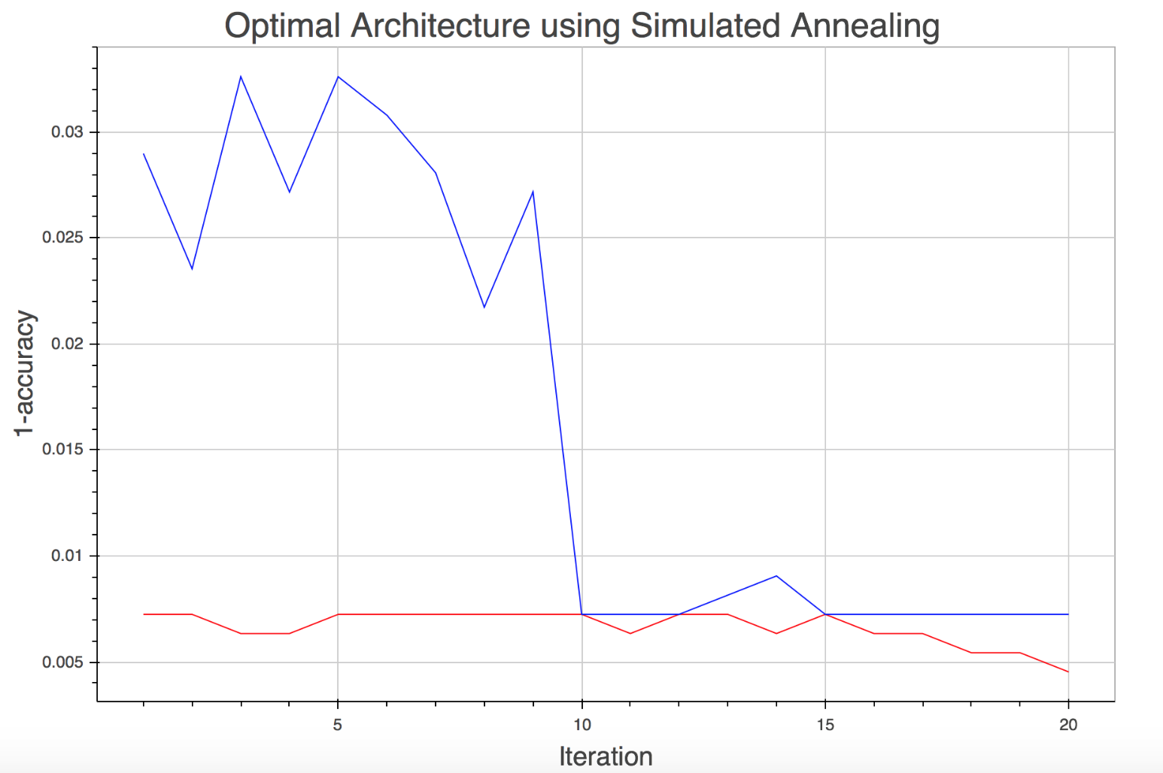
Human Activity Recognition using Time Series Analysis
Virgile Audi, Nicolas Drizard & Louie Hoang
[vaudi, nicolasdrizard, lhoang]@g.harvard.edu
AM 207 - Spring 2016
In this project, we studied various techniques to classify time series for Human activity recognition including Conditional Random Fields, Hidden Markov Models and Max-Entropy Models.
Introduction
Sensor-based activity recognition integrates the area of sensor networks with novel data mining and machine learning techniques to model a wide range of human activities.
In this project, we were interested in modeling the UCI HAR dataset and comparing various models such as Conditional Random Fields and Markov Models. To model transitions probabilities, we resorted to different techniques such as Gaussian fitting as well as Multi-Layer Perceptrons.
The latter sparked the question of how to find the MLP’s most suitable architecture: how many layers? what hidden dimensions to choose? We investigated this issue by implementing a simulated annealing algorithm to find the ‘best’ architecture.
The Models
MLP and Simulated Annealing
Conditional Random Fields
Hidden-Markov Models
Max-Entropy Markov Models
The objective of the MEMM is to find a distribution over the possible activities using features of the current observation and the previous activity recognized at each time step:
P(a_{i} | a_{i-1}, o_{i}) = softmax(f(a_{i-1}, o_{i}))
Where f(a, o) is the result yielded by the MLP. An MLP is a model that processes information through a series of interconnected computational nodes, such as linear transformation or activation layer that can propagate information in the network. This allows to skip the feature selection step.
D. Viterbi Algorithm
We used the Viterbi algorithm to find the most likely sequence of hidden states given the observations at each time step.
Choosing the architecture of an neural network is more an art than a science. We developed a simulated annealing algorithm to explore in a more systematic the range of possible architectures. The pseudo code is presented below:
Preliminary: Choose a “maximal” architecture to prune
Select a subset of this architecture as initial architecture and train the model
Evaluate the cost C_{curr} associated with this model
Sample a new architecture by perturbing the current one and evaluate the cost C_{new} after training
Accept this new architecture with probability:
exp(-(C_{new}-C_{curr})/T)
where T is a ‘temperature’ parameter
that dictates the acceptance rate
5. Repeat (2 – 4) until convergence
The Data
The data was collected by a group of 30 individuals who performed 6 activities wearing a smartphone:
For each time step, we were given a label as well as:
Triaxial acceleration from the accelerometer (total acceleration) and the estimated body acceleration.
Triaxial Angular velocity from the gyroscope.
A 561-feature vector with time and frequency domain variables
The objective of this project was to be able to classify any given time series into these 6 classes.
Walking
Walking Upstairs
Sitting
Standing
Laying
Walking Downstairs
Figure 1. Example of simple MLP architecture
Figure 2. SA for different initial architectures
Experiments and Results
Citations and Links
Data was split into a training and testing with a 70-30 ratio. We also held-out 10% of the training data as validation set.
We used Python for the CRF and HMM and Lua for the MEMM
Anguita et al.. A Public Domain Dataset for Human Activity Recognition Using Smartphones. 21th European Symposium on Artificial Neural Networks, Computational Intelligence and Machine Learning, ESANN 2013..
Arnaud et al. MLP Neural Networks Optimization through Simulated Annealing in a Hybrid Approach for Time Series Prediction. V Encontro Nacional de Inteligencia Artificial. ENIA 2005.
 | CRF | HMM | MEMM
Accuracy |  |  | 92.9%
Table 3. Accuracy on the predicted test sequence
John A. Paulson School of Engineering and Applied Sciences • Institute for Applied Computational Science

