Slide 1

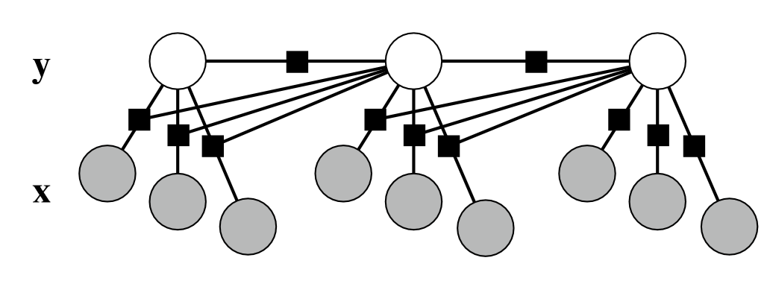
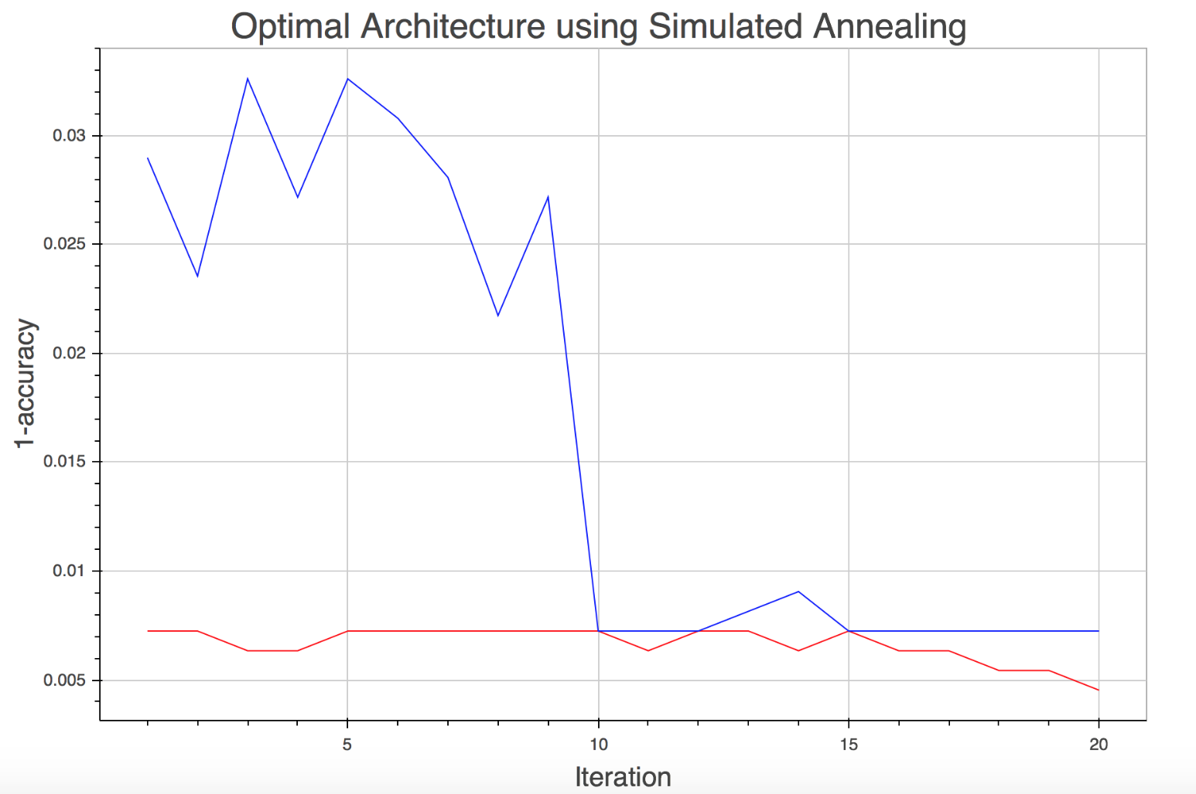
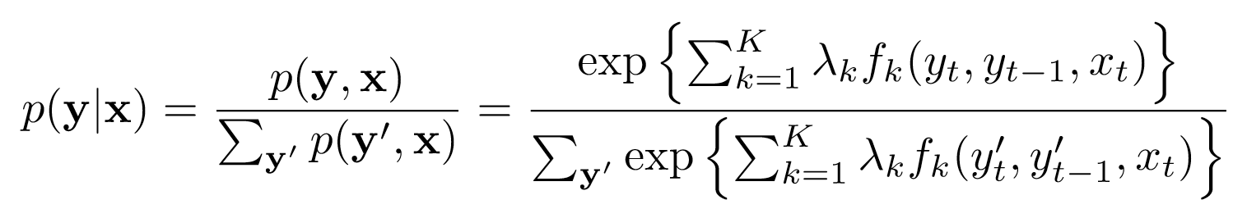
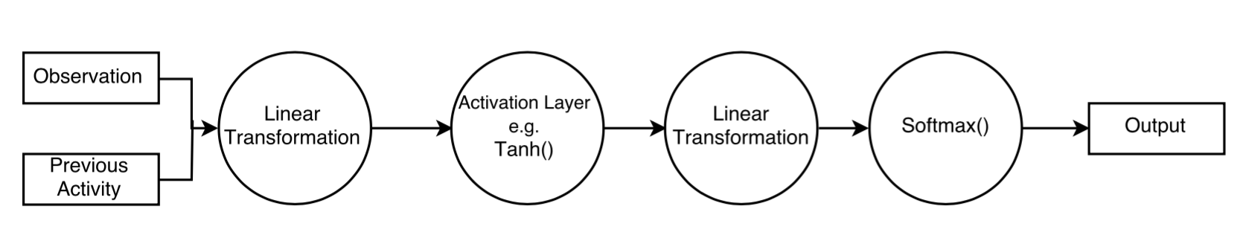
Human Activity Recognition using Time Series Analysis
Virgile Audi, Nicolas Drizard & Louie Hoang
[vaudi, nicolasdrizard, lhoang]@g.harvard.edu
AM 207 - Spring 2016
In this project, we studied various techniques to classify time series for Human activity recognition including Conditional Random Fields, Hidden Markov Models and Max-Entropy Models.
Introduction
Sensor-based activity recognition integrates the area of sensor networks with novel data mining and machine learning techniques to model a wide range of human activities.
In this project, we were interested in modeling the UCI HAR dataset and comparing various models such as Conditional Random Fields and Markov Models. To model transitions probabilities, we resorted to different techniques such as Gaussian fitting as well as Multi-Layer Perceptrons.
The latter sparked the question of how to find the MLP’s most suitable architecture: how many layers? what hidden dimensions to choose? We investigated this issue by implementing a simulated annealing algorithm to find the ‘best’ architecture.
The Models
MLP and Simulated Annealing
Hidden-Markov Models
HMM consists of a discrete-time, discrete-state Markov chain with hidden states s(t) and an observation model p(x(t) | z(t)).
The observations are assumed independent.
The joint distribution of the model is:
We focused on two tasks here: Decoding (i.e. inferring the most probable states sequence given observations and an HMM) with the Viterbi algorithm and Training (i.e. learning the best HMM parameters given an observation sequence and an initial HMM) with the Baum-Welch algorithm.
Conditional Random Fields
CRF is a discriminative sequence model and a generalization of HMM. Its optimization space is over all possible sequence labelings:
C. Max-Entropy Markov Models
The objective of the MEMM is to find a distribution over the possible activities using features of the current observation and the previous activity recognized at each time step:
P(a_{i} | a_{i-1}, o_{i}) = softmax(f(a_{i-1}, o_{i}))
Where f(a, o) is the result yielded by the MLP. An MLP is a model that processes information through a series of interconnected computational nodes, such as linear transformation or activation layer that can propagate information in the network. This allows to skip the feature selection step.
Choosing the architecture of an neural network is more an art than a science. We developed a simulated annealing algorithm to explore in a more systematic the range of possible architectures. The pseudo code is presented below:
Preliminary: Choose a “maximal” architecture to prune
Select a subset of this architecture as initial architecture and train the model
Evaluate the cost C_{curr} associated with this model
Sample a new architecture by perturbing the current one and evaluate the cost C_{new} after training
Accept this new architecture with probability:
exp(-(C_{new}-C_{curr})/T)
where T is a ‘temperature’ parameter
that dictates the acceptance rate
5. Repeat (2 – 4) until convergence
The Data
The data was collected by a group of 30 individuals who performed 6 activities wearing a smartphone:
For each time step, we were given a label and a 561-feature vector with time and frequency domain variables computing from the triaxial acceleration and angular velocity from the sensors
The objective of this project was to be able to classify any given time series into these 6 classes.
Walking
Walking Upstairs
Sitting
Standing
Laying
Walking Downstairs
Bibliography
Figure 2. SA for different initial architectures
Experiments and Results
Anguita et al.. A Public Domain Dataset for Human Activity Recognition Using Smartphones. 21th European Symposium on Artificial Neural Networks, Computational Intelligence and Machine Learning, ESANN 2013..
Arnaud et al. MLP Neural Networks Optimization through Simulated Annealing in a Hybrid Approach for Time Series Prediction. V Encontro Nacional de Inteligencia Artificial. ENIA 2005.
Kevin P Murphy, Machine learning: a probabilistic perspective, 2012
Human Activity Recognition Using Smartphone Sensors With Two-Stage Continuous Hidden Markov Models
Charissa A. Ronao, Sung-Bao Cho
2014 10th International Conference on Natural Computation
Lafferty, John, Andrew McCallum, and Fernando CN Pereira. "Conditional random fields: Probabilistic models for segmenting and labeling sequence data." (2001).
Data was split into a training and testing with a 70-30 ratio. We also held-out 10% of the training data as validation set.
We used Python for the CRF and HMM and Lua for the MEMM
 | CRF | HMM | MEMM
Accuracy |  |  | 92.9%
Figure 1. Example of simple MLP architecture
Table 3. Accuracy on the predicted test sequence

