Slide 1
GSoM Hackathon
Statistical Arbitrage
Early Warning System
Developing an LSTM-based Anomaly Detector on Bloomberg Macro Spread Data (2000–2021)
Candidates
Lorenzo Meloncelli · Nicoló Ferrari · Luca Palumbo · Antonio Fontanella
Course
New Technologies for Finance
1 111
42
4
21%

Slide 2
Agenda
1
Introduction
Dataset · Problem Statement · EWS Goal
2
Research Stage 1: Pair Selection
OPTICS Clustering · Cointegration Filters · 4 Pairs
3
Research Stage 2: Trading Models
Threshold Baseline · LSTM Anomaly Detection · Tuning
4
Conclusions
Model Comparison · Key Takeaways

Slide 3
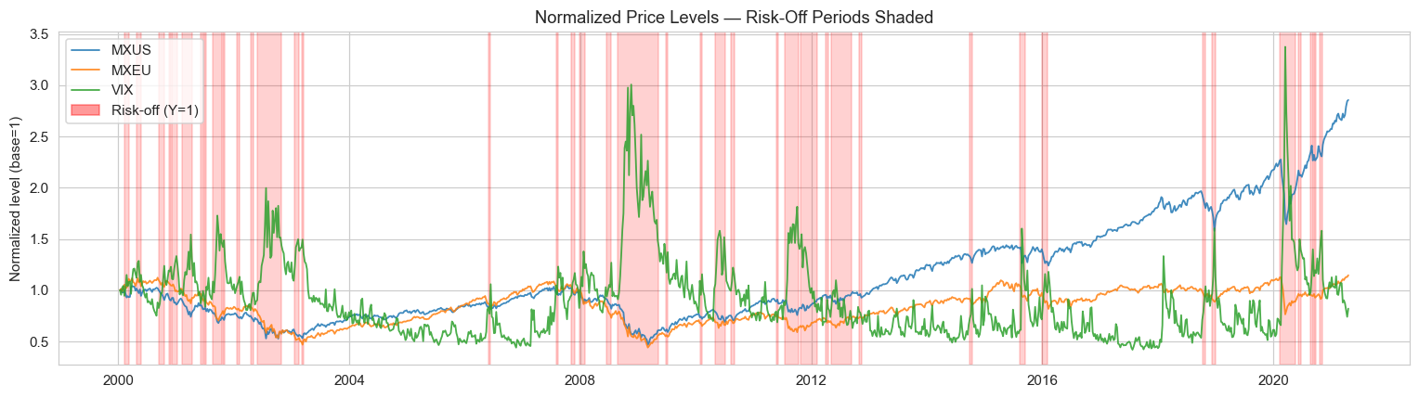
INTRODUCTION
RESEARCH STAGE 1
RESEARCH STAGE 2
CONCLUSIONS
Introduction: Dataset & Problem Statement
The goal is to build an Early Warning System (EWS) that detects when a financial spread diverges anomalously from its historical norm — framed as novelty detection on weekly macro data.
1 111 weekly observations
Risk-off episodes over time (Y=1 shaded)
January 2000 – April 2021 (21 years)
42 Bloomberg features
Bond indices, equity, FX, rates, commodities
Y = 0 → Risk-on (normal)
GOAL
874 weeks (79%) — standard market conditions
Train an LSTM on Y=0 (normal) weeks to predict the next spread value. The anomaly score is the prediction error — large errors flag stress events.
Primary metric: F1 on class Y=1.
Accuracy is misleading at ~21% prevalence.
Y = 1 → Risk-off (crisis)
237 weeks (21%) — financial stress events
GSoM Hackathon · Statistical Arbitrage EWS · Zenti Bloomberg Dataset
3

Slide 4
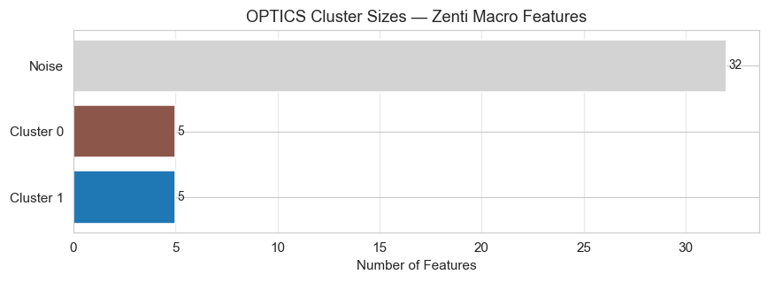
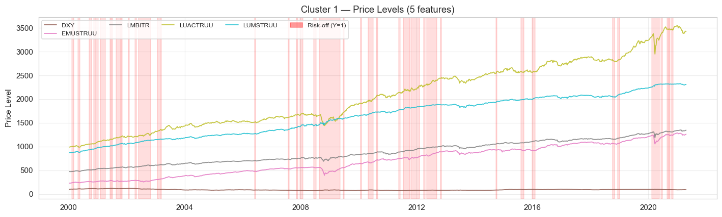
INTRODUCTION
RESEARCH STAGE 1
RESEARCH STAGE 2
CONCLUSIONS
Research Stage 1: Pairs Space Definition
With 42 Bloomberg features there are ~861 possible pairs. Most share no economic rationale for cointegration. We use unsupervised clustering to restrict the search to economically related instruments.
OPTICS cluster sizes
Goal
Efficiently pre-segment the feature universe without limiting combinations or requiring exhaustive search.
Solution
OPTICS (Ordering Points To Identify the Clustering Structure) on PCA-reduced weekly returns (10 components, 99.7% variance).
Normalized price series — Cluster 1 (5 features, 20 candidate pairs)
Result
2 clusters (10 features total) · 32 noise features excluded · 20 candidate pairs to evaluate.
GSoM Hackathon · Statistical Arbitrage EWS · Zenti Bloomberg Dataset
4

Slide 5
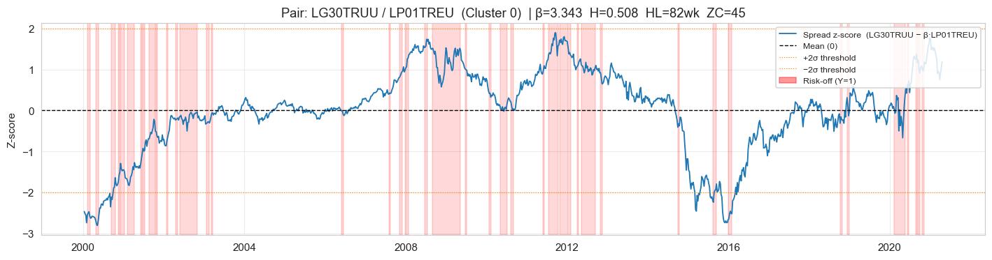
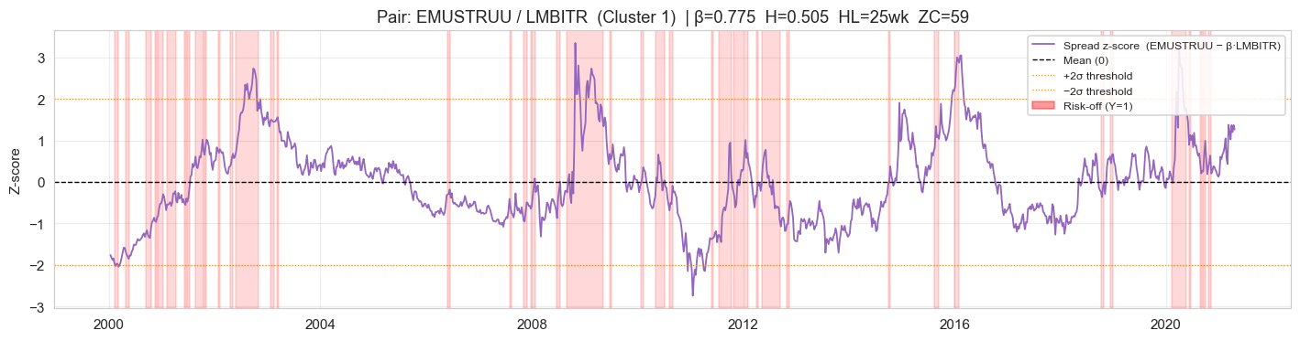
INTRODUCTION
RESEARCH STAGE 1
RESEARCH STAGE 2
CONCLUSIONS
Research Stage 1: Pairs Selection
A pair is accepted only if it passes all four statistical criteria applied in sequence. Failure at any step immediately discards the pair.
Non-stationarity
Cointegration spreads (z-scored) — green=long · red=short · pink=risk-off
1
ADF p-value > 0.10 on each price level → both legs must be I(1) random walks.
2
Cointegration
Engle-Granger OLS: spread must be stationary (ADF p < 0.10) with positive β.
3
Hurst Exponent
H < 0.55 on the spread → confirms mean-reverting behaviour.
4 Selected Pairs
Half-life
Pair | β | Half-life | Hurst
LG30TRUU / LP01TREU | 3.343 | 82 wk | 0.508
LP01TREU / MXEU | 0.101 | 64 wk | 0.549
EMUSTRUU / LMBITR | 0.775 | 25 wk | 0.505
LMBITR / LUACTRUU | 0.348 | 32 wk | 0.535
4
Ornstein-Uhlenbeck half-life between 2 and 156 weeks → practical mean reversion.
20 pairs tested → 15 rejected at cointegration · 1 at Hurst · 4 PASSED
GSoM Hackathon · Statistical Arbitrage EWS · Zenti Bloomberg Dataset
5

Slide 6
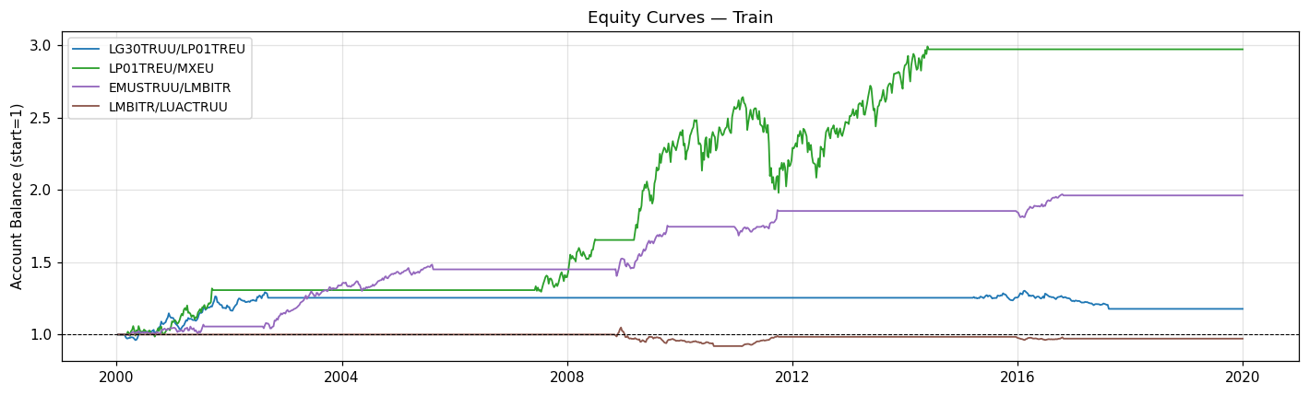
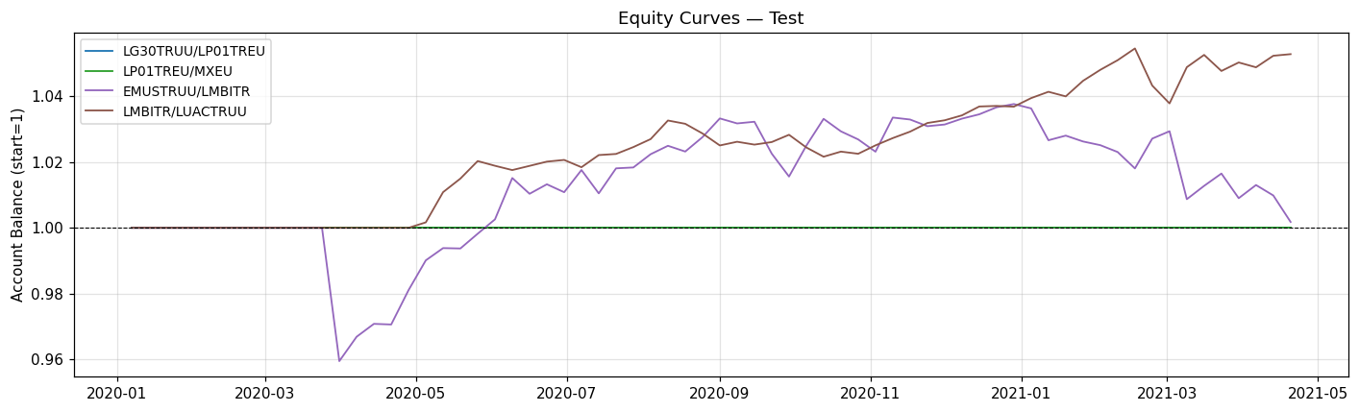
INTRODUCTION
RESEARCH STAGE 1
RESEARCH STAGE 2
CONCLUSIONS
Research Stage 2: Threshold Baseline Model
A z-score threshold strategy is used as baseline. It provides a simple, interpretable benchmark against which the LSTM model is evaluated.
Signal Logic
Portfolio equity curves — Train (Jan 2000 – Dec 2019)
→ Compute z-score using train mean/std only (no leakage)
→ LONG when z < −2σ (spread below historical norm)
→ SHORT when z > +2σ (spread above historical norm)
→ Exit when z crosses 0 (mean reversion complete)
→ 1-week execution delay · 5-bar stabilising period
Portfolio equity curves — Test (Jan 2020 – Apr 2021 · COVID)
Data Split
Train Jan 2000 – Dec 2019 (~1040 wks) ← StandardScaler fit here
Test Jan 2020 – Apr 2021 (~70 wks) ← COVID stress period
GSoM Hackathon · Statistical Arbitrage EWS · Zenti Bloomberg Dataset
6

Slide 7
INTRODUCTION
RESEARCH STAGE 1
RESEARCH STAGE 2
CONCLUSIONS
Research Stage 2: Threshold Model — Performance Evaluation
Per-pair results
Pair | Train Sharpe | Train ROI | Test Sharpe | Test ROI
LG30TRUU / LP01TREU | 0.518 | +17.77% | 0.000 | 0.00%
LP01TREU / MXEU | 0.901 | +197.38% | 0.000 | 0.00%
EMUSTRUU / LMBITR | 1.566 | +96.26% | 0.058 | +0.18%
LMBITR / LUACTRUU | −0.170 | −2.83% | 2.119 | +5.29%
Portfolio | 0.950 | avg +77.2% | 0.930 | avg +1.37%
Train Portfolio Sharpe
Test Portfolio Sharpe
Avg Test ROI
Test Trades
0.950
0.930
+1.37%
2 (2W/0L)
Observations
The threshold model is robust across training but nearly inactive during the COVID test window. The ±2σ threshold is calibrated on training variance; COVID drives spreads far beyond 2σ, generating only 2 trades. LMBITR/LUACTRUU is the sole active pair. Test performance is stable but modest (+1.37% ROI).
GSoM Hackathon · Statistical Arbitrage EWS · Zenti Bloomberg Dataset
7

Slide 8
INTRODUCTION
RESEARCH STAGE 1
RESEARCH STAGE 2
CONCLUSIONS
Research Stage 2: LSTM Anomaly Detection Model
The LSTM is trained exclusively on Y=0 (risk-on) weeks. It learns what 'normal' spread dynamics look like. Large prediction errors signal anomalous market behaviour.
Input Window
spread[t−W:t]
LSTM Layer
(hidden units)
Dropout
(p = 0.2)
Dense(1)
spread[t+1]
Anomaly Score
|actual−pred|
▶
▶
▶
▶
Train on normal only
Signal Formula
No knowledge of crises during training — the LSTM defines 'normal'.
anomaly_score(t) =
Anomaly = prediction error
| spread_actual(t) − spread_predicted(t) |
High |actual−pred| ↔ the spread is doing something unexpected.
signal = 1 if score(t) > threshold
Directional entry
Direction:
actual < pred → LONG (spread below expectation, mean-revert up).
actual > pred → SHORT (spread above expectation, mean-revert down).
actual < predicted → LONG
actual > predicted → SHORT
CV-tuned threshold
Position held while score > threshold. Threshold never set using test data.
Exit when score drops below threshold
GSoM Hackathon · Statistical Arbitrage EWS · Zenti Bloomberg Dataset
8

Slide 9
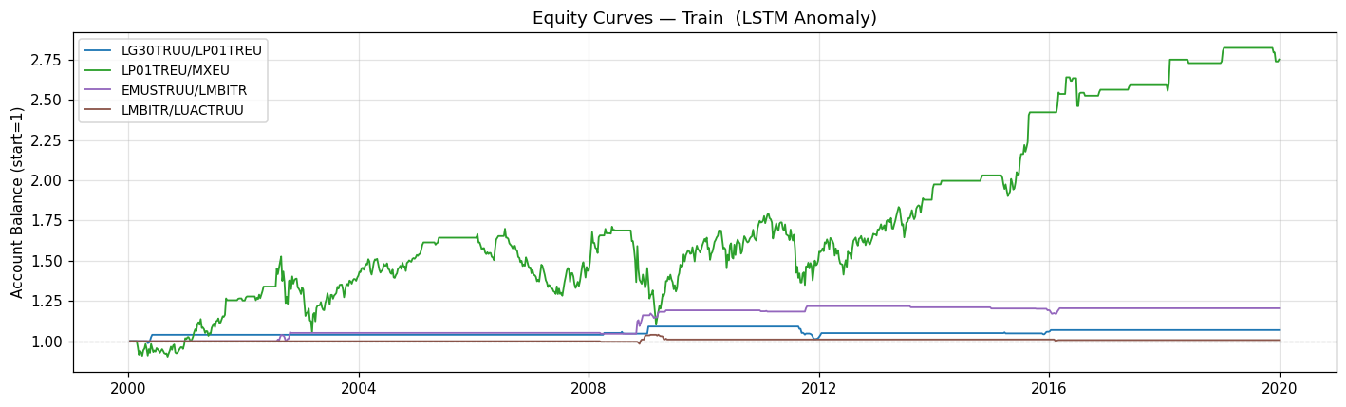
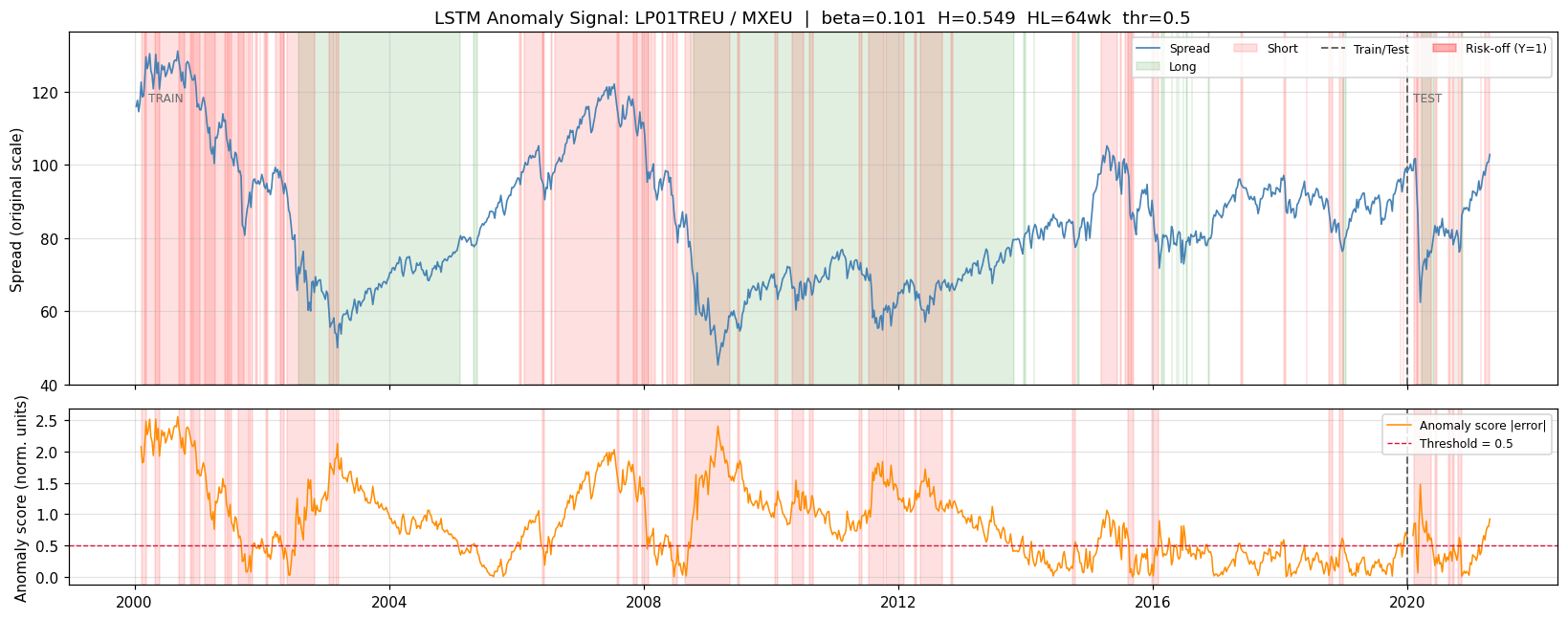
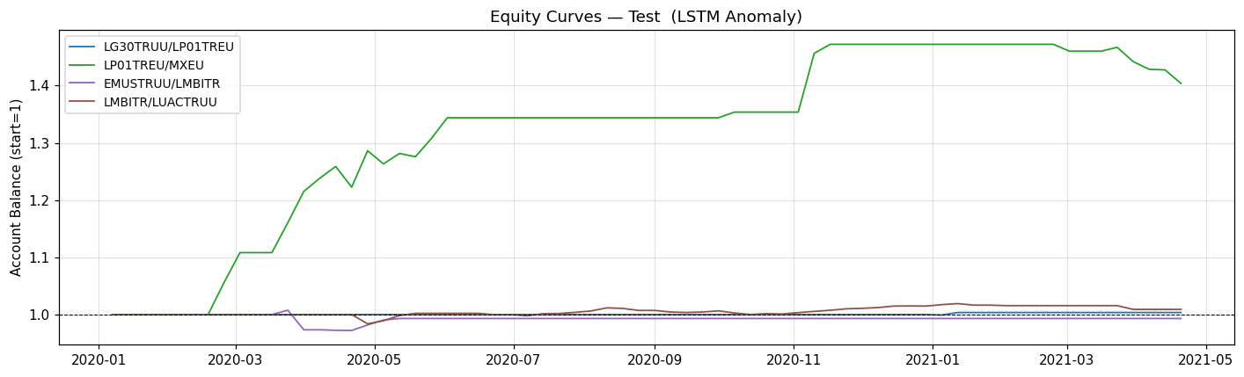
INTRODUCTION
RESEARCH STAGE 1
RESEARCH STAGE 2
CONCLUSIONS
Research Stage 2: LSTM Model — Performance Evaluation
Portfolio equity curves — Train (Jan 2000 – Dec 2019)
Anomaly signal — LP01TREU / MXEU (star pair, Sharpe=4.01)
Portfolio equity curves — Test (Jan 2020 – Apr 2021 · COVID)
Test Results (Jan 2020 – Apr 2021)
Portfolio Sharpe
Avg ROI
2.596
+10.23%
Avg Annual ROI
Total Trades
+7.60%
14 (9W/5L)
LP01TREU/MXEU — COVID crash caught cleanly: Sharpe=4.01 · ROI=+40.38% in ~70 weeks
GSoM Hackathon · Statistical Arbitrage EWS · Zenti Bloomberg Dataset
10

Slide 10
INTRODUCTION
RESEARCH STAGE 1
RESEARCH STAGE 2
CONCLUSIONS
Conclusions: Model Comparison
Two experiments with different train/test splits allow understanding of the LSTM's regime-specific behaviour.
Exp 1 Train 2000–2017 · Test 2018–2021 (3.3 yr — COVID embedded in long window)
Exp 2 Train 2000–2019 · Test 2020–2021 (COVID as dedicated test window) ★
Metric | Threshold Exp 1 | Threshold Exp 2 | LSTM Exp 1 | LSTM Exp 2 ★
Portfolio Sharpe | 0.853 | 0.930 | −0.195 | 2.596
Avg ROI | +1.22% | +1.37% | −1.13% | +10.23%
Avg Annual ROI | +0.37% | +1.03% | −0.34% | +7.60%
Total Trades | 2 | 2 | 19 | 14
Win Rate | 100% | 100% | 37% | 64%
Max Drawdown | −4.72% | −1.01% | n/a | −1.75%
LSTM vs Threshold (Sharpe delta) | — | — | −1.048 | +1.666 ↑
Key Insight:
The LSTM's edge is regime-specific. In Exp 2, with COVID as the entire test window, the anomaly score spikes sharply on the March 2020 crash and markets recover: Sharpe=2.596, ROI=+10.2%. In Exp 1, where COVID is diluted over 3.3 years, the model loses money (Sh=−0.195).
GSoM Hackathon · Statistical Arbitrage EWS · Zenti Bloomberg Dataset
11

Slide 11
INTRODUCTION
RESEARCH STAGE 1
RESEARCH STAGE 2
CONCLUSIONS
Conclusions
1
2
Threshold model is robust but inert under COVID
LSTM is purpose-built for regime breaks
The ±2σ threshold is calibrated on training variance. COVID drives spreads far beyond 2σ, generating only 2 trades across both experiments. Performance is stable but nearly identical (+1.22% vs +1.37%).
When the entire test window is the COVID shock (Exp 2), the anomaly detector spikes, positions are entered, and markets recover: Portfolio Sharpe=2.596, Avg ROI=+10.23%. The model's edge is context-dependent.
3
4
LP01TREU / MXEU is the key driver
Train Sharpe does not predict test Sharpe for the LSTM
European IG bonds vs MSCI Europe equities compressed severely in the COVID crash and rebounded fast. The LSTM caught this cleanly: ROI=+40.4%, Sharpe=4.01 in ~70 weeks.
Exp 1 train Sharpe (0.847) > Exp 2 (0.563), yet test results reverse completely (−0.195 vs +2.596). The model's advantage emerges only when the test contains a genuine out-of-distribution event.
GSoM Hackathon · Statistical Arbitrage EWS · Zenti Bloomberg Dataset
12

Slide 12
Thank you
for your attention!
GSoM Hackathon · Statistical Arbitrage EWS · Zenti Bloomberg Dataset

