Slide 1
HYDRAS
HYdrodynamic-aware Distributed Robots for mArine Source-seeking

Slide 2
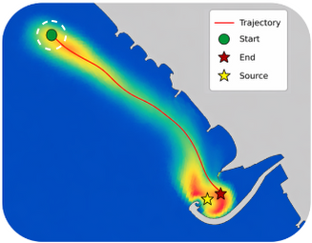
Marine source seeking
Guide autonomous marine vehicles toward an unknown pollutant source using pointwise concentration measurements
Local sensing in space and time: each sensor measures concentration at its own location at discrete sampling times, without observing the full field or the source position
Dynamic concentration field: advection and diffusion redistribute the pollutant, so the local concentration gradient may not point toward the source
Motion guided by measurements: use successive observations to decide where to sample next and steer the vehicles toward the source as the field evolves
Notes:
La sorgente è fissa, ma il campo evolve: dopo aver rilevato il plume, vogliamo guidare il veicolo fino a un intorno della sorgente, senza conoscerne la posizione.

Slide 3
Source-seeking methods: main approaches
MODEL-BASED
MODEL-FREE
Training-free
Reinforcement Learning
Transport-model inversion
Bayesian source estimation
Information-driven planning
Use source estimates and uncertainty to guide motion
Sensitive to model mismatch; may require substantial online computation
Field climbing
Extremum seeking
Bio-inspired plume tracing
No offline training; typically low online computational cost
Rely on predefined search rules; gradient-based search can stall in weak gradients or converge to local concentration maxima
Policy: maps observations and memory to motion commands
Training: learns the policy through interaction with simulated world to maximize cumulative reward
Fast online action selection; no transport-model solution
Depends on reward design and training coverage; generalization to unseen conditions requires validation
📄 Zhang, Qin, Tang, Li, “Distributed information-based source seeking,” IEEE Trans. on Robotics, 2023
📄 Briñón-Arranz, Renzaglia, Schenato, “Multirobot Symmetric Formations for Gradient and Hessian Estimation With Application to Source Seeking,” IEEE Trans. on Robotics, 2019
📄 Hu, Song, Chen, “Plume Tracing via Model-Free Reinforcement Learning Method,” IEEE Trans. on Neural Networks and Learning Systems, 2019
Notes:
Chen, Rhodes, Liu, Dual Control for Exploitation and Exploration (DCEE) in autonomous search, Automatica, 2021.
Vergassola, Villermaux, Shraiman, ‘Infotaxis’ as a strategy for searching without gradients, Nature, 2007.
Bio-inspired plume tracing: Li, Farrell, Pang, Arrieta, Moth-inspired chemical plume tracing on an autonomous underwater vehicle, IEEE Transactions on Robotics, 2006.
Ariyur & Krstić (2003), Real-Time Optimization by Extremum-Seeking Control, Wiley.
Intrappolamento di FCM nei massimi locali non va attribuito automaticamente a tutti i metodi training-free
Esistono anche metodi ibridi e model-based RL.
Our approach: offline training in hydrodynamic simulations; online source seeking through a learned feedback policy.

Slide 4
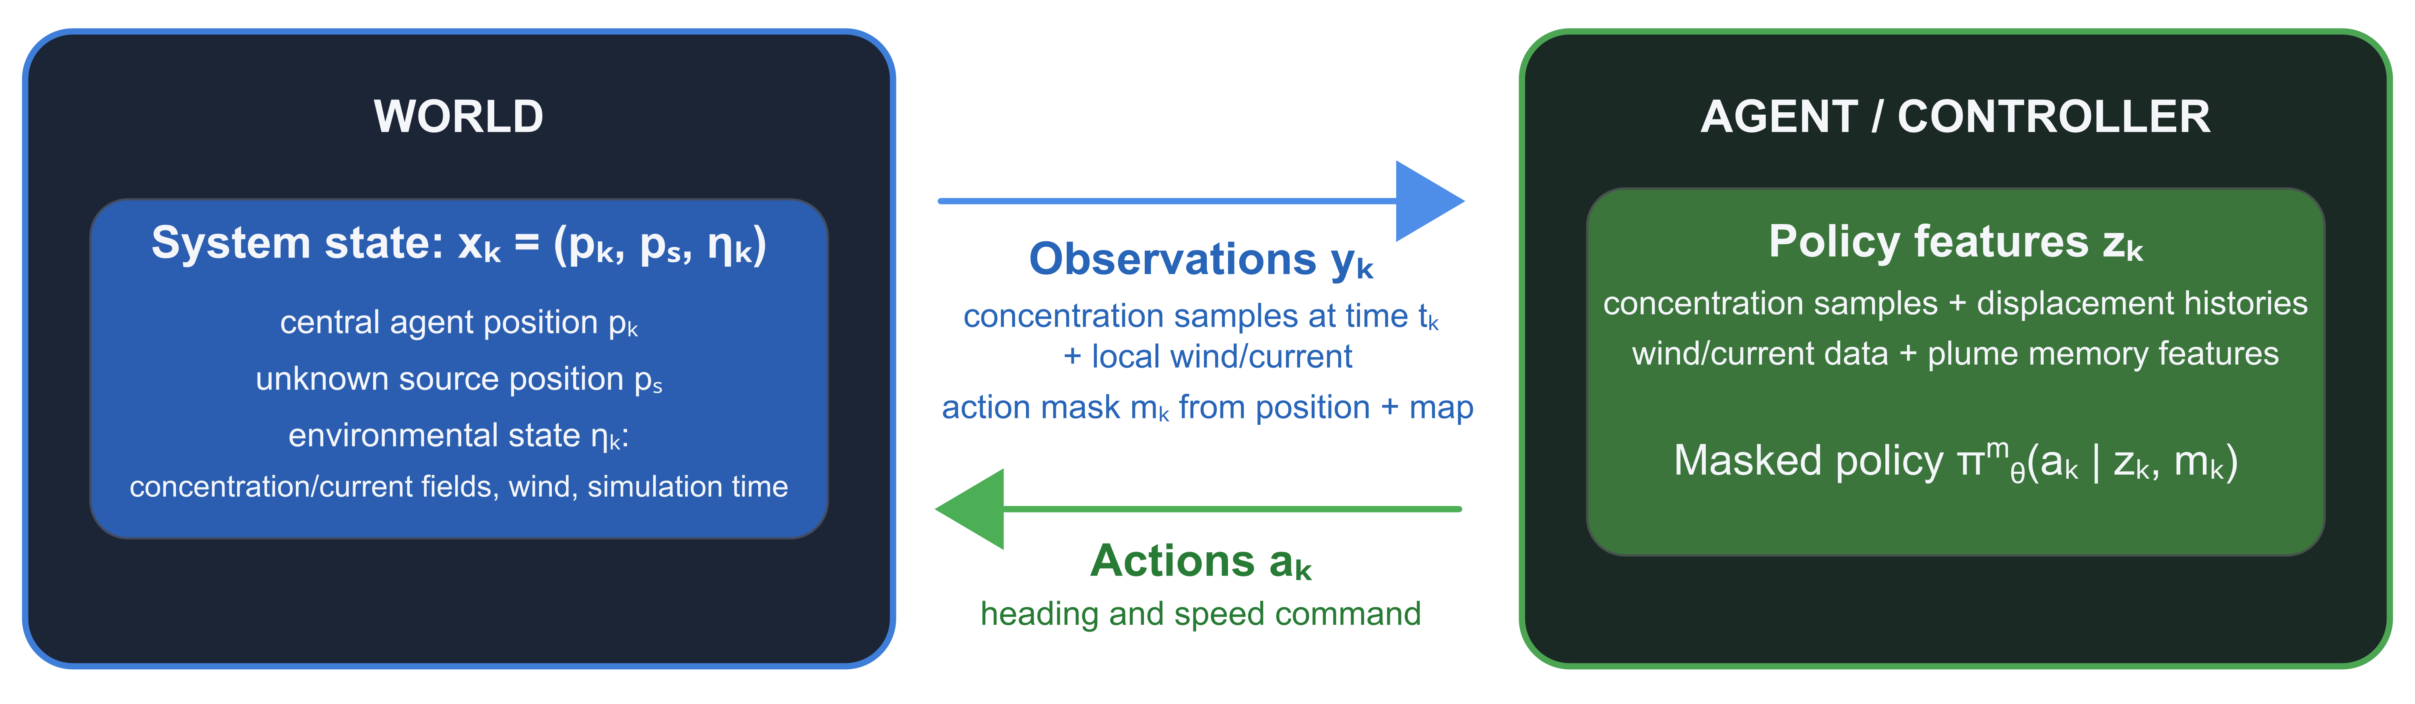
Source seeking as a partially observable Markov decision process
Actions: select the central agent’s heading and speed from admissible commands
Objective: reach a neighbourhood of the unknown source as quickly as possible using local measurements
Offline training: learn a feedback policy through interaction with high-fidelity hydrodynamic simulations
Online execution: use local measurements and memory to select admissible motion commands, without solving transport equations or explicitly estimating the source position
Notes:
La sorgente e i campi ambientali non sono completamente osservabili: il controllore sceglie le azioni usando misure locali e memoria delle informazioni raccolte.
Plume memory features: max concentration, relative location, and time since last detection.

Slide 5
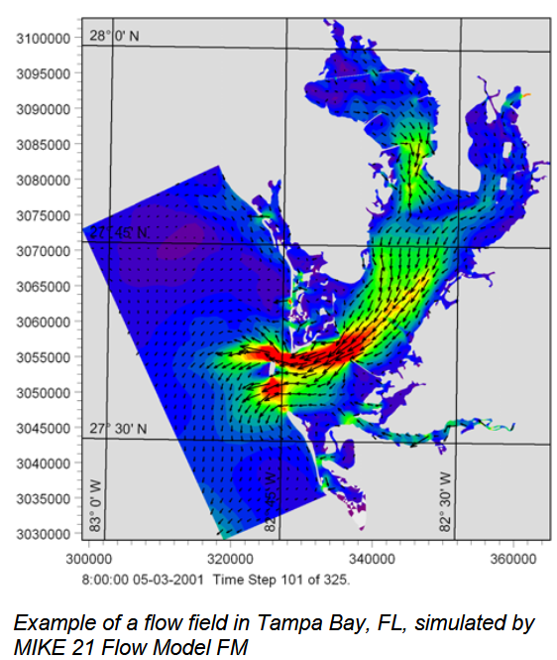
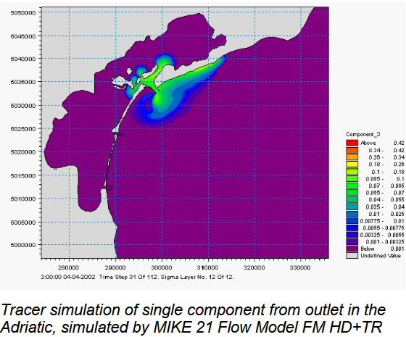
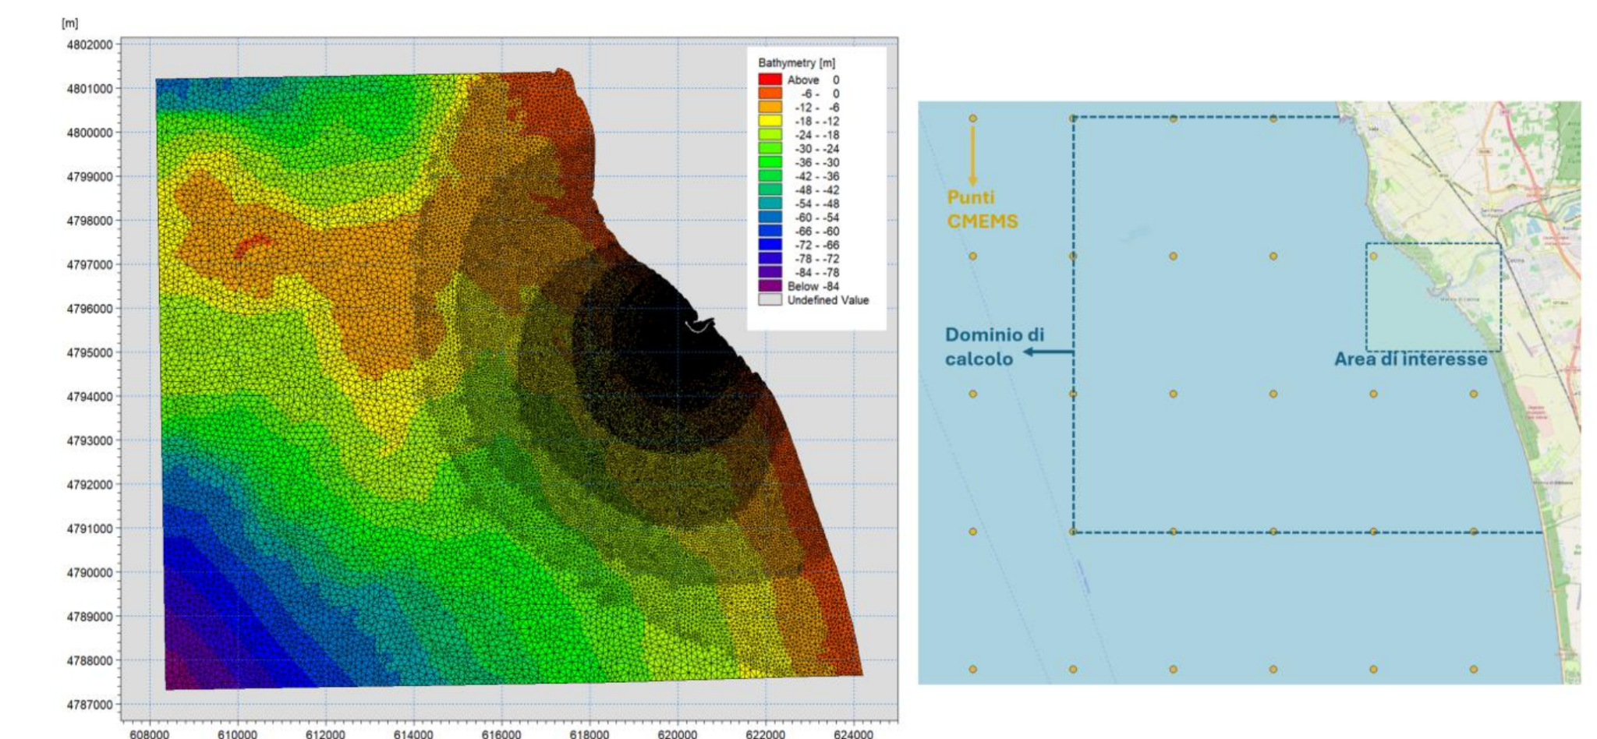
Dataset: hydrodynamic and transport modelling
Pollutant concentration fields from MIKE21 Flow Model FM (DHI): 2D shallow-water equations, Eulerian advection-diffusion of a non-reactive tracer
Domain: Cecina bay (~16 × 14 km), triangular mesh with variable resolution (~10 m near the port, ~150 m offshore)
Hydrodynamic downscaling: from Mediterranean basin (~4.5 km) to local coastal mesh (~10 m)
Environmental forcing: CMEMS currents and sea level at open boundaries (Flather conditions), plus time-varying, spatially uniform ERA5 wind
Reference hydrodynamic regime: Class 2 (moderate currents, persistent direction and low sea-level variability, selected from four clusters of CMEMS data)
Dataset

Slide 6
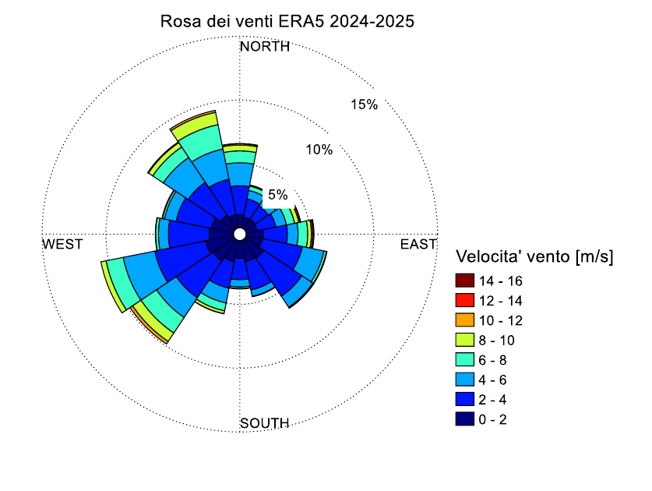
Dataset: wind scenarios
Class V0: calm/light wind conditions; low-intensity wind (approximately 1.5-2 m/s), with no significant prevailing direction
Class V1: persistent wind from the NW; prevailing direction between 310° and 330°, with a typical duration of 8-12 hours and speeds up to 8-10 m/s
Class V2: persistent wind from the SW; prevailing direction between 230° and 250°, with a typical duration of 8-12 hours and speeds up to 8-10 m/s
Class V3: wind from the eastern sector; prevailing direction between 110° and 130°, with a typical duration of 8-12 hours and speeds up to 6-8 m/s
Dataset

Slide 7
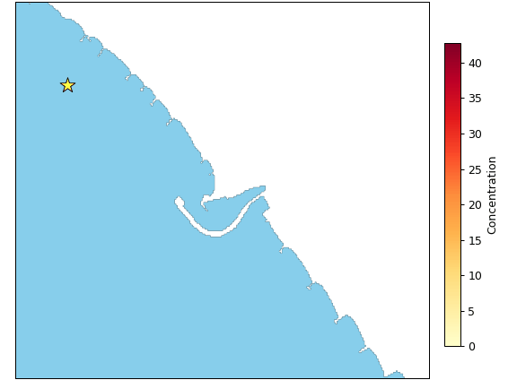
Dataset: training and evaluation setup
Dataset format: NetCDF concentration and current fields on a 10 m grid, sampled every 2 min over a 3 × 2.5 km coastal window
Source scenarios: 132 source locations (~200 m spacing), each simulated under four wind scenarios with identical, constant release conditions (50 L/s)
Training and evaluation: 106 source locations for training and 26 held-out locations for evaluation
Initial plume age: episodes start at 25%, 50% or 75% of the simulated time series, exposing the agent to different stages of plume evolution
  Q1/4 (compact)
  Q1/2 (partly dispersed)
  Q3/4 (heavily dispersed)
From dataset to simulations

Slide 8
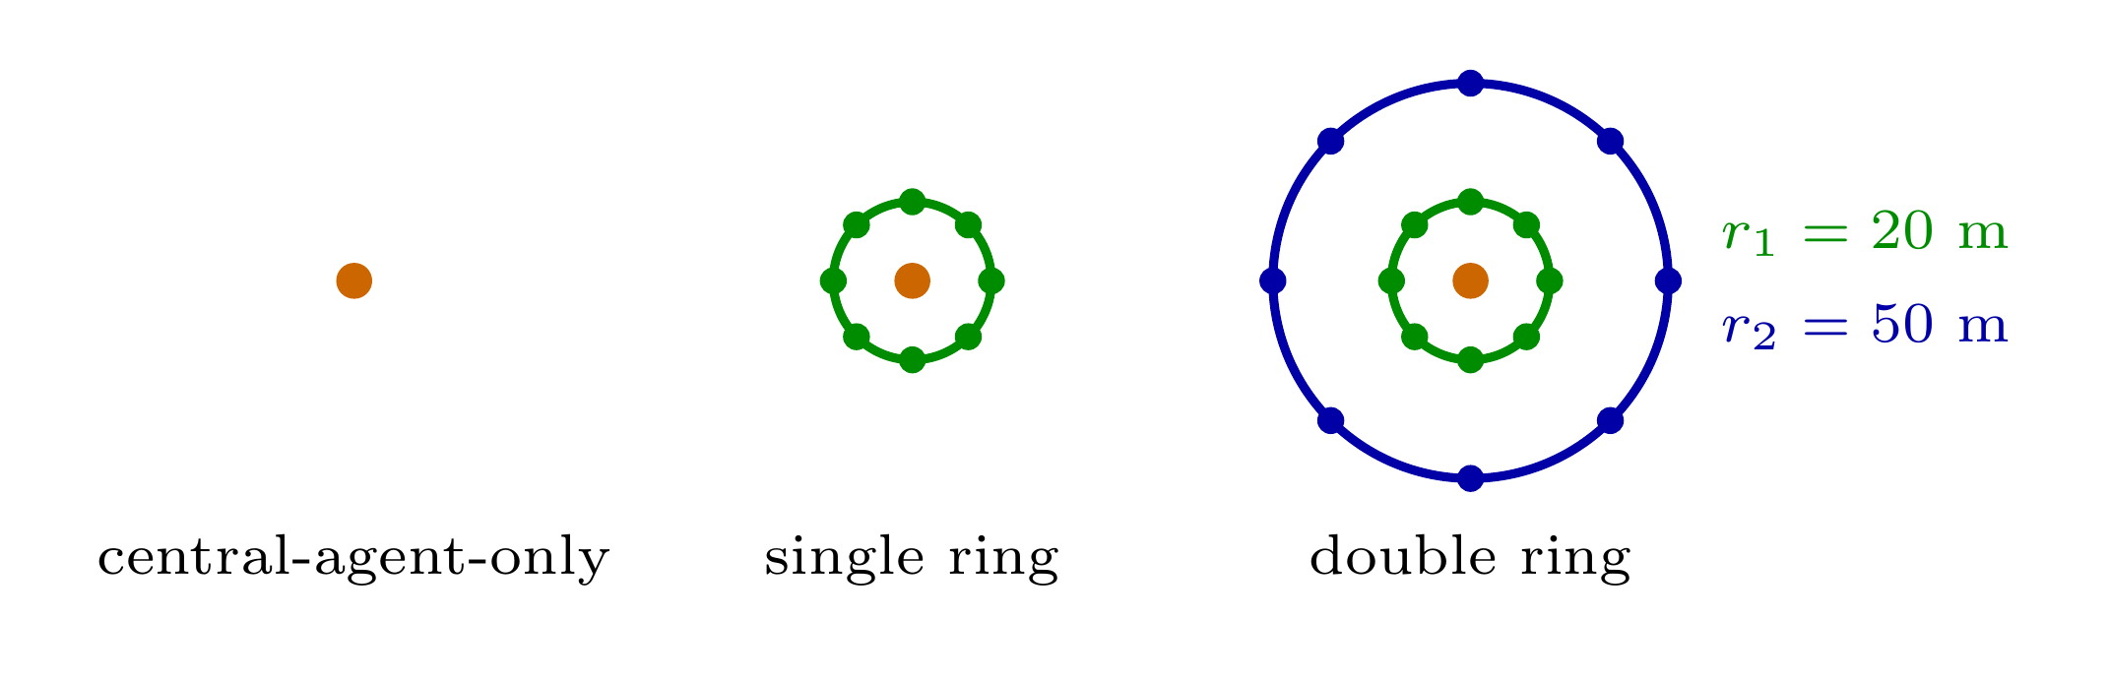
Centralized fixed-formation sensing
Centralized control: one policy selects the central agent’s action using all available measurements
Three sensing configurations: central agent only; one ring with 8 additional sampling points at 20 m; two rings with 8 further points at 50 m
Ideal co-moving sensors: ring locations maintain fixed offsets from the central agent, measurements instantaneously available to the policy
Single-agent decision process: ring sensors have no independent policies or vehicle dynamics; communication constraints are not modeled
Notes:
The joint observation mimics spatially distributed measurements, but follower dynamics, communication, and formation transients are absent.
The second ring tests whether a longer spatial look-ahead improves the learned policy.

Slide 9
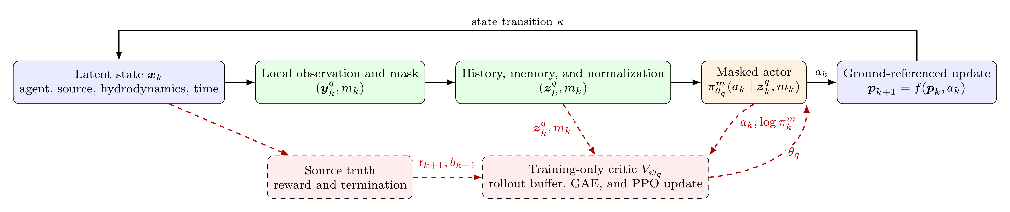
Policy architecture and training: Maskable PPO
Architecture
Policy input: 36/116/196 features for central-only/single-ring/double-ring sensing; current + 9 previous measurements
Actor-critic networks: separate MLPs, each with two 256-unit hidden layers and tanh activations
Action space: 40 heading-speed combinations (8 headings × 5 speed levels)
Action masking: exclude commands whose endpoints lie on land or outside the domain before selecting an action
Training
Masked PPO: clipped policy updates with Generalized Advantage Estimation (GAE)
Parallel sampling: 6 environments × 4,096 steps = 24576 transitions per rollout
Optimization: minibatches of 128 transitions, up to 10 epochs per update, clipping parameter ε = 0.15
Notes:
Training architecture:
-Solid arrows are available during policy execution
-Dashed red arrows identify privileged source information and optimization operations used only during training or evaluation
True source distance determines reward and success, but it never enters the actor input

Slide 10
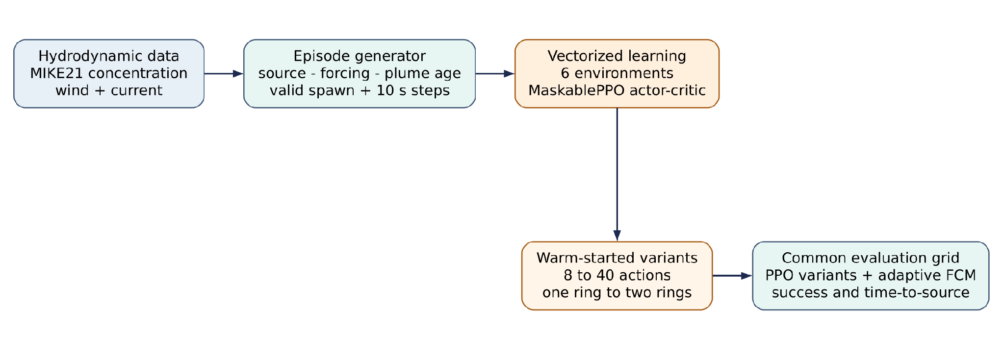
Hydrodynamic data flow

Slide 11
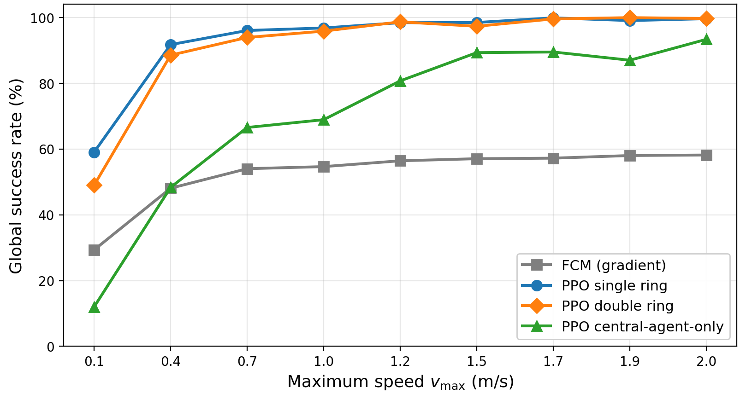
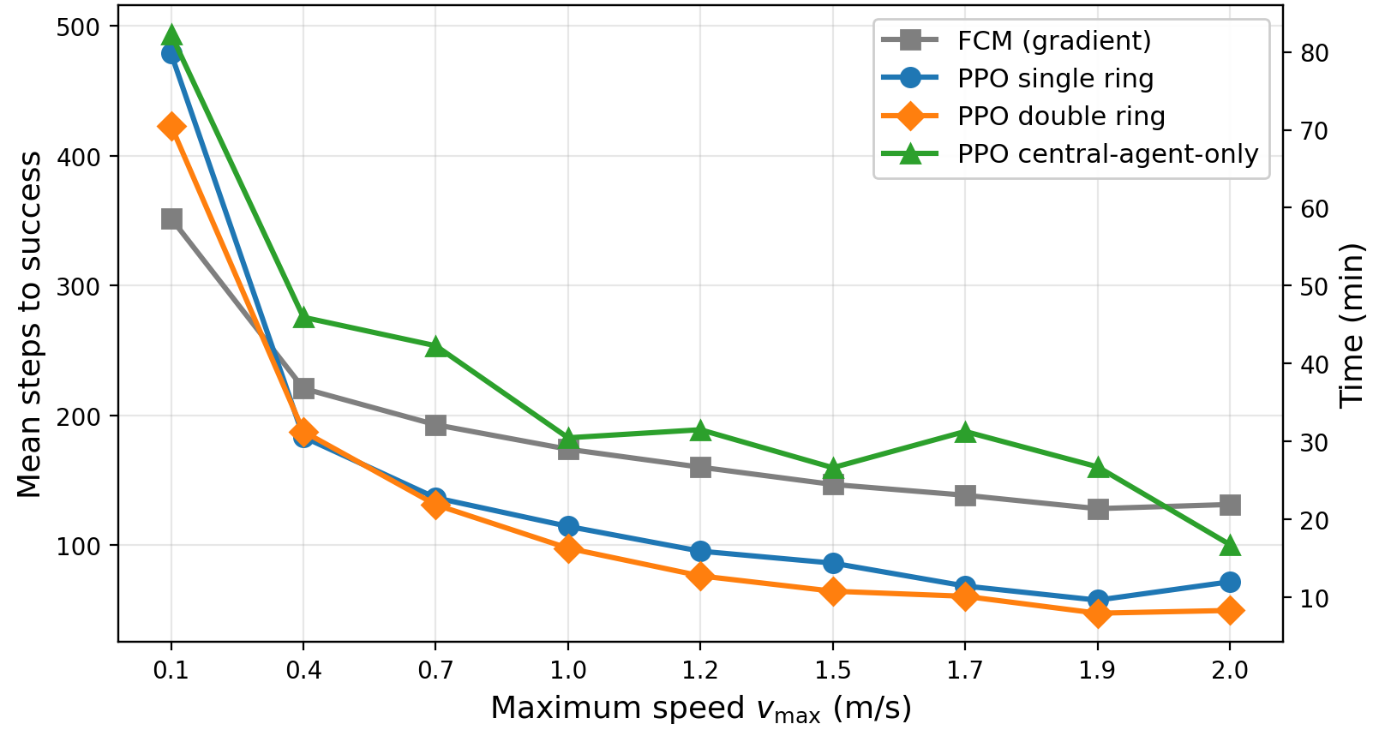
Experimental results
General results

Slide 12
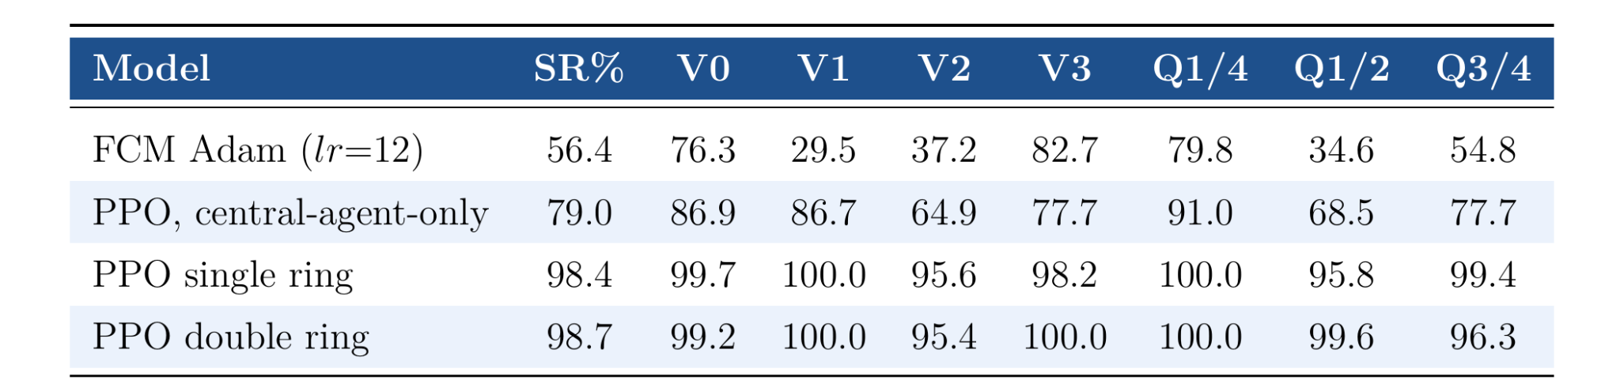
Experimental results
Total held out sources: 26
Total episodes: 26 x 4 winds (V*) x 3 plume ages (Q*) x 5 episodes for combination = 1560 episodes
Results single scenario

Slide 13
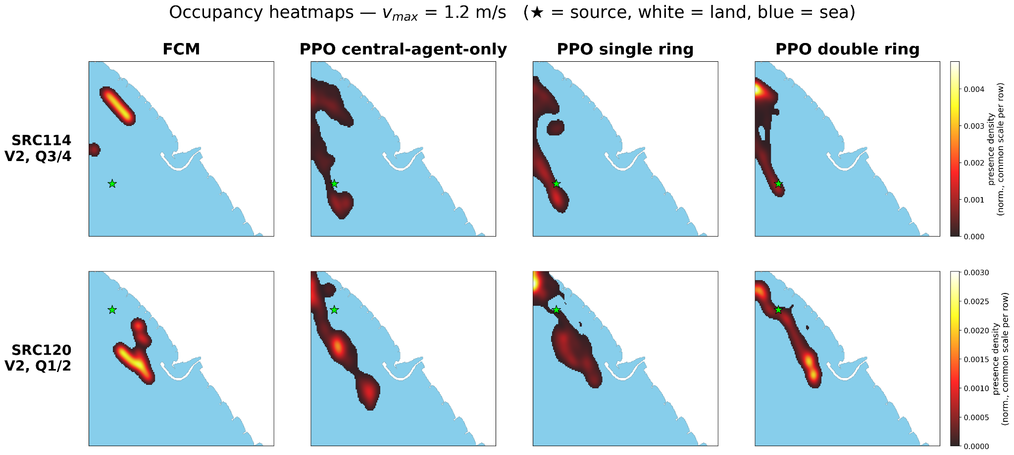
Experimental results

Slide 14
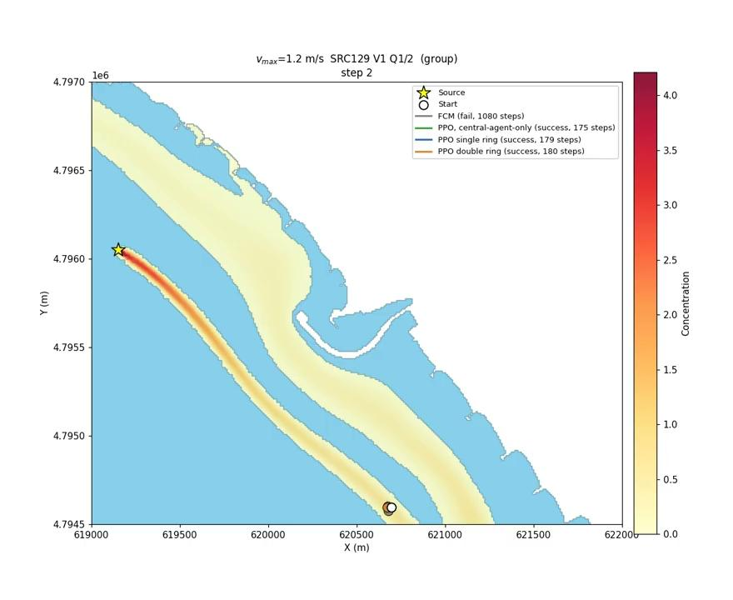
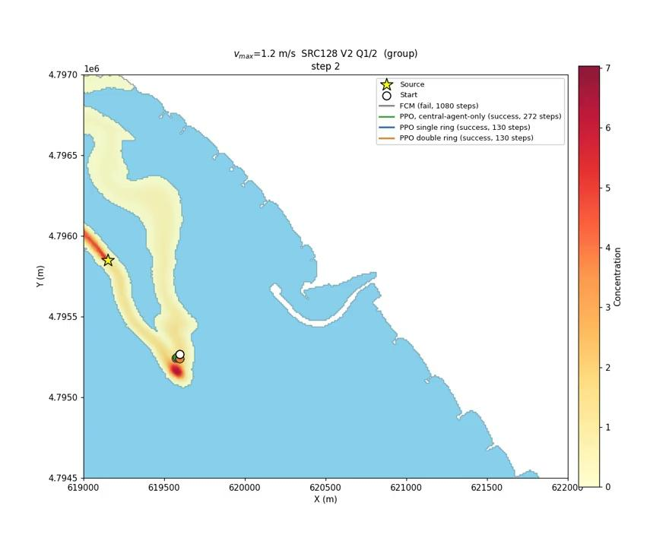
Video demonstration

Slide 15
Conclusions
Does RL outperform classical field climbing?
  Yes. At 1.2 m/s, ring-based PPO achieves 98.4-98.7% success versus 56.4% for FCM.
  FCM performs poorly in diffuse-plume conditions (V1, V2 and Q1/2), and representative trajectories show trapping at local concentration maxima away from the source.
Does spatial sensing improve performance?
  Yes, across the evaluated speed range (0.1-2.0 m/s). Ring-based policies achieve higher overall success rates and fewer mean successful steps than central-agent-only PPO. At 1.2 m/s, the outer ring reduces mean successful steps from 95 to 75, with similar success rates.
Which reward works best?
  The minimal variant achieves the highest success rate in the reward comparison: 96.9%, without explicit wind/current alignment bonuses.
How does the policy use the available information?
  It combines concentration and motion histories with local current information.
  Ablations show the strongest impact on success from ring-measurement history with formation and displacement history without formation.
Conclusions

Slide 16
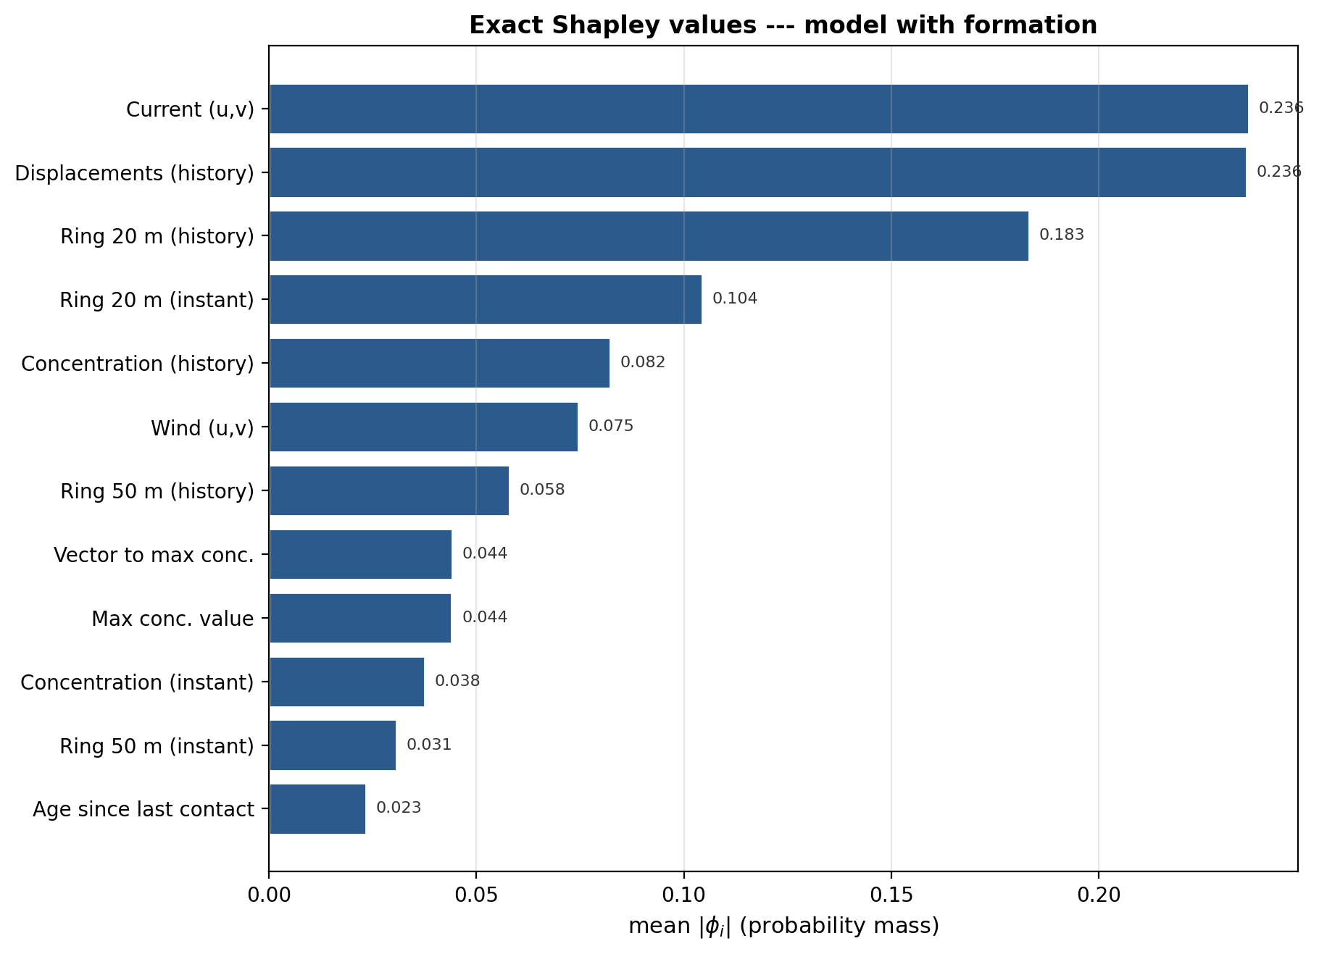
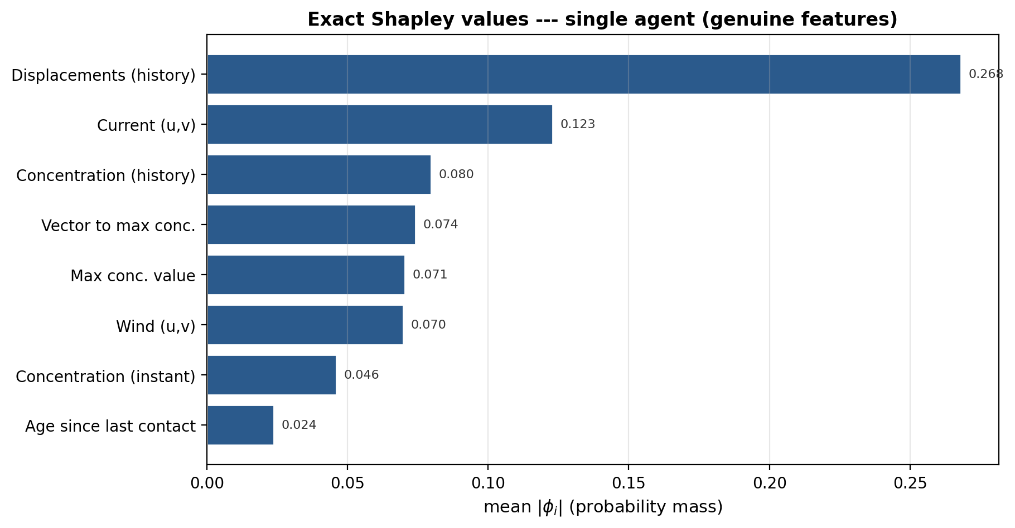
Policy interpretation: group Shapley analysis
Double-ring PPO
Central-agent-only PPO
Shapley Values
Notes:
Displacement history receives high attribution in both policies.
With ring sensing, current information and inner-ring measurement history also receive high attribution.
Task-level importance is assessed separately through rollout ablations.

Slide 17
Conclusions
Limitations
Future work
Incomplete mission: plume detection is assumed; source arrival is verified using ground truth
Centralized decision-making: sensing rings have no independent policies or vehicle dynamics
Limited temporal representation: fixed observation history; remaining episode time is not provided
Idealized deployment: simplified motion, noise-free sensing, ideal communication; missing readings are zero-filled
Limited environmental coverage: one coastal domain and one representative boundary-forcing regime
End-to-end autonomy: exploration, plume detection, source seeking, onboard arrival detection
Cooperative multi-agent control: decentralized policies and information sharing, e.g. MAPPO/CTDE
Time-aware policies: remaining-time input and learned memory using LSTM or Transformer models
Realistic deployment and validation: vehicle dynamics, sensor noise and delays, domain randomization
Generalization across hydrodynamic regimes and coastal domains: train under diverse hydrodynamic conditions, assess generalization to unseen environments
Limitations and future work

Slide 18
Thank you for your attention

