Slide 1
Home Advantage in North American Professional Sports Before and During COVID-19: A Bayesian Perspective
Master’s thesis by
Nicholas Higgs

Slide 2

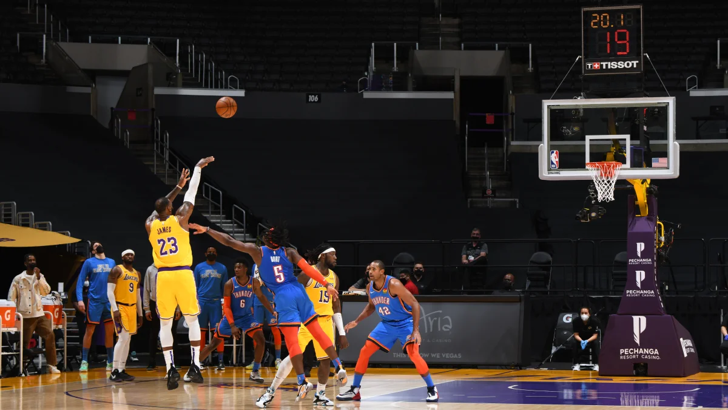
Introduction
Home advantage folklore.
Lack of controlled experiments.
COVID-19 return to play “opportunity”.

Slide 3
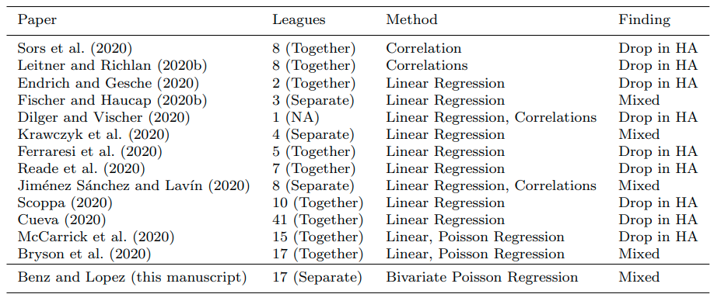
Related Work

Slide 4
Related Work
Lack of work analyzing North American professional leagues.
Shifting away from simpler averaging and correlations toward regression modelling
Increasing sophistication of regression models

Slide 5
Contributions
The efficacy of Bayesian multilevel modelling for sports data.
Use of Negative Binomial distribution to better model overdispersion of point totals in North American professional sports.
Evidence that strict COVID-19 lockdowns in the NHL and NBA negatively impacted home advantage; weaker restrictions in the MLB and NFL did not.

Slide 6
Baye’s Theorem
posterior
likelihood
prior
My belief of what the model parameters are is proportional to my prior belief conditioned on the new data I see

Slide 7
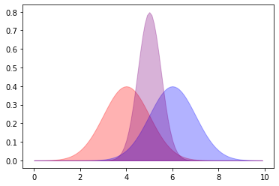
Bayesian Model
posterior
likelihood
prior

Slide 8
Multilevel Modeling
“Complete-Pooling”
“No-Pooling”
All information is pooled into one average used for each group.
No information pooled. Each group computes its average independent of all others.
“Partial-Pooling”
Individual group averages are shrunk to overall mean based on sample-size, within-group variance, and among-group variance

Slide 9
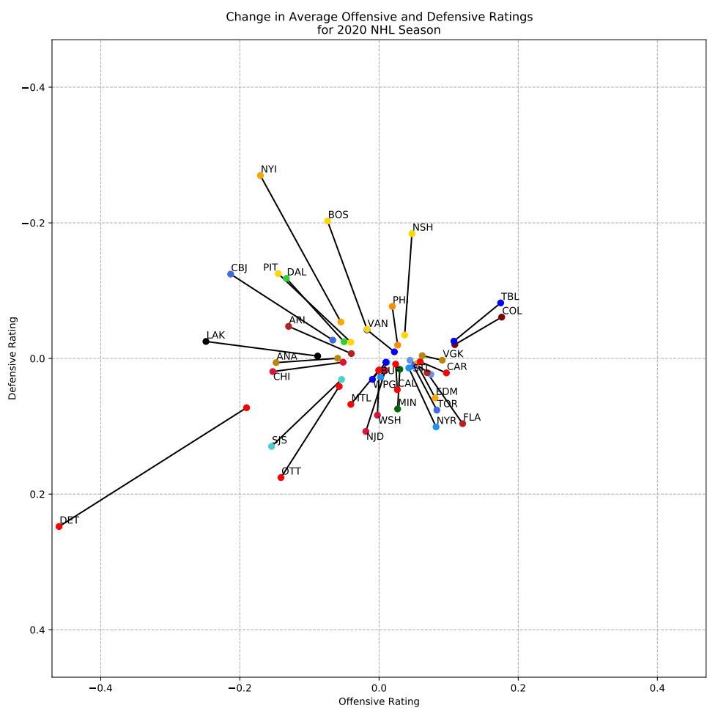
Multilevel Modelling

Slide 10
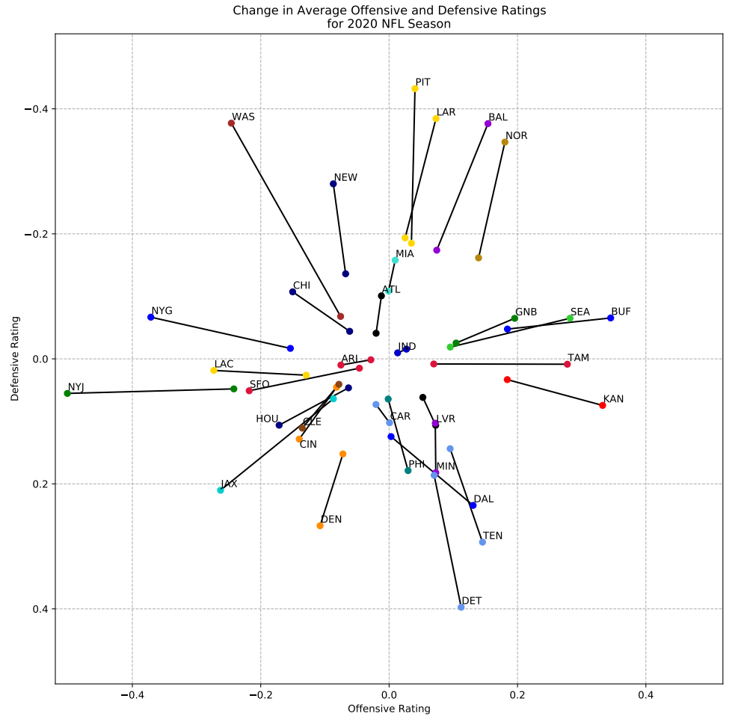
Multilevel Modelling

Slide 11
Data
Previous five seasons (2016-2020) for the National Hockey League (NHL), National Basketball Association (NBA), Major League Baseball (MLB), and the National Football League (NFL).
For each game, we track the teams that are playing, which teams are home and away, their respective game point totals, which season the game occurred, and whether or not the game occurred in the playoffs or regular season.

Slide 12
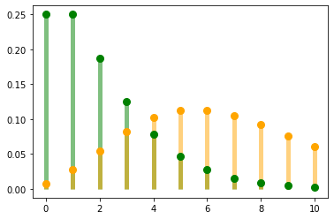
Model

Slide 13
Model
The expected number of points for the home team in game i is equal to the average number of points scored across all teams that season adjusted by home advantage as well as the home team’s offensive rating and the away team’s defensive rating.

Slide 14
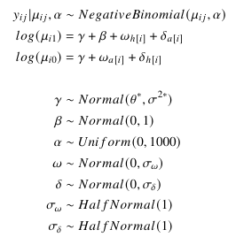
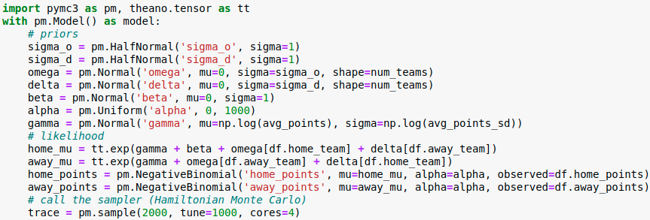
Model

Slide 15
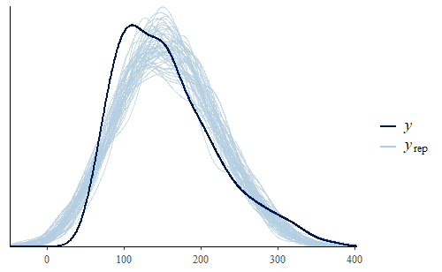
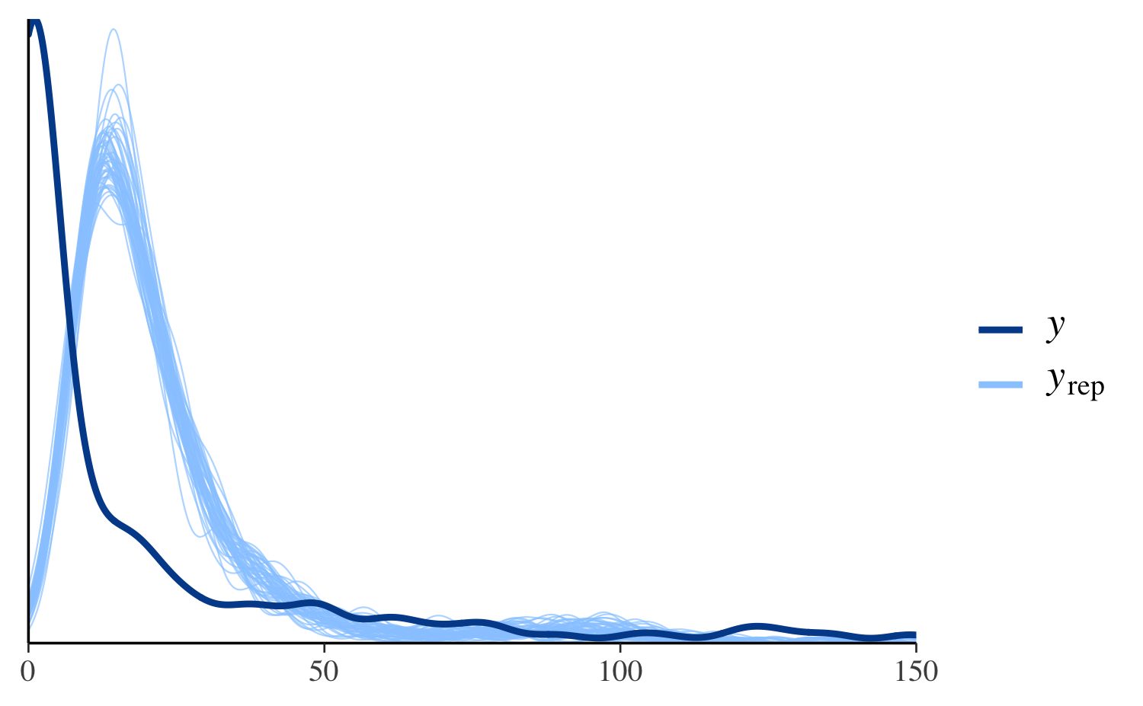
Model Evaluation
Posterior Predictive Checks

Slide 16
Model Evaluation
Log-score
Pareto-Smoothed Importance Sampling Leave-one-out Cross Validation (PSIS-LOO)
The log-score will generally always improve as the model becomes more complex and thus has the potential to overfit the dataset.

Slide 17
First Experiment
Comparison simple averaging (complete pooling), traditional regression (no pooling), and multilevel regression (partial pooling).
Efficacy of PSIS-LOO
50% train-test split. Log-score computed for train and test sets. PSIS-LOO evaluated on train set.

Slide 18
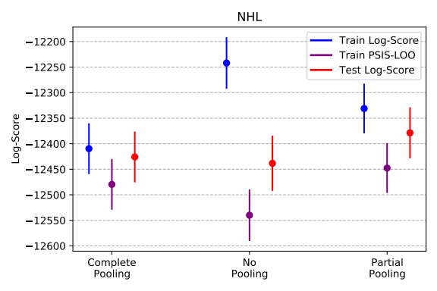
Results

Slide 19
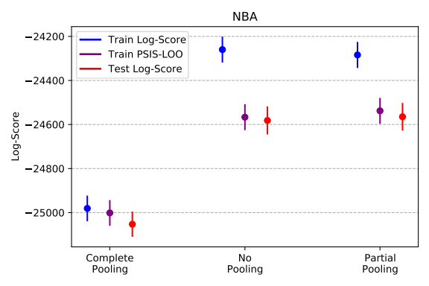
Results

Slide 20
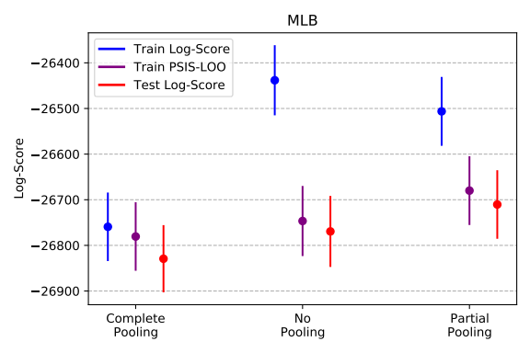
Results

Slide 21
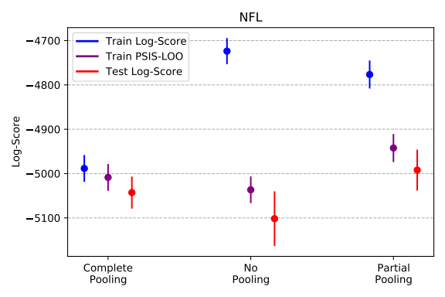
Results

Slide 22
Second Experiment
Comparison of three different likelihoods for our model (Normal, Poisson, and Negative Binomial).
Demonstrate the impact of overdispersion.
Use PSIS-LOO estimates and Posterior Predictive Checks to evaluate models.

Slide 23
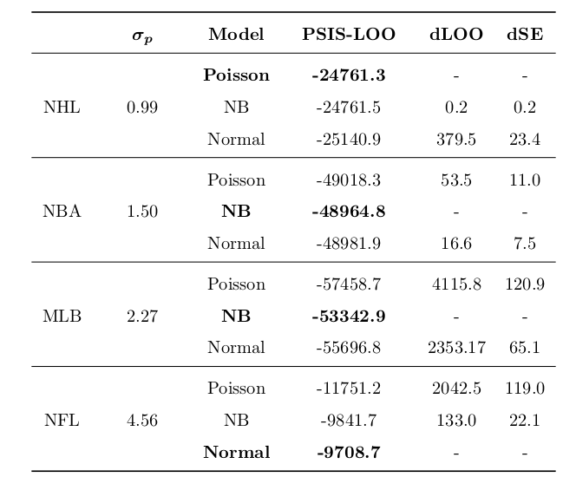
Results

Slide 24
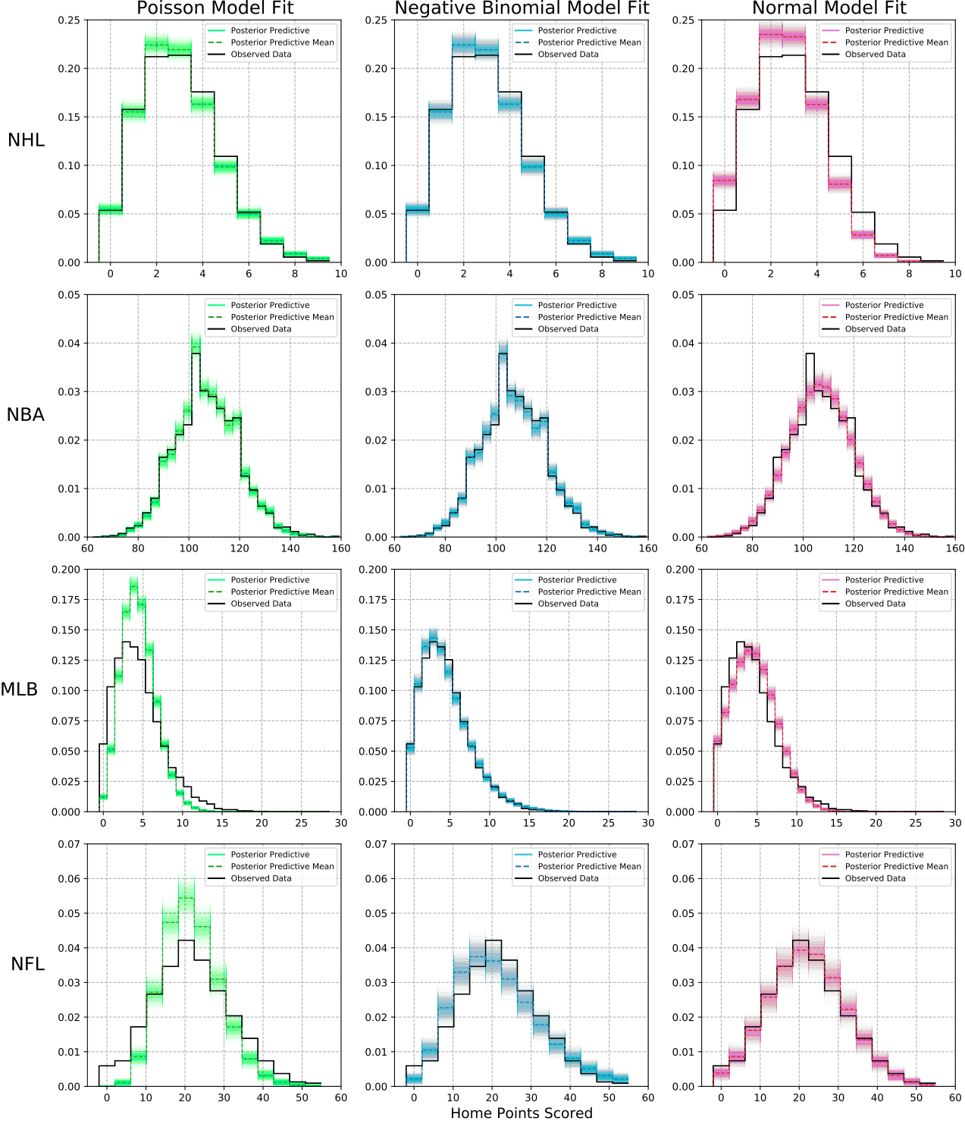
Results

Slide 25
Final Experiment
Infer the potential effect of and change in home advantage in North American professional sports prior to and during COVID-19.
Examine the distributions of the parameter estimates for home advantage that result from the model fit.

Slide 26
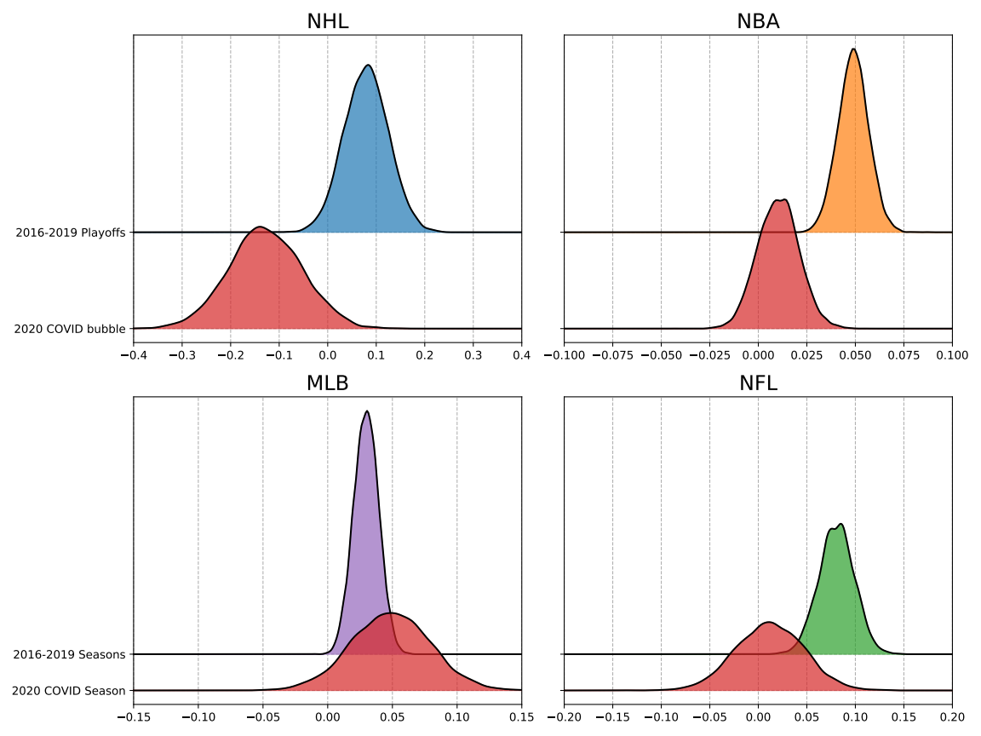
Results

Slide 27
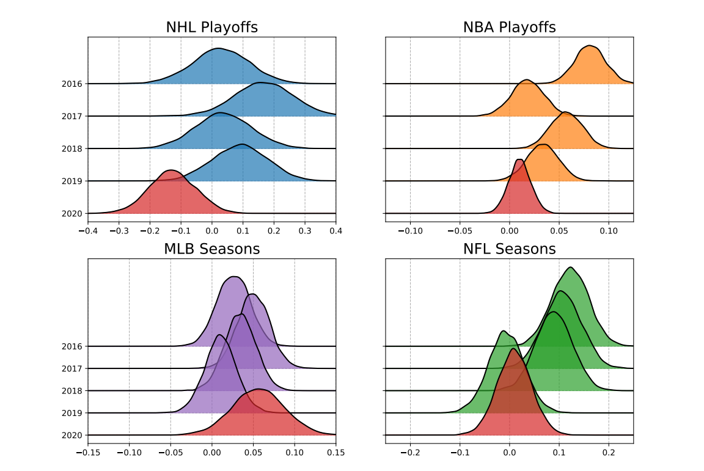
Results

Slide 28
Discussion
The efficacy of Bayesian multilevel modelling for sports data.
Use of Negative Binomial distribution to better model overdispersion of point totals in North American professional sports.
Evidence that strict COVID-19 lockdowns in the NHL and NBA negatively impacted home advantage; weaker restrictions in the MLB and NFL did not.

Slide 29
Limitations
Our model does not explicitly account for travel and rest.
Generalized over differences among different sports.
COVID-19 had more impact than just keeping fans away.

Slide 30
Future Work
Officiating/penalties.
Shrinkage to the regression line instead of the mean.
Other domains.

Slide 31
