Slide 1
Home Advantage in North American Professional Sports Before and During COVID-19: A Bayesian Perspective
Master’s thesis by
Nicholas Higgs

Slide 2
Introduction
Home advantage folklore.
Lack of controlled experiments.
COVID-19 “opportunity”.

Slide 3
Introduction
Related Work
Contributions
Bayesian Inference
  Baye’s Theorem
  Multilevel Modelling
Model
  Model Definition
  Model Evaluation
Experiments and Results
  Complete Pooling, No Pooling, and Partial Pooling
  Negative Binomial Regression
  Inferring Home Advantage
Discussion
  Limitations
  Future Work

Slide 4
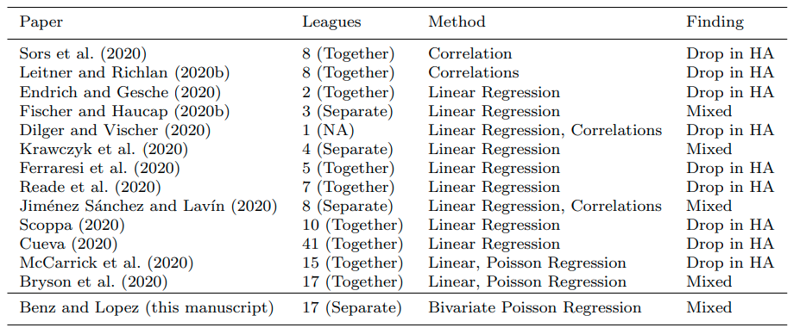
Related Work

Slide 5
Related Work
Lack of work analyzing North American professional leagues.
Shifting away from simpler averaging and correlations toward regression modelling
Increasing sophistication of regression models

Slide 6
Contributions
The efficacy of Bayesian multilevel modelling for sports data.
Use of Negative Binomial distribution to better model overdispersion of point totals in North American professional sports.
Evidence that strict COVID-19 lockdowns in the NHL and NBA negatively impacted home advantage; weaker restrictions in the MLB and NFL did not.

Slide 7
Baye’s Theorem
posterior
likelihood
prior
My belief of what the model parameters are is proportional to my prior belief conditioned on the new data I see

Slide 8
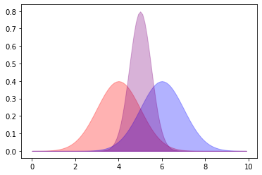
Bayesian Model
posterior
likelihood
prior

Slide 9
Multilevel Modeling
“complete-pooling”
“no-pooling”
“partial-pooling”

Slide 10
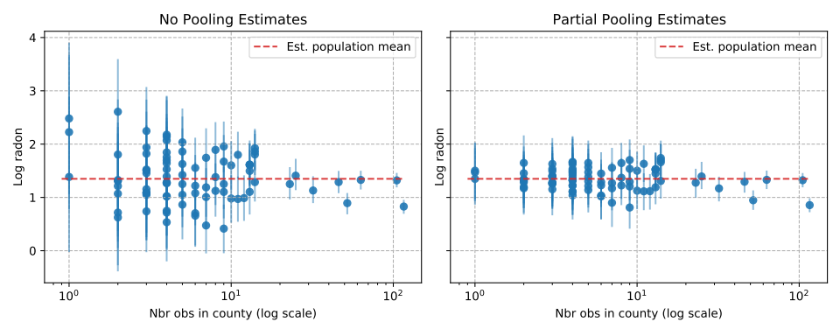
Multilevel Modeling

Slide 11
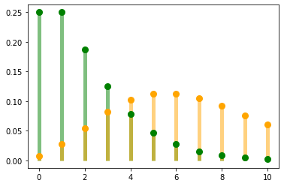
Model

Slide 12
Model
The expected number of points for the home team in game i is equal to the average number of points scored across all teams that season adjusted by home advantage as well as the home team’s offensive rating and the away team’s defensive rating.

Slide 13
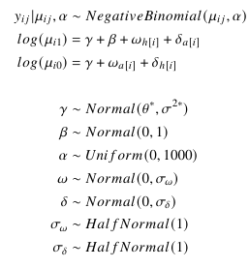
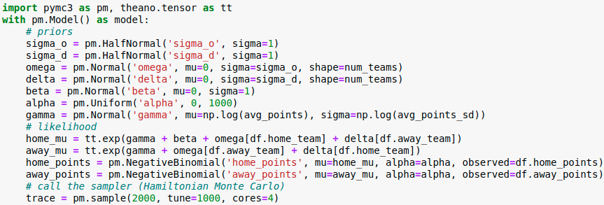
Model

Slide 14
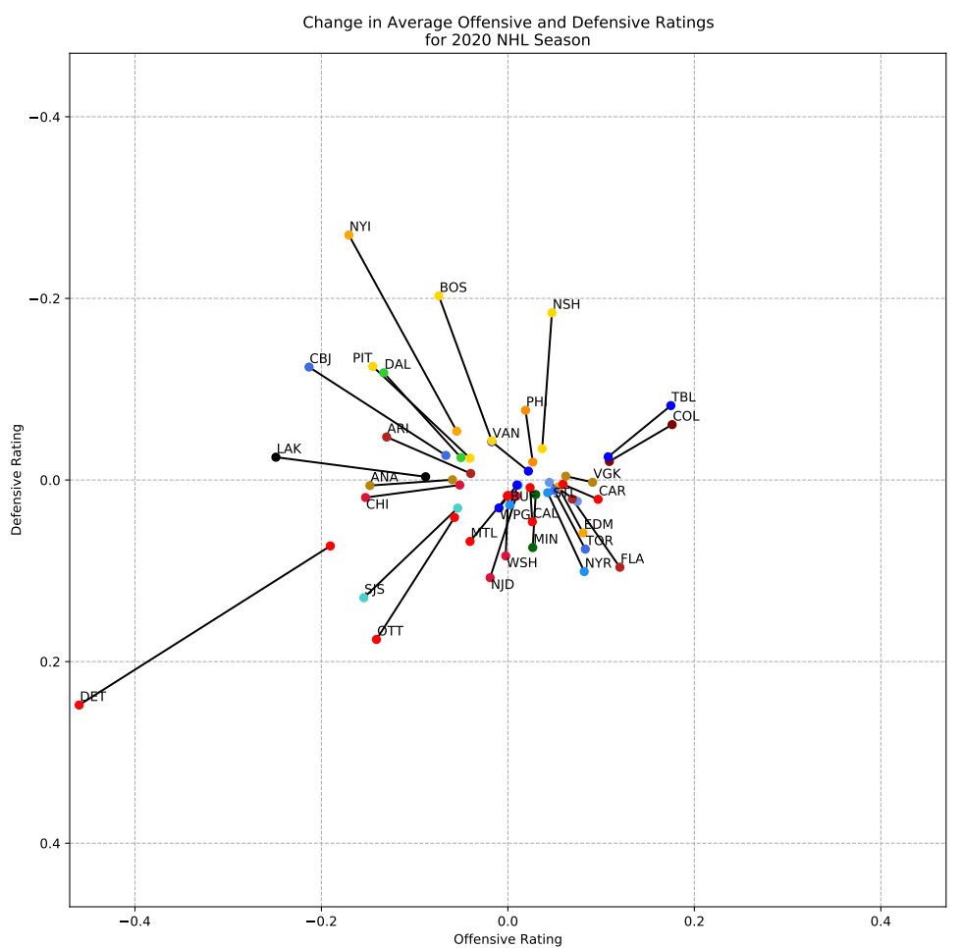
Model

Slide 15
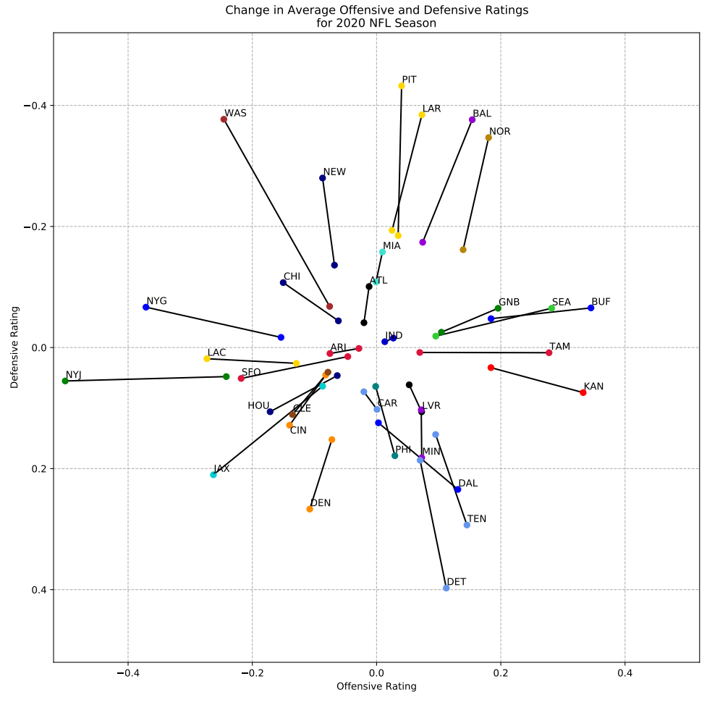
Model

Slide 16
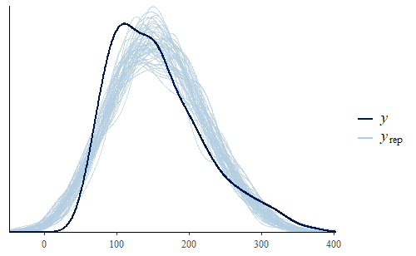
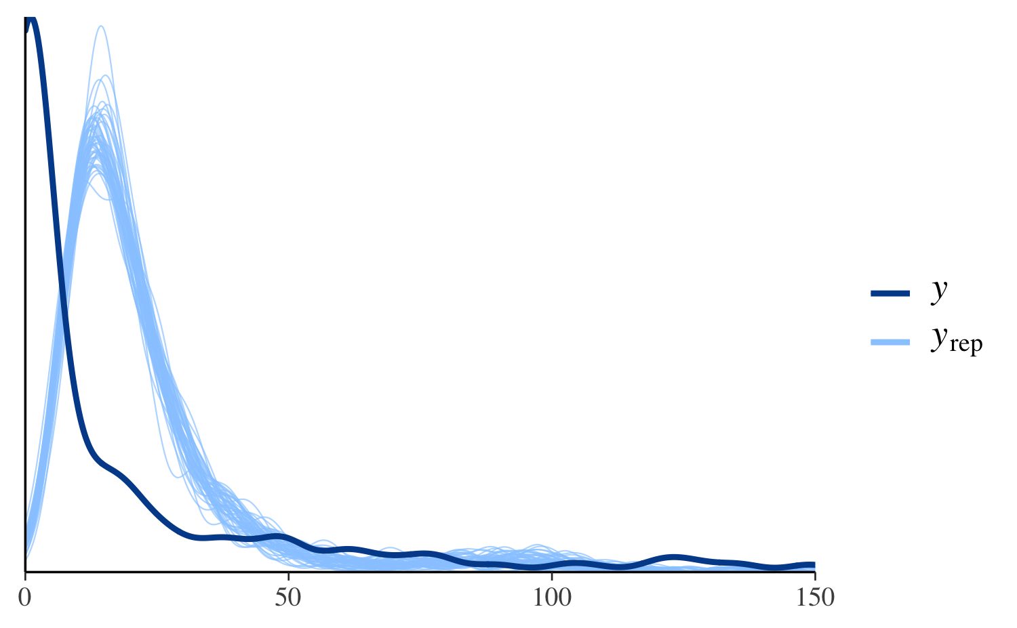
Model Evaluation
Posterior Predictive Checks

Slide 17
Model Evaluation
Information Theory
KL-divergence
Log-score
The log-score will generally always improve as the model becomes more complex and thus has the potential to overfit the dataset.

Slide 18
Model Evaluation
Information Theory
KL-divergence
Log-score
The log-score will generally always improve as the model becomes more complex and thus has the potential to overfit the dataset.

Slide 19
First Experiment
Comparison of multilevel modelling (partial pooling) to traditional regression (no pooling) and simple averaging (complete pooling)
Efficacy of PSIS-LOO
50% train-test split. Log-score computed for train and test sets. PSIS-LOO evaluated on train set.

Slide 20
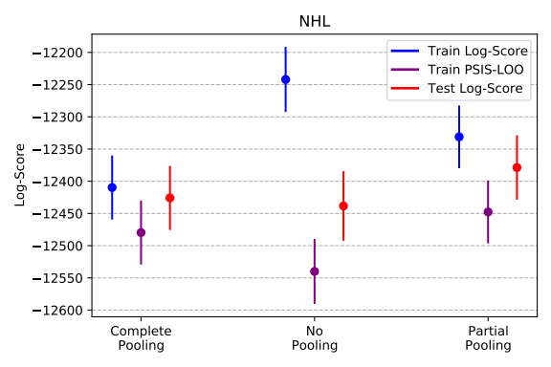
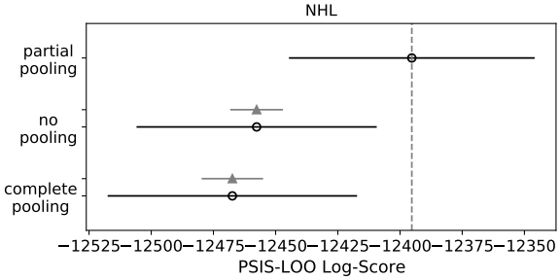
Results

Slide 21
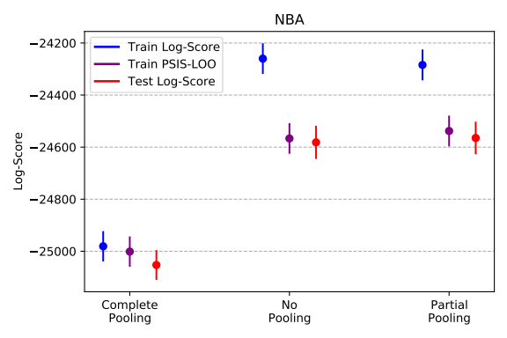
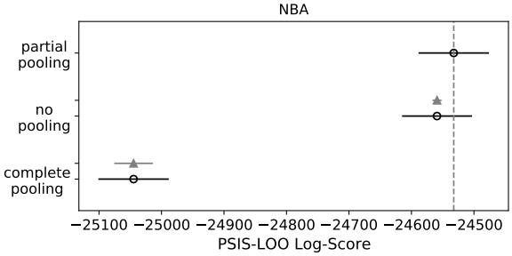
Results

Slide 22
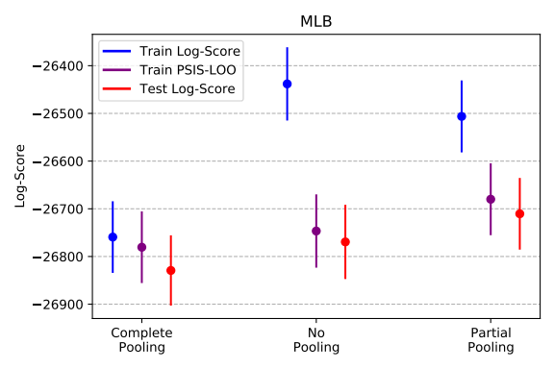
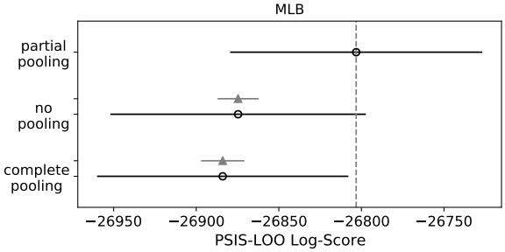
Results

Slide 23
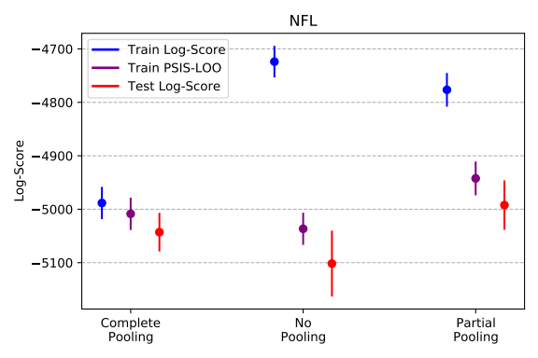
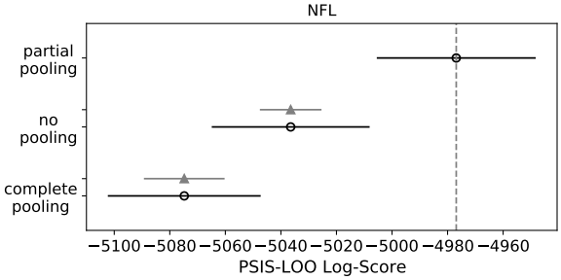
Results

Slide 24
Second Experiment
Comparison of three different likelihoods for our model (Normal, Poisson, and Negative Binomial).
Demonstrate the impact of overdispersion.
Use PSIS-LOO estimates and Posterior Predictive Checks to evaluate models.

Slide 25
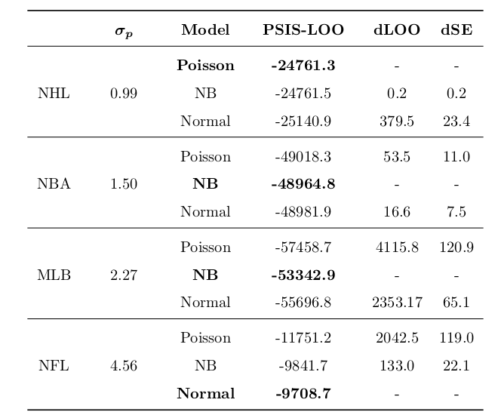
Results

Slide 26
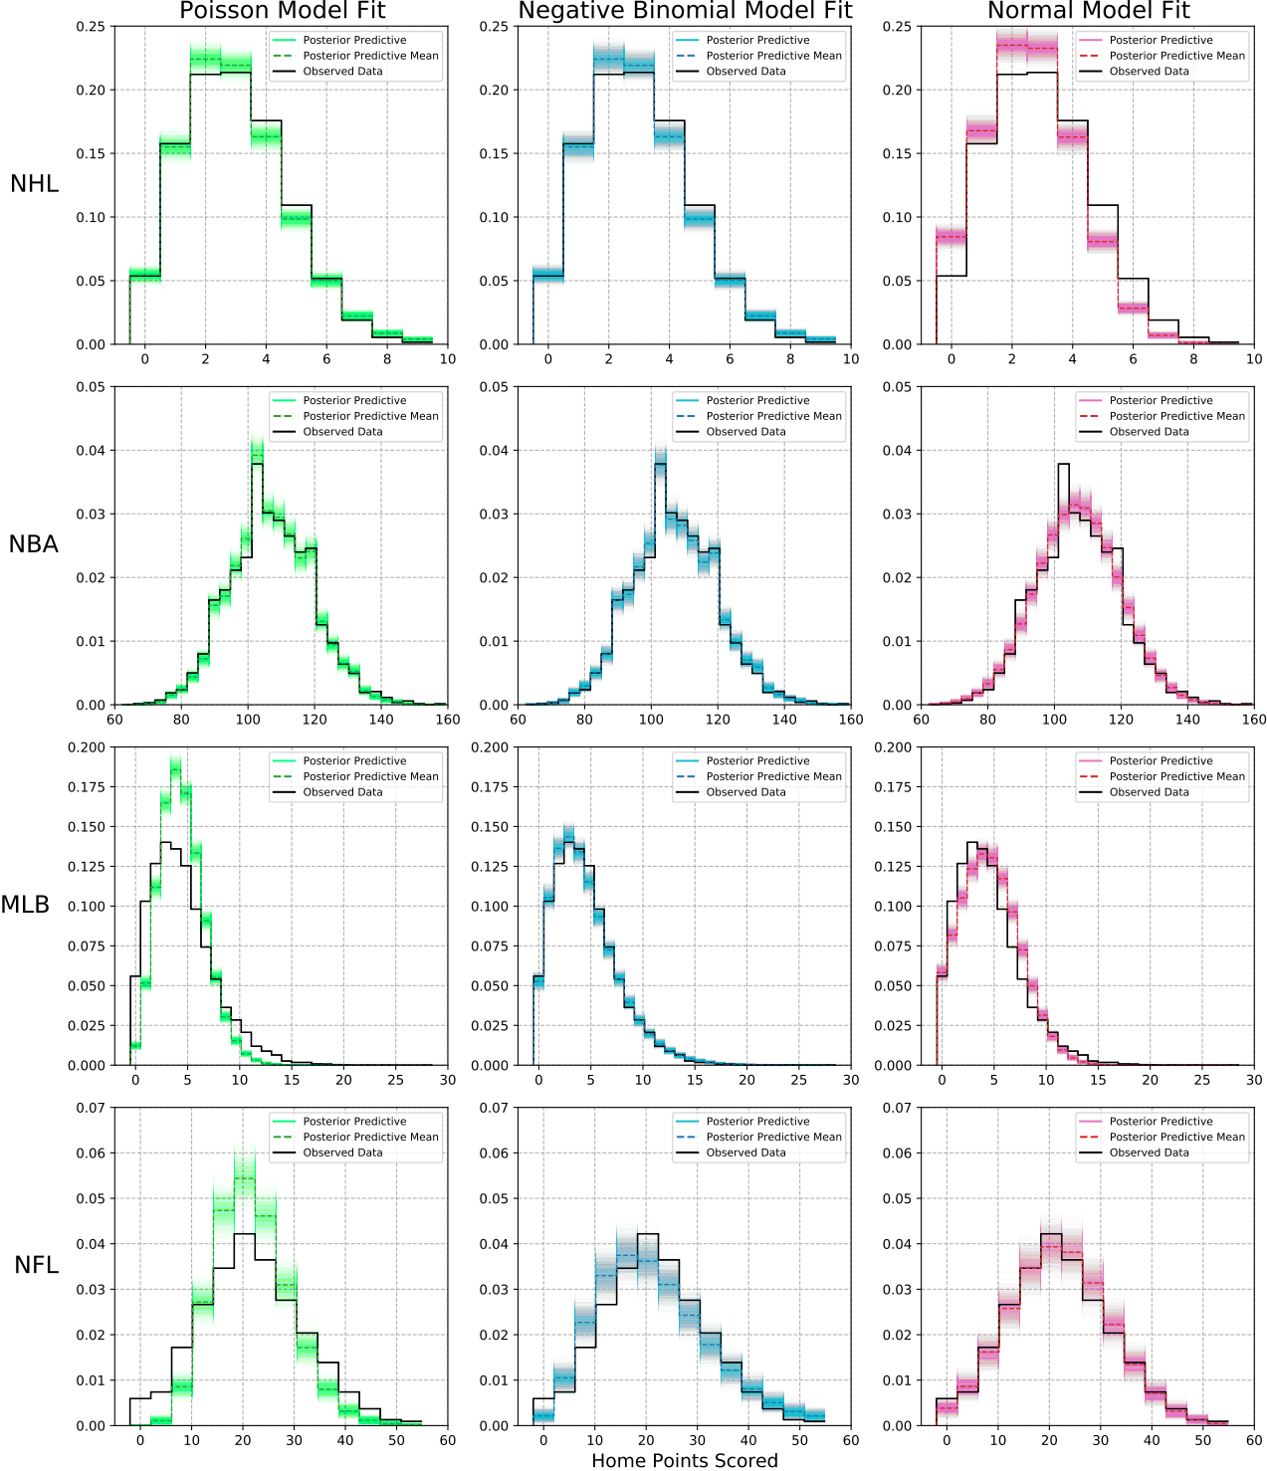
Results

Slide 27
Final Experiment
Infer the potential effect of and change in home advantage in North American professional sports prior to and during COVID-19.
Examine the distributions of the parameter estimates for home advantage that result from the model fit.

Slide 28
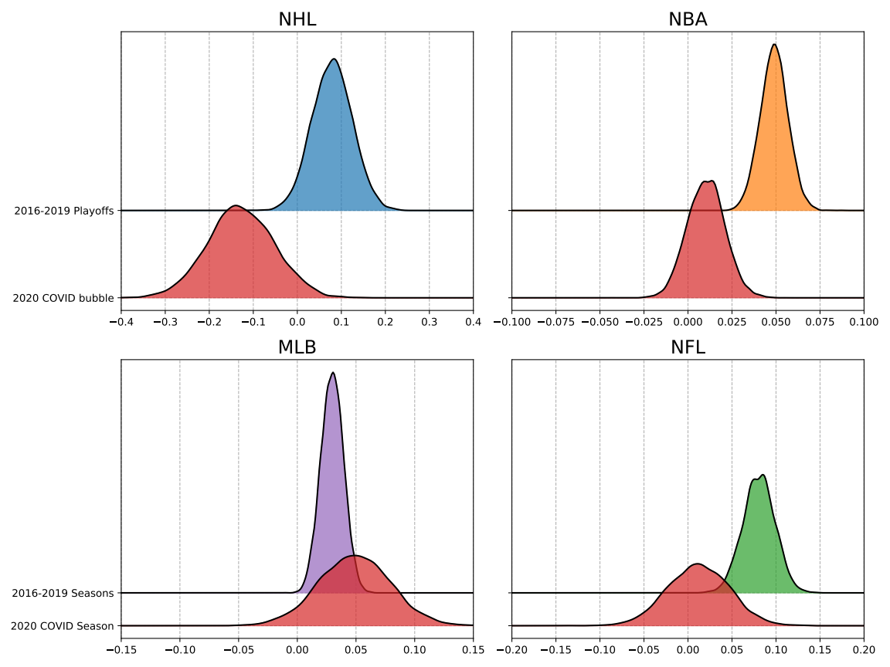
Results

Slide 29
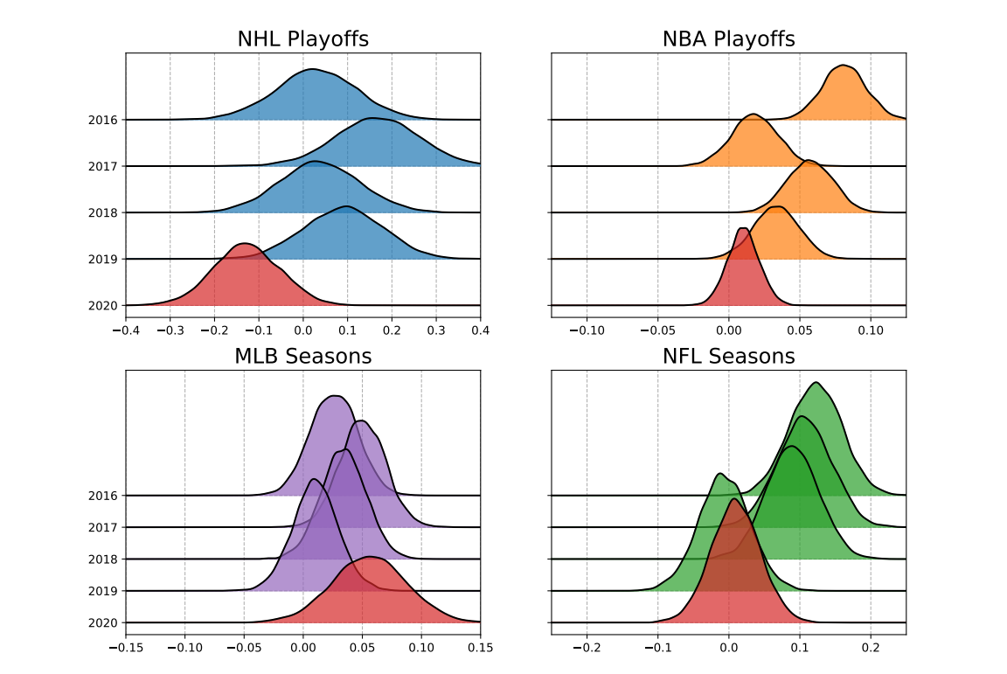
Results

Slide 30
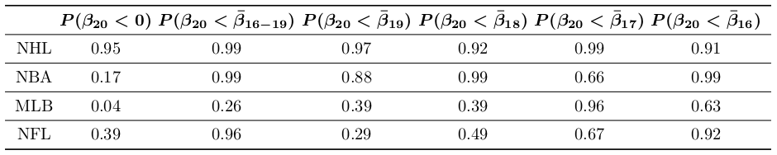
Results

Slide 31
Discussion
The efficacy of Bayesian multilevel modelling for sports data.
Use of Negative Binomial distribution to better model overdispersion of point totals in North American professional sports.
Evidence that strict COVID-19 lockdowns in the NHL and NBA negatively impacted home advantage; weaker restrictions in the MLB and NFL did not.

Slide 32
Limitations
COVID-19 had more impact than just keeping fans away.
Our model does not account for travel and rest.
Generalized over differences among different sports.

Slide 33
Future Work
Officiating/penalties
Shrinkage to the regression line instead of the mean

