Slide 1


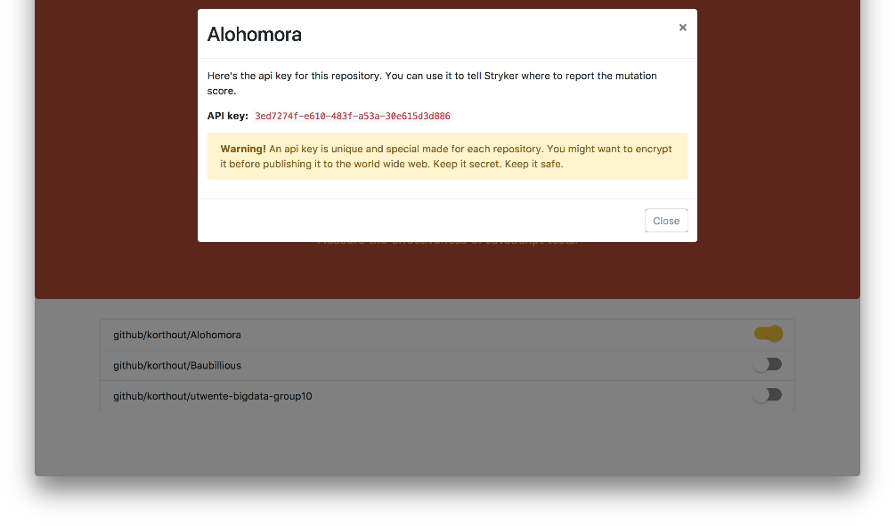

https://dashboard.stryker-mutator.io
Enable repo
Configure
Report

