Slide 1
Flowchart
Data Science Center WebPage

Slide 2
Features and requirements
Data Science Center is a web application designed to offer educational resources and interactive tools for professionals in data science, machine learning, data engineering, and software development. Its main features include:
Home Section: Highlighted information on key topics such as Data Science, Machine Learning, Data Engineering, and Software Engineering.
Blog: Articles and posts about the latest trends and advancements in these fields (Future Work).
Login and Sign-Up Forms: Allowing users to join the community.
AI Chat: An interactive chatbot to answer questions about data science.
Contact Section: Contact information and a form to send messages.
Thematic pages by specialty

Slide 3
Where does its data come from (external/internal APIs)?
The data for the application comes from internal APIs designed to handle static content of the website, as well as an external API for the chatbot functionality, which uses OpenAI's GPT-3.5-turbo.

Slide 4
How is this data processed and displayed?
The data is processed through API calls and displayed using DOM manipulation techniques with JavaScript. Static content is presented using HTML and CSS, while chatbot responses are fetched and displayed in real-time through fetch requests and dynamic DOM updates.

Slide 5
How can the user interact with your application?
Users can interact with the application in several ways:
Navigating through different sections using the navigation bar.
Registering or logging in through modal forms.
Using the chatbot to ask questions and receive real-time responses.
Sending messages via the contact form.
Reading and commenting on blog posts.

Slide 6
What JS techniques have you used (e.g., objects, arrays, DOM functions, loops, functions)?
Various JavaScript techniques have been used, including:
DOM manipulation to show/hide elements and update page content.
Arrays to manage chatbot conversations.
Fetch API to make HTTP requests to the external API.
Event handling functions for user interactions like clicks and form submissions.
Loops and conditionals to process and display data dynamically.

Slide 7
What external tools/libraries have you used (e.g., bootstrap/axios/charts)? How? Why?
Font Awesome: For including icons in buttons and forms, enhancing the user interface.
Google Fonts: To use custom fonts that improve the site's aesthetics.
Swiper.js: To handle carousel and sliding functionalities.
OpenAI API: To implement the AI chatbot functionality, providing intelligent and contextual responses to user queries.

Slide 8
What kinds of HTML elements have you used (e.g., tables, forms, divs, lists, headings, menus, videos, images)?
Various HTML elements have been used, including:
Divs: For structure and content organization.
Headings (h1, h2, etc.): For section titles and subtitles.
Forms: For login, registration, and contact.
Lists: For navigation elements.
Videos: To provide multimedia content in the "About Us" section.
Images: To enhance visual appeal and provide icons.

Slide 9
9. What kinds of CSS features have you used (e.g., animations, backgrounds, fonts, colours, flexbox, grid)?
Several CSS features have been utilized, including:
Animations: For visual effects on headings and buttons.
Backgrounds: Background images and gradients to enhance aesthetics.
Fonts: Custom fonts using Google Fonts.
Colors: Consistent color palette for the user interface.
Flexbox: For responsive design and element alignment.
Grid: For page layout organization.

Slide 10
10. How might you extend the features of your application in the future?
Forum Section: To enable discussions among users.
User Profile: Where users can customize their profiles and view their activity.
Events and Webinars: Calendar integration and event registrations.
Newsletter: Functionality to subscribe to news and updates.
SEO Optimization: Improvements to increase visibility in search engines.
Analysis and Feedback Tools: To collect and display data on user interaction and usage.

Slide 11
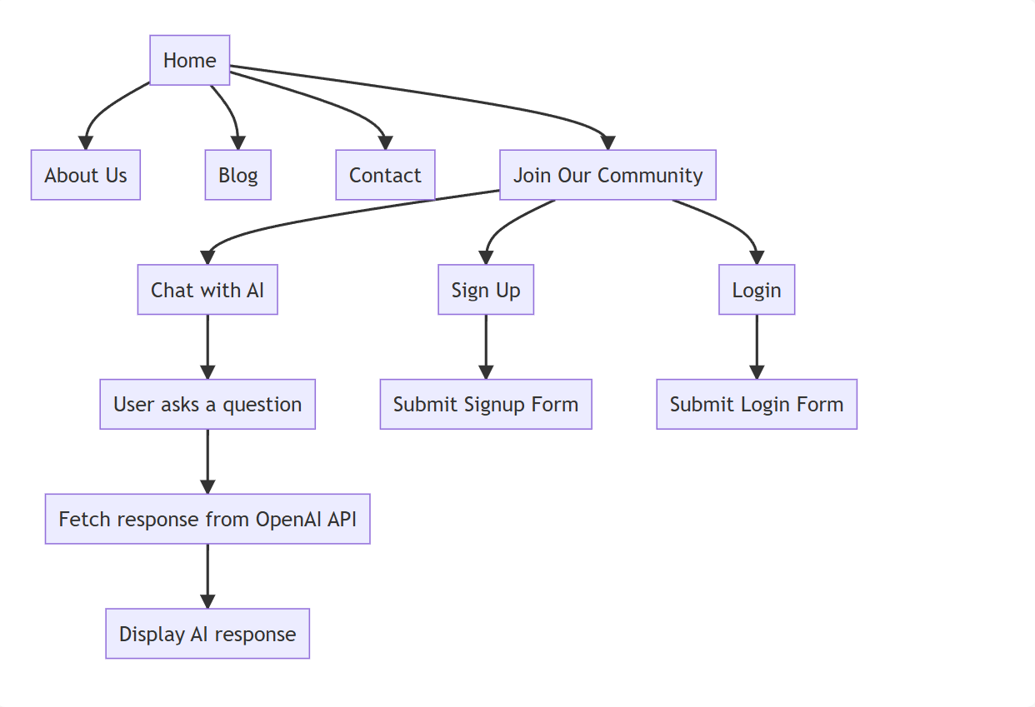

Slide 12
