Slide 1
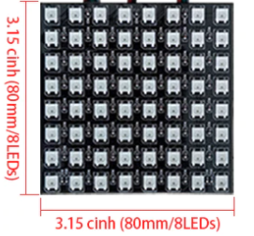
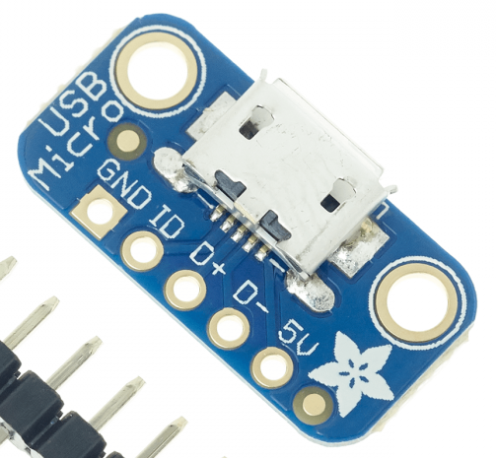
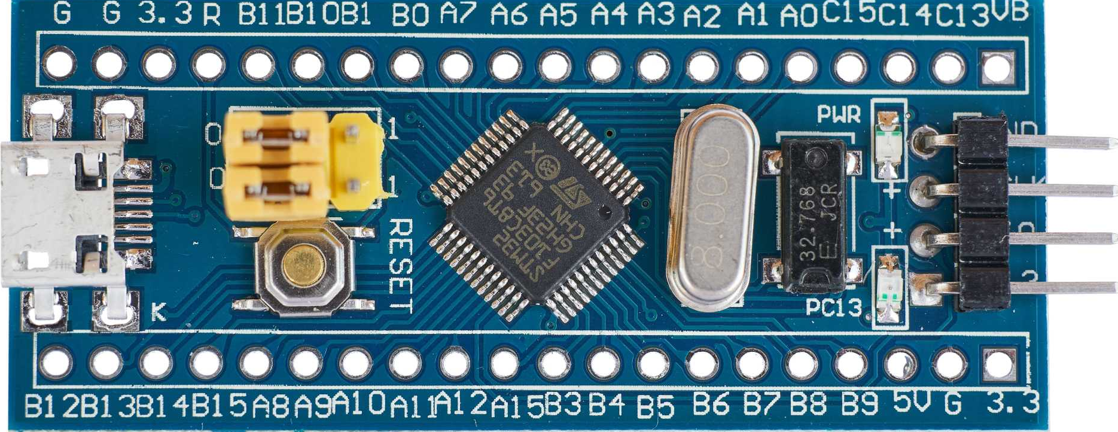
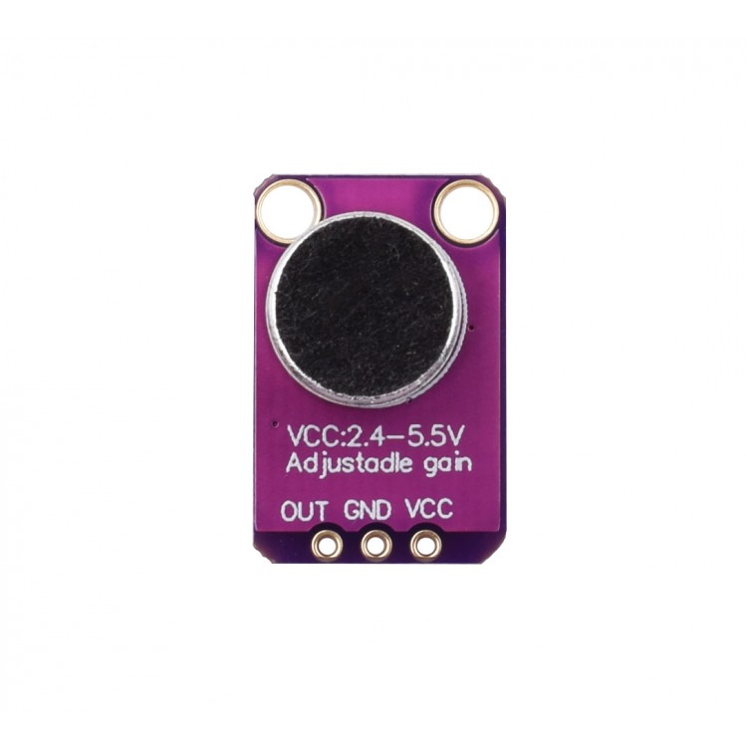
2 x WS2812B 8x8 Panel «CJMCU-8*8»
For the right orientation have a look on the assembly pics
Adafruit USB Micro-B Breakout Board
Blue Pill Board, STM32F103C8T6
MAX4466 Microphone

