Slide 1
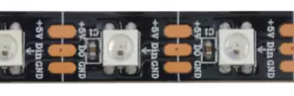
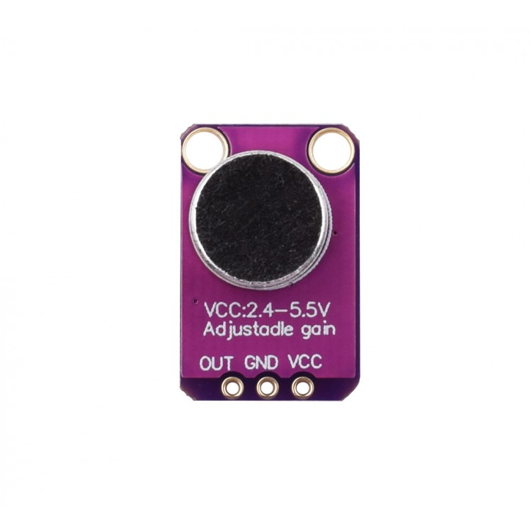
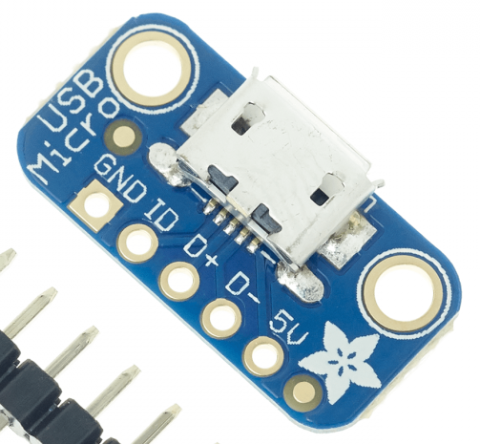
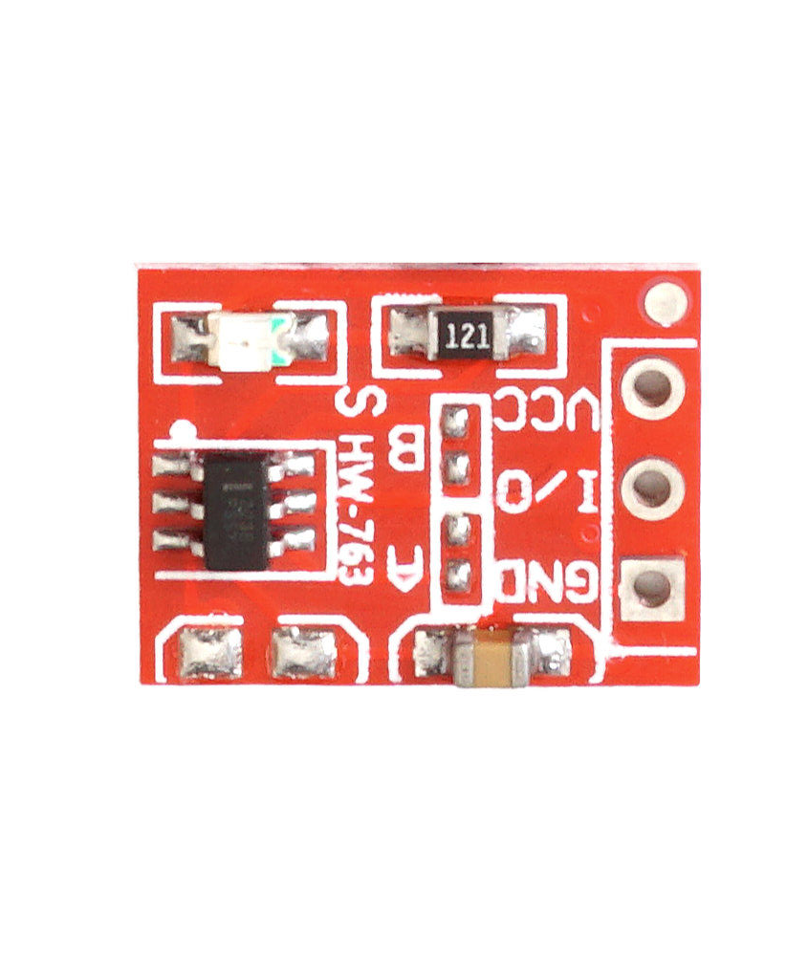
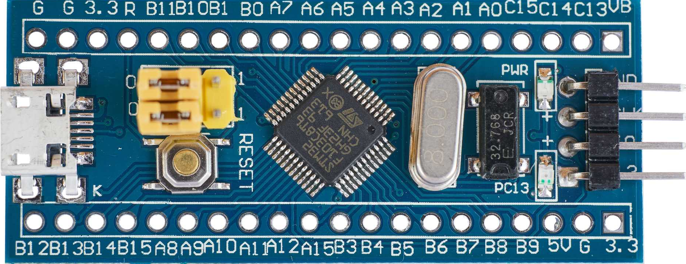
WS2812b led stripe 75 LEDs/m (15 leds)
MAX4466 Microphone
Adafruit USB Micro-B Breakout Board
TTP223 Touchfield
Blue Pill Board, STM32F103C8T6

