Slide 1
Table Analyzer
Turn you tabular data into publication-ready
summary tables and plots
01.12.2025
Developed by Nicola Palmieri

Slide 2
Who am I
Bioinformatician specializing in microbial genomics, neuroinformatics, and high-throughput data analysis
Researcher at Vetmeduni Wien and data analyst at a:head Bio with >10 years experience
Experience in biological signal processing, microscopy image analysis
Developer of R/Streamlit applications for biological data analysis
Passionate about transforming complex datasets into clear, interpretable, publication-ready insights
My research
Genomics of bacterial, viral, and protozoan pathogens in veterinary medicine, focusing on evolution, virulence factors, antimicrobial resistance, and outbreak characterization using NGS.
Development of pipelines and apps to extract and analyze functional and morphological metrics from brain-organoid activity data

Slide 3
What is Table Analyzer
  • Lightweight R Shiny app for analyzing tabular datasets
  • Generates publication-ready tables and plots
  • Designed for clarity, reproducibility, and speed
  • Based on a modern, model-based statistical framework (ANOVA, LM, LMM)
What it can do
  • Seven analysis modules: Descriptive Statistics, One-way ANOVA, Two-way ANOVA, LM, LMM, Pairwise Correlation, PCA
  • Download publication-formatted tables
  • Export plots at 300 dpi (PNG)
What it is not
  • Not a replacement for Excel, GraphPad Prism, or SPSS
  • Not intended for data editing or spreadsheet management
Why it speeds up analysis
  • Multiple responses in parallel: run the same model across several outcomes
  • Stratification: fit models within groups (batch, treatment, animal group)
  • Plots adapt automatically to both multiple responses and stratification

Slide 4
NOTES on DESCRIPTIVE STATISTICS

Slide 5
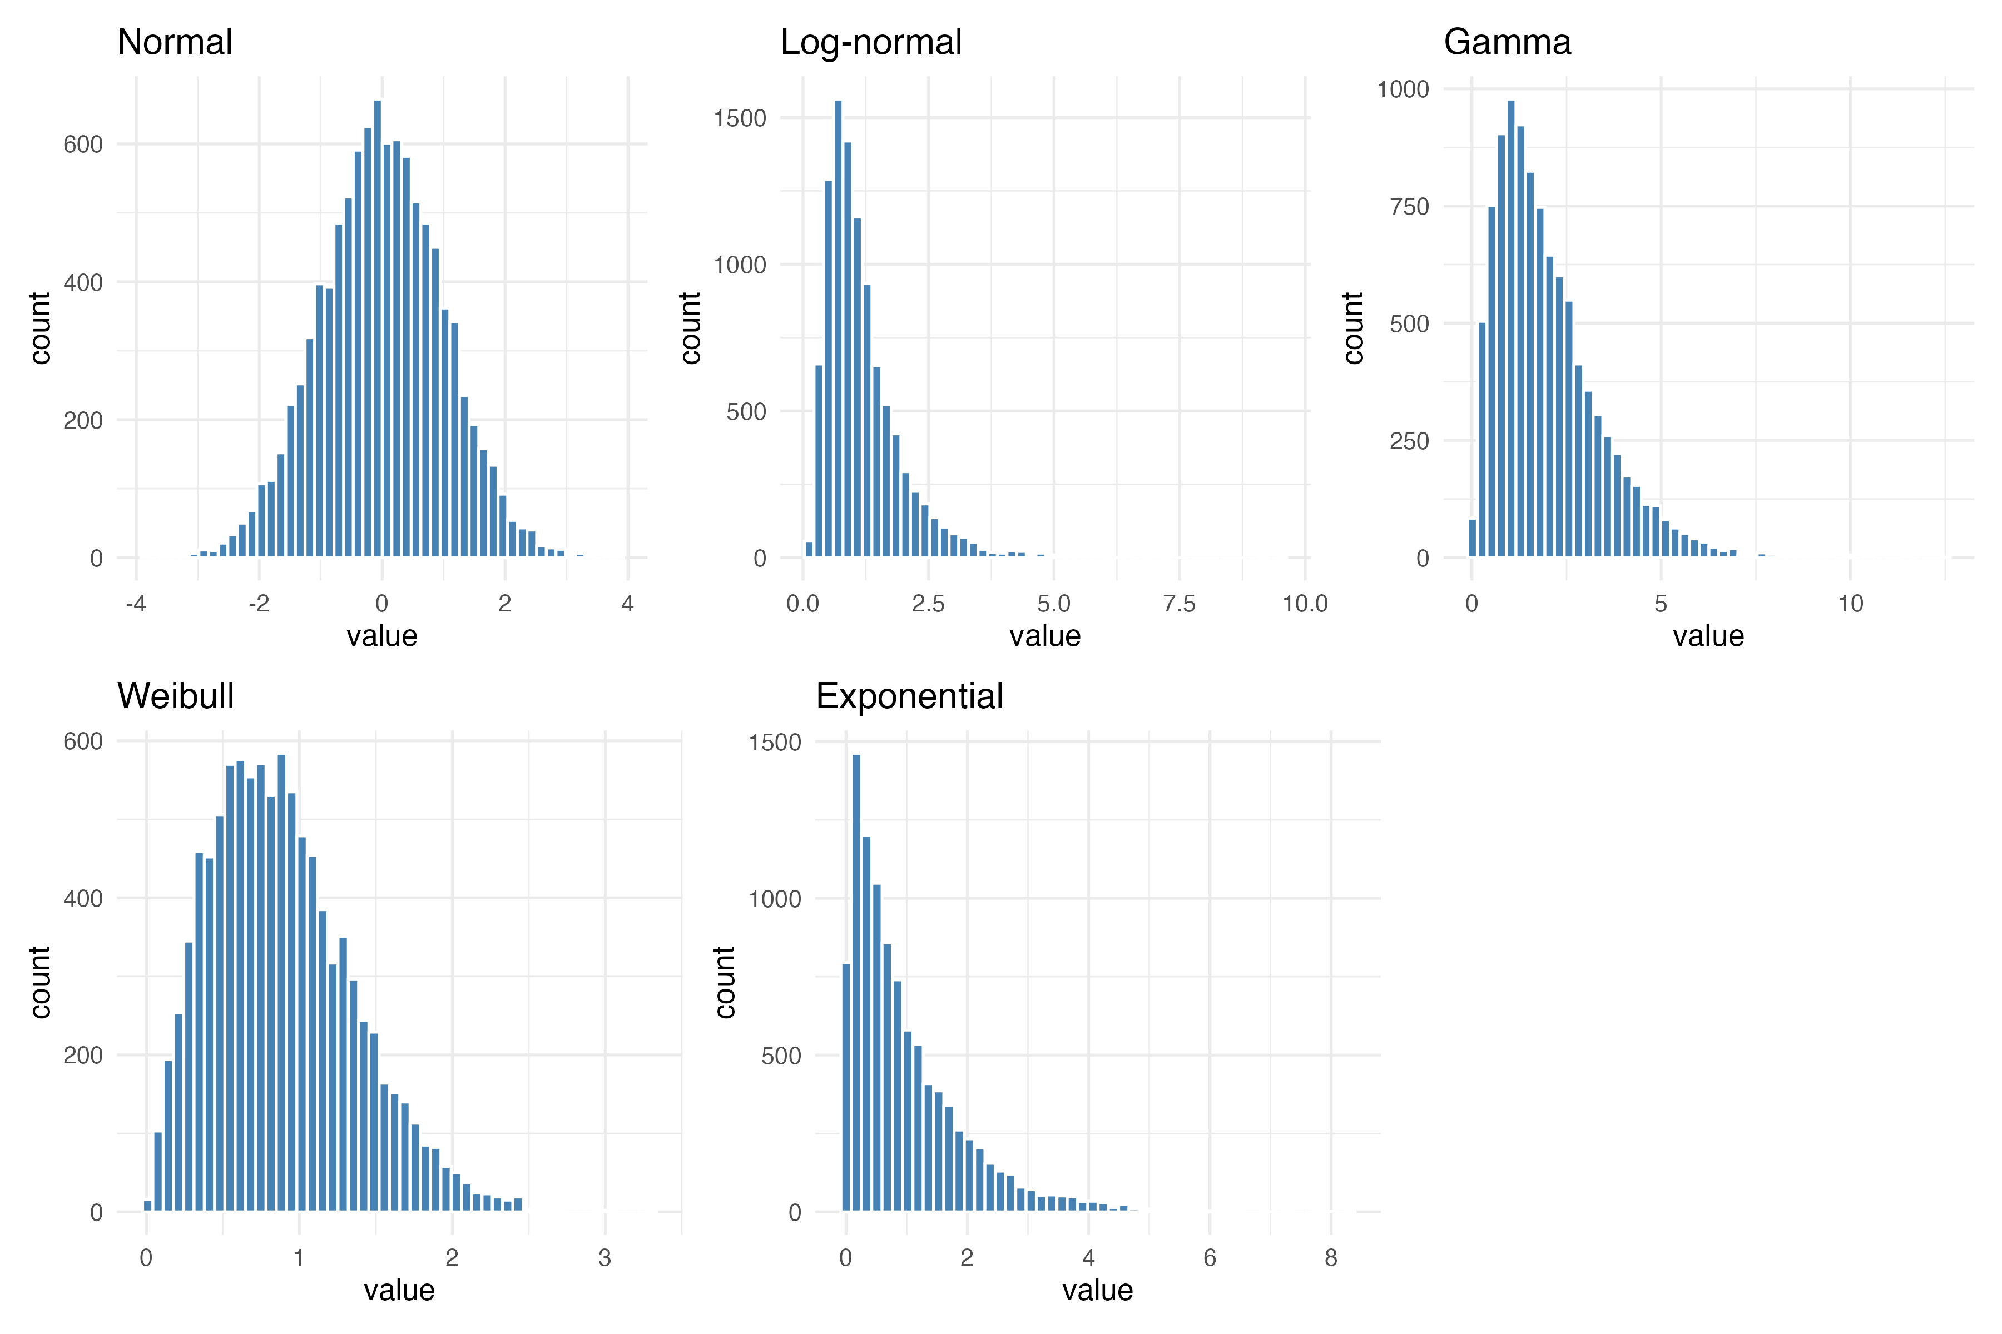

Slide 6
🐔 What the Different Statistical Distributions Mean
Normal distribution
Classic “bell-shaped” pattern.
Most animals cluster around an average value.
Good for traits with natural biological symmetry (e.g., body weight in a uniform flock).
Log-normal distribution
Always positive, with a long tail to the right.
Many animals have low values, few animals have very high values.
Typical for hormone levels, parasites, and any measurement that multiplies rather than adds.
Gamma distribution
Positive-only, skewed to the right.
Suited for measurements that cannot go below zero and vary a lot.
Common for time-to-event data, inflammation markers, or enzyme activities.
Weibull distribution
Flexible shape; can model early risk or late risk.
Widely used in survival analysis.
Good for time until disease, time until failure, or longevity studies.
Exponential distribution
Memoryless “time-to-event” model.
Describes processes where the chance of an event is constant over time.
Useful for modeling infection waiting times or time until the next occurrence.

Slide 7
NOTES on LMM

Slide 8
🐔 Random Effects
What they represent
They capture natural differences between individual animals.
Every chicken has its own baseline weight or behavior.
Random effects allow the model to give each animal its own starting level, instead of forcing all animals to be identical.
Why we need them
Animals in the same treatment group are not clones.
Some chickens naturally grow faster or slower, regardless of treatment.
Ignoring these differences makes the analysis less accurate, more biased and too optimistic about significance.
What the model does with them
The model estimates how much animals differ from each other on average.
It adjusts treatment effects so they are not inflated by animal-to-animal variation.
The random effect acts like a baseline correction for each individual animal.
Veterinary practice interpretation
If random-effect variance is large:
→ animals in the trial vary a lot biologically.
If it's small:
→ animals behave very similarly; group differences dominate.

Slide 9
🐔 Intraclass Correlation Coefficient (ICC)
What ICC measures
ICC tells you how much of the total variability comes from real biological differences between animals.
It is the proportion of variance explained by the animal itself, not by treatment or random noise.
How to read ICC values
ICC ≈ 0.00–0.10 → low animal individuality
Animals behave similarly; treatment or noise dominates.
ICC ≈ 0.20–0.40 → moderate individuality
Animals have meaningful biological differences.
This is typical in growth, behavior, physiology.
ICC > 0.40 → strong individuality
Each animal is quite different, and repeated measurements cluster tightly within each animal.
What ICC means in practice
High ICC means repeated measurements from the same animal are more similar to each other than to measurements from other animals.
Low ICC means each animal behaves more like the group, with weak individuality.

Slide 10
NOTES on PCA

Slide 11
🐔 How to Interpret PCA
1. Standard deviations (PC strength)
Each principal component has a standard deviation showing how widely animals spread along that axis.
Bigger SD = more biological variation captured.
  PC1 SD = 1.45 → strongest pattern
  PC2 SD = 1.18
  PC3 SD = 0.99
2. Proportion of variance (importance)
Tells how much of the entire dataset each PC explains.
PC1 = 35%, PC2 = 23%, PC3 = 16%
PC1 + PC2 = 58% → more than half of all differences between animals.
── PCA Summary ──
Importance of components:
PC1 PC2 PC3 PC4 PC5 PC6
Standard deviation 1.4475 1.1806 0.9907 0.7925 0.69433 0.64737
Proportion of Variance 0.3492 0.2323 0.1636 0.1047 0.08035 0.06985
Cumulative Proportion 0.3492 0.5815 0.7451 0.8498 0.93015 1.00000
── PCA Loadings (rotation matrix) ──
PC1 PC2 PC3 PC4 PC5 PC6
Weight_baseline -0.062 -0.227 -0.965 0.046 0.001 0.106
Cortisol -0.587 0.034 -0.057 0.035 -0.013 -0.806
Glucose -0.482 -0.388 0.159 0.048 0.701 0.314
FeedIntake 0.172 -0.662 0.092 -0.685 -0.138 -0.187
HeartRate 0.296 -0.570 0.125 0.719 -0.093 -0.216
BodyTemp -0.550 -0.185 0.126 0.088 -0.693 0.399
3. Loadings (what each PC represents biologically)
Loadings show how each original measurement contributes to a PC.
Large absolute values = strong influence.
Same sign = variables increase together; opposite sign = move in opposite directions.

