Slide 1

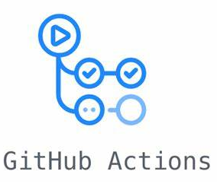










M5-G1-Repo
AWS Step Functions
314146336986.dkr.ecr.us-east-1.amazonaws.com/gruppo1
M5-G1-EB-Ingestion-shedule
cron(0 7 ? * 1 *)
M5-G1-lambda-exec-uuid
s3://data-remote-repository-cefriel/gruppo-1/processed/
M5-G1-lambda-trigger
SageMaker CreateProcessingJob
s3://data-remote-repository-cefriel/gruppo-1/model/
M5-G1-lambda-ingestion
SageMaker CreateTraningJob
s3://data-remote-repository-cefriel/gruppo-1/raw/
s3://data-remote-repository-cefriel/gruppo-1/outputs/
SageMaker CreateTraningJob
M5-G1-sfjobswaterfall
Cloud Watch Log
Cloud Watch Alarm

