Slide 1
PLS for fault detection
Adaptive Learning, Estimation and Supervision of dynamical systems (ALES)
a.a. 2022/2023
1053015: Nicola Zambelli
1054918: Alessandro Chaar

Slide 2
Summary
01. Introduction
02. PLS methodology
Pag. 3
Pag. 4:11
03. PLS vs PCA
04. NIPALS alghoritm
05. Case study 1
Fisher Dataset
06. Case study 2
Baering fault Dataset
Pag. 12
Pag. 13:17
Pag. 18:21
Pag. 22:30

Slide 3
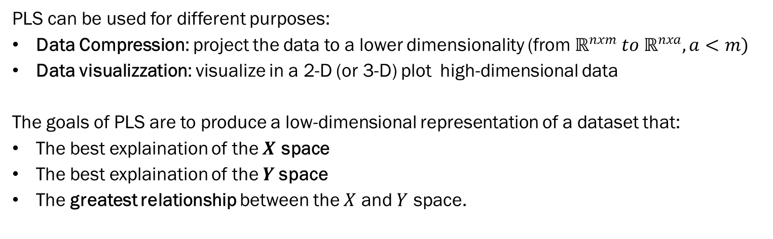
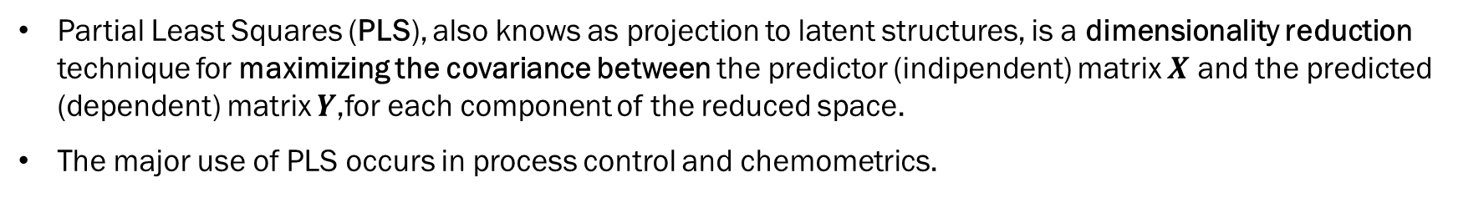
Introduction
Partial Least Squares (PLS), also knows as projection to latent structures, is a dimensionality reduction technique for maximizing the covariance between the predictor (indipendent) matrix $X$ and the predicted (dependent) matrix $Y$,for each component of the reduced space.
The major use of PLS ​​occurs in process control and chemometrics.
PLS can be used for different purposes:
Data Compression: project the data to a lower dimensionality (from ${\text{ℝ}}^{nxm} to {\text{ℝ}}^{nxa}, a<m)$
Data visualizzation: visualize in a 2-D (or 3-D) plot high-dimensional data
The goals of PLS are to produce a low-dimensional representation of a dataset that:
The best explaination of the $X$ space
The best explaination of the $Y$space
The greatest relationship between the $X$ and $Y$ space.

Slide 4
Metodologhy
Partial Least Squares

Slide 5
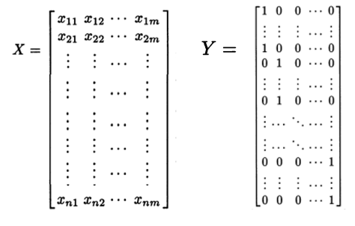
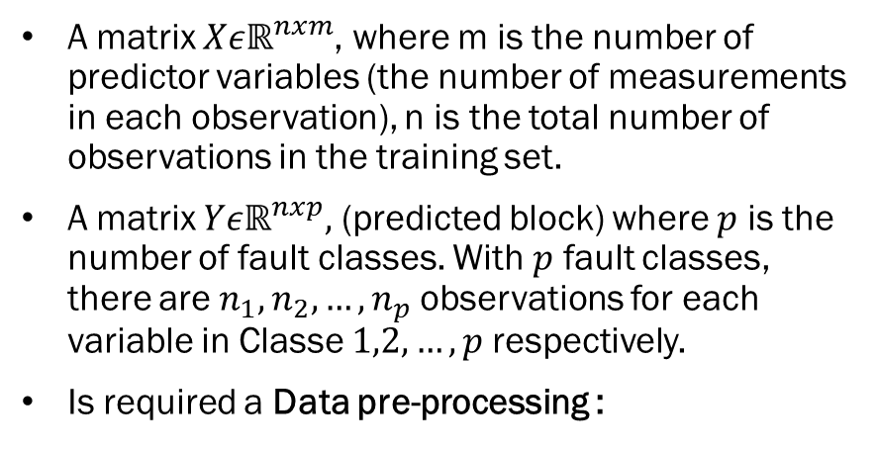
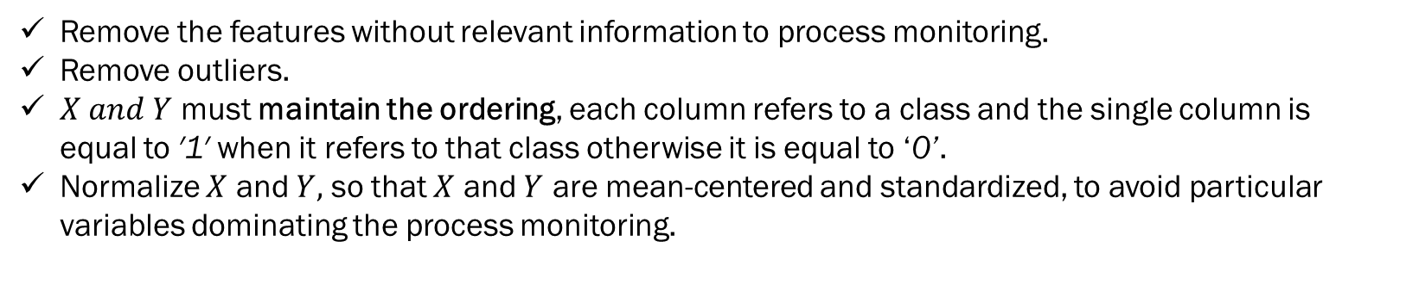


Input Data
A matrix $Xε{\text{ℝ}}^{nxm}$, where m is the number of predictor variables (the number of measurements in each observation), n is the total number of observations in the training set.
A matrix $Yεℝ^{nxp},$ (predicted block) where $p$ is the number of fault classes. With $p$ fault classes, there are $n_{1},n_{2},…,n_{p}$observations for each variable in Classe $1,2,…,p$respectively.
Is required a Data pre-processing :
$$n×m$$
$$n×p$$
Remove the features without relevant information to process monitoring.
Remove outliers.
$X and Y$ must maintain the ordering, each column refers to a class and the single column is equal to ′1′ when it refers to that class otherwise it is equal to ‘0’.
Normalize $X$ and $Y,$ so that $X$ and $Y$ are mean-centered and standardized, to avoid particular variables dominating the process monitoring.

Slide 6





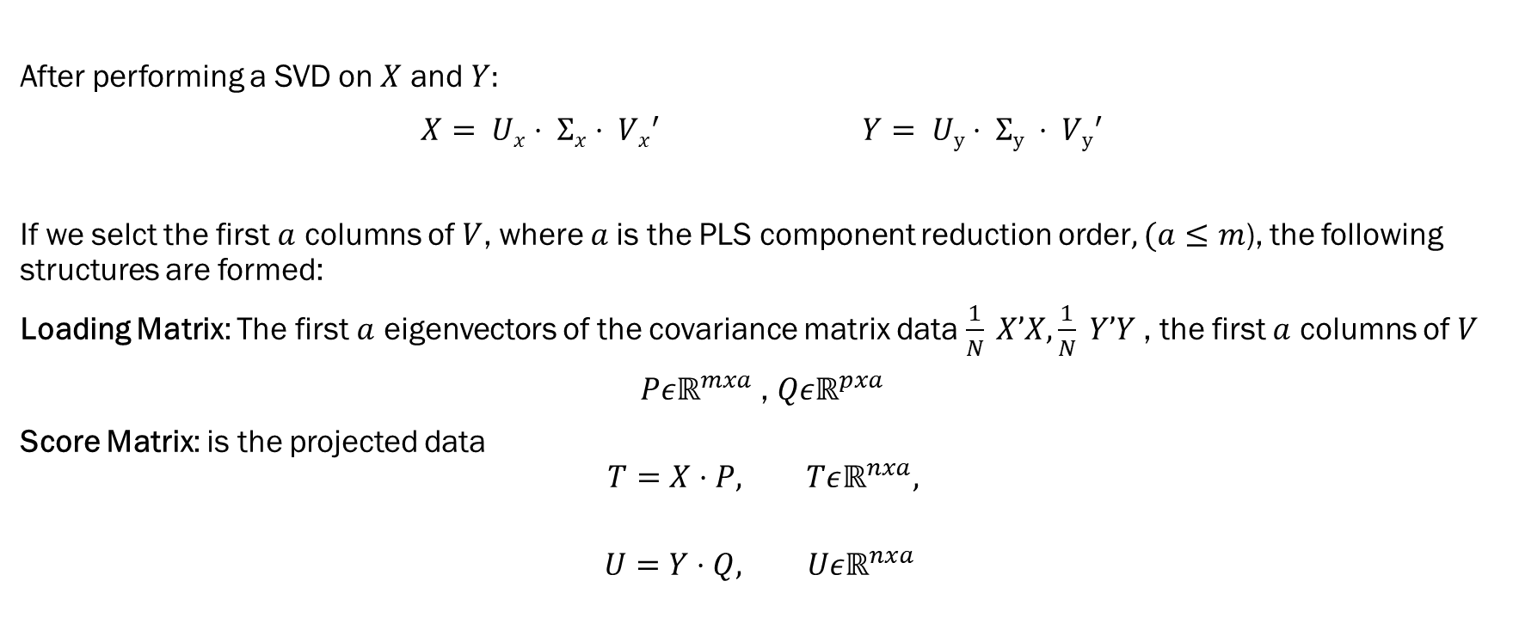








Singular Value Decomposition (SVD)
After performing a SVD on $X$ and $Y:$
$X= Ux⋅ Σx⋅ {Vx}^{′}$ $Y= Uy⋅ Σy ⋅ {Vy}^{′}$
If we selct the first $a$ columns of $V$, where $a$is the PLS component reduction order$, (a≤m$), the following structures are formed:
Loading Matrix: The first $a$ eigenvectors of the covariance matrix data $\frac{1}{N} X’X,\frac{1}{N} Y’Y$ , the first $a$ columns of $V$
$Pε{\text{ℝ}}^{mxa}$ , $Qε{\text{ℝ}}^{pxa}$
Score Matrix: is the projected data
$$T=X⋅P, Tεℝ^{nxa},$$
$$U=Y⋅Q, Uεℝ^{nxa}$$
$$n×m$$
$$n×m$$
$$n×p$$
$$n×p$$
$$n×n$$
$$m×m$$
$$n×n$$
$$p×p$$
$$n×a$$
$$m×a$$
$$n×m$$
$$n×a$$
$$p×a$$
$$n×p$$

Slide 7


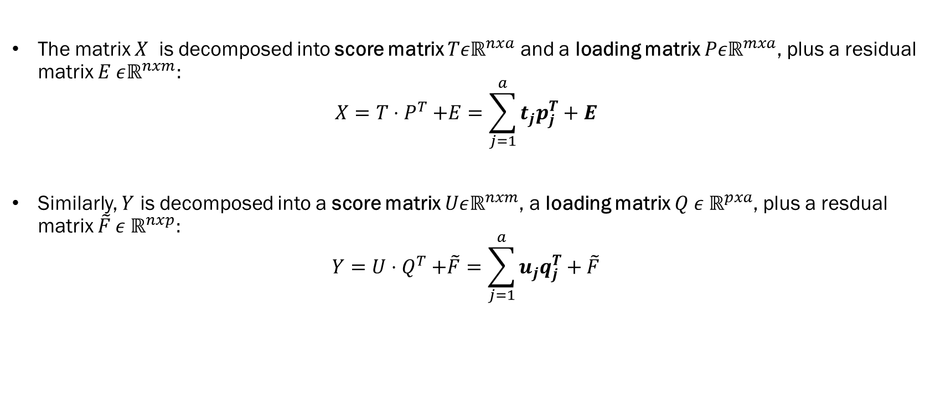


Decomposition
The matrix $X$ is decomposed into score matrix $Tεℝ^{nxa}$ and a loading matrix $Pεℝ^{mxa}$, plus a residual matrix $E εℝ^{nxm}:$
$$X=T{⋅P}^{T}+E=\sum_{j=1}^{a}{t_{j}p_{j}^{T}+E}$$
Similarly, $Y$ is decomposed into a score matrix $Uεℝ^{nxm}$, a loading matrix $Q ε ℝ^{pxa}$, plus a resdual matrix $\tilde{F} ε{ \text{ℝ}}^{nxp}:$
$$Y=U{⋅Q}^{T}+\tilde{F}=\sum_{j=1}^{a}{u_{j}q_{j}^{T}+\tilde{F}}$$
$$n×m$$
$$a×m$$
$$n×a$$
$$n×m$$
$$n×p$$
$$a×p$$
$$n×a$$
$$n×p$$

Slide 8
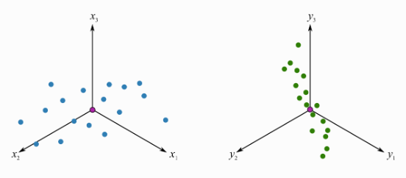
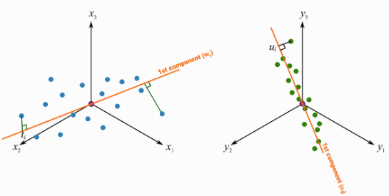


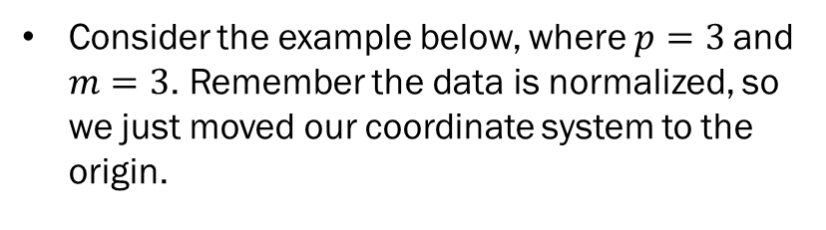

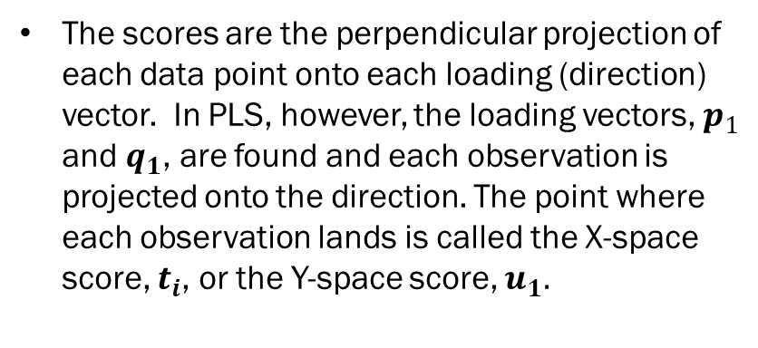

Geometric Interpretation
Consider the example below, where $p=3$and $m=3$. Remember the data is normalized, so we just moved our coordinate system to the origin.
The scores are the perpendicular projection of each data point onto each loading (direction) vector. In PLS, however, the loading vectors, $p_{1}$ and $q_{1}$, are found and each observation is projected onto the direction. The point where each observation lands is called the X-space score, $t_{i}$, or the Y-space score, $u_{1}.$
$$q_{1}$$
$$u_{n}$$
$$p_{1}$$
$$t_{i}$$

Slide 9
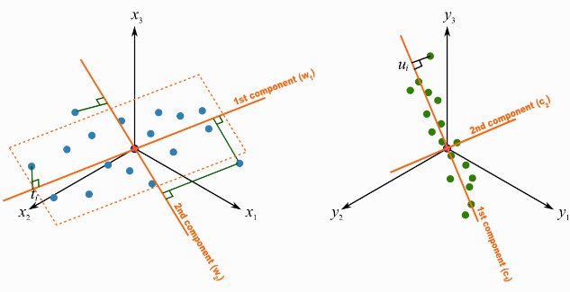








Geometric Interpretation
These scores are found in a way that maximizes the covariance between the t-values ​​and u-values.
The directions of the latent variables are oriented in such a way as to better explain X, and better explain Y, and have the greatest possible relationship between X and Y.
The second component is then found to be not necessary orthogonal to the first component in space X.
$$p_{1}$$
$$t_{2,k}$$
$$q_{2}$$
$$t_{1,n}$$
$$t_{1,1}$$
$$t_{2,n}$$
$$p_{2}$$
$$q_{1}$$

Slide 10
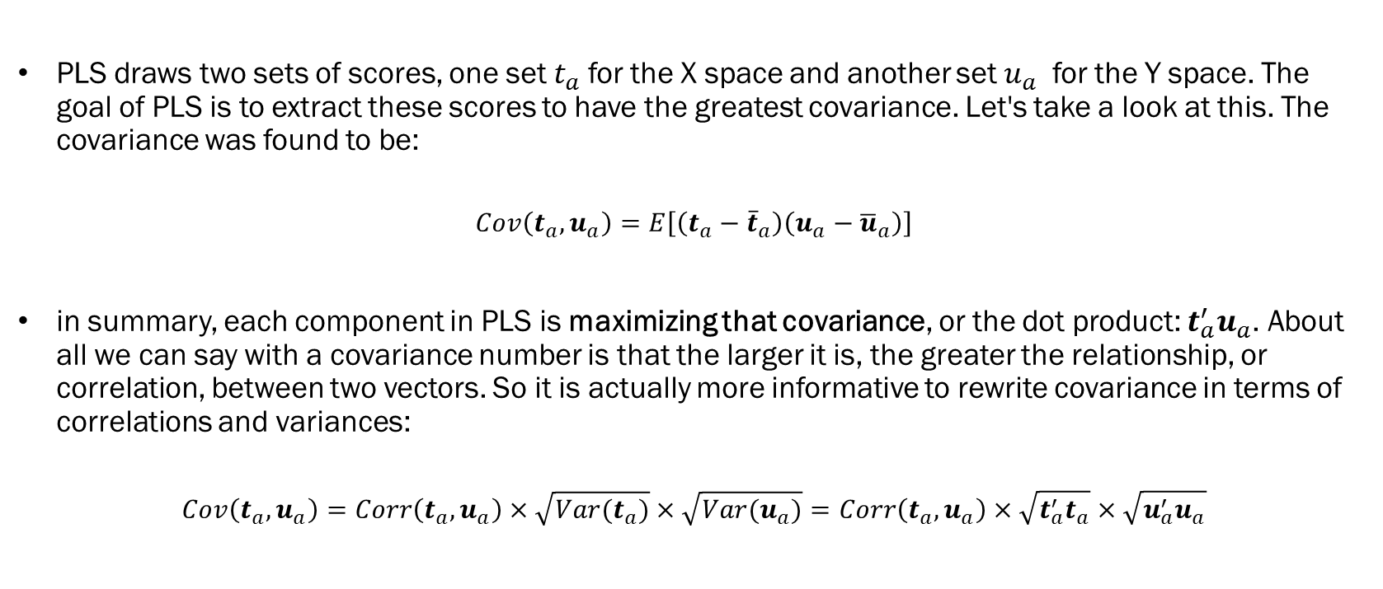
Mathematical/statistical interpretation:
PLS draws two sets of scores, one set $t_{a}$for the X space and another set $u_{a}$ for the Y space. The goal of PLS ​​is to extract these scores to have the greatest covariance. Let's take a look at this. The covariance was found to be:
$$Cov\left(t_{a},u_{a}\right)=E\left[\left(t_{a}−{\overline{t}}_{a}\right)\left(u_{a}−{\overline{u}}_{a}\right)\right]$$
in summary, each component in PLS is maximizing that covariance, or the dot product: $t_{a}^{′}u_{a}$. About all we can say with a covariance number is that the larger it is, the greater the relationship, or correlation, between two vectors. So it is actually more informative to rewrite covariance in terms of correlations and variances:
$$Cov\left(t_{a},u_{a}\right)=Corr\left(t_{a},u_{a}\right)×\sqrt{Var(t_{a})}×\sqrt{Var(u_{a})}=Corr\left(t_{a},u_{a}\right)×\sqrt{t_{a}^{′}t_{a}}×\sqrt{u_{a}^{′}u_{a}}$$

Slide 11
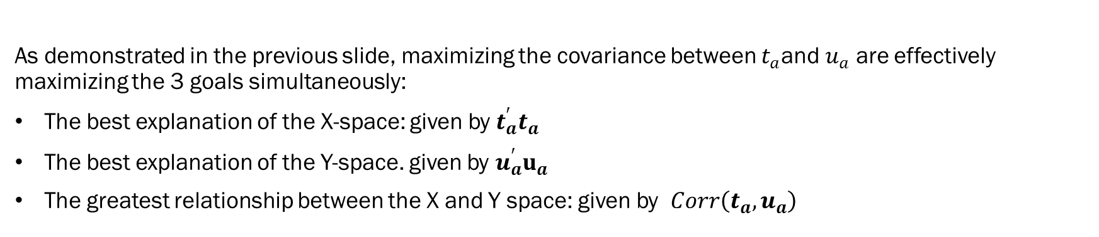
Mathematical/statistical interpretation:
As demonstrated in the previous slide, maximizing the covariance between $t_{a}$and $u_{a}$ are effectively maximizing the 3 goals simultaneously:
The best explanation of the X-space: given by $t_{a}^{′}t_{a}$
The best explanation of the Y-space. given by $u_{a}^{′}u_{a}$
The greatest relationship between the X and Y space: given by $Corr\left(t_{a},u_{a}\right)$

Slide 12
PCA vs PLS
In PCA, loading vectors are orthogonal while for PLS they are rarely orthogonal.
PCA maximizes the variance in X while PLS maximizes the X and Y covariance.
In PLS, by specifying Y to include error information, the PLS vectors are computed to give a lower-dimensional representation related to class error differences, and this leads that:
fewer PLS carriers should be required.
should get lower misclassification rates.
Usually provide better fault diagnosis of faults.

Slide 13
NIPALS
Nonlinear Iterative Partial Least Squares

Slide 14


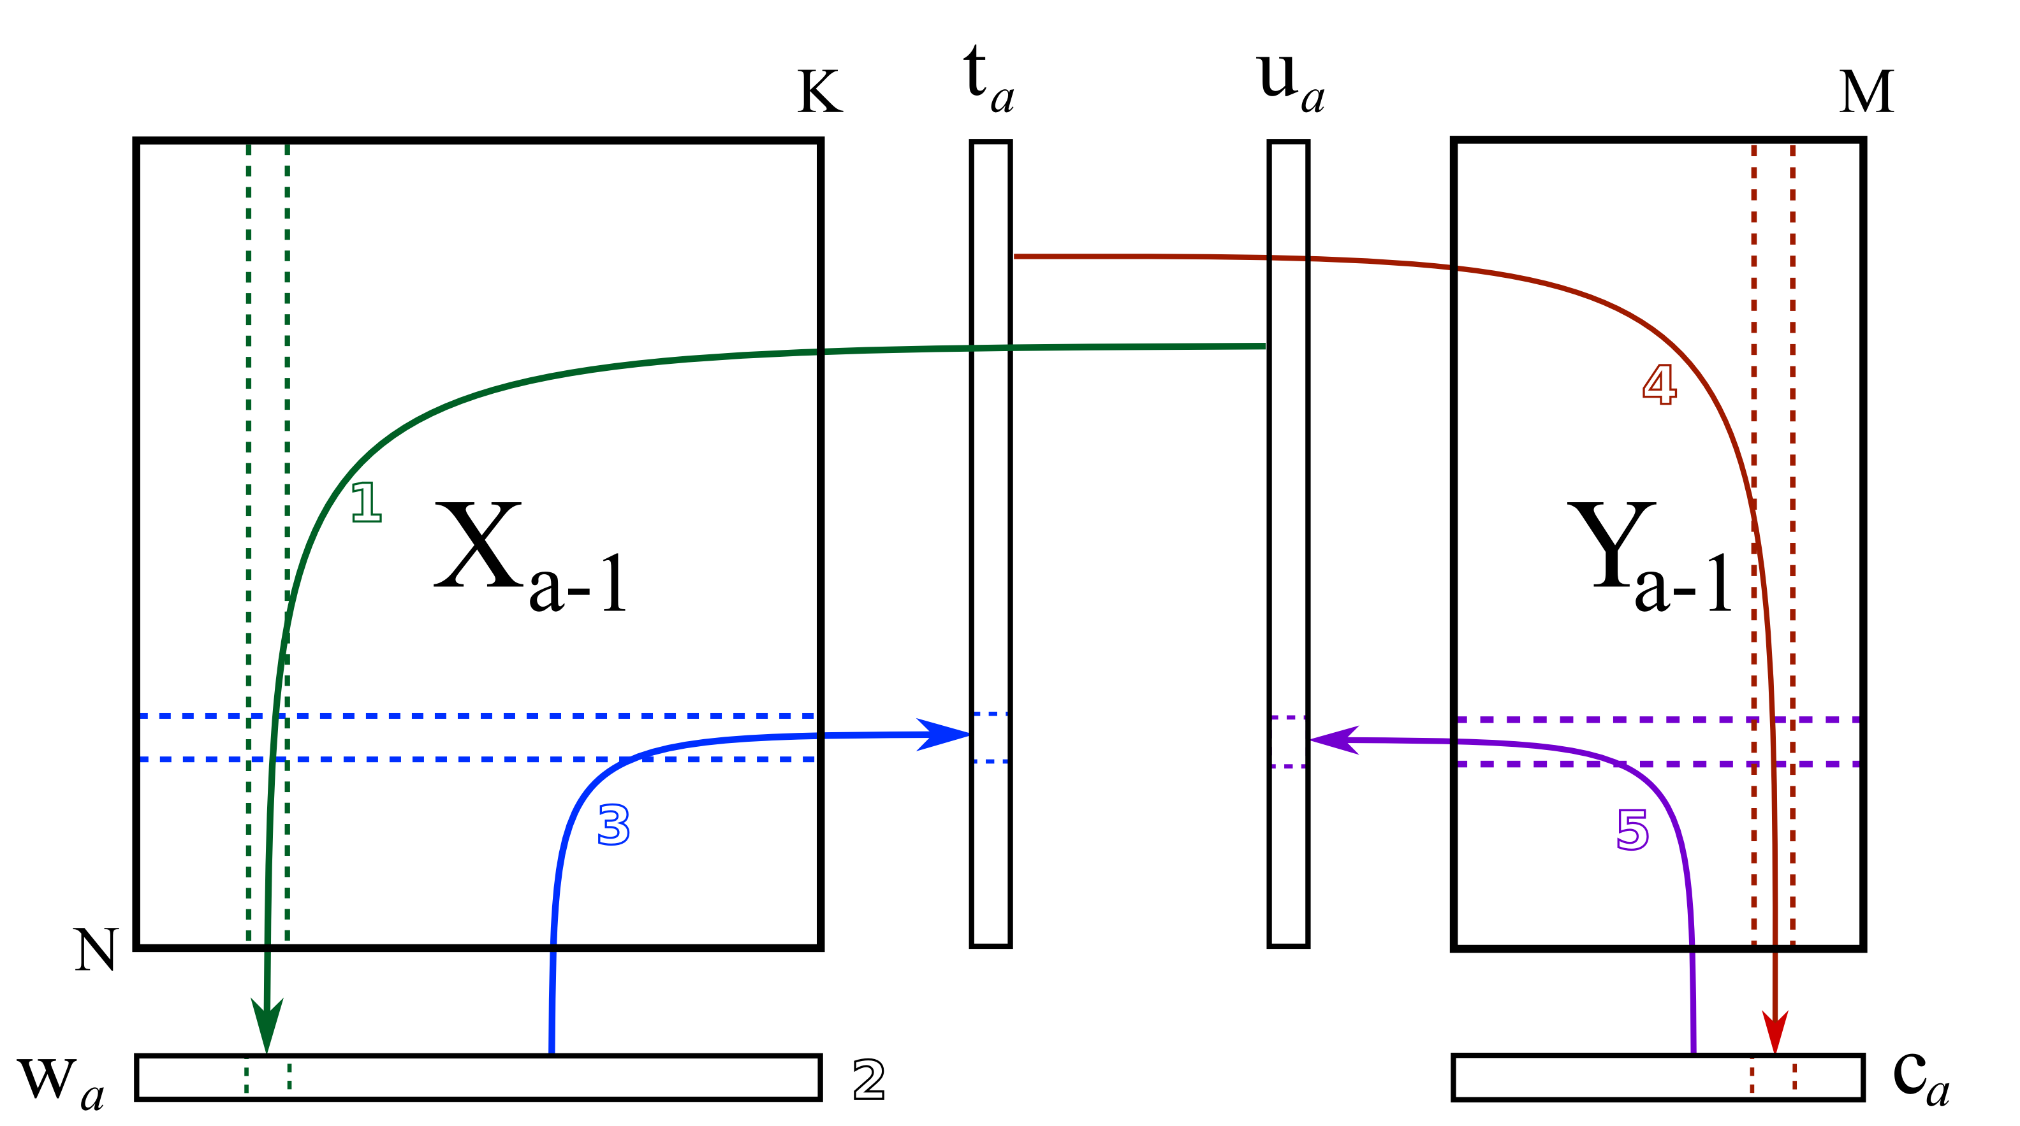



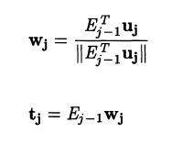
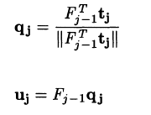

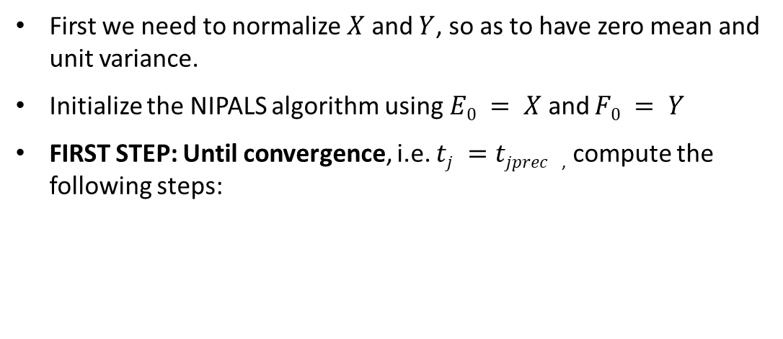
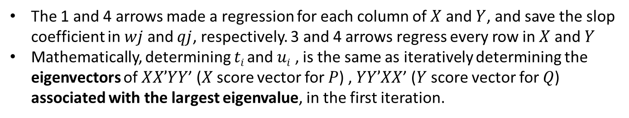
NIPALS first step
First we need to normalize$X$and $Y$, so as to have zero mean and unit variance.
Initialize the NIPALS algorithm using$E0 = X$and $F0 = Y$
FIRST STEP: Until convergence, i.e. $tj =tjprec$ , compute the following steps:
The 1 and 4 arrows made a regression for each column of $X$ and $Y$, and save the slop coefficient in $wj$ and $qj$, respectively. 3 and 4 arrows regress every row in $X$ and$Y$
Mathematically, determining $ti$and $ui$ , is the same as iteratively determining the eigenvectors of $XX’YY$’ ($X$score vector for $P$) , $YY’XX$’ ($Y$ score vector for $Q$) associated with the largest eigenvalue, in the first iteration.

Slide 15
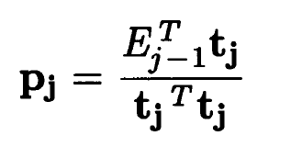
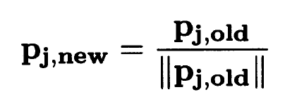
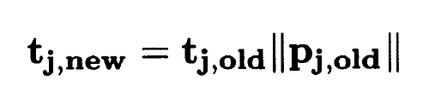

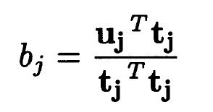


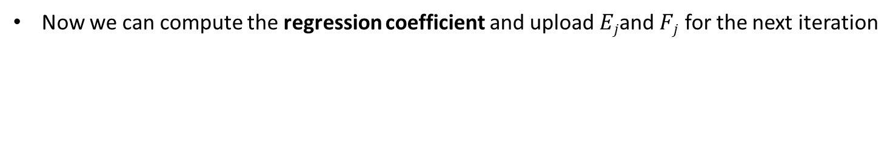
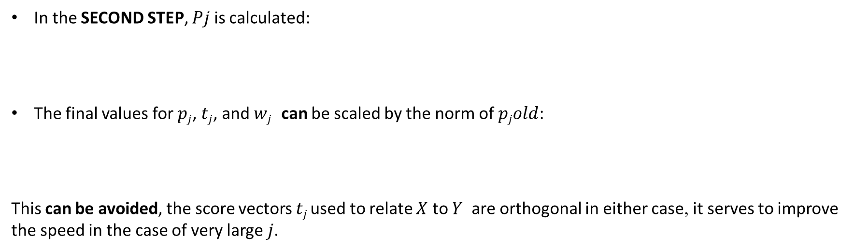
NIPALS second step
In the SECOND STEP, $Pj$ is calculated:
The final values for $pj$, $tj$, and $wj$ can be scaled by the norm of $pjold$:
This can be avoided, the score vectors $tj$used to relate $X$ to $Y$ are orthogonal in either case, it serves to improve the speed in the case of very large $j$.
Now we can compute the regression coefficient and upload $Ej$and $Fj$ for the next iteration

Slide 16
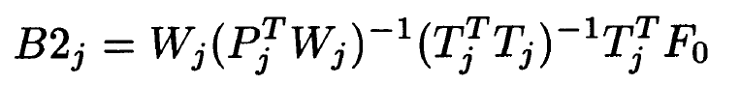
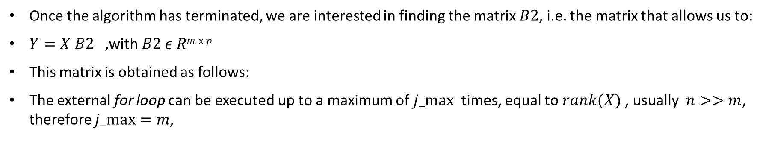
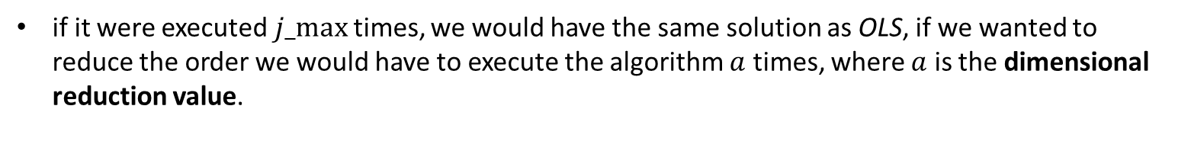
NIPALS consideration
Once the algorithm has terminated, we are interested in finding the matrix $B2$, i.e. the matrix that allows us to:
$Y=X B2$ ,with$B2 ε Rm x p$
This matrix is obtained as follows:
The external for loop can be executed up to a maximum of $j_max⁡$ times, equal to $rank(X)$, usually $n>>m$, therefore $j_max=m$,
if it were executed$j_max⁡$times, we would have the same solution as OLS, if we wanted to reduce the order we would have to execute the algorithm $a$ times, where $a$ is the dimensional reduction value.

Slide 17
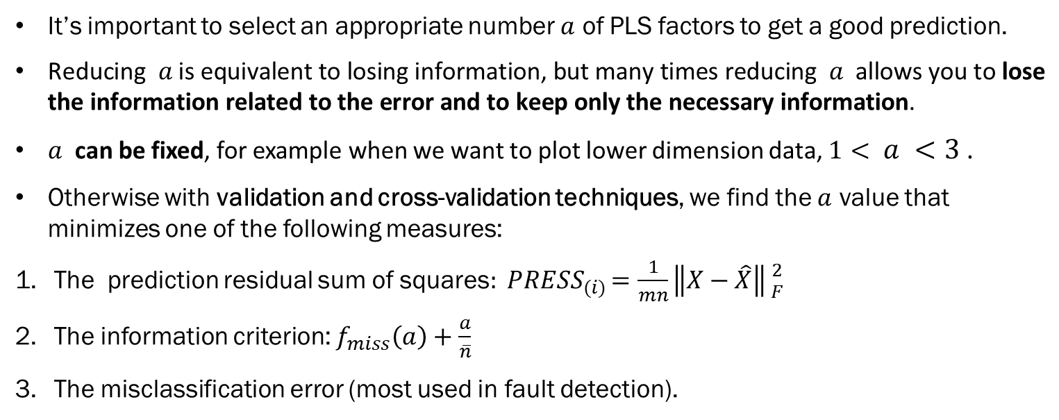
Reduction Order
It’s important to select an appropriate number $a$ of PLS ​​factors to get a good prediction.
$\text{Reducing} a \text{is} \text{equivalent} \text{to} \text{losing} \text{information}\text{, }\text{but} \text{many} \text{times} \text{reducing} a \text{allows} \text{you} \text{to} \text{lose} \text{the} \text{information} \text{related} \text{to} \text{the} \text{error} \text{and} \text{to} \text{keep} \text{only} \text{the} \text{necessary} \text{information}\text{.}$
$a$ can be fixed, for example when we want to plot lower dimension data, $1< a <3$.
Otherwise with validation and cross-validation techniques, we find the $a$ value that minimizes one of the following measures:
The prediction residual sum of squares${: PRESS}_{(i)}=\frac{1}{mn}\left\|\left.X−\hat{X}\right\|\right.{2 \atop F}$
The information criterion: $f_{miss}\left(a\right)+\frac{a}{\overline{n}}$
The misclassification error (most used in fault detection).

Slide 18
Case study 1
Fisher Dataset

Slide 19
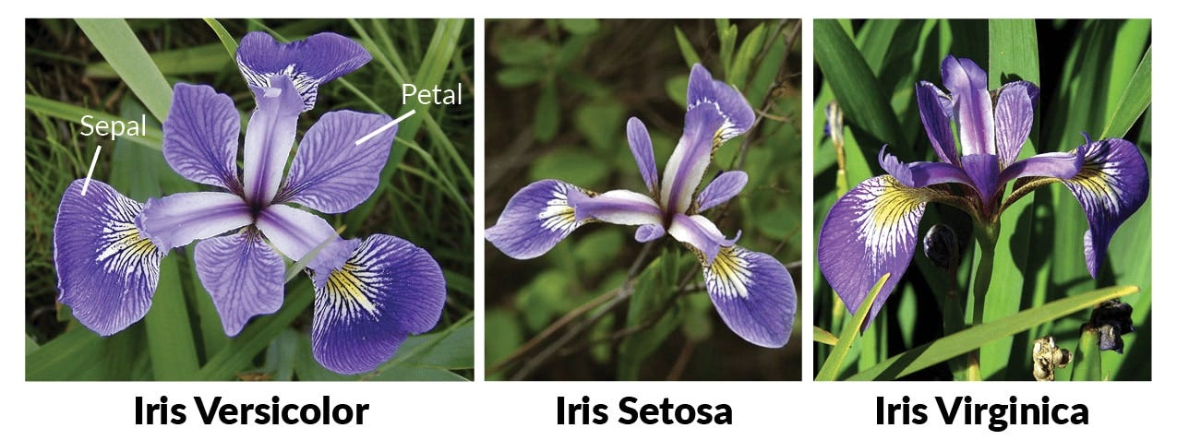
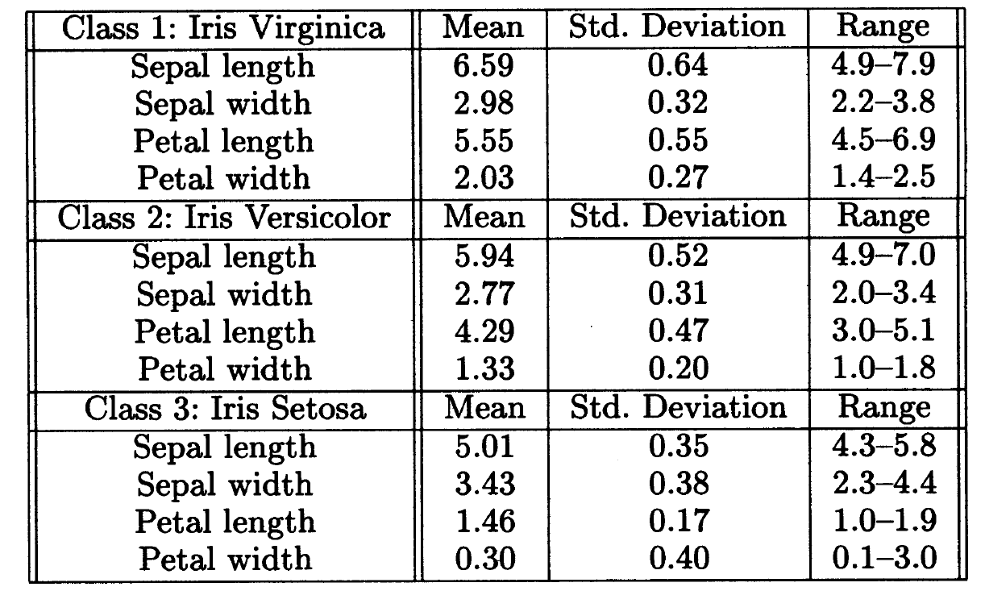
Fisher Dataset
This PLS case study will be illustrated using the classic Fisher dataset.
The dataset is composed of three classes, each of which contains m = 4 measurements and n = 50 observations.
We use NIPALS for classify the flowers

Slide 20
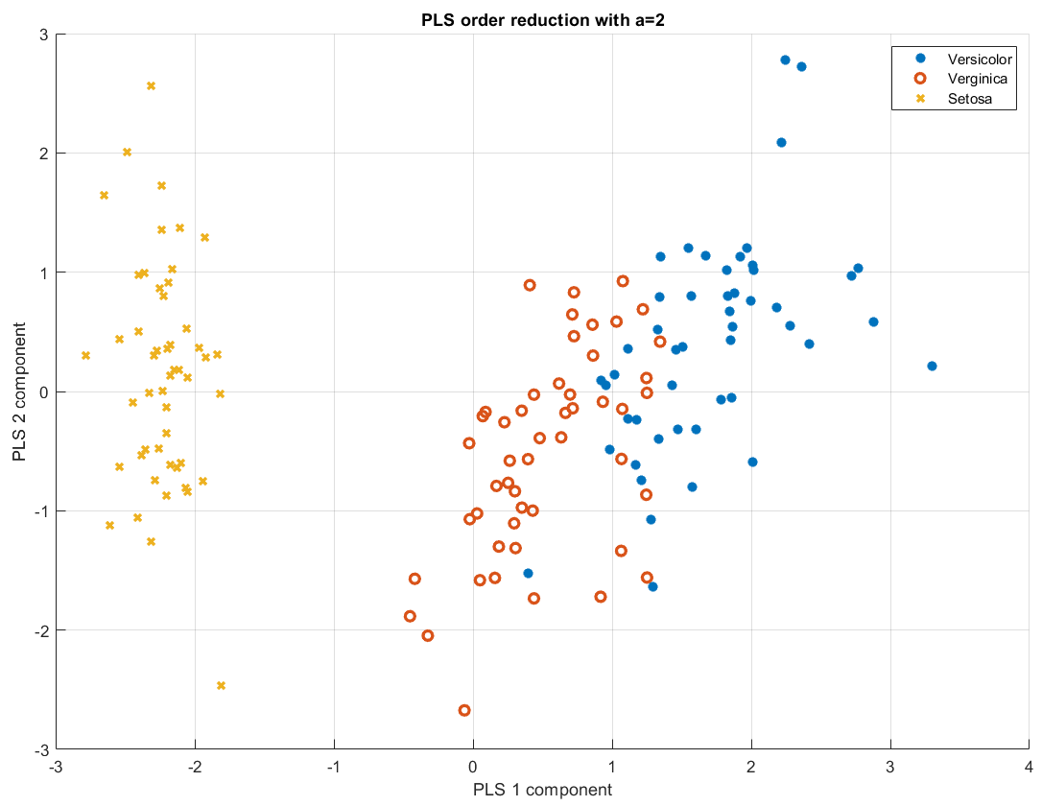
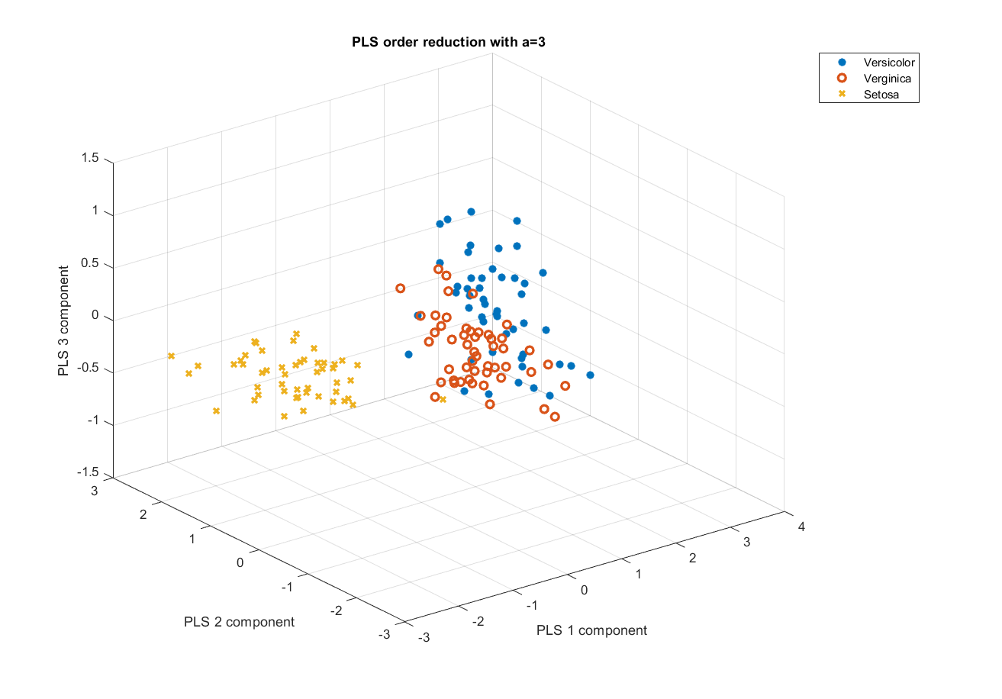
Low-dimensional representation

Slide 21
Fisher Confusion Matrix
 | Predict Versicolor | Predict Verginica | Predict Setosa
Observed Versicolor | 43 | 7 | 0
Obs. Verginica | 20 | 30 | 0
Obs. Setosa | 0 | 1 | 49
Accuracy | 81.33
Error | 18.67
Sensitivity | 81.33
Specificity | 90.67

Slide 22
Case study 2
Baering fault Dataset

Slide 23
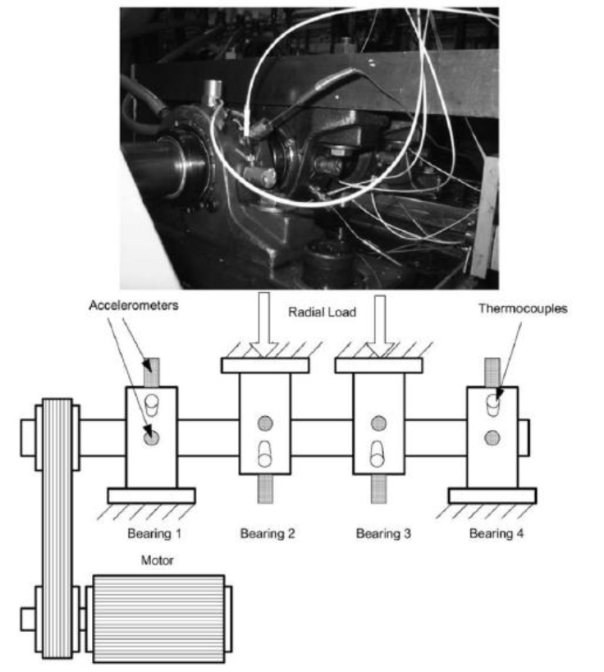
Baering fault Dataset
The data was generated by the NSF I/UCR Center for Intelligent Maintenance Systems (IMS – www.imscenter.net).
Four bearings were installed on a shaft. The rotation speed was kept constant at 2000 RPM by an AC motor coupled to the shaft via rub belts. A radial load of 6000 lbs is applied onto the shaft and bearing by a spring mechanism. All bearings are force lubricated.

Slide 24

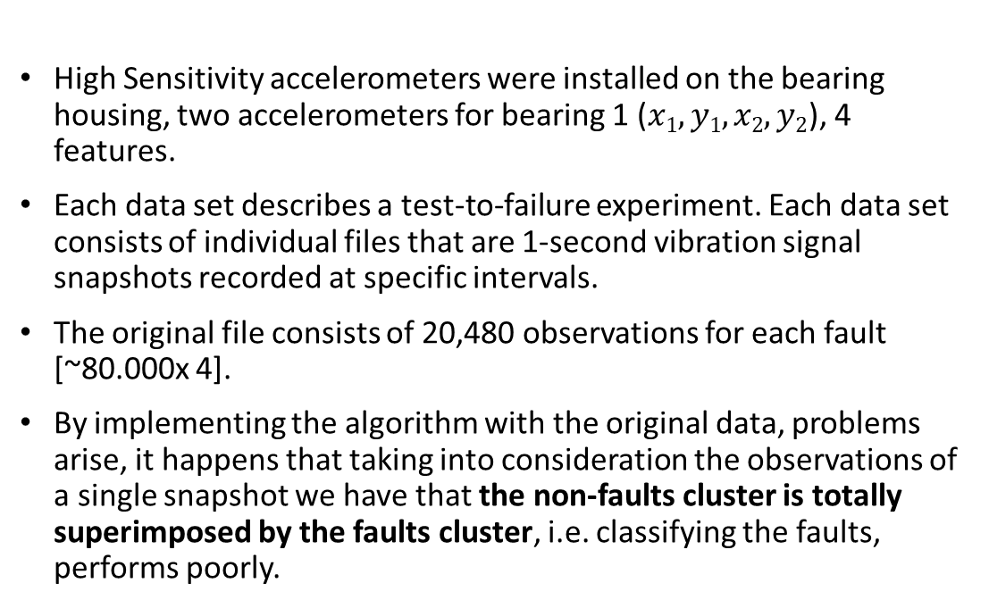
Data Issues
High Sensitivity accelerometers were installed on the bearing housing, two accelerometers for bearing 1 ($x1,y1,x2,y2$), 4 features.
Each data set describes a test-to-failure experiment. Each data set consists of individual files that are 1-second vibration signal snapshots recorded at specific intervals.
The original file consists of 20,480 observations for each fault [~80.000x 4].
By implementing the algorithm with the original data, problems arise, it happens that taking into consideration the observations of a single snapshot we have that the non-faults cluster is totally superimposed by the faults cluster, i.e. classifying the faults, performs poorly.
Healty bearing
Faulty bearing

Slide 25
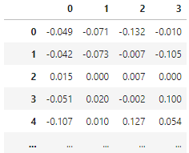

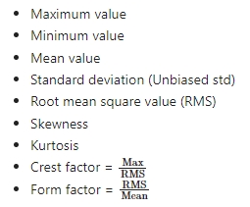
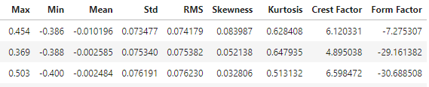
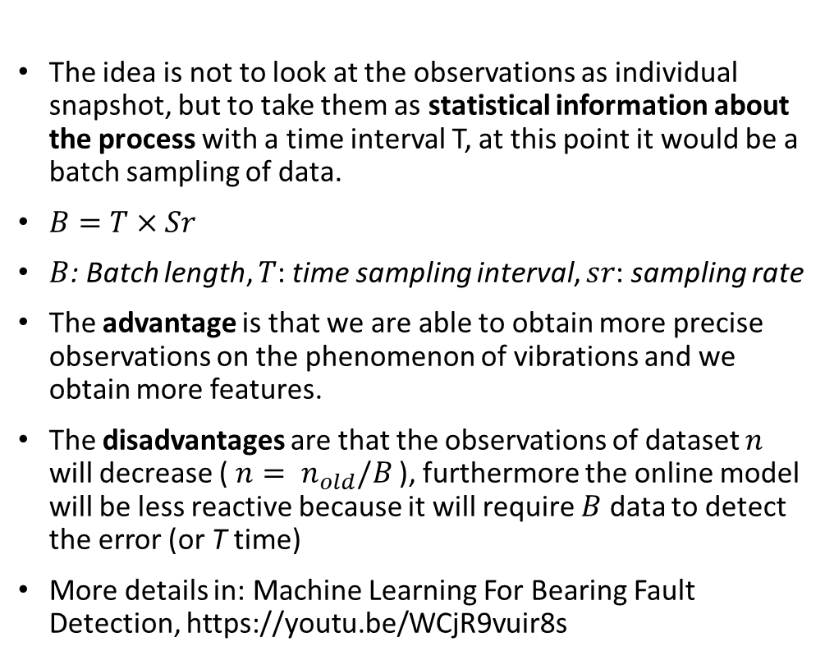



Data Processing
$$x1 y1 x2 y2$$
The idea is not to look at the observations as individual snapshot, but to take them as statistical information about the process with a time interval T, at this point it would be a batch sampling of data.
$B=T×Sr$
$B$: Batch length, $T$: time sampling interval, $sr$: sampling rate
The advantage is that we are able to obtain more precise observations on the phenomenon of vibrations and we obtain more features.
The disadvantages are that the observations of dataset $n$ will decrease ( $n= n_{old}/B$), furthermore the online model will be less reactive because it will require $B$ data to detect the error (or T time)
More details in: Machine Learning For Bearing Fault Detection, https://youtu.be/WCjR9vuir8s
$$B=T×Sr$$
$Stat$_{B}

Slide 26
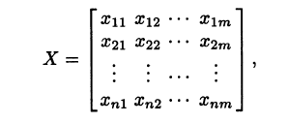
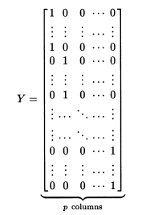
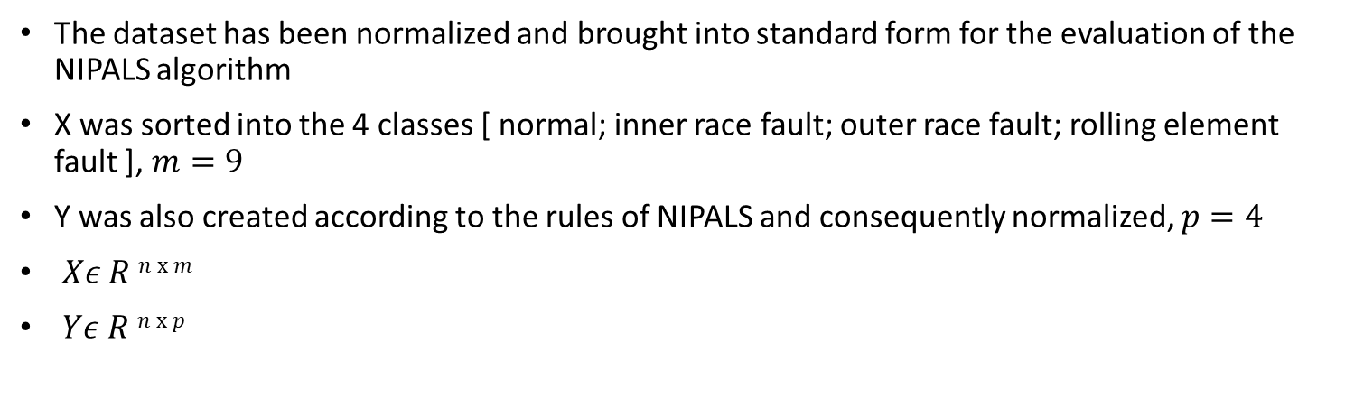
Data Processing
The dataset has been normalized and brought into standard form for the evaluation of the NIPALS algorithm
X was sorted into the 4 classes [ normal; inner race fault; outer race fault; rolling element fault ], $m=9$
Y was also created according to the rules of NIPALS and consequently normalized, $p=4$
$Xε R n x m$
$Yε R n x p$

Slide 27
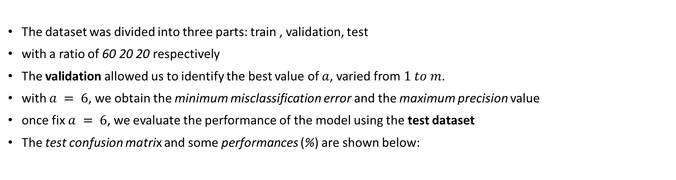
Data Splitting and Results
The dataset was divided into three parts: train , validation, test
with a ratio of 60 20 20 respectively
The validation allowed us to identify the best value of $a$, varied from $1 to m$.
with $a = 6$, we obtain the minimum misclassification error and the maximum precision value
once fix $a = 6$, we evaluate the performance of the model using the test dataset
The test confusion matrix and some performances (%) are shown below:
 | Predict Normal | Predict IR Fault | Predict OR Fault | Predict RE Fault
Observed Normal | 155 | 0 | 0 | 0
Obs. IR Fault | 0 | 78 | 0 | 15
Obs. OR Fault | 0 | 0 | 45 | 0
Obs RE Fault | 0 | 2 | 0 | 91
Accuracy | 95.6
Error | 4.4
Sensitivity | 95.4
Specificity | 98.5
Precision | 95.8

Slide 28
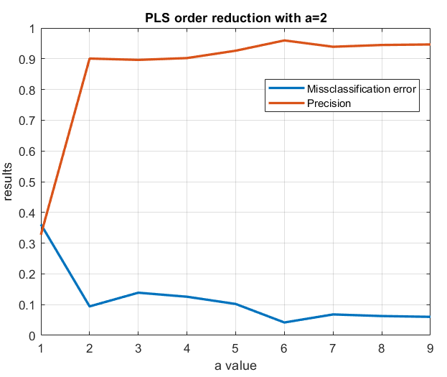
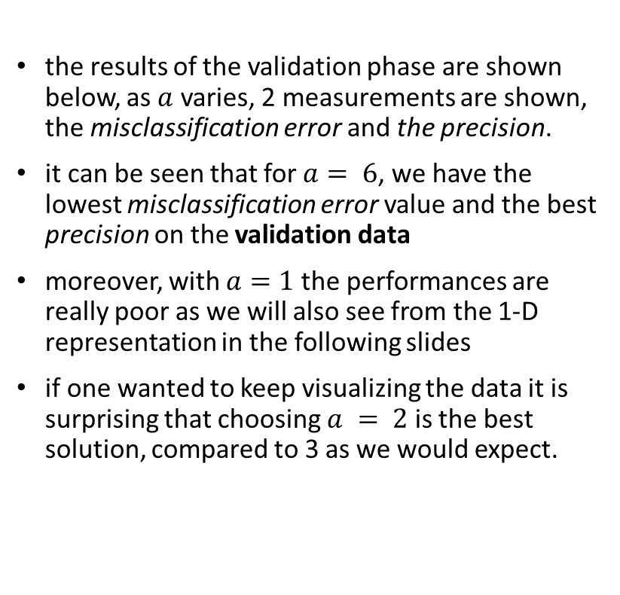
Validation Result
the results of the validation phase are shown below, as $a$ varies, 2 measurements are shown, the misclassification error and the precision.
it can be seen that for $a= 6$, we have the lowest misclassification error value and the best precision on the validation data
moreover, with $a=1$the performances are really poor as we will also see from the 1-D representation in the following slides
if one wanted to keep visualizing the data it is surprising that choosing $a = 2$is the best solution, compared to 3 as we would expect.

Slide 29
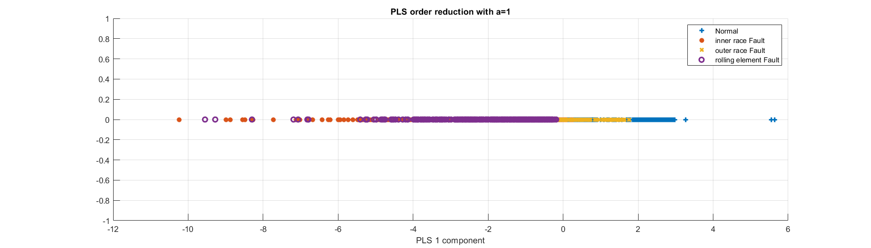
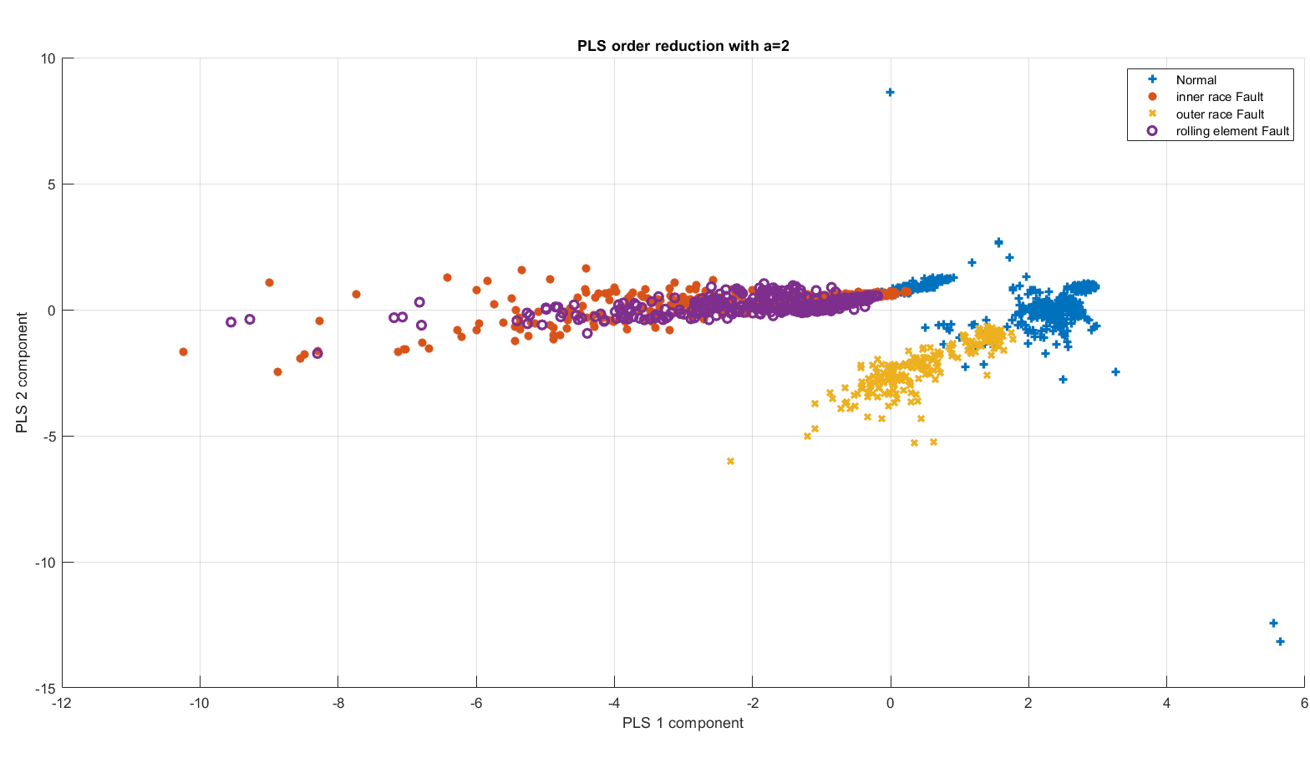
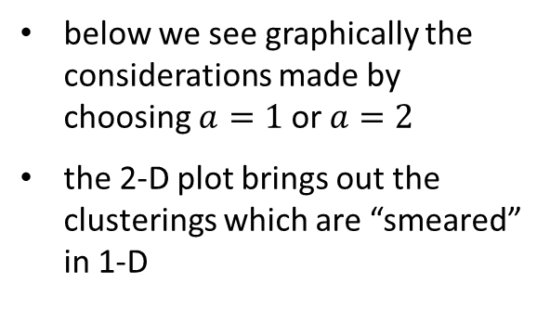
1-D and 2-D low-dimensional representation
below we see graphically the considerations made by choosing $a=1$or $a=2$
the 2-D plot brings out the clusterings which are “smeared” in 1-D

Slide 30
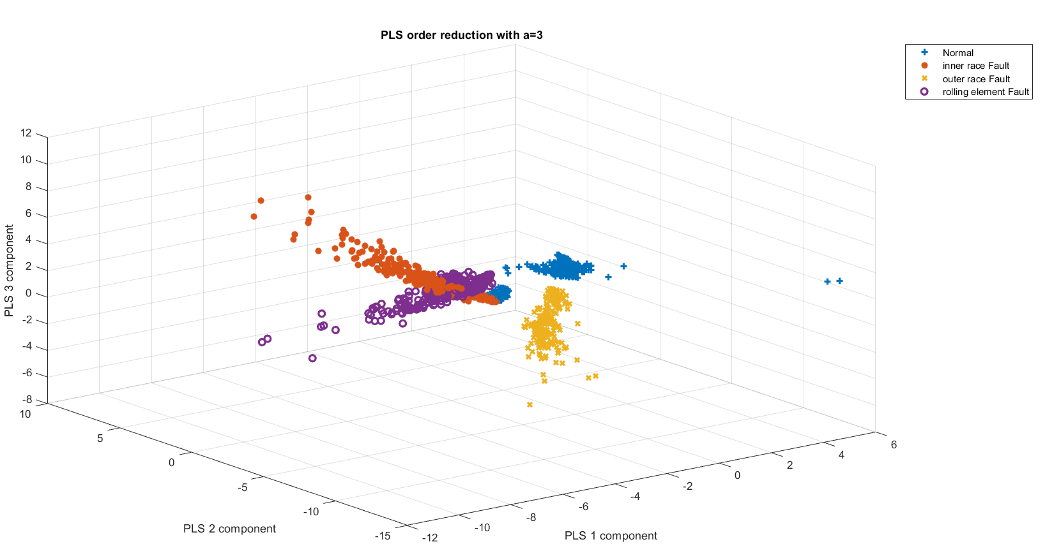
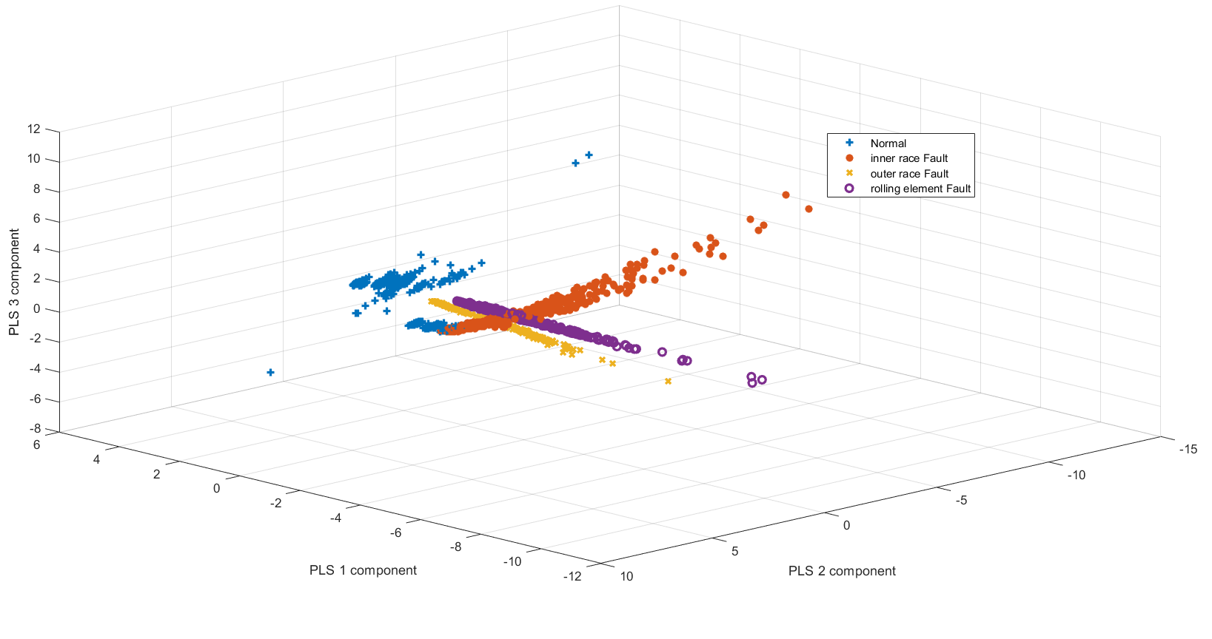
3-D low-dimensional representation
In the case of 3 dimensions, we report 2 different angles of the graph
Here the idea of custering is much more evident

Slide 31
The end
Adaptive Learning, Estimation and Supervision of dynamical systems (ALES)
a.a. 2022/2023
1053015: Nicola Zambelli
1054918: Alessandro Chaar

