Slide 1

Hotel SERVICE management
Serverless Computing for IoT-Project

Slide 2


Problem description
The basic problem that this project aims to solve is the management of all kind of accesses in a building.
It can be initially applied to a hotel building scenario, but it can be potentially extended to all buildings that need access management.

Slide 3
«serverless»
Serverless Computing is a cloud computing model in which code is run as a service without the need for the user to maintain or create the underlying infrastructure.
This doesn’t mean that serverless architecture doesn’t require servers, but instead that a third party is managing these servers instead of the developers.

Slide 4
04
01
Project requisites
Details and requisites of the
project

Slide 5
Project requisites
In a hotel scenario, in most cases, there are many services available to guests such as spa, games room, gym, and so on. However each guest cannot access each service for free, but each service has its cost.
Games Room
Gym
Spa
Room with all kind of games: poker, pool…
Gym room and specialized training rooms
Mineral bath with health-giving properties
Restaurant
Laundry
Massages
Sea and land food restaurant
Clothes can be washed and ironed.
Experienced people with years of experience

Slide 6



ROLES
To manage the access to these services some roles are assigned to the guests. When a guest pays for the services he wants, a bracelet is issued to the guest. The bracelet will represent the access pass to the services purchased by the guest.
BRONZE
GOLD
SILVER
The access is allowed for every service, but for a limited number of times.
The access is allowed only in the games room.
The access is allowed for every service unlimited.

Slide 7
02
USE CASE
Tipical use case

Slide 8
USE CASE ( access service request )
01
02
03
A guest wants to access the games room, so he puts his bracelet on the reader sensor near the games room door.
A function checks the role of the guest who made the access request and store the request on database.
If that role is allowed to access that particular service, then a message is showed on the screen near the service door:
“access allowed" or "access not allowed".

Slide 9
03
Solution description
General description of the solution, its architecture and its components

Slide 10


IoT Sensors EMULATION
The serverless functions are trigged by events generated from small devices such as sensors and mobile (IoT devices), commonly these devices communicates using message-passing, in particular on dedicated protocols as AMQP or MQTT.
In this project to emulate the IoT sensors the events could be generated either by another function or from a MQTT client(mobile app).
Anyway it would be easy to test using a real device that allows to send messages on MQTT or AMQP topic).
Nuclio Function that generate the event
MQTT Client

Slide 11
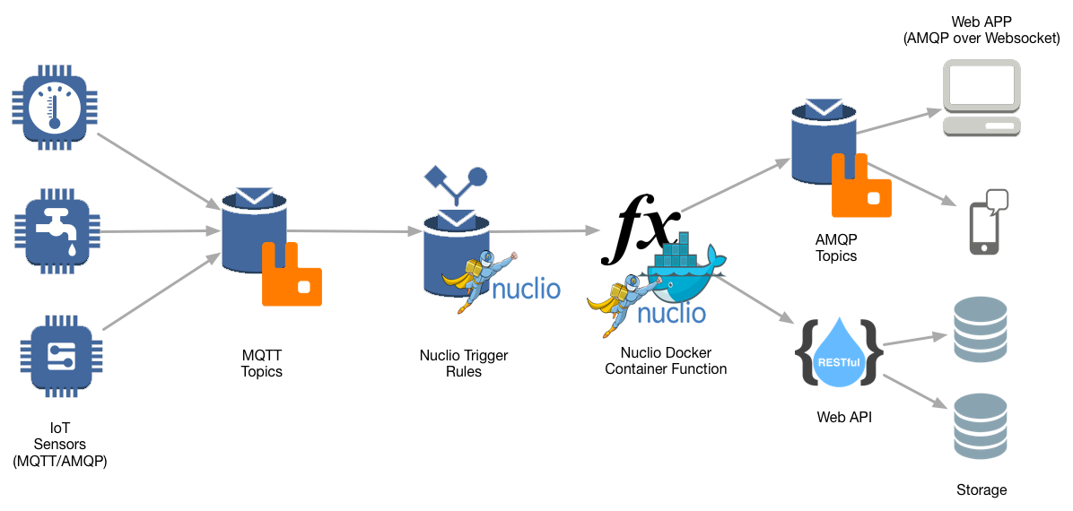





architecture
Consumer
Result Reader
AMQP Topic
Result_reader_logger.js
Iot/sensors/result
IoT Sensors
Smart Bracelet
MQTT Topic
Nuclio Trigger
Rules
Iot/sensors/services
Nuclio Docker
Container
Function
Validate_request_function
AWS API
Gateway
AWS DynamoDB

Slide 12

Rabbit MQ: open source message-broker
RabbitMQ is an open-source message-broker software that supports various communication protocols, AMQP and MQTT.
In our architecture we use both mentioned protocols:
MQTT
AMQP
MQTT to publish a message on a topic in order to trigger a Nuclio Function
AMQP to send the result of the access request on a topic in order to be consumed and showed

Slide 13
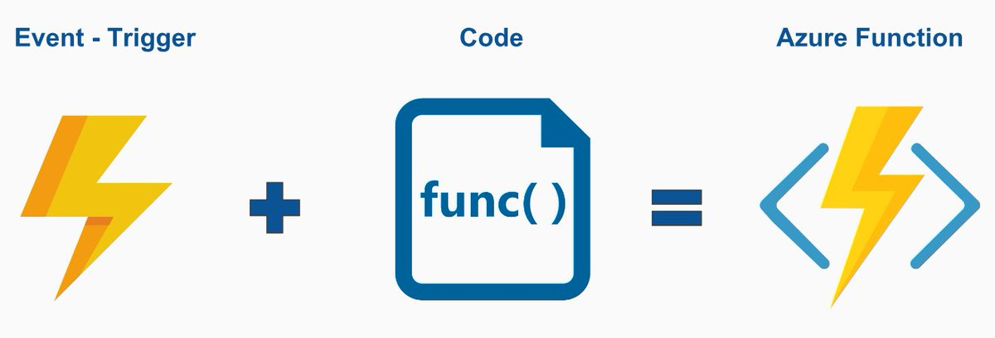
Nuclio
Nuclio is an open source and managed serverless platform used to minimize development and maintenance overhead and automate the deployment of data-science based applications
In our architecture we use Nuclio for:
A Nuclio trigger rule ignite the execution of a Nuclio serverless function
Nuclio Docker Container Function
Nuclio Trigger Rules

Slide 14

DYNAMO DB
It is a fast and flexible NoSQL database service for any scale.
This DB choice is made because:
No particular structure or relations are needed for our application
No server to manage: DynamoDB is serverless with no servers to provision, patch, or manage and no software to install, maintain, or operate.

Slide 15
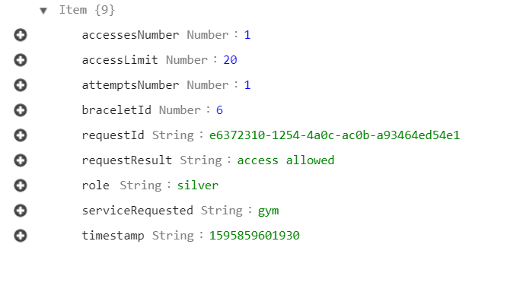
Dynamo DB TABLE
hotel_service_management
requestId | timestamp | braceletId | role | Access Limit | Attempts Number | Accesses Number | Service Requested | Request Result
Item_example
*Requests of guests with bronze and gold role can have unlimited access to the allowed services so this attribute is needed only with silver role

Slide 16
AWS API gateway
Amazon API Gateway is a fully managed service that makes it easy for developers to create, publish, maintain, monitor, and secure APIs at any scale.
We use it in our architecture as “front door” for serverless functions to access data in DynamoDB.

Slide 17

API KEY
To secure the APIs, in order to make them accessible only to the applications allowed and not publicly we use API KEYs, created in AWS and inserted in each request header.
Without the API Key a «forbidden error message» will be given.
API

Slide 18
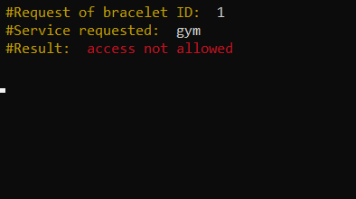
CONSUMER APP JS
A NodeJS app is developed to consume the result published on a topic and show it on screen (in reality the result message would be showed on a screen near the hotel service door)

Slide 19
04
Code in details
Highlights of implementation

Slide 20
Validate_request_function.js (1)
Nuclio Trigger Rules
exports.handler = function(context, event) {
var _event = JSON.parse(JSON.stringify(event));
var _data = bin2string(_event.body.data);
var extractedStrings = _data.split("-");
var braceletId = parseInt(extractedStrings[0]);
var serviceRequested = extractedStrings[1];
if(check_wrong_service(serviceRequested)){
//The requested service is wrong: it is not present in the list of services
send_result(braceletId + "-"+ serviceRequested + "-errorService");
}else{
//Ther requested service is one of the avalaible services
check_requisites(braceletId, serviceRequested);
}
Take and convert the message read on topic : (e.g. “1-gym”)
Check if there is an error in the service requested name
If the requested service exists, then check the requisites of the guest ->

Slide 21
Validate_request_function.js (2)
function check_requisites(braceletId, serviceRequested){
…GET REQUEST: take from DB the last request made from guest with given braceletID
//Handling error inexistent ID in the DB
if(body.Count == 0){
//The bracelet ID that has issued the request is not registered into DB
send_result(braceletId + "-"+ serviceRequested + "-errorBracelet");
}else{
//bracelet ID existent in DB
lastRequest = body.Items[0];
//check role requisites
Take the role of given braceletId and check if the guest
who made the request is allowed to access the service
…

Slide 22
Validate_request_function.js (3)
if(reqResult){
resultString = "access allowed";
updatedAccessNumber = parseInt(lastRequest.accessesNumber.N) + 1;
}else{
resultString = "access not allowed";
updatedAccessNumber = parseInt(lastRequest.accessesNumber.N);
}
//Save request to DB for further analytics
send_result(braceletId + "-"+ serviceRequested + " " + resultString);
Set the result of the access request depending on the role requisites of the guest
Publish on topic using AMQP, the result of the request to be consumed by another
serverless function that
shows the result

Slide 23
05
How to execute: usage path
Installing and compiling code to run the project

Slide 24
NUCLIO
Rabbit MQ
Start Nuclio using a Docker Container and run its graphical user interface where you can create a project and add functions
$ docker run -p 8070:8070 -v /var/run/docker.sock:/var/run/docker.sock -v
/tmp:/tmp nuclio/dashboard:stable-amd64
Start RabbitMQ (message-broker) instance with MQTT enabled using Docker Container.
$ docker run -p 9000:15672 -p 1883:1883 -p 5672:5672 cyrilix/rabbitmq-mqtt

Slide 25
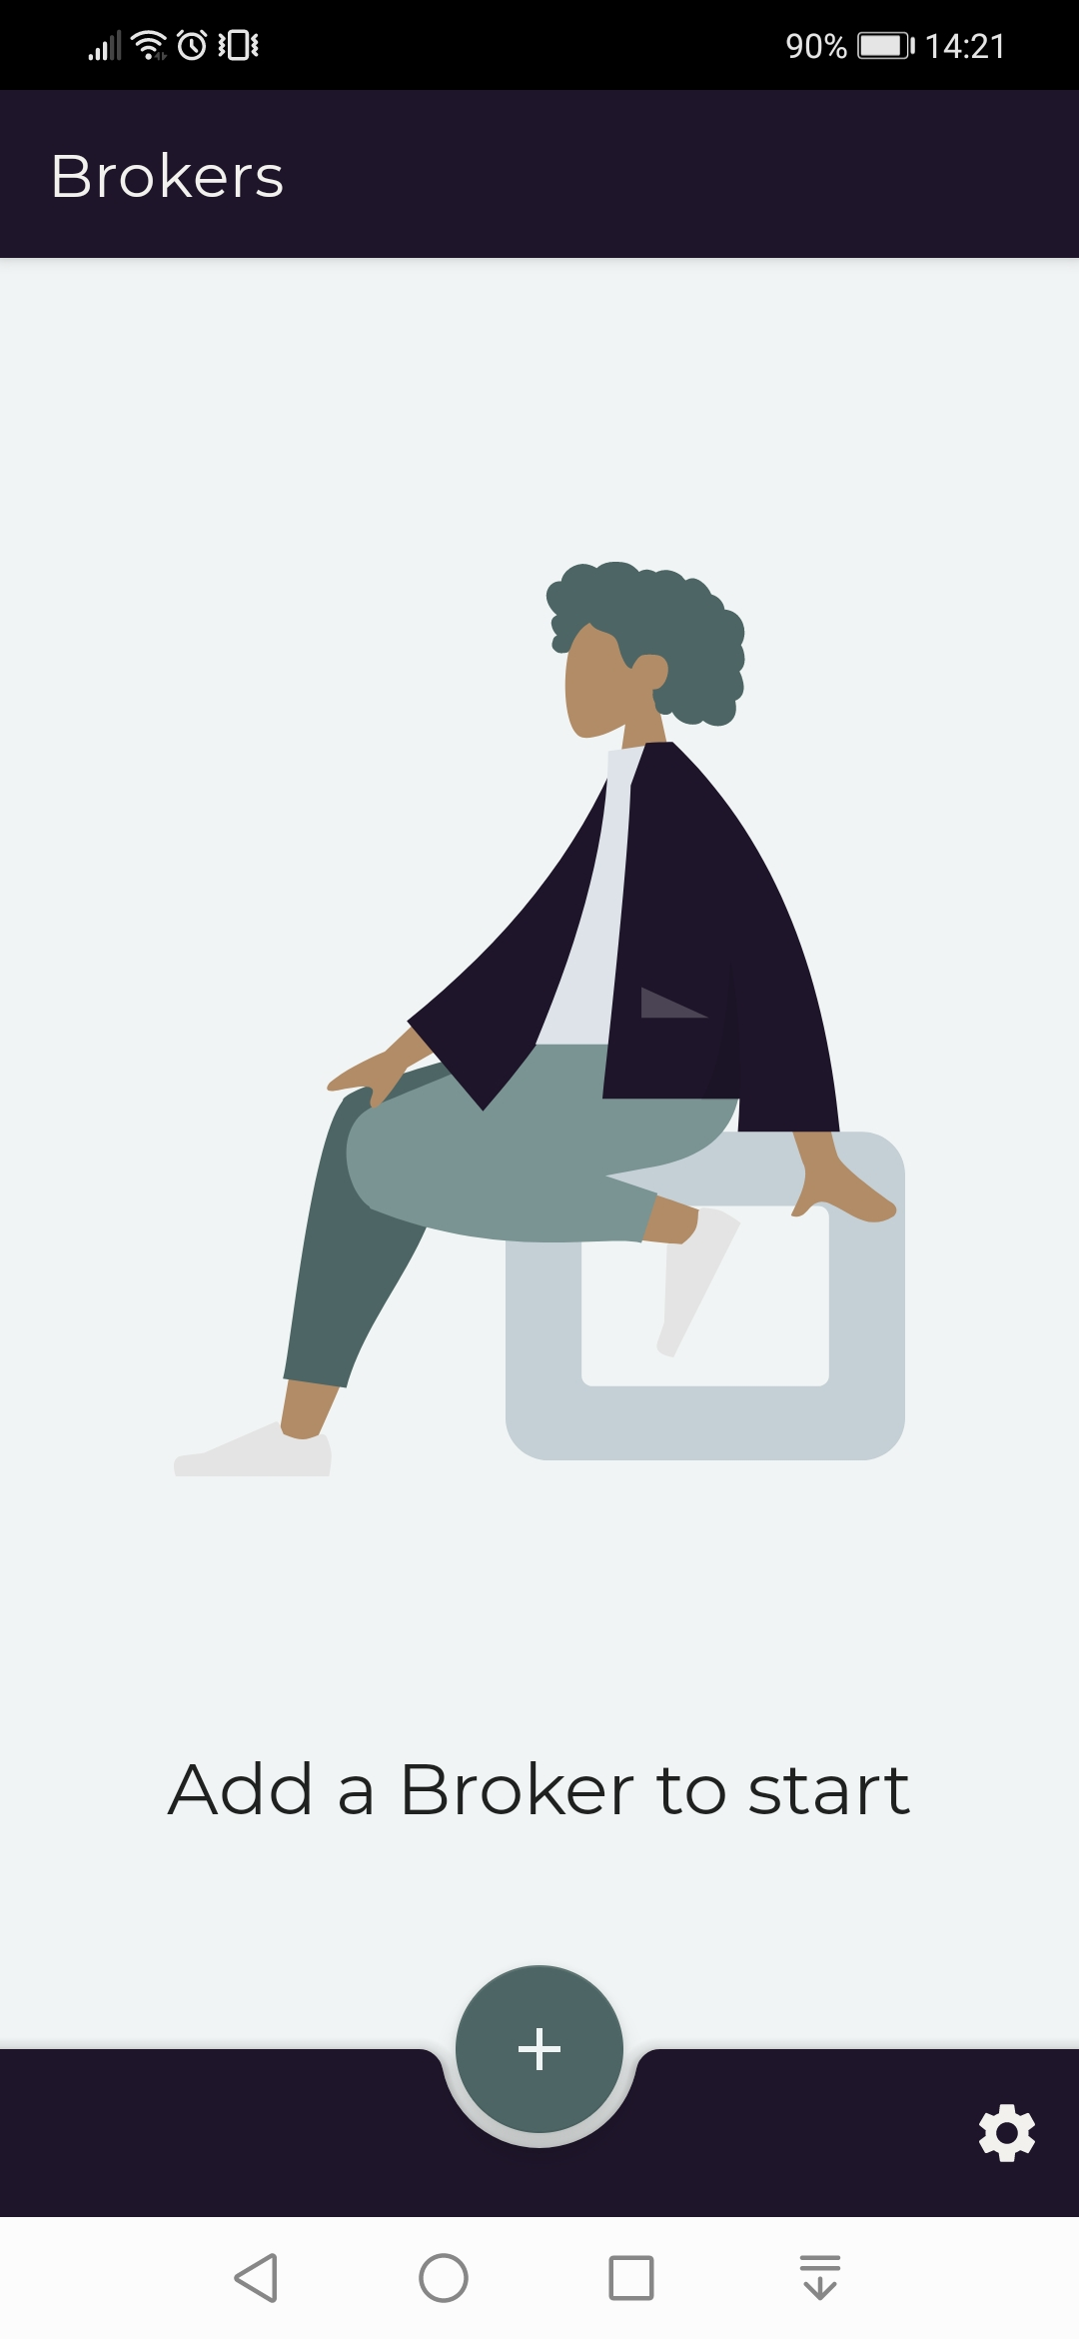
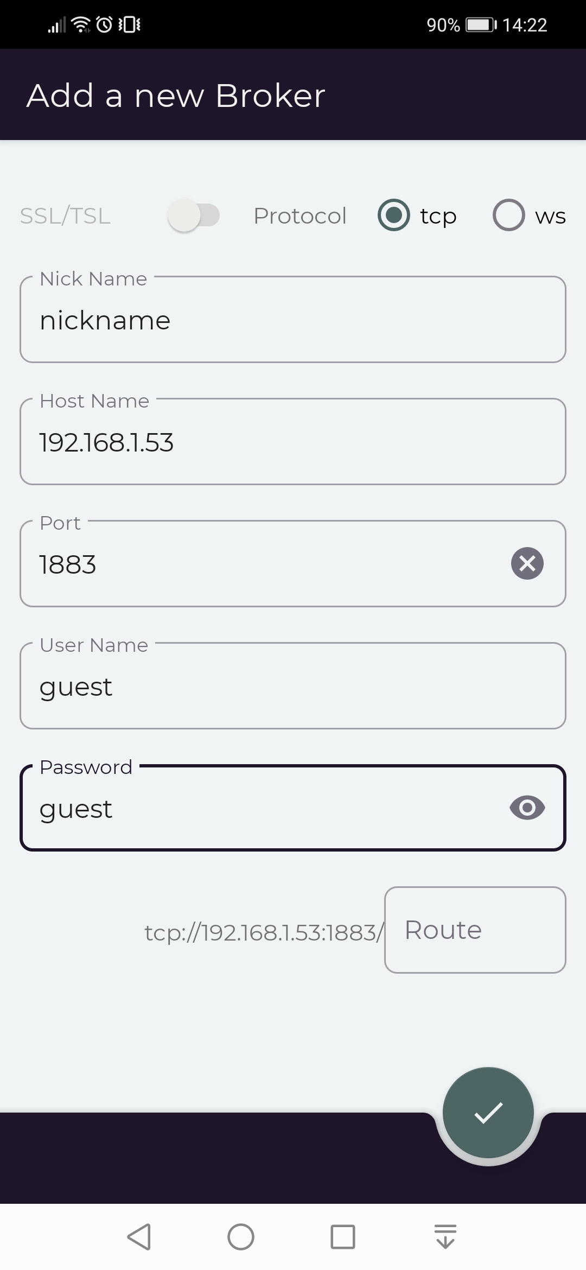
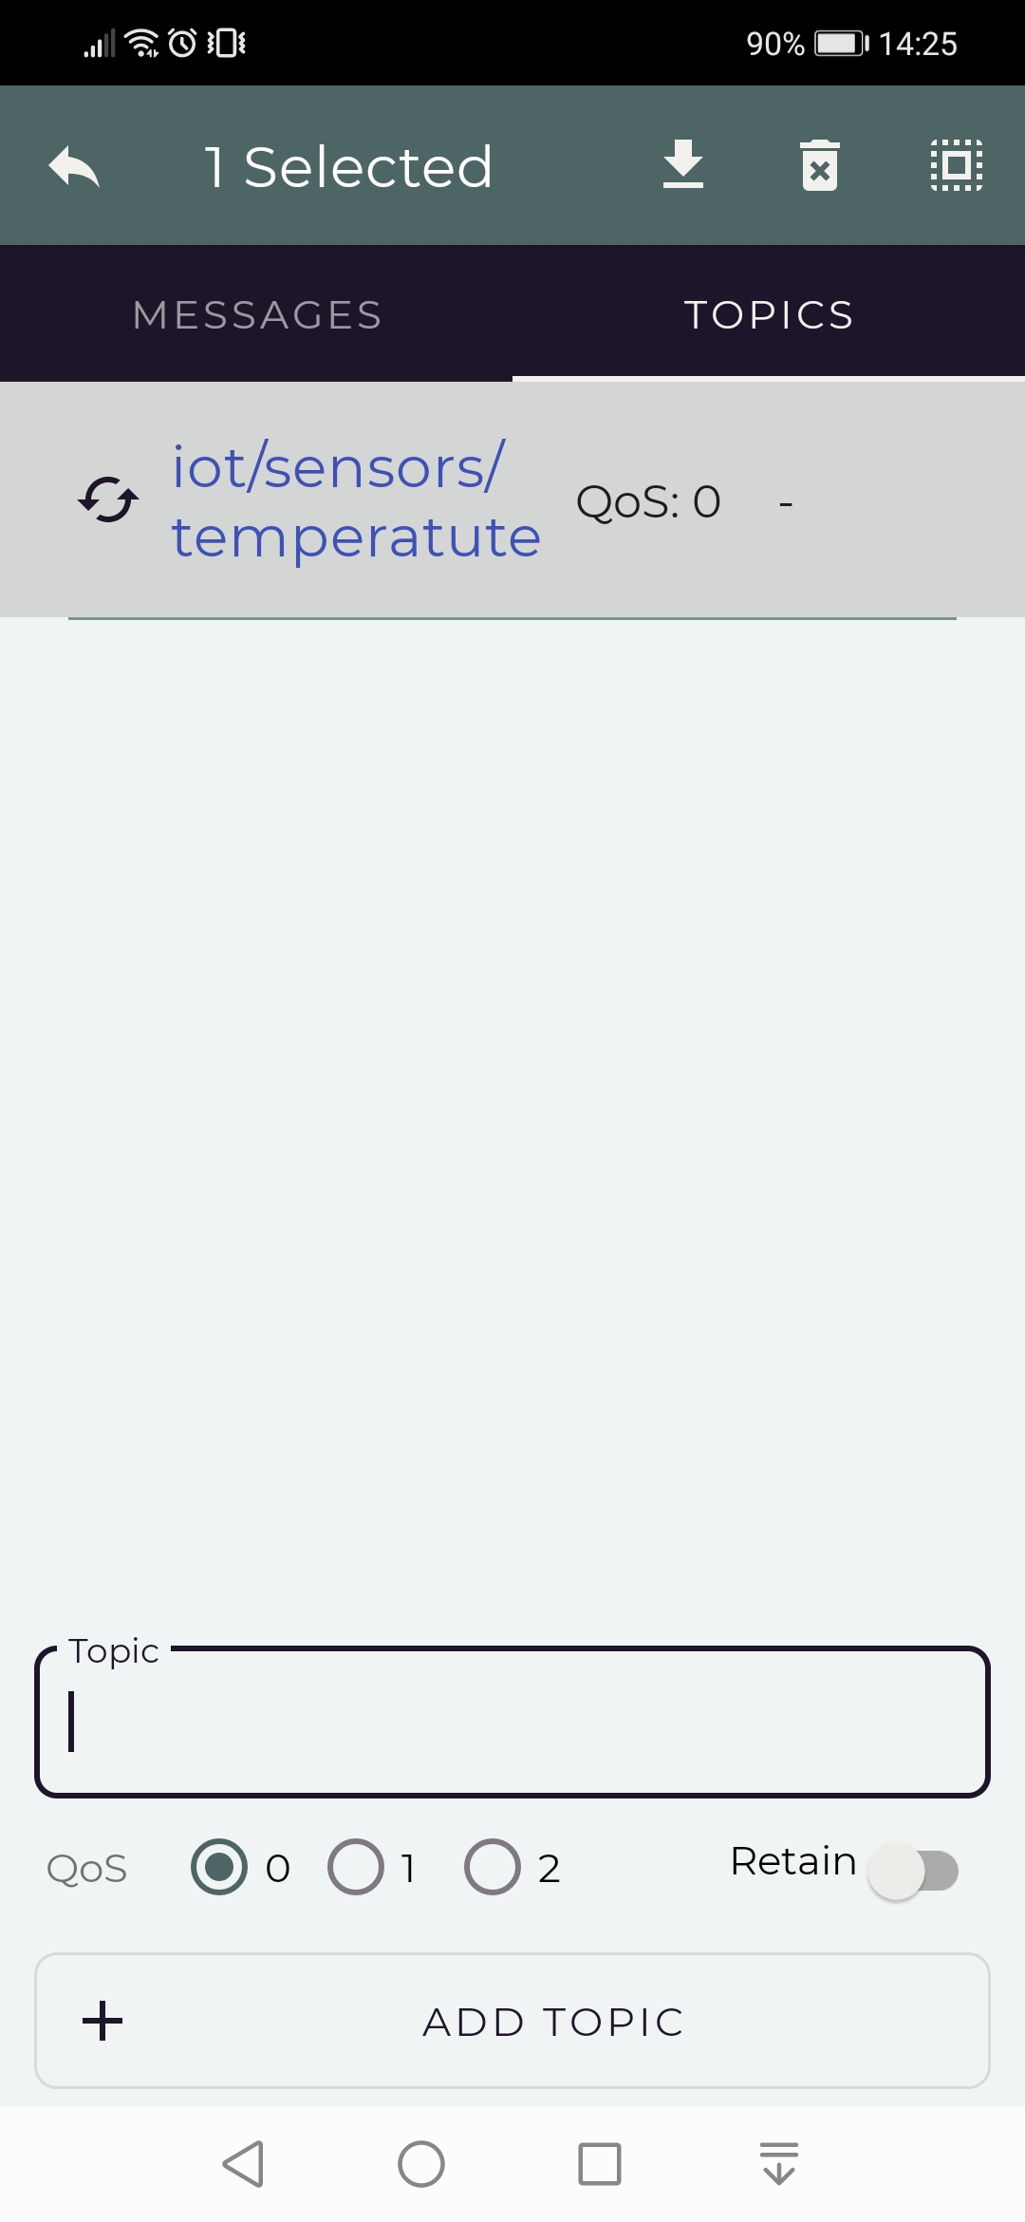
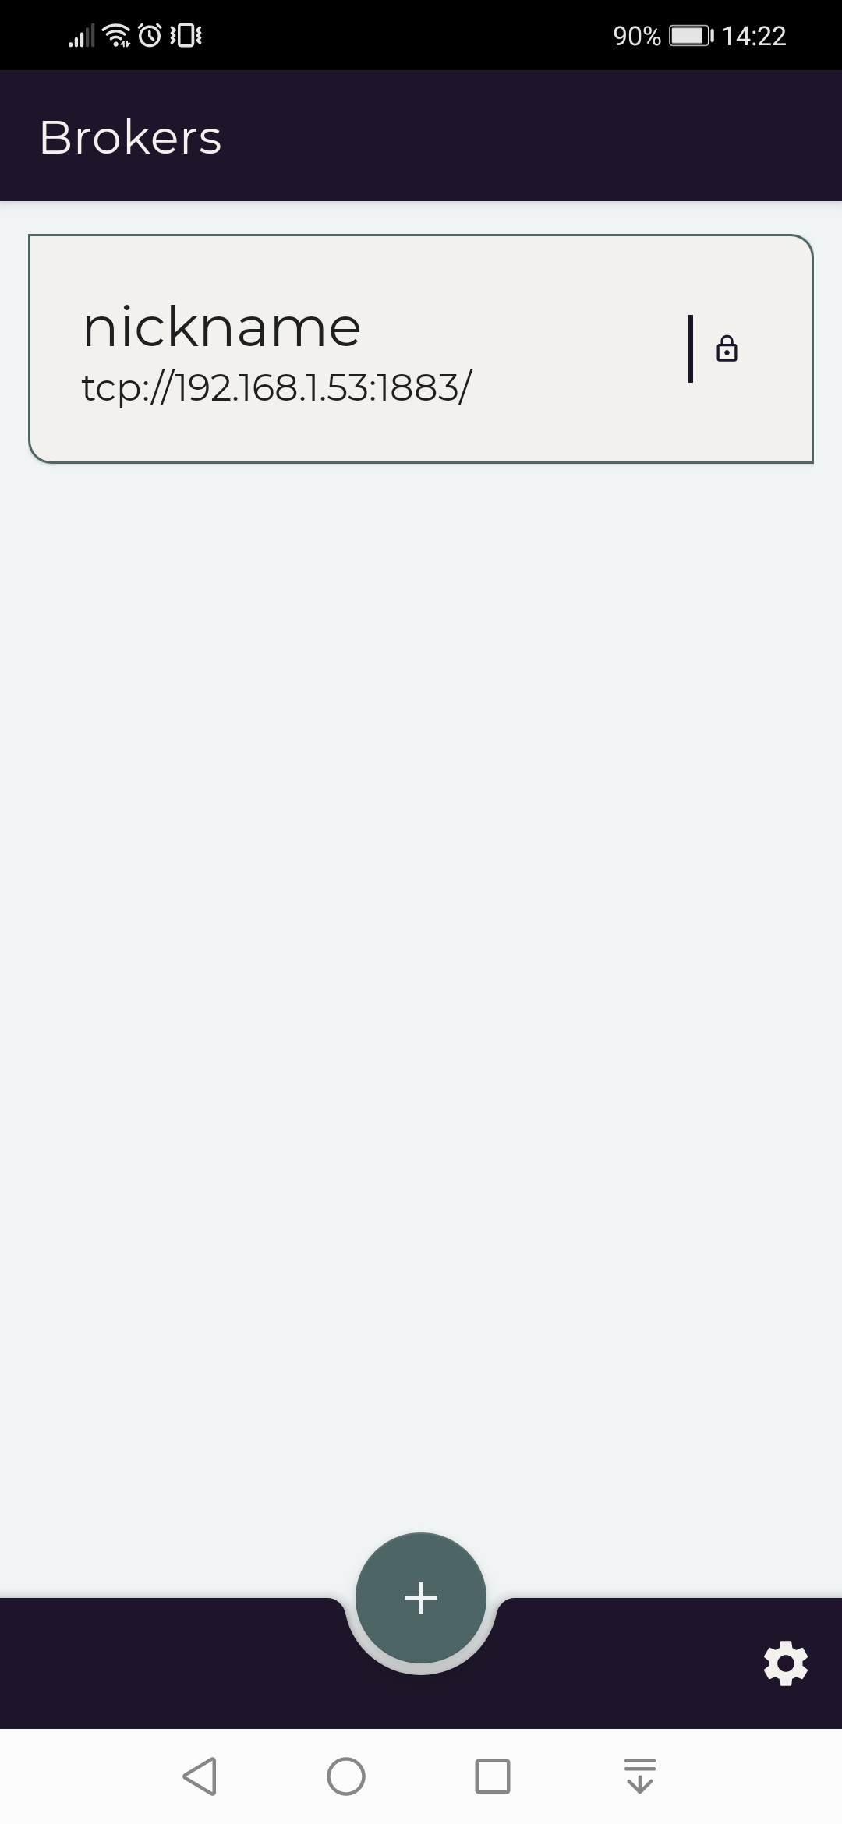
ANDROID MQTT CLIentt
MQTIZER Android MQTT Client that simulates the event of an IoT Device that trigger the serverless function sending a message on topic using MQTT
1
2
3
4

Slide 26
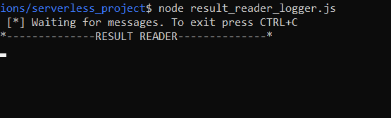
Consumer js app
Node JS application that represents the reader of the access request result.
$ npm install amqplib
$ node result_reader_logger.js

Slide 27
06
running example
Screenshots of typical use case execution

Slide 28
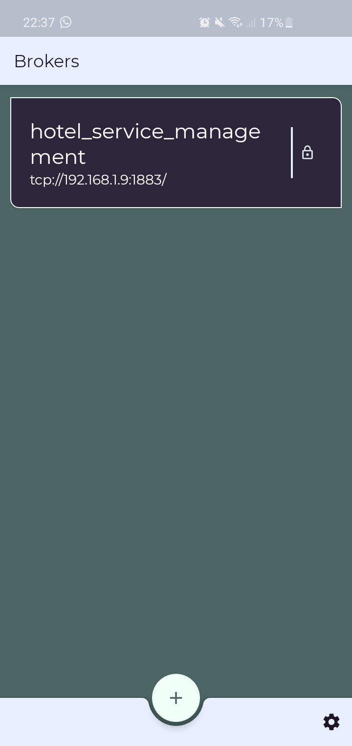
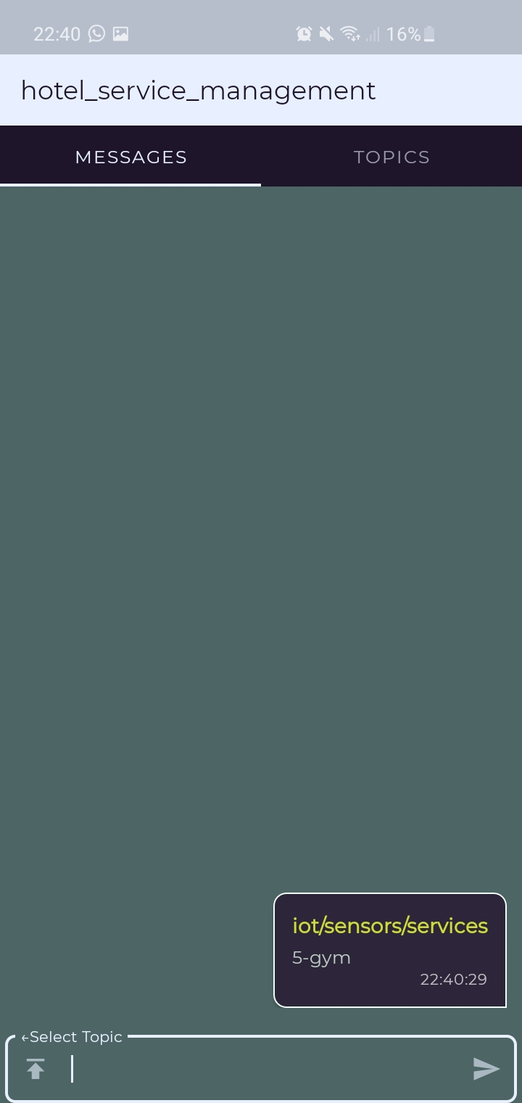
Running example (1)
(5-gym)
Iot/sensors/services
Nuclio function is triggered «validate_request_function»

Slide 29
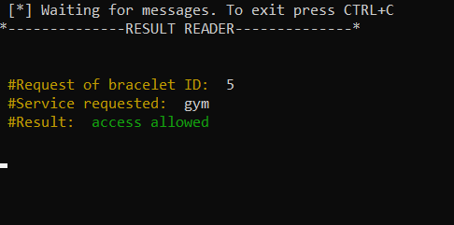
Running example (2)
(access allowed)
Result_reader_logger.js
Iot/sensors/result

Slide 30
07
analytics
Analytics on data collected into database

Slide 31
analytics
Analytics is the analysis of data or statistics. It is used for the discovery, interpretation, and communication of meaningful patterns in data. Organizations may apply analytics to business data to describe, predict, and improve business performance.

Slide 32


Analytics_role
An example of data analytics: retrieve from DB the requests made by guests with a particular role (e.g. Bronze)
AttemptsNumber
AccessesNumber
Number of times a user has tried to access a hotel service
Number of times a user has effectively accessed a hotel service
If we find that a user has tried many times to access a hotel service unsuccessful, namely the number of attempts of this user is higher than normal in comparison with number of accesses
this could be an insight that this user wants to obtain a higher level role to access more hotel services.
Promotional ads should be presented to this user in order to increase the potential profit.

Slide 33
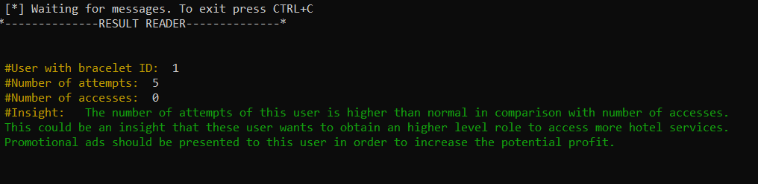
Analytics Result
Publish “bronze” on topic “iot/sensors/analytics” to trigger the function that make the analytics operations.

Slide 34
Other possible analytics functions
Access Frequence
Analyze all the services accessed in order to identify the access frequence and then boost the resources for the services more accessed
Peak/Low usage Periods
Analyze the dates of the requests to notice if there are periods of peak or low usage in order to decide in what period increase the advertising campaign

Slide 35
07
conclusions
Conclusions and serverless benefits in this architecture

Slide 36
Why serverless architecture
01
02
03
04
No maintenance of infrastructure
00
Rapid development and deployment
Ease of use
Enhanced Scalability
Lower Cost

Slide 37
THANKS
Nicola De Cristofaro
nico.de.cristofaro97@gmail.com
n.decristofaro2@studenti.unisa.it
Nicola De Cristofaro

