Slide 1

Personalized Search
Project Meeting 12/05/2010
Nicolaas Matthijs

Slide 2

Introduction
Data
User Profile Generation
Google Re-ranking
Evaluation
  Relevance judgments
  Results
  Interleaved evaluation
Future

Slide 3
Where we left off
AlterEgo FireFox add-on
Capture browsing history
41 users installed this
A lot of data!
Transformed into large
XML file per user

Slide 4
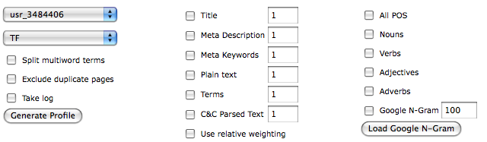
User profile generation
User profile generation
Highly configurable
  Weighting scheme, Input data, Filtering, …

Slide 5
User profile generation
Implemented
  Google N-Gram filtering
  Relative weighting
User profile consists of
  Vector of terms and weights
  List of visited URLs
  List of URLs clicked / Google query

Slide 6
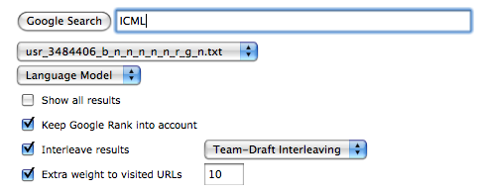
Google Re-ranking
Re-rank the first 50 results for a query on Google given profile
Highly configurable
  Re-ranking method, keep Google rank into account, interleaving, extra weight to visited URLs

Slide 7

Google Re-ranking
Implemented
  PClick
  Team-Draft Interleaving
  Balanced Interleaving
Specify a profile
Re-rank any query

Slide 8
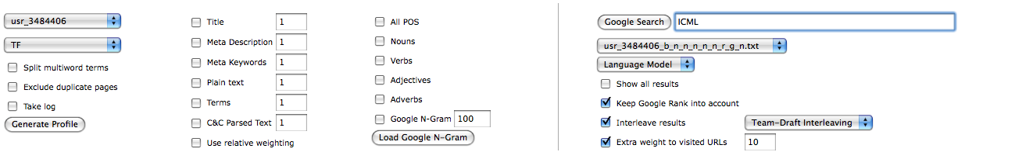
Testing environment
Allows testing everything in 1 environment

Slide 9
Evaluation
Difficult problem for Personalized Search
3 obvious options
  A) Have people judge documents on relevance for a set of queries
    Allows for testing a lot of profiles
    Slow and tedious for users
    Not normal user behavior
  B) Have people judge which ranking is best (side-by-side comparison)
    Doesn’t allow for testing a lot of profiles
    Not normal user behavior
    Slow and tedious for users
  C) Have people use the re-ranked results in real life (interleaved evaluation)
    Doesn’t allow for testing a lot of profiles
    Reflects normal browsing behavior
    Doesn’t take any of their time

Slide 10
Evaluation
Ideally => Option C
  Strongest evaluation
  Hardest to show improvement
An incredibly large number of possible combinations
  Can’t present them all to users
  Let alone get representative data
  How to pick the ones to test ?
2-step evaluation process
  1) Relevance judgments (A): Trim down the possible combinations to 3-4 most promising
  2) Interleaved evaluation (C): Use most promising for real life evaluation

Slide 11
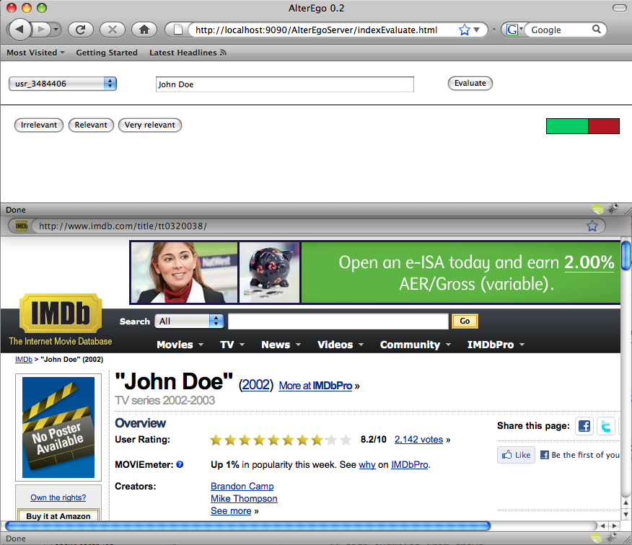
Relevance judgments
Evaluation method used in most papers (Teevan etc.)
Judge first x documents for a query on relevance
  Not relevant - Relevant - Very relevant
Calculate (N)DCG score
Implemented evaluation environment

Slide 12
Relevance judgments
Judgment session on 30/04 with 6 users
Each user judged the first 50 documents returned by Google for 12 queries
  The user’s name
  6 general queries (TREC + Cambridge general interest)
  5 previous search queries
All participants found new, but interesting websites of which a lot were bookmarked and are currently used by the participants
  Shows potential for search personalization

Slide 13
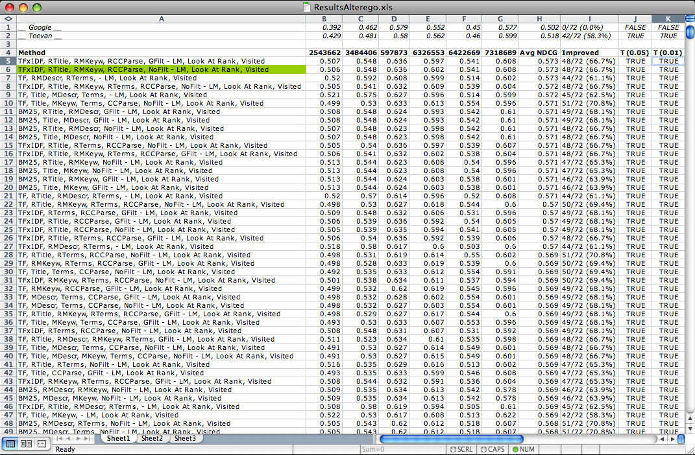
Relevance judgments
Selected parameters to vary (1034 profiles - 15890 re-rankings)
Generated profiles for users
Calculated NDCG score for Google, Teevan and 15890 rankings
=> Results are great!

Slide 14
Results
15890 profile - reranking combinations investigated
4450 are better than Google
1556 are better than Google for all users
3060 significantly (0.05) better
1748 significantly (0.01) better
3335 are better than Teevan
413 are better than Teevan for all users

Slide 15
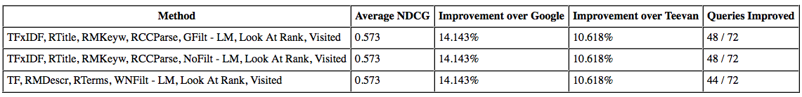

Results
Best profiles (Average NDCG)
Best profiles (Most improved queries)
=> Better than anything published so far!

Slide 16
Results: re-ranking
LM >>>>>> PClick >>> UMatching > Matching
Extra weight to visited URLs >>> No extra weight
Keep Google rank into account >>> Not keep Google rank into account
Remark
  Only need to consider 1 re-ranking configuration
  Combination of profile based and click based profiles works
  Slightly outperform Teevan twice without keeping Google rank into account

Slide 17
Results: Weighting scheme
In general BM25 > TFxIDF > TF
  But for best profiles performance is TFxIDF > TF > BM25
  But for best profiles number of profiles is TF > TFxIDF > BM25
  TF and TFxIDF have more outliers?
In general No Filtering > Ngram Filtering > WN Noun Filtering
  But for best profiles performance WN > No = Ngram
  But for best profiles number of profiles is No = Ngram > WN
  WN Filtering only works when the input data is very noisy?

Slide 18
Results: Input Data
No Plain Text >> RPlain Text > Plain Text
RTitle > Title > No Title
RMDescr > MDescr > No Mdescr (weak)
RMKeyw > MKeyw > No Mkeyw
RTerms > Terms > No Terms
RCCParse > CCParse > No CCParse (weak)
In general, relative weighting works consistently better
Input sources in order of usefulness:
  Mkeyw > Terms > Title > Mdescr > CCParse >> Plain Text
  Mkeyw, Terms, Title, Mdescr and CCParse all help make the profile better
    But certain combinations work better than others

Slide 19
Results
I’d like to suggest the following 3 profiles to continue evaluating
  TFxIDF, RTitle, RMKeyw, RCCParse, NoFilt - LM, Look At Rank, Visited
    Best profile in evaluation
  TF, RTerms, RCCParse, NoFilt - LM, Look At Rank, Visited
    Most improved queries in evaluation
  BM25, RTitle, RMKeyw, RTerms, NoFilt - LM, Look At Rank, Visited
    Most useful values for all parameters combined

Slide 20
Interleaved evaluation
Next step of project
New FireFox plug-in
Team Draft interleaving algorithm
Re-ranking in the user’s browser
Interleave Google with randomly chosen evaluation profile
Clicks are stored in database
Continuously re-generate user profiles
Run for 2/3 weeks

Slide 21
Future
Show from interleaved ranking evaluation that personalization works in real life
Determine what the best profile - re-ranking method is
Answer additional questions
  How old should the profile be
  …
Write masters thesis
Write paper and submit to WSDM 2011
Conference (Hong Kong)
  => Exciting results!

