Slide 1

Personalized Search
Project Meeting 13/04/2010
Nicolaas Matthijs

Slide 2

Introduction
State-of-the-art personalization
AlterEgo Firefox add-on
Data capturing results
Data format
User profile generation
Google re-ranking
Current best approach
Differences with state-of-the-art methods
What comes next

Slide 3
State-of-the-art personalization
Teevan, Dumais, Horvitz (2005)
  User representation though Desktop Index
  Profile based
  Relevance Feedback Framework
  Modified version of BM25
  Best results
    Rich user representation (entire Desktop Index)
    Rich document representation (all words)
    Basic corpus representation (snippet)
  Less good than web ranking
  Better than web ranking if combined

Slide 4

P-Click
Dou, Song, Wen (2007)
  P-Click (Click-based)
  Clicks(q,p,u) = click number on web page p by user u on query q in past
  Performs consistently better than web ranking
  Doesn’t work for unseen queries

Slide 5
AlterEgo Firefox add-on
AlterEgo Firefox add-on
Dissemination website
Unique identifier per user
Captures
  URL
  Length of source HTML
  MD5 sum of source HTML
  Time spent on page
  Date and time
Doesn’t capture
  Private pages (https)
  Login pages
Stored in a MySQL database
Still running

Slide 6
Data Capturing Results
40 users installed the add-on
Filtered out users with less than 500 page visits
Division into development (1), train (17) and test (16) set
Data at development cut-off point:
  34 users
  182854 page visits (5541 per user on average)
  11536 Google searches (349 per user on average)
  82 Bing searches (2 per user on average)
  553 Wikipedia pages (17 per user on average)

Slide 7
Data Capturing Results

Slide 8
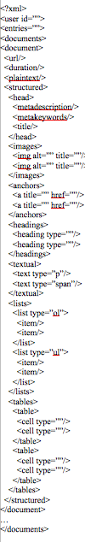
Data Format
Large XML file per user
Generation script (PHP)
Makes use of structure of web page

Slide 9
Data Format

Slide 10
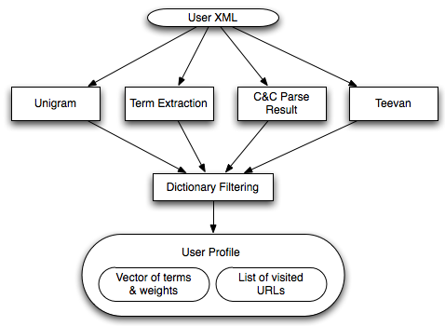
User Profile Generation
From user XML
Consists of
  Vector of terms
  + weights
  List of URLs

Slide 11
User Profile Generation
Highly configurable
Weight calculation
  TF
  TFxIDF
  BM25
IDF => Google N-Gram corpus
Term extraction uses re-implemented
of Vu Term Extraction (2008) algorithm
Use of C&C Parser for Noun phrase extraction

Slide 12
User Profile Generation
C&C and Term Extraction use full page text
Unigram can use a linear combination of
title, meta, text, links, …
Dictionary filtering uses WordNet
Had to adjust Teevan to use log(IDF)
to get reasonable results
Final profile can be linear combination
of the different approaches

Slide 13
Google re-ranking
Re-rank first 50 results
Use Google AJAX APIs
Re-ranking methods
  Matching
  Unique Matching
  Language Model
Keep Google rank into account
Extra weight to visited URLs (click-based)
  Combination of profile-based and click-based seems to make sense

Slide 14
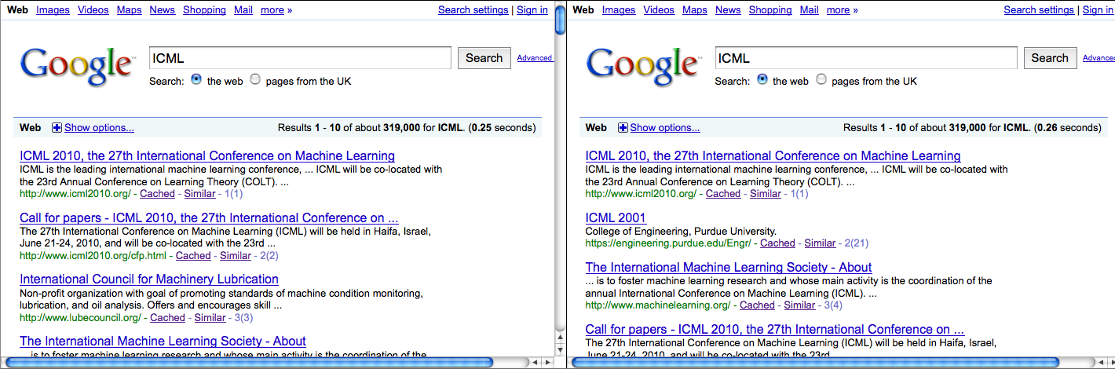
Google re-ranking
Side-by-side comparison
  Profile stored as static file => re-ranking nearly instant
Interleaving

Slide 15
Current best approach
Impossible to tell
Test queries show most success for:
  TFxIDF
  Meta keywords (5)
  Terms (5)
  C&C Parse (1)
  no dictionary filtering
  LM re-ranking using Add1 smoothing
  keep Google rank into account
  extra weight to visited URLs (10)

Slide 16
Differences with state-of-the-art methods
Access to entire browsing history
  Not just search queries
  Beneficial for click-based approaches
  Visit duration
Use of specific web data and structure
  Metadata
  Page & HTML structure
Application of advanced NLP techniques on web pages
  Term extraction
  Parsing

Slide 17
What comes next
P-Click implementation
Use short-term + long-term profiles
Evaluation (?)

