Slide 1


Programmable Logic Controller (PLC) for Industrial Applications
Nicolae-Andrei Vasile
Thesis advisor: Conf. Dr. Ing. Dan Stefan Tudose

Slide 2

Objectives
describe the scientific and industry approaches regarding Programmable Logic Controllers (PLCs) and other related topics.
discussed topics:
Petri Nets (PNs)
Model Verification and Validation
Security

Slide 3
Summary
Programmable Logic Controllers (PLCs)
electronic device used in many industries to monitor and control various processes
designed to perform a single set of tasks under real-time constraints with superior reliability and performance
can be placed in an industrial environment with harsh characteristics
Standards and Norms
very influential in the design and development of industrial automation software
provide the technical rules that ensure the safety and performance
most important standards: IEC 61131-3 and IEC 61499
Relay Ladder Logic (RLL) and Petri Nets (PNs)
PNs are the solution to the limitations imposed by the increasing complexity of RLLs

Slide 4
Petri Nets
used as a solution for the limitations of the increasing complexity of RLLs
on the theoretical side, viewed as a mathematical model whose capabilities can be extended
on the practical side, used for specification, verification and performance evaluation

Slide 5


Petri Nets
a PN can be defined as a five-tuple:
$PN=(P, T, I, O, M_{0})$; where:
$P=\{p_{0}, p_{1}, …, p_{m}\}$ is a finite set of places;
$T=\{t_{0}, t_{1}, …, t_{n}\}$ is a finite set of transitions, where $P∪T≠∅$ and $P∩T=∅$
$I:P×T→N$ is an input function that specifies arcs directed from places to transitions, where $N$ is the set of all natural numbers;
$O:P×T→N$ is an output function which defines directed arcs from transitions to places;
$M_{0}:P→N$ is the initial marking;

Slide 6

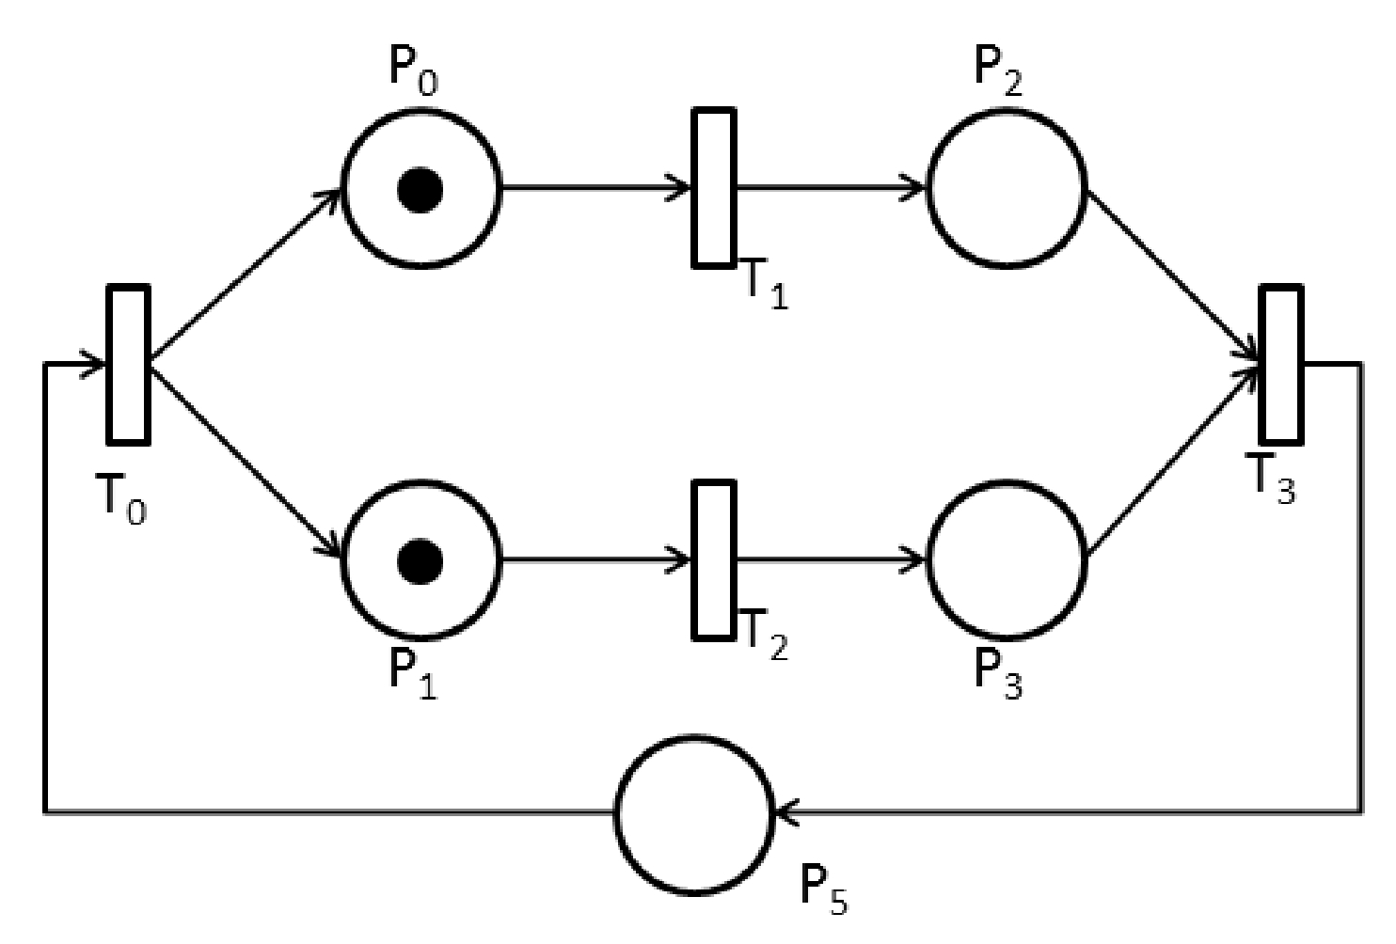

Slide 7
Petri Nets Properties
Reachability
the system can reach a specific state as a result of a required functional behavior
Boundedness and Safety
determines whether a modeled system has overflows or not; a PN is said to be k-bounded if the number of tokens at any place is smaller or equal to k; a PN is safe if it is 1-bounded
Conservativeness
a transaction as the same amount of output arcs as input arcs
Liveness
multiple levels of liveness
Reversibility and Home State
the system can recover from failure states and return to preceding correct states

Slide 8
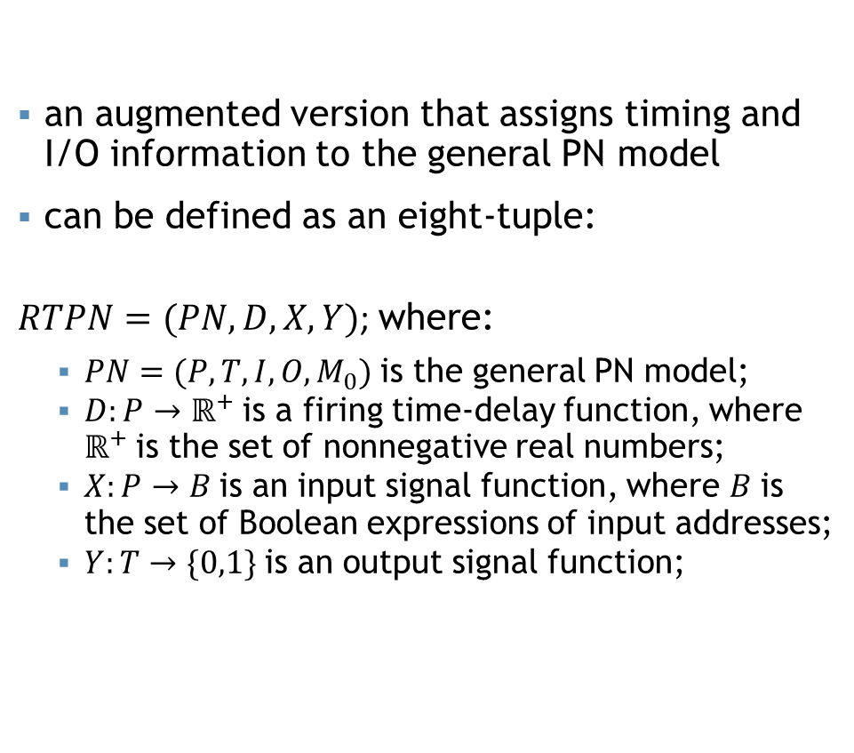
Real-Time Petri Nets
an augmented version that assigns timing and I/O information to the general PN model
can be defined as an eight-tuple:
$RTPN=(PN,D,X,Y)$; where:
$PN=(P, T, I, O, M_{0})$ is the general PN model;
$D:P→ℝ^{+}$ is a firing time-delay function, where $ℝ^{+}$ is the set of nonnegative real numbers;
$X:P→B$ is an input signal function, where $B$ is the set of Boolean expressions of input addresses;
$Y:T→\{0,1\}$ is an output signal function;

Slide 9
Model Verification
system failures or undetected errors can have hazardous effects on people and the environment
highly recommended that proper verification and validation to be performed
different techniques are used in industry to check PLC programs (manual and automatic testing or simulations)
various limitations regarding popular verification techniques
formal verification is a a complete solution to the problem

Slide 10
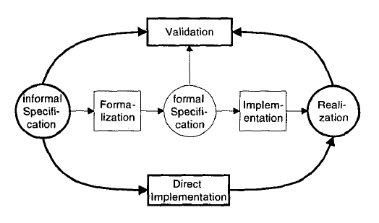
Design process for logic control systems
outer circle
the popular approach in industry
implementation done using informal specification
validation is made by control designers and users
formal methods
formed by steps in the middle part
implementation done using formal specification

Slide 11
State Space Explosion Problem
biggest problem model checking is currently facing
the number of states in a system can reach enormous values in certain cases
various techniques have been proposed to combat the problem:
Symbolic Model Checking with Binary Decision Diagrams
finite state-transition systems can be represented and manipulated as OBDDs
OBDD is more compact and efficient than by listing each state individually
Partial Order Reduction
many events are independent of each other and can be executed in arbitrary order
Counterexample-Guided Abstraction Refinement
uses counterexamples to refine an initial abstraction
Bounded Model Checking
one of the most used approaches in dealing with the state explosion problem

Slide 12
Security
control systems and are responsible for the safe operation for physical processes
it is required to ensure that no other sequence is executed, rather than the one intended for that specific system
an increasing amount of attention has been paid since the Stuxnet attack regarding the vulnerability and susceptibility of PLCs of such breaches

Slide 13
Stuxnet attack
500-kilobyte worm
targeted industrial control systems which are mainly used in factories, industry lines and power plants
very complex implementation, showing detailed knowledge of the system
precise target selection, unlike other cyber attacks
making use of multiple “zero-day” Windows exploits

Slide 14
Other malware approaches
four main steps:
Infection
Process analysis – extract necessary information for model creation and peripherals detection
Payload generation
Payload execution – uploading the payload into PLC for execution
flexibility of the dynamic payload, unlike Stuxnet worm which came with a precompiled one

Slide 15
Conclusion
basic overview of the approaches of related topics
PLCs have been a fundamental part in automation processes and raised attention in both industrial and academic scene
Future work consists of documenting new software architectures that have emerged recently and, ultimately, building a programmable logic controller

Slide 16

Thank you
Q&A

