Slide 1
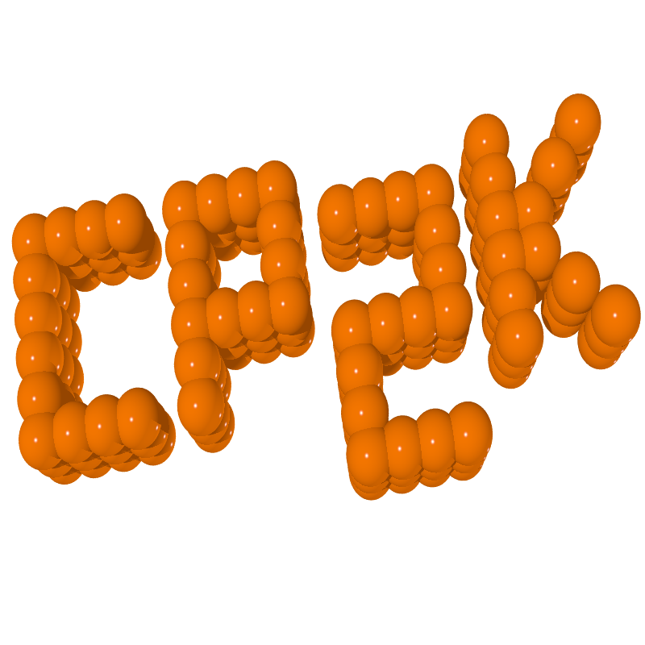
CP2K Open Source Molecular Dynamics
software package that can perform atomistic simulations of solid state, liquid, molecular, periodic, material, crystal, and biological systems
can be run efficiently in parallel using a combination of multi-threading, MPI, and CUDA
provides state-of-the-art methods for efficient and accurate atomistic simulations. Some of the key parts of CP2K are Quickstep, FIST, and QM/MM

Slide 2
Visual Molecular Dynamics (VMD)
molecular visualization program for displaying, animating, and analyzing large biomolecular systems using 3D graphics and built-in scripting
provides a wide variety of methods for rendering and coloring a molecule: simple points and lines, CPK spheres and cylinders, licorice bonds, backbone tubes and ribbons, cartoon drawings, and others
2 examples can be observed below (MD – molecular dynamics – simulations for atoms of Hydrogen and Argon)
2 atoms of Hydrogen
108 atoms of Argon

Slide 3
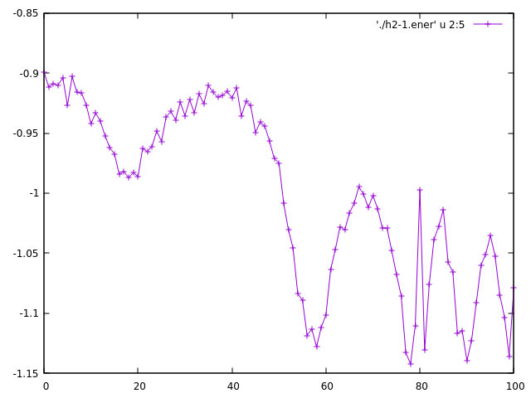
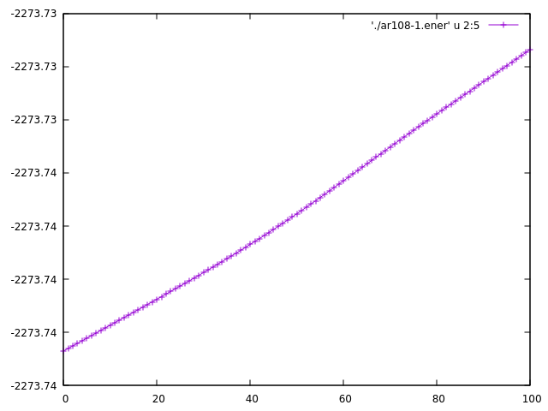
gnuplot
a portable command-line driven graphing utility for Linux, OS/2, MS Windows, OSX, VMS, and many other platforms
input files are generated automatically by the solver (ex.: h2-1.ener, ar108-1.ener) containing different columns with information, which can be plotted using gnuplot
2 examples can be observed below (total energy resulted from the simulation for atoms of Hydrogen and Argon)
2 atoms of Hydrogen
108 atoms of Argon

Slide 4
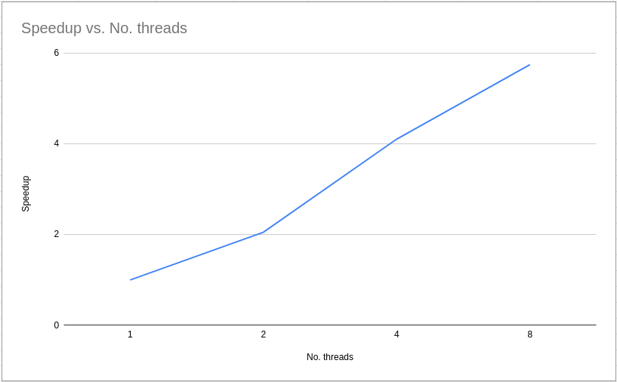
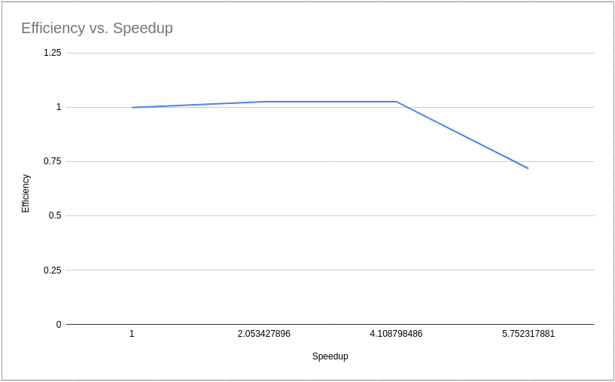
CP2K Acceleration
Used acceleration: MPI
Use case: compute total energy of 108 atoms of Argon from a simulation with 100 steps (constant temperature of 100K)
All tests have been executed on AMD Ryzen 7 5000 Series (3.2GHz)

