Slide 1

CP2K Open Source Molecular Dynamics
software package that can perform atomistic simulations of solid state, liquid, molecular, periodic, material, crystal, and biological systems
can be run efficiently in parallel using a combination of multi-threading, MPI, and CUDA
provides state-of-the-art methods for efficient and accurate atomistic simulations. Some of the key parts of CP2K are Quickstep, FIST, and QM/MM

Slide 2
CP2K Overview
CP2K available versions:
sopt – serial, optimized
ssmp – Single process + symmetric multiprocessor (OpenMP)
popt – Parallel (MPI), optimized
psmp – Parallel (MPI) + symmetric multiprocessor (OpenMP)
POPT version has been chosen for the simulations to be presented in the following sections. A basic example of CP2K run can be seen below:
mpirun –n 4 cp2k.popt –i <input_file> –o <output_file>
other useful options:
cp2k.popt --version
cp2k.popt --help

Slide 3
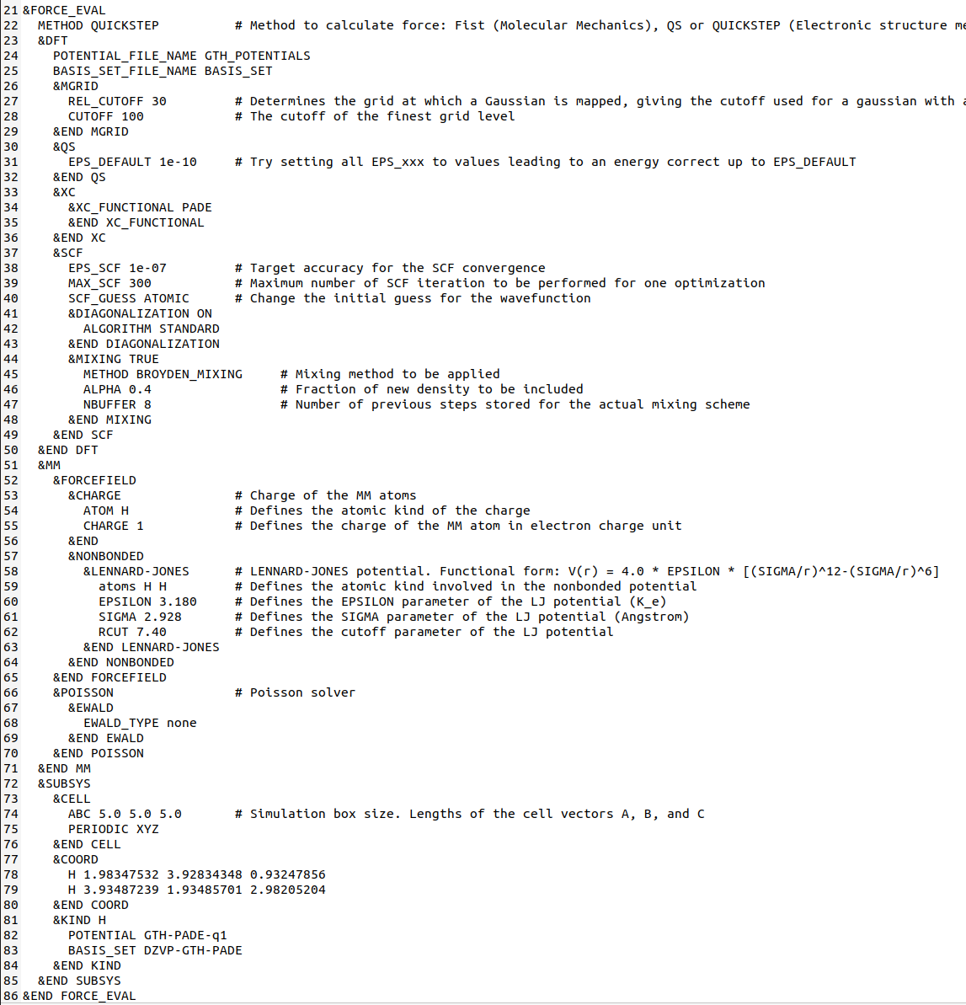
CP2K Files
Inputs:
project.inp (input file)
POTENTIAL_GTH (psuedo-potential library - optional)
BASIS_SET (basis set library - optional)
Outputs:
project-1.restart (input file to restart calculation)
project-pos-1.xyz (trajectory for MD or GEO_OPT)
project-1.ener (MD energies, temperature, etc.)
project-RESTART.wfn (orbitals for restart)

Slide 4
Visual Molecular Dynamics (VMD)
molecular visualization program for displaying, animating, and analyzing large biomolecular systems using 3D graphics and built-in scripting
provides a wide variety of methods for rendering and coloring a molecule: simple points and lines, CPK spheres and cylinders, licorice bonds, backbone tubes and ribbons, cartoon drawings, and others
2 examples can be observed below (MD – molecular dynamics – simulations for atoms of Hydrogen and Argon)
2 atoms of Hydrogen
108 atoms of Argon

Slide 5
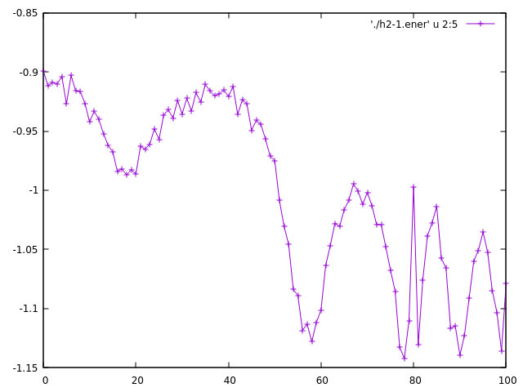
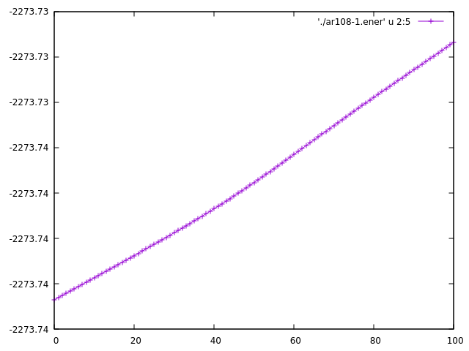
gnuplot
a portable command-line driven graphing utility for Linux, OS/2, MS Windows, OSX, VMS, and many other platforms
input files are generated automatically by the solver (ex.: h2-1.ener, ar108-1.ener) containing different columns with information, which can be plotted using gnuplot
2 examples can be observed below (total energy resulted from the simulation for atoms of Hydrogen and Argon)
2 atoms of Hydrogen
108 atoms of Argon

Slide 6
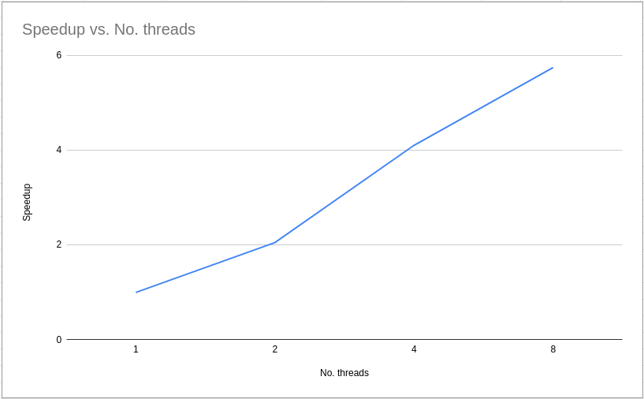
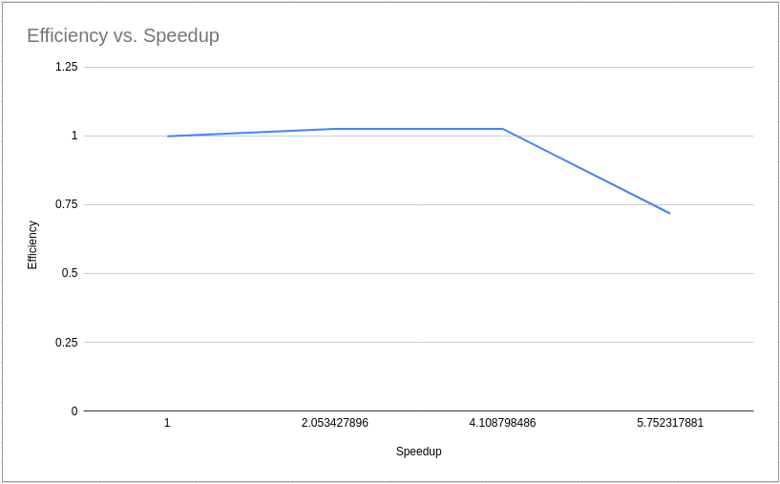
CP2K Acceleration
Used acceleration: MPI
Use case: compute total energy of 108 atoms of Argon from a simulation with 100 steps (constant temperature of 100K)
All tests have been executed on AMD Ryzen 7 5000 Series (3.2GHz)

