Slide 1
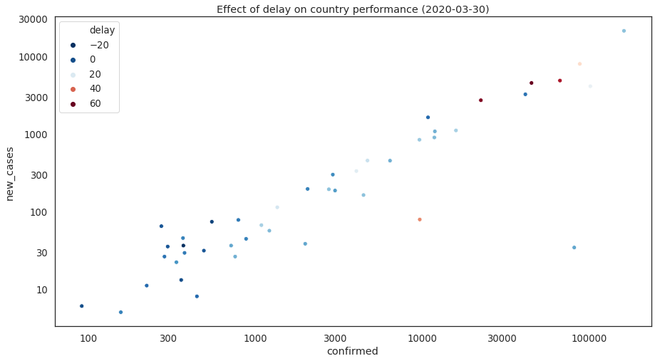
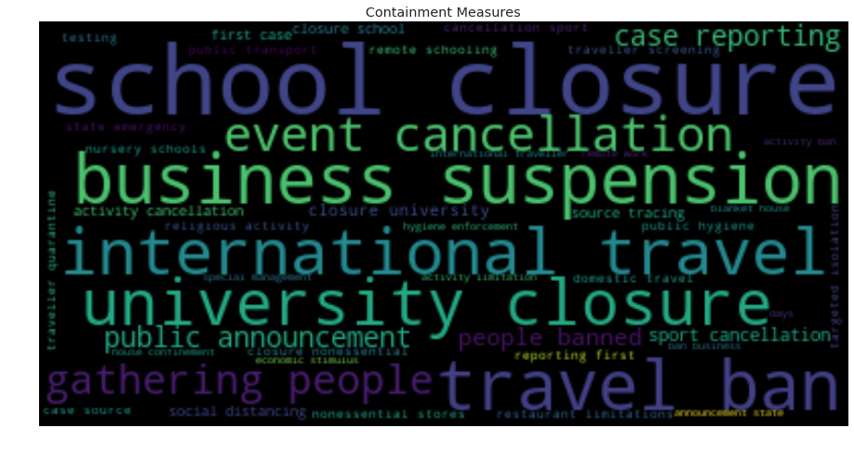
COVID-19 containment and mitigation measures
SRC: https://www.kaggle.com/paultimothymooney/covid19-containment-and-mitigation-measures/kernels
Provides measures including start and end-date, downside: measures are given in descriptions
Kernel: https://www.kaggle.com/mohammadtraboulsi/covid-19-spread-and-effect-of-delay provides word cloud of
Many of these Kernels provide very valuable insight, maybe we should assign a member watching and analyzing kernels occasionally
https://www.kaggle.com/sudalairajkumar/novel-corona-virus-2019-dataset
Next steps: find broad categories as summary of measures + add to dataset
Shows effects on delay of meassures from first infection

Slide 2
Data for Public Transport
hard to obtain from local sources → Might get to work intensive to gather data for each country
Singapore data(22 datasets): volume only reported monthly: https://www.mytransport.sg/content/mytransport/home/dataMall/dynamic-data.html
API access needs to be requested
Deutsche Bahn can provide information about train departures and arrivals, limited information about capacity
This will be much to
Look into Google Transit API: https://developers.google.com/transit/gtfs-realtime
Trip updates - delays, cancellations, changed routes
Service alerts - stop moved, unforeseen events affecting a station, route or the entire network
Vehicle positions - information about the vehicles including location, congestion level and occupancy
Can we obtain that data? API aimed at public transport companies to provide data for Google Maps
https://openmobilitydata.org/p/freiburger-verkehrs-ag/1228/latest/route/11-3-I-j20-1/20200325
Too detailed to obtain
What we actually want occupancy level for public transport.
Next Steps: Find broader statistics for public transport

Slide 3
Data for weather
https://openweathermap.org/api
Historical, live and forecast for weather
Free with limited API calls, no bulk downloads
Next steps: Evaluate on how we could use weather data

