Slide 1
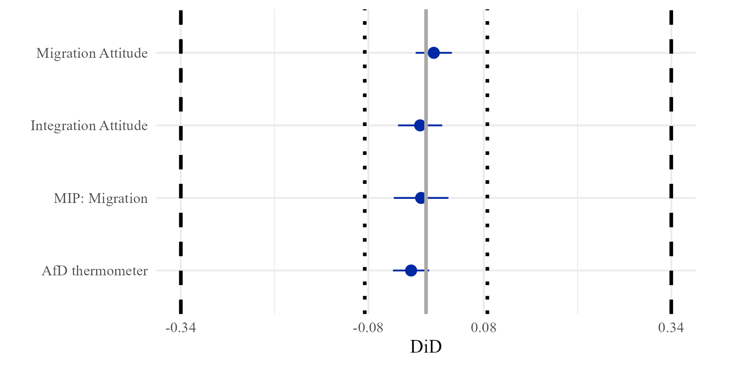
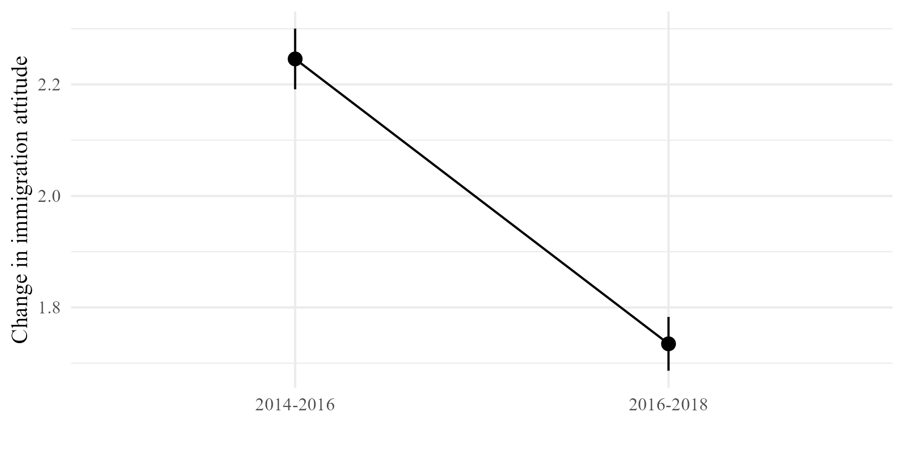
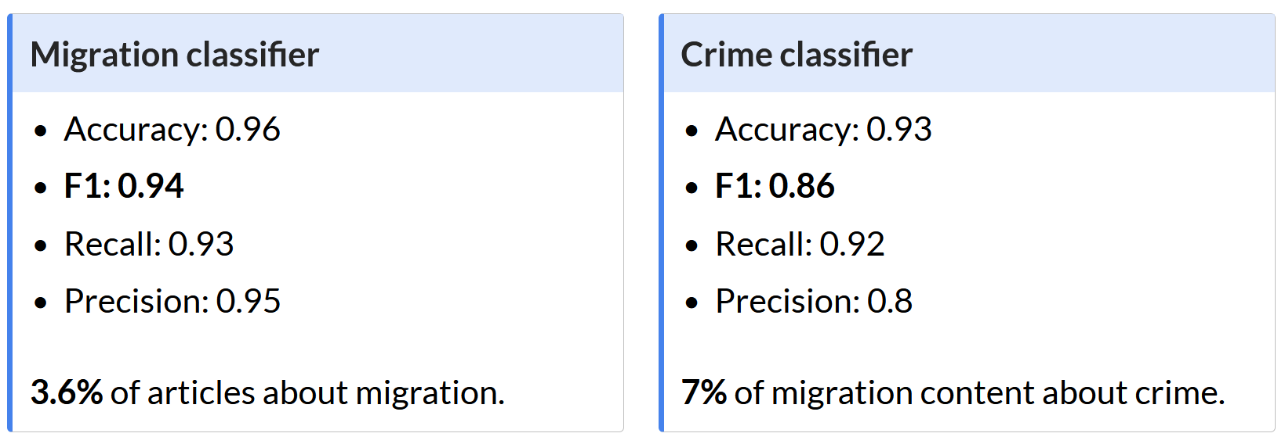
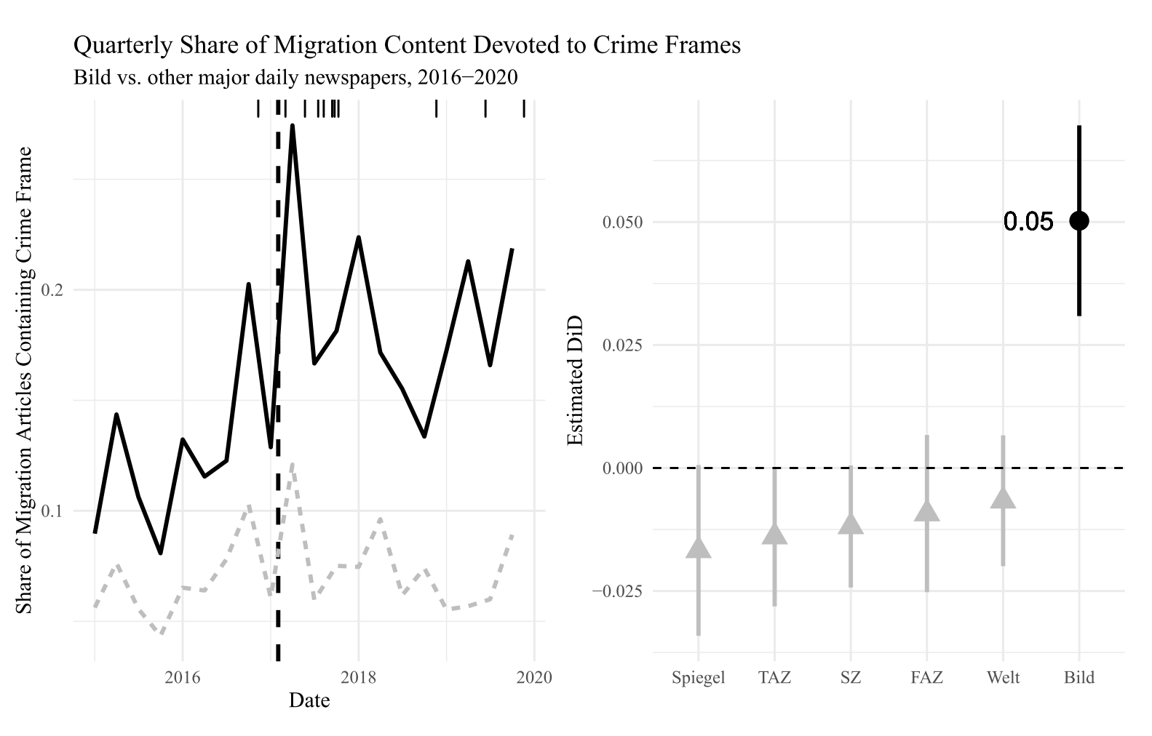

Limits of Media Effects - Studying Framing in the Wild
Nicolai Berk ¹
Provides quasi-experiment: Sudden change in framing, exogenously timed.
More-likely case:
Large, influential outlet.
Strong frame on contested issue.
→ UPPER LIMIT ESTIMATE OF INFLUENCE OF A SINGLE OUTLET ON PUBLIC OPINION ON SALIENT ISSUES
Measuring Media Framing
Collection of 2.5M news articles.
Annotation of stratified sample for crime and immigration content.
Classification of remainder using fine-tuned BERT models.
Near-perfect performance in classification task:
Estimation
Comparison of Bild readers and non-Bild readers allows Difference-in-Differences design (DiD). GLES 2017 Election Panel (Debus, Faas, and Roßteutscher 2017) with 15 waves from 2016-2020 provides ideal data to measure attitudinal changes over time.
Precise null effects are found for changes on immigration attitudes, integration attitudes, problem perceptions of migration, as well as support for the far-right AfD.
Further analyses:
No consumption effects.
No heterogeneity across different news diets.
No substantial effects of long-term exposure.
→ NO DISCERNIBLE EFFECT OF SUBSTANTIAL CHANGE IN BILD’S IMMIGRATION COVERAGE
→ EVIDENCE OF ATTITUDE CRYSTALLISATION
5. Conclusion & Limitations
The findings suggest very limited influence of even large news outlets on politicised issues, supporting empirical findings of attitudinal stability and persistence of crystallised attitudes (Kustov, Laaker, and Reller 2021; Lecheler, De Vreese, and Slothuus 2009). Instead, attitude formation among the public takes place during brief windows of opportunity for media effects.
This research is limited in several aspects: first, while these findings likely travel to issues such as the assault on Ukraine, less salient issues might be more responsive. Additionally, the public might be more reactive to increased issue emphasis rather than framing or react to visual framing online and on television.
nicolai.berk@hu-berlin.de
1. Framing Effects
A large literature in political communication suggests large framing effects on political attitudes. However, this evidence is almost exclusively experimental in nature. It is unclear how well these findings generalise to the real world.
Observational media effects studies mostly assessing long-term changes (Foos & Bischof 2022) or interested in „slant“ broadly, with little consideration of the precise changes in media content driving this (Grossman et al. 2022; Levendusky 2023).
→ MORE RESEARCH ON SHORT-/MEDIUM-TERM IMPACT OF MEDIA FRAMING NEEDED
Emphasis Framing:
Emphasis of certain considerations, guiding the recipient to evaluate an issue with those considerations in mind that are promoted by the frame.
2. The Case
In December 2016, Kai Dieckmann, the chief editor of the tabloid Bild, leaves over allegations of sexual harassment. Julian Reichelt, known for his advocacy of a ‚sober view on immigrants‘, takes over. In the following months, Bild increasingly emphasises crime in its migration coverage.
References
Debus, Marc, Thorsten Faas, and Sigrid Roßteutscher. 2017. “GLES Panel 2016-2021, Wellen 1-15.” Köln: GESIS Datenarchiv. https://doi.org/10.4232/1.13783.
Foos, Florian, and Daniel Bischof. 2022. “Tabloid Media Campaigns and Public Opinion: Quasi-Experimental Evidence on Euroscepticism in England.” American Political Science Review 116 (1): 19–37. https://doi.org/10.1017/S000305542100085X.
Grossman, Guy, Yotam Margalit, and Tamar Mitts. 2022. “How the Ultra-Rich Use Media Ownership as a Political Investment.” The Journal of Politics. https://doi.org/10.1086/719415.
Lecheler, Sophie, Claes De Vreese, and Rune Slothuus. 2009. “Issue importance as a moderator of framing effects.” Communication Research 36 (3): 400–425. https://doi.org/10.1177/0093650209333028.
Kustov, Alexander, Dillon Laaker, and Cassidy Reller. 2021. “The stability of immigration attitudes: Evidence and implications.” Journal of Politics. 83 (4): 1478–94. https://doi.org/10.1086/715061.
Levendusky, Matthew S. 2022. “How Does Local TV News Change Viewers’ Attitudes? The Case of Sinclair Broadcasting.” Political Communication 39 (1): 23–38. https://doi.org/10.1080/10584609.2021.1901807.
Change in Emphasis of Crime in Migration Coverage following Reichelt takeover, Bild vs. other outlets.
¹NICOLAI BERK is part of the Research Training Group DYNAMICS, funded by the Deutsche Forschungsgemeinschaft (DFG, German Research Foundation) – 390285477/GRK 2458.
Find out more about my research →

