Slide 1
How (not) To Stage Your (Kubernetes) Platform

Slide 2
Speaker

Slide 3
LAB -> DEV -> QS -> PROD
Notes:
It's quite simple, isn't it? We just introduce a couple of stages, let's say lab, devqs, and prod, and we're done.

Slide 4
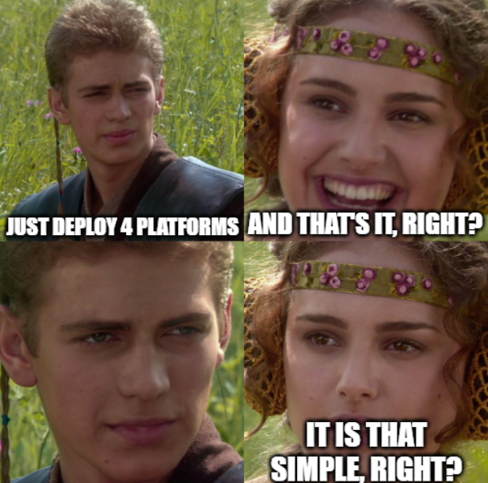
Notes:
Well a perfect world uh where everything is awesome and we have no dependencies, that would be it. But I think the live reviewers wouldn't have accepted my talk if would have been that simple.

Slide 5
What is a platform

Slide 6
What is a platform
Notes:
First of all we have to think a little bit about what actually is our platform. Don't worry, this is not a baseline discussion on what a platform is and a pl and isn't. This is just in order to talk so that we can talk about the same thing.

Slide 7
What is a platform made of
Notes:
We don't really care about the what do we actually want to achieve with our platform. It could be running normal applications, it could be running applications for customers, shared hosting, or even AI. What we really care about is what parts and dependencies does our platform have.

Slide 8
What is our platform made of
Notes:
Let's just introduce a sample that most of you might know. We have some kind of infrastructure, it might be on premises, it might be in the cloud, let's just say we start with VMs. And on top of that, we are running some kind of Kubernetes. And inside Kubernetes we run some operate. Gateways and stuff like that for internal developers to deploy their applications.

Slide 9
What is our platform depending on
Notes:
The first things we have to identify is what is our platform depending on. For example, if we are running on a hyperscaler in the cloud, we don't really have to care about the hypervisor itself, but we might need to keep an eye on operating system versions. For example, the newest Buntu releases. Or flat car releases or whatever operating system of which you have. That is something we have to update and something that could break our platform, especially when it comes to patches. So this is our first dependency.

Slide 10
What is our platform depending on
Notes:
The more obvious one for most of you is probably Kubernetes itself, so we have different Kubernetes minor versions different patches. Sometimes your features get reduced, sometimes stuff gets deprecated, and I'm very happy that we are living in the current year. So it really never happens. Sometimes stuff just breaks.
Let's add this to our baseline of stuff that has to be kept in sync.

Slide 11
What is our platform running
Notes:
And then there is all of the stuff that actually runs on the platform. As previously stated, that might be some custom operator or gateway API provider, it could be an abundance of solutions that might be part of a platform. Or even happen outside your platform. For example, if you have a dedicated database team or a dedicated MLOps team. All of that makes staging complicated.

Slide 12
The real problem
Notes:
Now you should have realized that the problem itself isn't actually providing different environments. The problem is keeping an eye on what we have to stage and what might break during staging.

Slide 13
How do we manage „state“

Slide 14
Just do IaC and gitops
Notes:
For most things running on top of Kubernetes, the answer to how do we make sure that we have a now in good state is pretty simple. It's GitOps. Tools like Argo or Flux all they do a very nice job of this. Things get more interesting when it comes to managing Kubernetes itself, or even the underlying infrastructure. You're probably also familiar with infrastructure as code tools like Terraform or Pulumi that can be used to manage VMs and even the operating system inside the VMs

Slide 15
Seperation of concerns
Notes:
Now we have at least two tools and they both manage different levels of our platform. In reality it will probably not just be two tools, it will be like three or four. And our main question will now be how can we keep things still matched in one central place.

Slide 16
Manage everything via Bash
Notes:
One end of the spectrum would be just managing everything with bash scripts. That's the old and trusted way of administrating stuff on Linux and to be honest at the end of the day everything we do here is just stuff on Linux plus plus or maybe stuff on Windows if you're really into pain.
This works But it isn't really the perfect way of doing desire state. You will always have some kind of disconnect and you have to write your own reconciliation logic.
So you can just run your pipeline every five minutes and decide that this is basically decide stage, but stuff will break over time, like for example when CLI versions change.

Slide 17
Manage everything in Kubernetes
Notes:
The other end of our spectrum is managing everything through Kubernetes. You can use tools like Crossplane or dedicated operators for your favorite cloud provider to manage even infrastructure components through Kubernetes.
This might be a very good solution for you, but it won't be a solution for everyone and introduces some problems when starting from zero again.
Also solutions, I really recommend uh a talk from last year's Cloud Native Rechects EU about if basically ephemeral setup cluster running in GitHub actions. It will be linked at the end of the slides.

Slide 18
How do we promote state
Notes:
So now we basically have decided on a way to manage our stage. That's awesome.
We have to talk about that important word in the title of this session. Staging.

Slide 19
In your dreams
Notes:
Automated Tests with maybe delays from stage to stage

Slide 20
In many engineers‘ reality
Notes:
You‘re probably just manually updating you files

Slide 21
The first step
Notes:
Define rules for promoting

Slide 22
The failed promotion
Notes:
Promotions can fail because of all kind of differneent reasons:
New CLI Version does not support a flag
Merge conflicts
And so to
So now our question is: How do we handle these failures? Do we fix first or bypass?

Slide 23
What can i do?

Slide 24
Create a stable identifier for your state

Slide 25
Define clear promotion requirements

Slide 26
Automate as many tests as possible

