Slide 1
WIREFRAMES
Full Screen Image – with video icon ready to launch

Slide 2


Slide 3




CHORUS
LOCAL ISSUES
transit
pre-school
homelessness
90%
50%
75%
75%
75%
75%
75%
75%
75%
75%
75%
75%

Slide 4





Design Matrix
High-End/
Designer
Serious/
Expert
Playful/
Novice
Generic

Slide 5

Buy Partisan – buypartisan.com

Slide 6

PoliticalTracker – politicaltracker.com

Slide 7

iCitizen – www.icitizen.com

Slide 8

Politifact – www.politifact.com

Slide 9
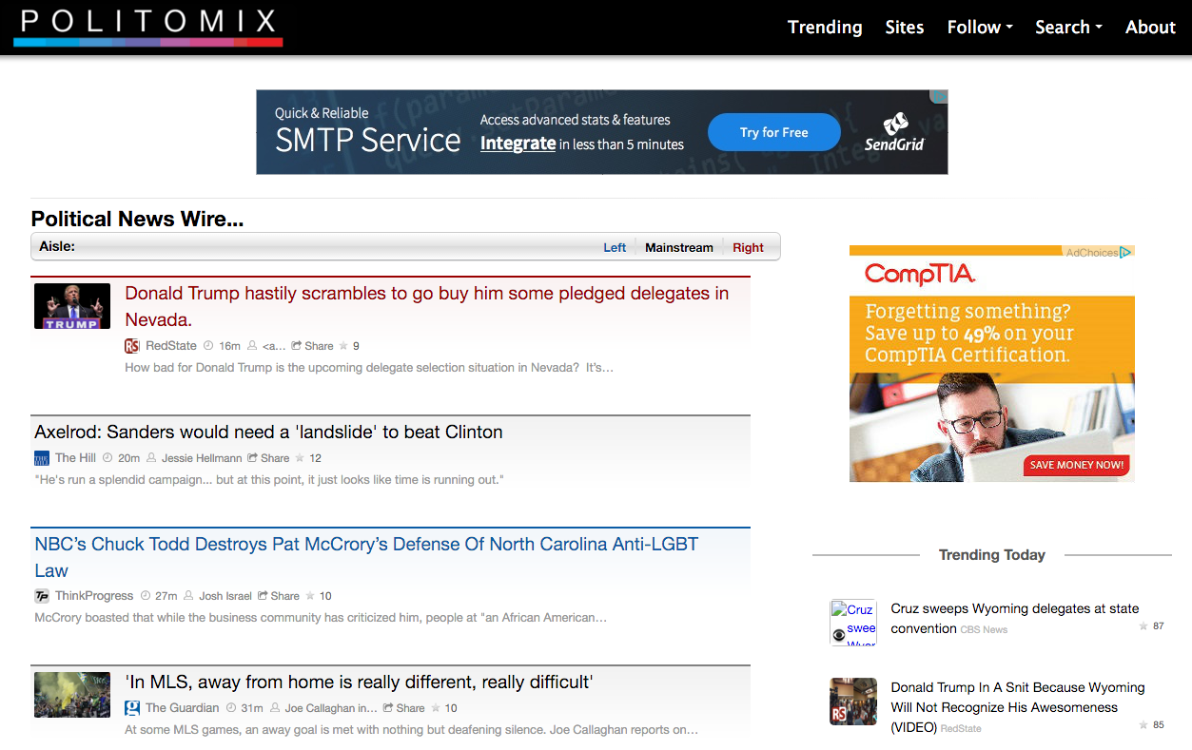
Politomix – politomix.com

