Slide 1
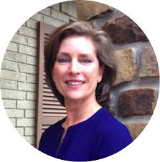



CHORUS
LOCAL ISSUES
transit
pre-school
homelessness
90%
50%
75%
75%
75%
75%
75%
75%
75%
75%
75%
75%

