Slide 1
What is Infrastructure as Code? (IaC)
Notes:
I want to be clear, “Infrastructure” as code doesn’t just mean “Infrastructure”
One common misunderstanding is that IaC is just for customers working with IaaS
In fact, IaC can be used across all of your resources:
•PaaS and serverless resources, like App Service, Azure Functions, and Logic Apps
•Networks, and network configuration like subnets, routing tables, peerings, and NSGs
•Access control policies, specifying who can access which resources in your Azure environment
•Databases, and database objects like tables, stored procedures, and views
•And the configuration of any Azure resource

Slide 2





What is Infrastructure as Code?
A way of describing our infrastructure in a machine-usable format.
‘Infrastructure’ doesn’t just mean IaaS.
PaaS and serverless resources
Networks and config
Access control policies
Databases and database objects
Azure resource config
Notes:
I want to be clear, “Infrastructure” as code doesn’t just mean “Infrastructure”
One common misunderstanding is that IaC is just for customers working with IaaS
In fact, IaC can be used across all of your resources:
PaaS and serverless resources, like App Service, Azure Functions, and Logic Apps
Networks, and network configuration like subnets, routing tables, peerings, and NSGs
Access control policies, specifying who can access which resources in your Azure environment
Databases, and database objects like tables, stored procedures, and views
And the configuration of any Azure resource

Slide 3





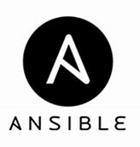











Infrastructure as Code Options
AZURE
Consistently deploy, monitor, and manage solution resources as a group
Clients
Control
Plane
API endpoint (management.azure.com)
Activity logs, Access control, policy, Locks, template engine, Deployments, Resource group
Resource providers
Data
Plane
Notes:
Implementing Infra as Code is one of the first steps you need to take to develop a devops process.
You need Infrastructure as Code to do devops.
There are three major components that make up Infrastructure As Code.
There are many tools out there that help with Infra as Code.
Here is the technology landscape.
Compare and contrast the different technologies and what areas they play a role in.
Deploying Infra => ARM/Terraform/Ansible
Config Management => PowerShell DSC/Chef/Puppet/Salt/Ansible/shell scripts
Orchestration => Jenkins/Spinnaker/AzureDevOps/Github

Slide 4
Basic IaC Terms
Variable
Parameter
Function
Module
Resources
Outputs

Slide 5
ARM Templates

Slide 6

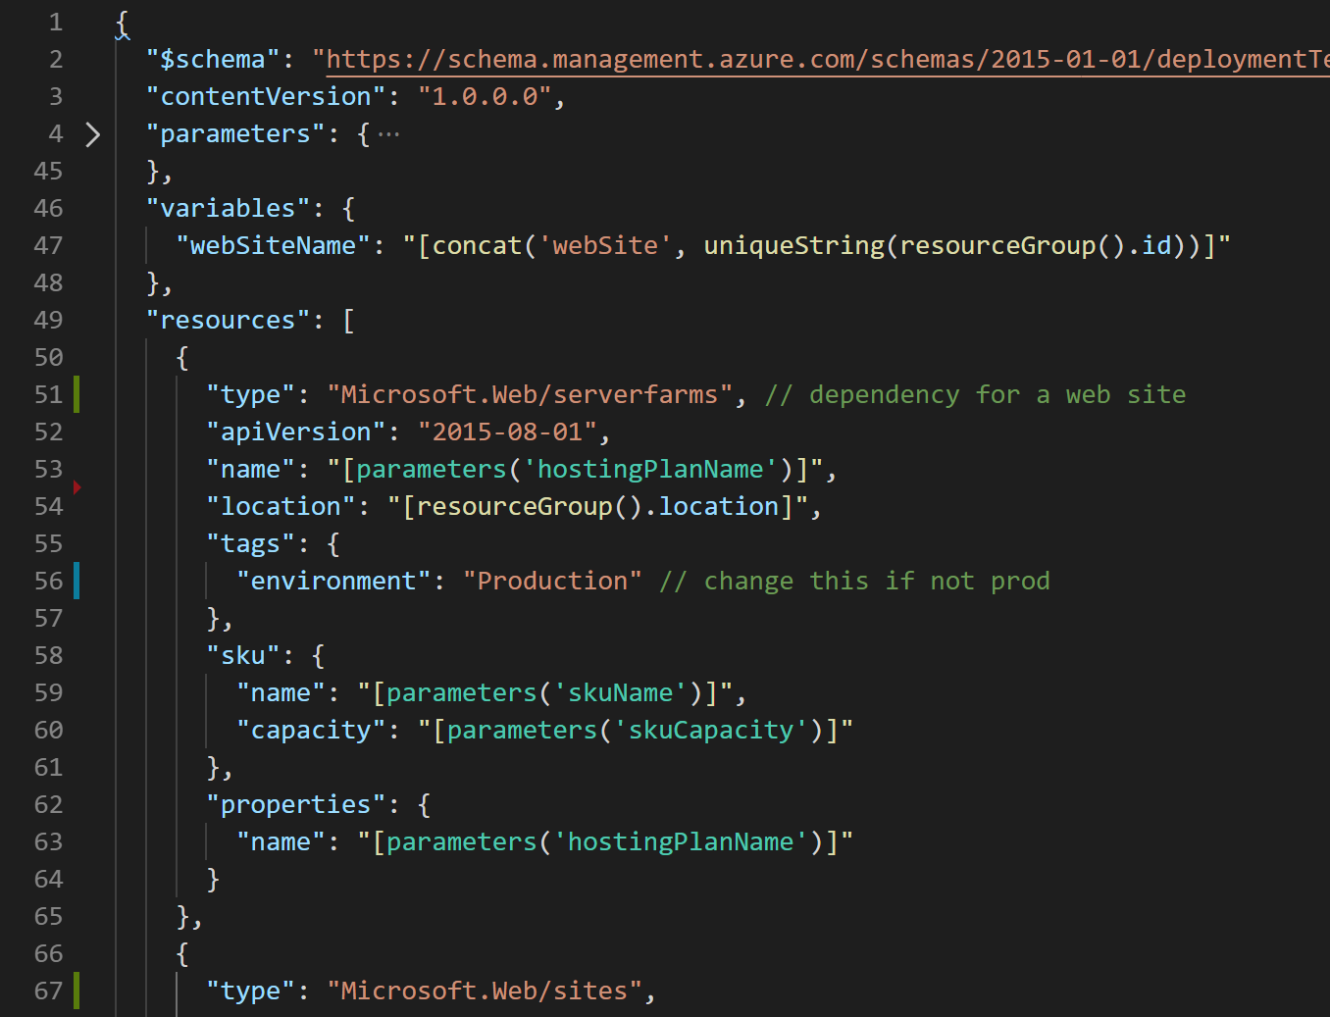




What are ARM Templates?
Declarative files for creating Azure resources in a reliable, repeatable and auditable way.
Infrastructure as Code
Define Azure resources using text files.
Declarative Syntax
Declare how the resources should be and Azure Resource Manager “makes it so”.
JSON
ARM Templates are JSON format text files. Edit them in Visual Studio Code (or other text editors). Version control them.
Meta-Language
Contains some programming language constructs such as functions and loops.
➔
https://docs.microsoft.com/en-us/azure/templates/

Slide 7
Resource Group
AZURE
ARM template deployment
PUT https://management.azure.com/subscriptions/(Id)/resourceGroups/(name)/Microsoft.Resources/deployments/(name)?api-version=2017-05-10
template-driven
declarative
idempotent
multi-service
multi-region
extensible
implicit & explicit dependency graph
functions and expressions
Backend Pool (NICs)
Storage Account
VM
NIC
VM IP Address
VNet
Load Balancer
LB IP Address
Subnet
Disk (blob)
Reference
Reference
Reference
Reference
Depends On
Reference
Network Security Group
Notes:
1. As easy to read as it is to write: Config is priority over code. Easy transition for PowerShell users and DevOps engineers. Ease of learning is priority over ease of use.
2. Transparent Abstraction: Simplify as much as possible without abstracting the platform in any way. Day Zero support will continue.
3. Imperative constructs for a declarative language: Common syntax patterns for looping, conditionals, transformations designed to be use in a declarative way
4. Modularity: Abstract common blocks of configuration into reusable elements. Publish modules to make common resources easy to consume with defaults, then progressively disclose complexity and allow for overrides.
5. Tighten the dev/test loop: Help catch as many errors as possible before I send the template to ARM
Day Zero provider coverage, Policy remediations etc.
You can read more about ARM templave benefits : https://docs.microsoft.com/en-us/azure/azure-resource-manager/templates/overview#why-choose-arm-templates

Slide 8
What is Bicep?

Slide 9
Project ‘Bicep’
Simple declarative language to provision infrastructure on Azure
Bicep Language
Transpiles to ARM Templates: Should be able to leverage ARM template knowledge and investments.
bicep build
ARM Templates
Regular release cycle: Stability and Tooling updates
az deployment group create
Azure Resource Manager
Modular: Abstract common blocks of config into reusable elements
Storage
Compute
Network
Identity
…
ARC
K8s
GitHub
…
Open Source: Transparency and community
+250 Resource Providers
3rd party extensibility
Lots of ways to contribute:
Open issues for syntax discussions, bugs, etc.
Submit PRs to the examples directory
Take a look at “Good first issue” label for feature PRs
Learn more: aka.ms/Bicep
Releases · Azure/bicep (github.com)
Notes:
A new declarative domain-specific language (DSL) for deploying Azure resources
•Bicep syntax reduces complexity and improves developer experience over JSON
•Bicep files ARE considered ARM Templates!
•Bicep is a “transpiled” language
•During deployment, Bicep files are “transpiled” (or converted) into ARM Templates with JSON as an intermediate language (IL)

Slide 10


Benefits of Azure Bicep
AZURE
Bicep is a Domain Specific Language used to create Resource Manager Templates
Simpler Syntax. No JSON noise
Define Azure resources using a simple language to learn, read and understand.
Declarative Syntax
Declare how the resources should be and Azure Resource Manager “makes it so”.
Modularity
Modules to break your bicep code into manageable chunks. Public and Private module registries
Built for tool-ability
First class authoring experience in VSCode. Rich type-safety, intellisense and validation.
Convert existing templates
Easy conversion of ARM Templates to Bicep
https://aka.ms/BicepDocs
Notes:
More readable and write-able syntax. No JSON noise.
Day Zero support for all Azure resource types.
No state management. State is managed by the Azure platform.
Richer type-safety, validation, IntelliSense. Built for Toolability.
Modules to break your bicep code into manageable chunks.
Integrated into the platform (Export Templates, Remediate resources with templates in policy)
Support for all resource types and API versions: Bicep immediately supports all preview and GA versions for Azure services. As soon as a resource provider introduces new resources types and API versions, you can use them in your Bicep file. You don't have to wait for tools to be updated before using the new services.
Simple syntax: When compared to the equivalent JSON template, Bicep files are more concise and easier to read. Bicep requires no previous knowledge of programming languages. Bicep syntax is declarative and specifies which resources and resource properties you want to deploy.
Authoring experience: When you use VS Code to create your Bicep files, you get a first-class authoring experience. The editor provides rich type-safety, intellisense, and syntax validation.
Modularity: You can break your Bicep code into manageable parts by using modules. The module deploys a set of related resources. Modules enable you to reuse code and simplify development. Add the module to a Bicep file anytime you need to deploy those resources.
Integration with Azure services: Bicep is integrated with Azure services such as Azure Policy, template specs, and Blueprints.
No state or state files to manage: All state is stored in Azure. Users can collaborate and have confidence their updates are handled as expected. Use the what-if operation to preview changes before deploying your template.
No cost and open source: Bicep is completely free. You don't have to pay for premium capabilities. It's also supported by Microsoft support.

Slide 11
When to use Bicep
When to use Bicep?
Azure-native: With Bicep, you're using a language that is native to Azure. When new Azure resources are released or updated, Bicep will support those features on day one. When using other third-party tools, it might take some time for new features to be defined in the tool set.
Azure integration: ARM templates, both JSON and Bicep, are fully integrated within the Azure platform. With Resource Manager-based deployments, you can monitor the progress of your deployment in the Azure portal.
Azure support: Bicep is a fully supported product with Microsoft Support.
No state management: Bicep deployments compare the current state of your Azure resources with the state that you define in the template. You don't need to keep your resource state information somewhere else, like in a storage account. Azure automatically keeps track of this state for you.
Easy transition from JSON: If you're already using ARM JSON templates as your declarative template language, it isn't a difficult process to transition to using Bicep. You can use the Bicep CLI to decompile any ARM template into a Bicep template by using the bicep decompile command.
When is Bicep not the right tool?
When to use Bicep - Learn | Microsoft Docs

Slide 12

What Bicep is NOT
AZURE
One language to rule them all
Bicep does not have awareness of State so if this is a requirement Terraform may be a better option
Invent new technology
Based off existing Azure Resource Manager principles.
the first question to ask is, "Does my organization already have a tool set in use?" Many tooling options are available that can be used for infrastructure as code-based resource provisioning. Sometimes, it makes sense to use existing financial and knowledge investments when you consider adopting a new process.
Multi-cloud: If your organization uses multiple cloud providers to host its infrastructure, Bicep might not be the right tool. Other cloud providers don't support Bicep as a template language. Open-source tools like Terraform can be used for multi-cloud deployments, including deployments to Azure.
When to use Bicep - Learn | Microsoft Docs
https://aka.ms/BicepDocs

Slide 13
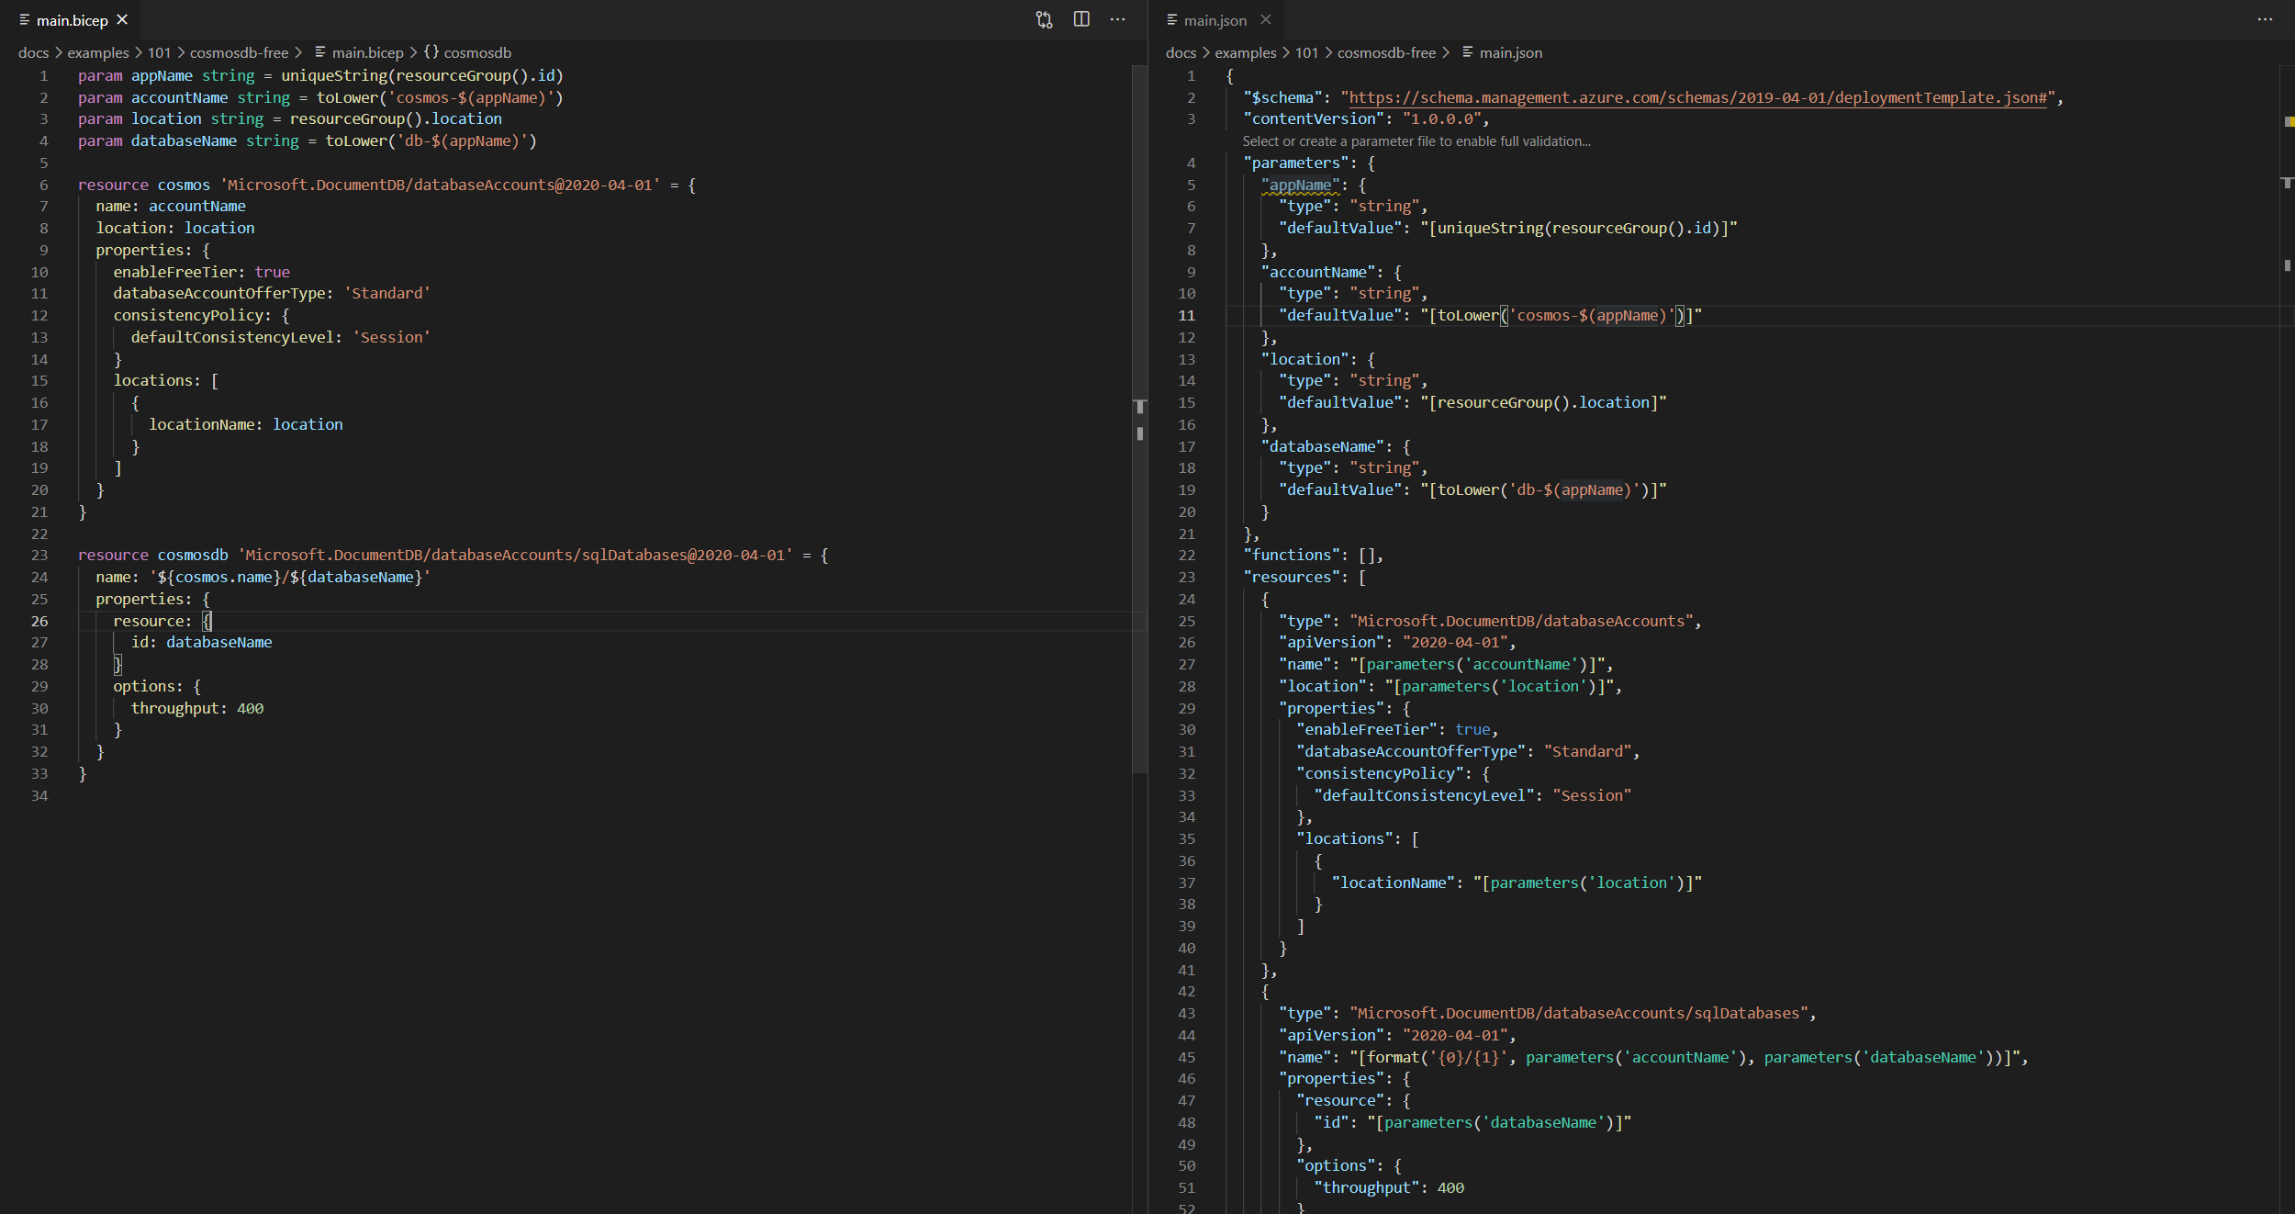
Simpler Syntax. No JSON noise.
Notes:
More readable and write-able syntax. No JSON noise like […] for expressions, or double-quotes on property names, or functions to access parameters/variables or constructing heinous reference() functions,

Slide 14
v0.1 + v0.2
The State of Bicep
AUTUMN ‘20
MARCH
JUNE
v0.3
v0.4
Experimental
Production ready
ARM template parity
First post-production release
Emphasis on quality and stability
Speeding up the inner loop

Slide 15
v0.4
Future releases
TODAY
AUGUST
OCTOBER
v0.5
v1.0
Latest release
Public + Private module registries
Passing resources between modules (#2245)
loadTextContent(…)
Strict breaking change policy
Type updates separate from core updates
Preview of bicep extensibility
https://github.com/Azure/bicep/releases
Notes:
alex

Slide 16
Let’s get a look at a Bicep template…

Slide 17
Bicep Improvements
Symbolic Names
Parameters
Variables
Resources
Outputs
Declare stuff anywhere
No more dependsOn
Improved resource referencing
Improved String operations
Improved conditions, loops, conditional expressions
Improved lots of things!

Slide 18
Bicep Template Variables
Easier to read and edit
It can simplify your template, making it easier to read
Complex objects
Group variables into an object helps understand the template design
Custom values
Use expressions and functions to modify parameter values and construct new values

Slide 19
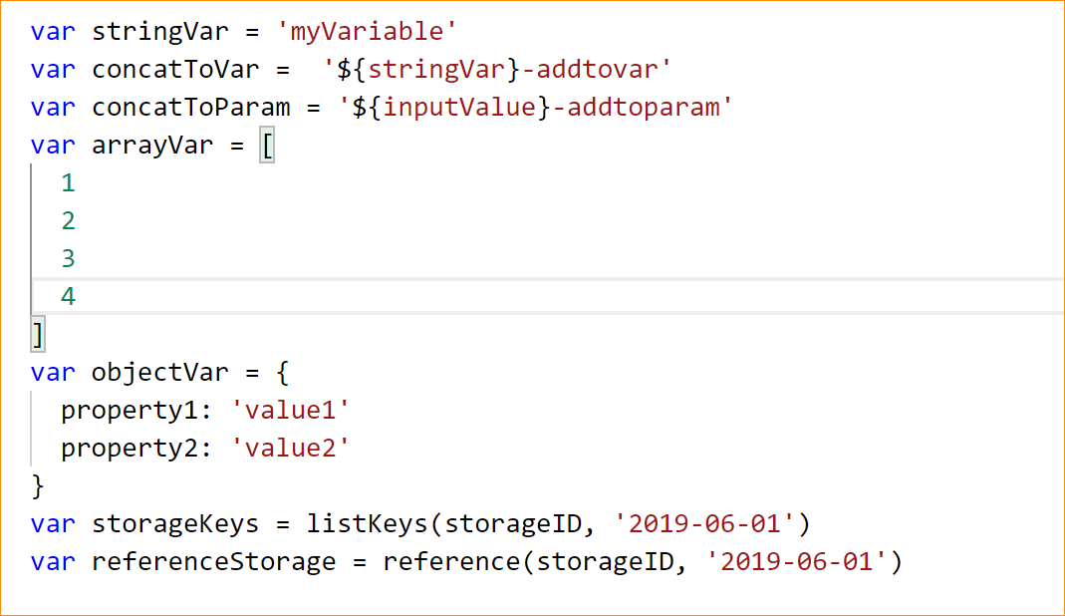
Bicep Template Variables - Examples

Slide 20
Bicep Template Parameters
Minimize parameters
Too many parameters may confuse the user
Use the “description” decorator to describe the parameter
This can help the user identify how and where the value will be used
Define default values
Setting default values guides user and reduces chances of invalid values
Parameters are mandatory, use default value to “make it optional”
Use securestring type
Passwords and secrets should use the securestring type

Slide 21
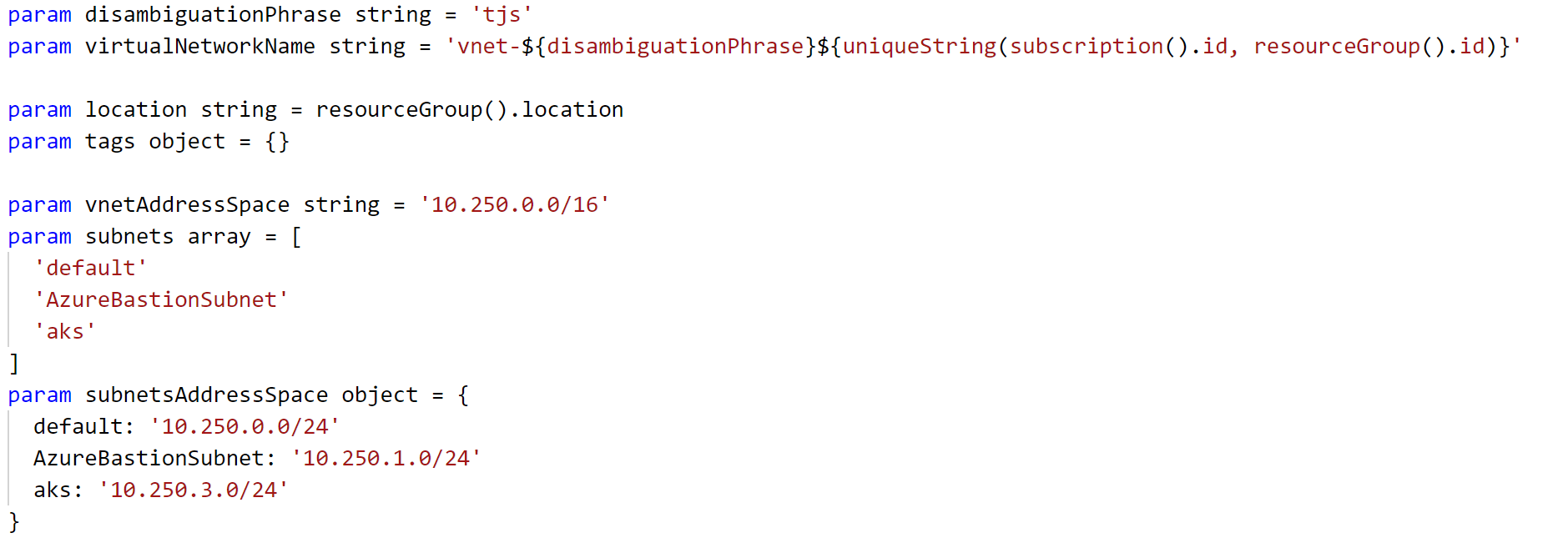
Bicep Template Parameters - Examples

Slide 22
Bicep Template Resources
Use “//comments”
Bicep allows comments to help others understand the purpose of the resource
ApiVersion
This property value will define the structure of the “properties” section of the resource
Hard-code it on the resource, so Visual Studio Intellisense can recognize it
Protected Settings
Use this property to pass secrets if the resource type supports it

Slide 23
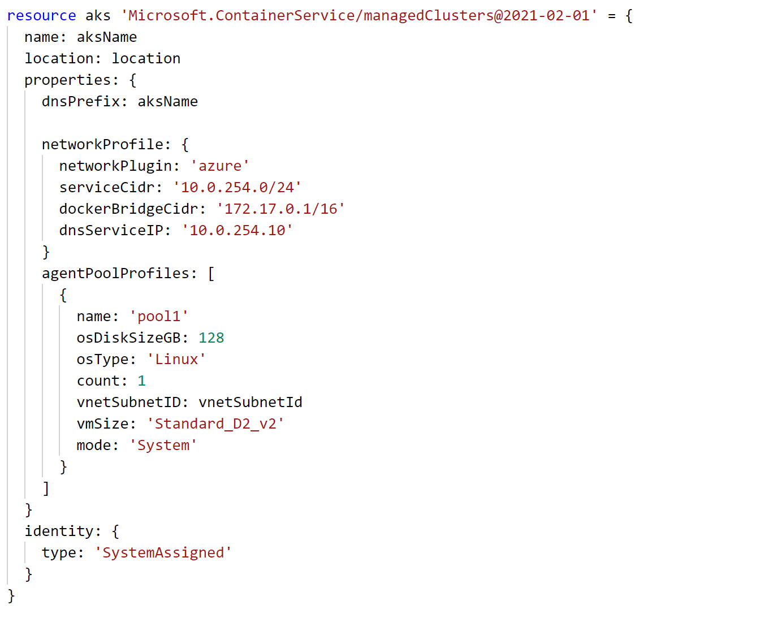
Bicep Template Resources - Examples

Slide 24
Bicep Template Deployment Revisited
PowerShell
PS C:\> New-AzResourceGroupDeployment -TemplateFile exampleTemplate.bicep -Name ExampleDeployment -ResourceGroupName ExampleResourceGroup
Azure CLI
terminal:~$ az deployment group create -f exampleTemplate.bicep –-resource-group exampleResourceGroup -n exampleDeployment

