Slide 1

Combine Azure Bicep and Octopus Deploy
Sarah Lean
Senior Solutions Architect @Techielass

Slide 2
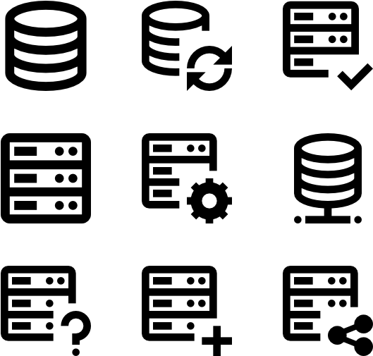
Deploying infrastructure
Deploying infrastructure in the Cloud can be complex.
A solution needs to help resolve problems with consistency, repeatability, and reduce management overhead.

Slide 3


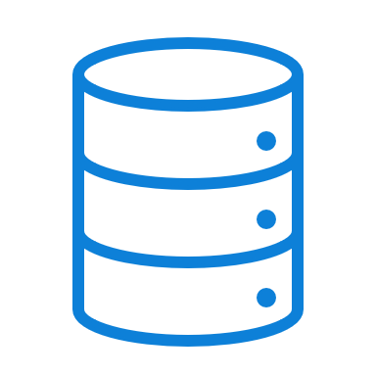


Infrastructure as Code
Infrastructure as code, sometimes referred to as IaC, is the process of provisioning infrastructure resources like how software is deployed.

Slide 4
Why Infrastructure as Code?
Adopting an infrastructure as code approach offers many benefits to resource provisioning.
Increase confidence in your deployments.
Manage multiple environments.
Better understand your cloud resources.

Slide 5
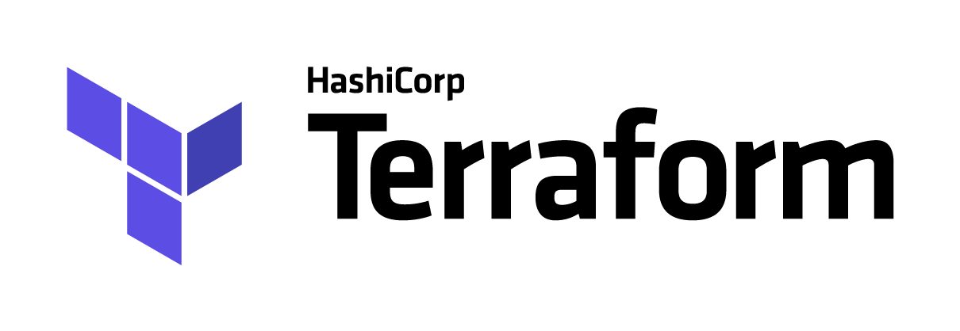

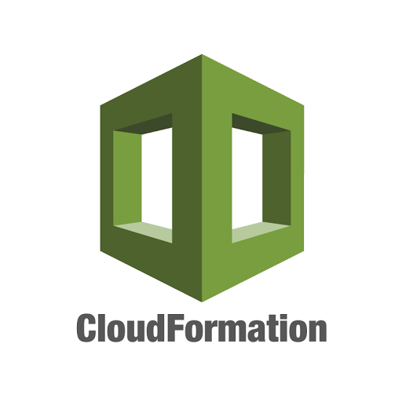
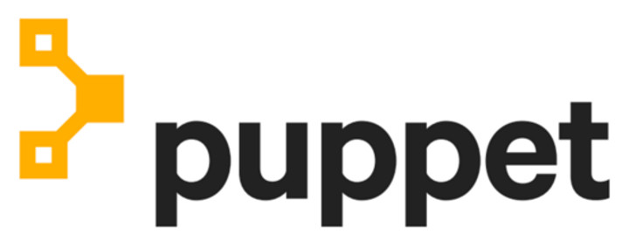
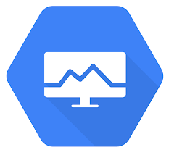

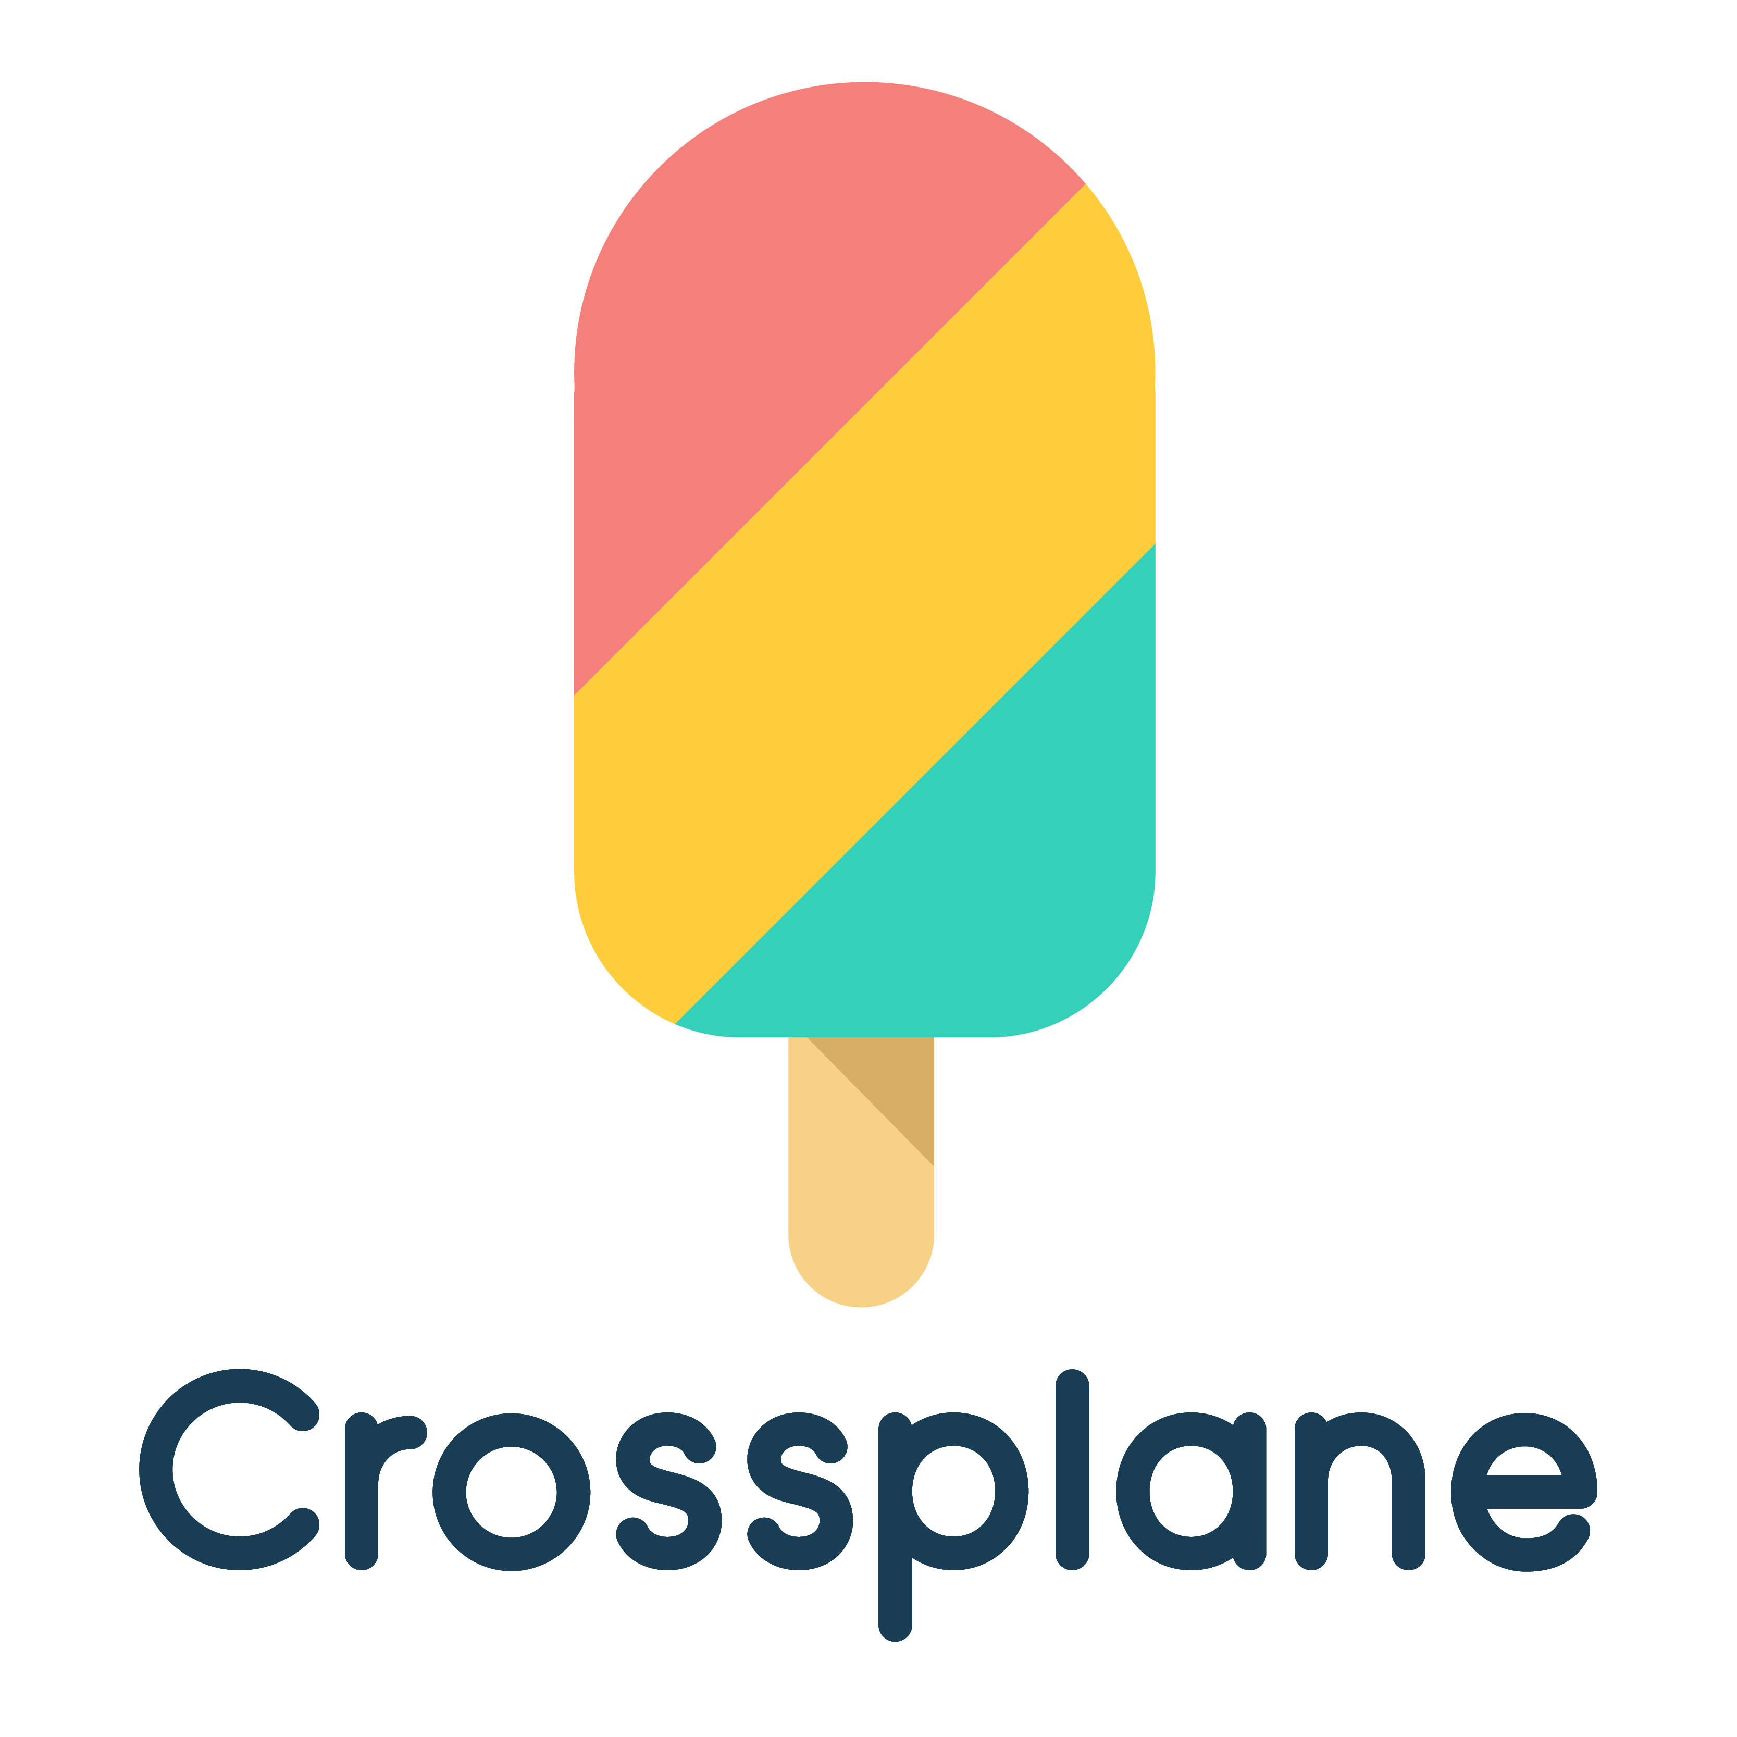
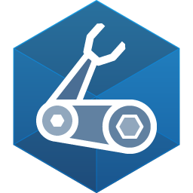
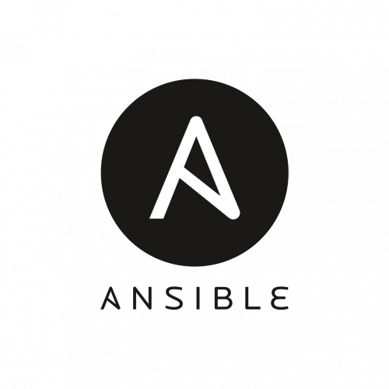

Infrastructure as Code languages

Slide 6
What is Azure Bicep?

Slide 7
What is Azure Bicep?
Bicep is a Resource Manager template language that's used to declaratively deploy Azure resources.
Intended to be easy to understand and straightforward to learn.
It is a Domain Specific Language (DSL).
100% free and open source.

Slide 8



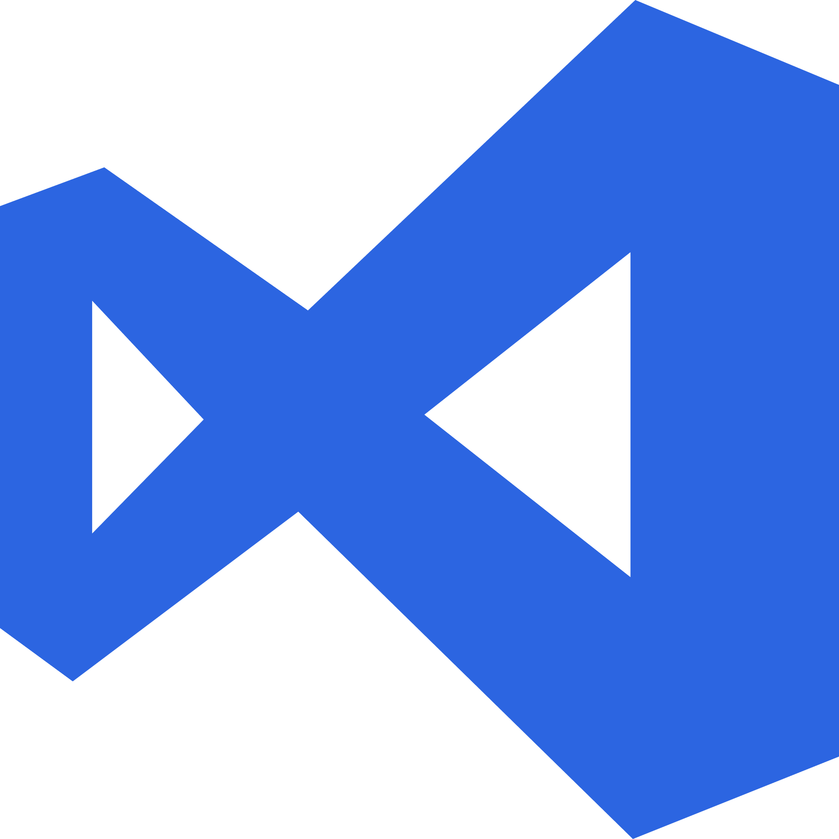
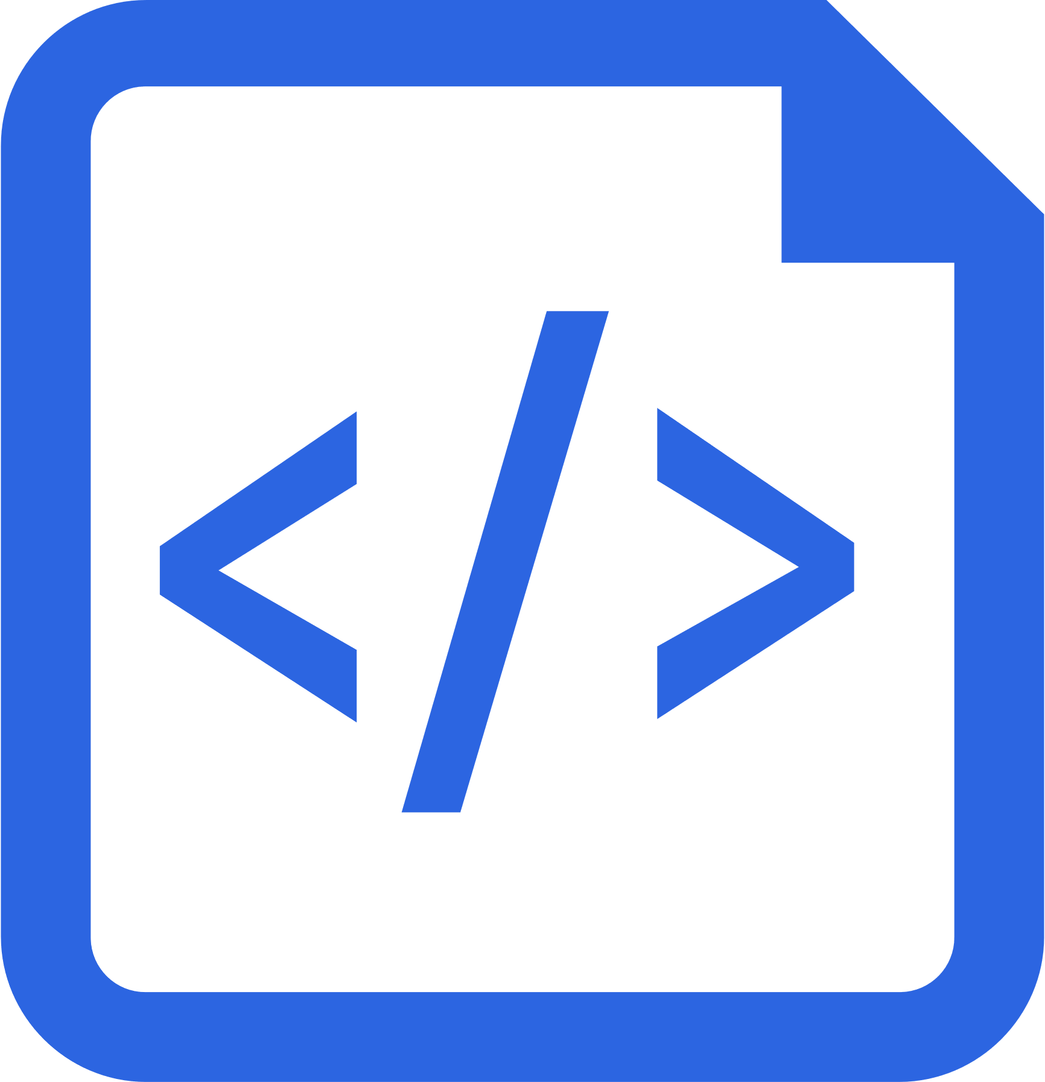
Benefits of Azure Bicep
Simpler Syntax. No JSON noise
Define Azure resources using a simple language to learn, read and understand.
Declarative Syntax
Declare how the resources should be and Azure Resource Manager “makes it so”.
Modularity
Modules to break your bicep code into manageable chunks. Public and Private module registries
Built for tool-ability
First class authoring experience in VSCode. Rich type-safety, intellisense and validation.
Convert existing templates
Easy conversion of ARM Templates to Bicep

Slide 9

When is Azure Bicep the right tool?
Azure Support: Bicep is fully supported by Microsoft Support.
Easy transition from JSON: If you are already using Azure ARM JSON templates you can easily transition to Azure Bicep templates.
Azure-native: When new Azure resources are released or updated, Bicep will support those features on day one.

Slide 10
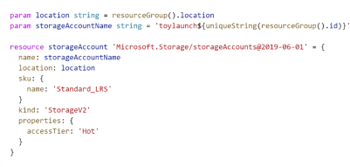

When is Azure Bicep not the right tool?
Existing tool set: Sometimes it make sense to use existing financial and knowledge investments.
Multi-cloud: Other cloud providers don’t support Azure Bicep as a template language.

Slide 11
What is Octopus Deploy?

Slide 12
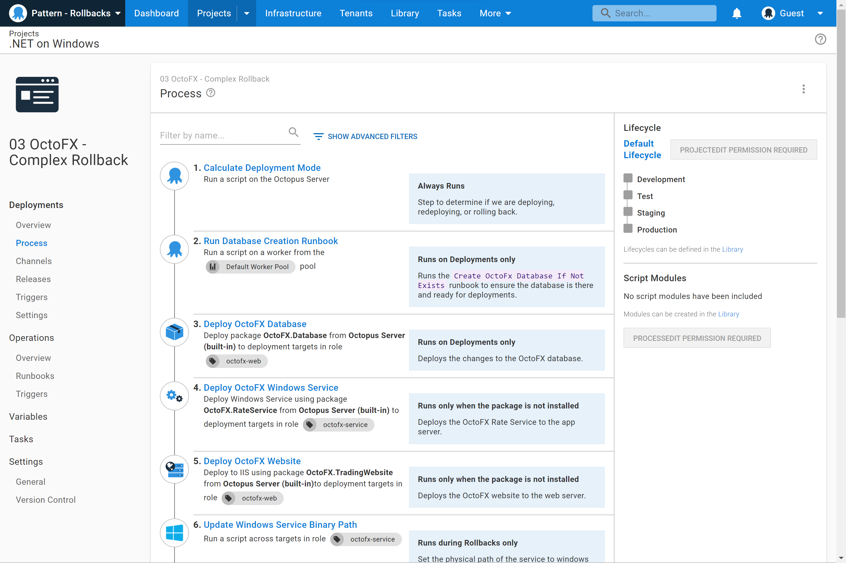
What is Octopus Deploy?
A unified DevOps Automation platform.
Octopus Deploy is a single place for your team to manage releases, automate deployments, and automate the runbooks that keep your software operating.

Slide 13
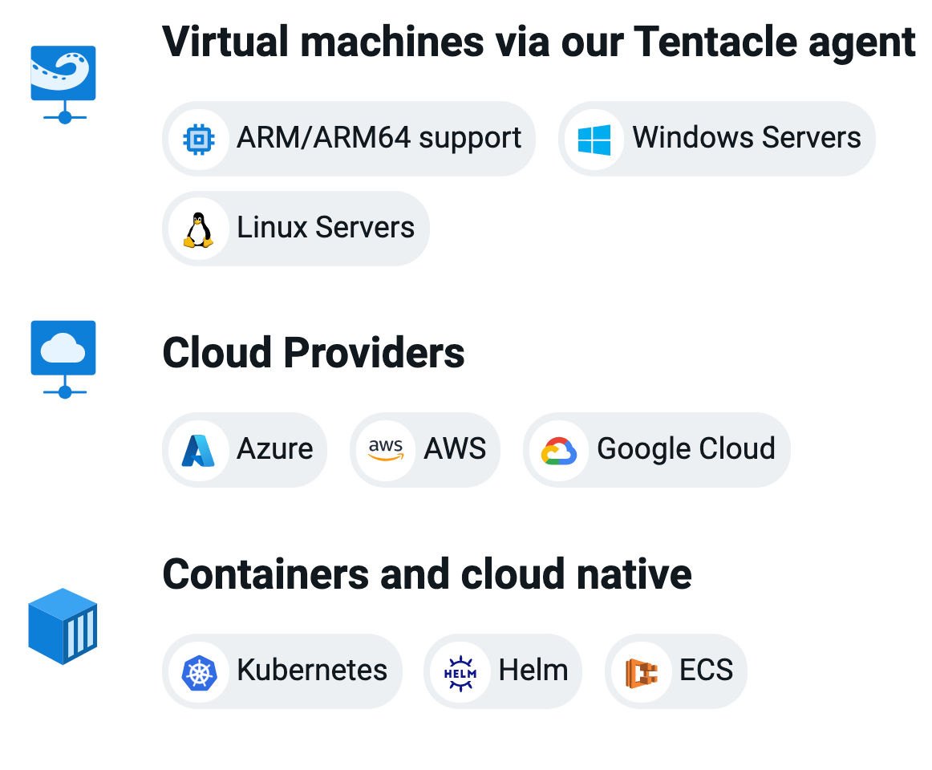
Run on any infrastructure
Support for legacy to modern infrastructure from virtual machines to containers
Cloud agnostic with built-in functionality for Azure, AWS, and Google Cloud
Support for all major CI servers with native plugins including Jenkins, GitHub Actions, Jetbrains TeamCity, Azure DevOps and more

Slide 14
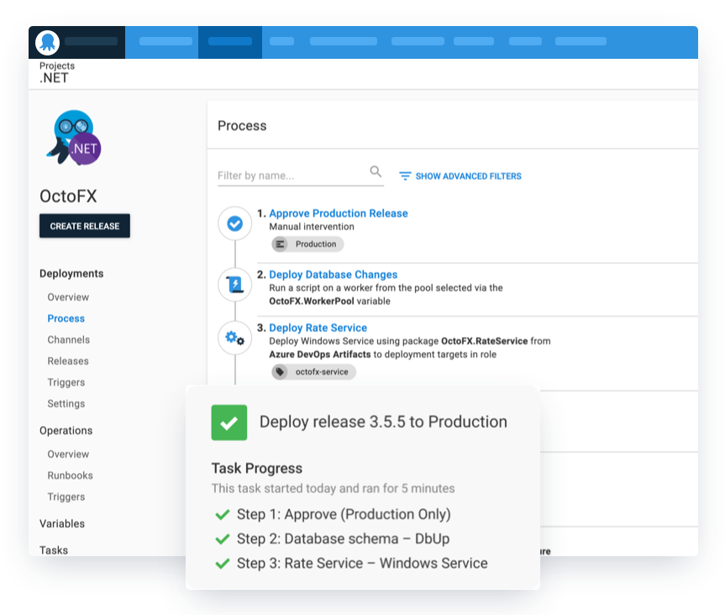
Define your deployment process once
Differences are handled via variables and scoping steps to specific environments
Releases snapshot your deployment configuration and build artifacts for repeatable and reliable deployments
Advanced deployment patterns including rolling, blue-green, canary deployments and multi-tenancy

Slide 15
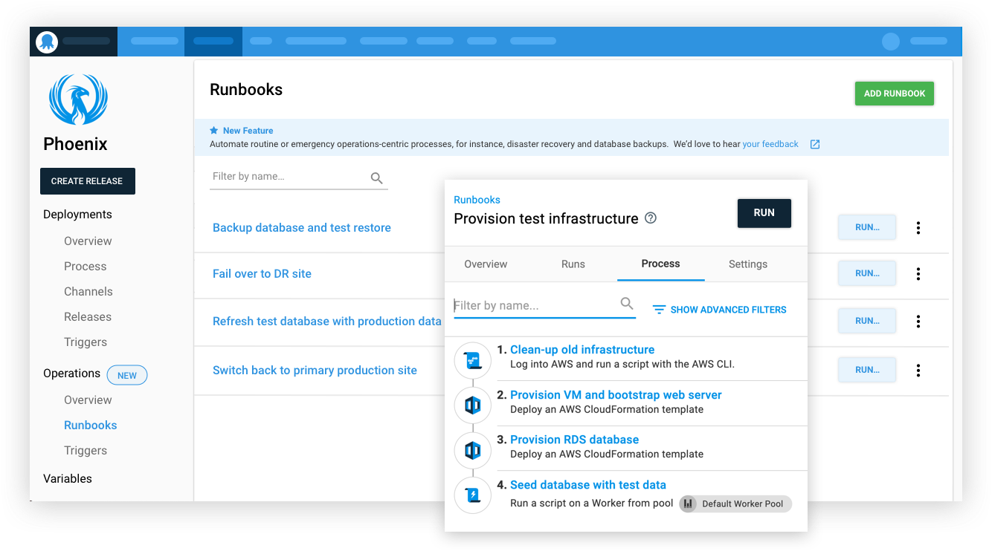
Runbooks
Runbooks allow teams to automate routine maintenance and incident management (emergency) operations tasks

Slide 16
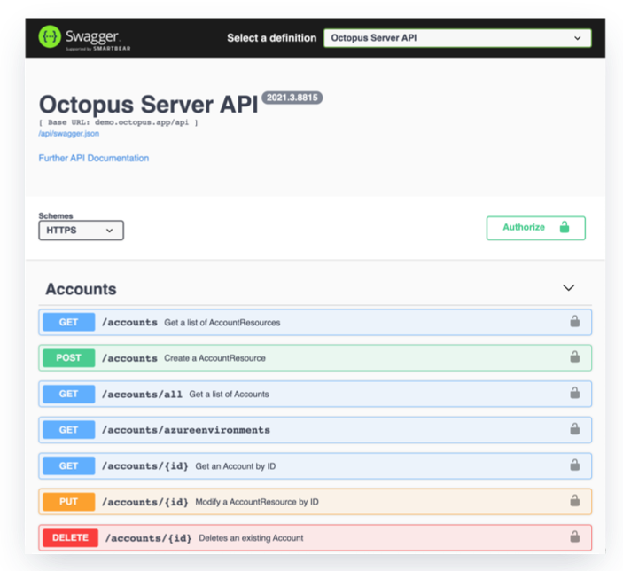
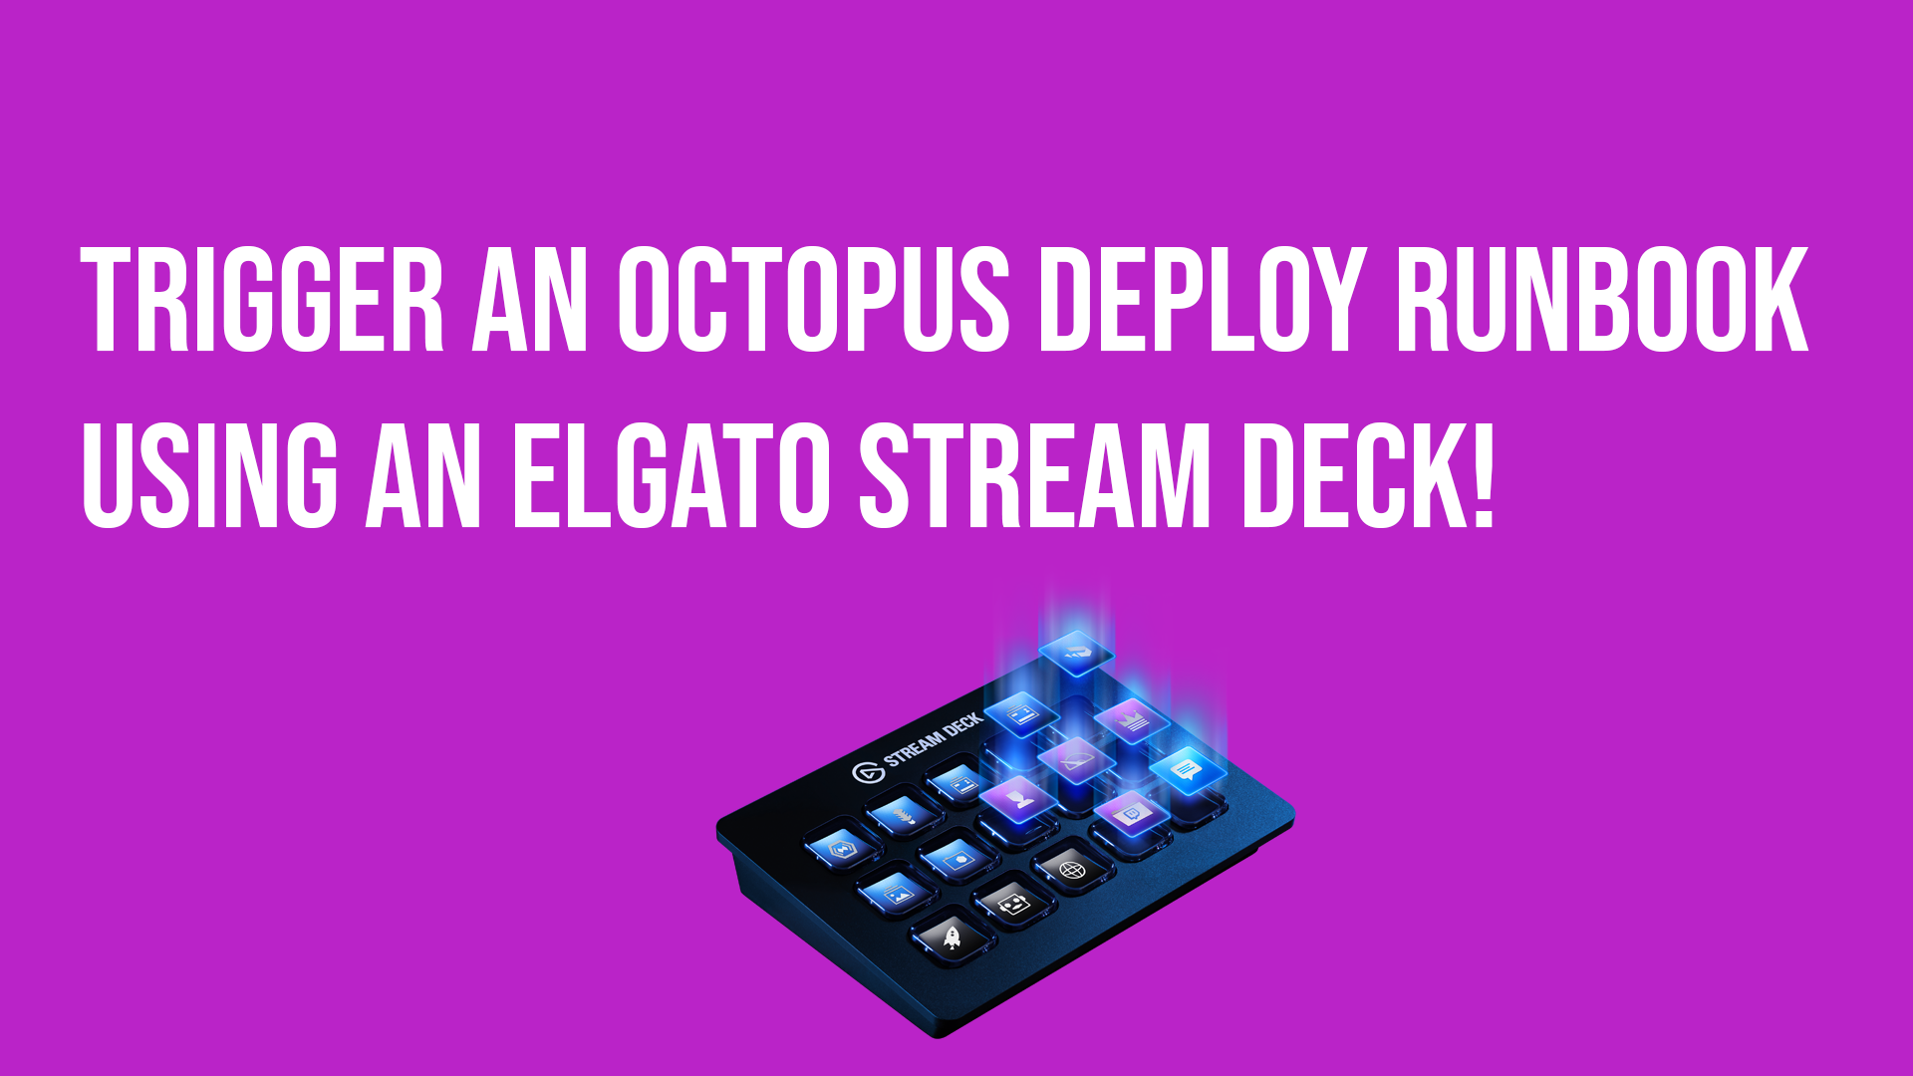
API-first architecture
API-first architecture for automation, customization and flexibility
Cross-platform integrations that suit your team. Octopus CLI, RESTful client, C# API client, Java SDK, Golang API client, and TypeScript API client

Slide 17
DEMO

Slide 18
























Next Steps

Slide 19
What did we cover?
What is Azure Bicep
Deploying an Azure Bicep template with PowerShell
What is Octopus Deploy
Deploying an Azure Bicep template with Octopus Deploy

Slide 20

Sign up for a trial
https://octopus.com/start

Slide 21

Thank you! Resources: https://g.octopushq.com/bicepoctopus
Sarah Lean
Senior Solutions Architect
@Techielass
www.techielass.com

