Slide 1

Combine Azure Bicep and Octopus Deploy
Sarah Lean
Senior Solutions Architect @Techielass

Slide 2
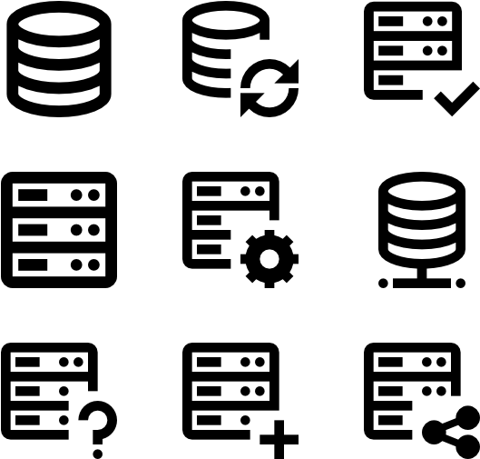
Deploying infrastructure
Deploying infrastructure in the Cloud can be complex.
A solution needs to help resolve problems with consistency, repeatability, and reduce management overhead.

Slide 3


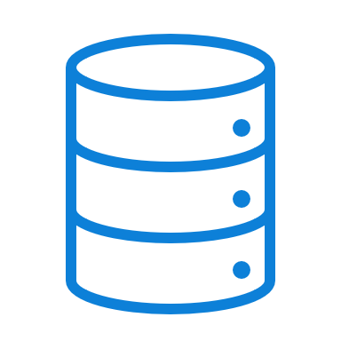


Infrastructure as Code
Infrastructure as code, sometimes referred to as IaC, is the process of provisioning infrastructure resources like how software is deployed.

Slide 4
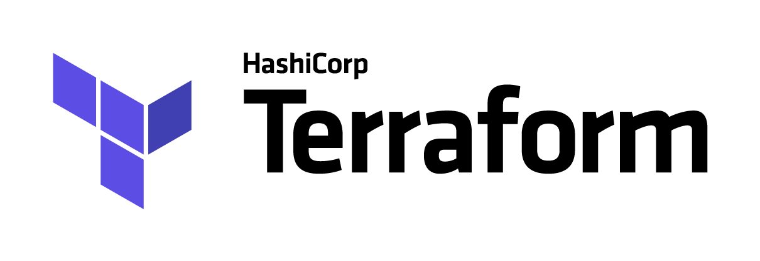

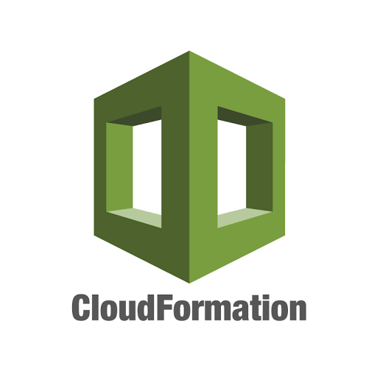





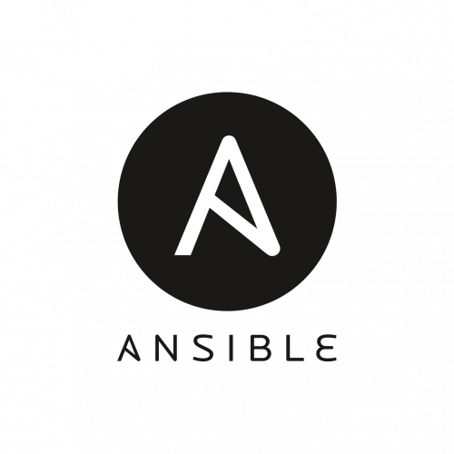

Infrastructure as Code languages

Slide 5
What is Azure Bicep?

Slide 6
What is Azure Bicep?
Bicep is a Resource Manager template language that's used to declaratively deploy Azure resources.
Intended to be easy to understand and straightforward to learn.
It is a Domain Specific Language (DSL).
100% free and open source.

Slide 7




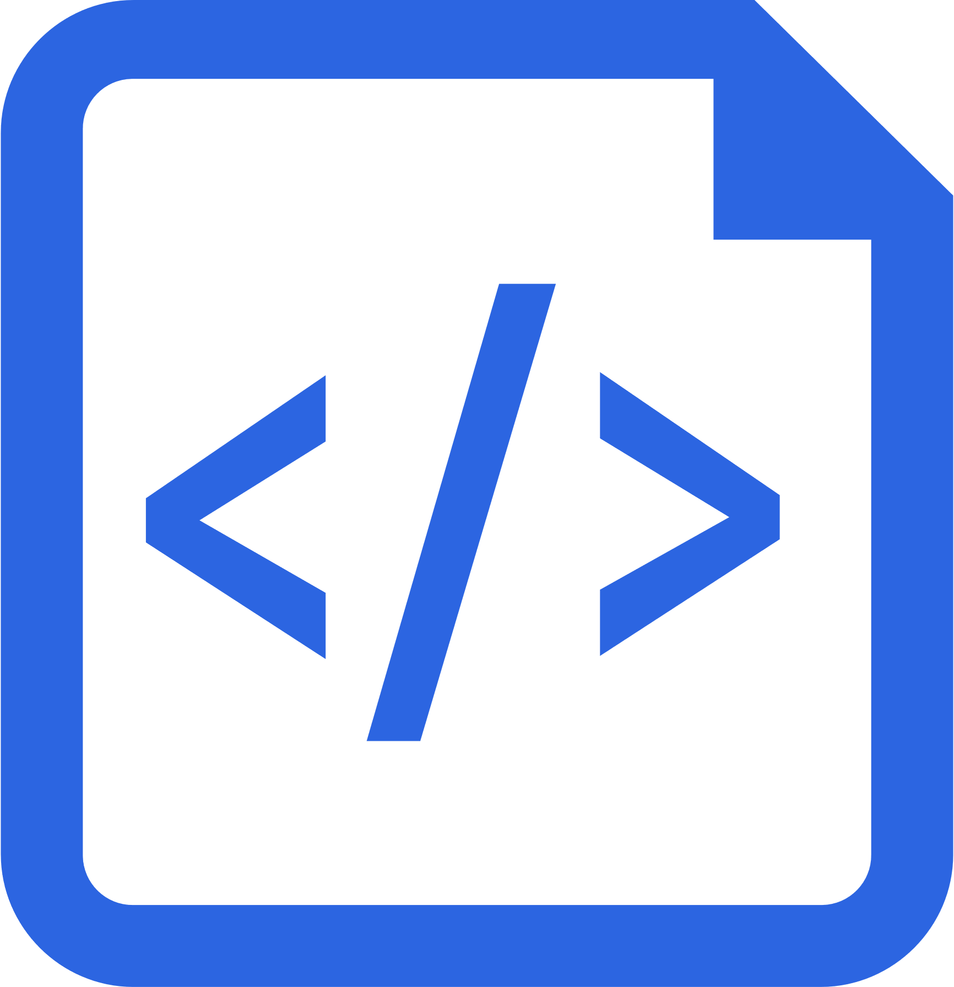
Benefits of Azure Bicep
Simpler Syntax. No JSON noise
Define Azure resources using a simple language to learn, read and understand.
Declarative Syntax
Declare how the resources should be and Azure Resource Manager “makes it so”.
Modularity
Modules to break your bicep code into manageable chunks. Public and Private module registries
Built for tool-ability
First class authoring experience in VSCode. Rich type-safety, intellisense and validation.
Convert existing templates
Easy conversion of ARM Templates to Bicep

Slide 8
What is Octopus Deploy?

Slide 9
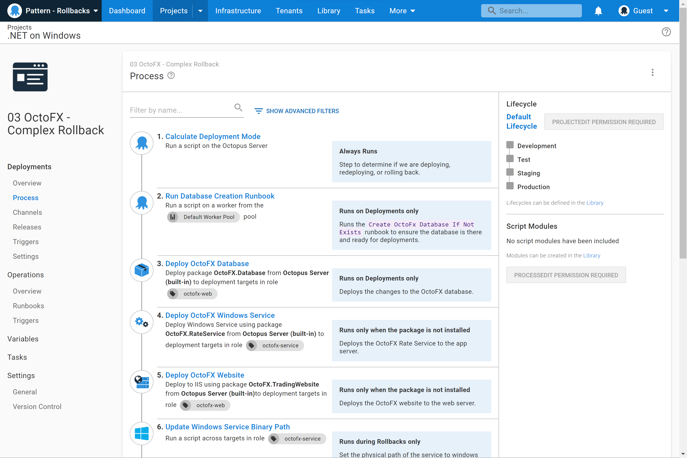
What is Octopus Deploy?
A unified DevOps Automation platform.
Octopus Deploy is a single place for your team to manage releases, automate deployments, and automate the runbooks that keep your software operating.

Slide 10
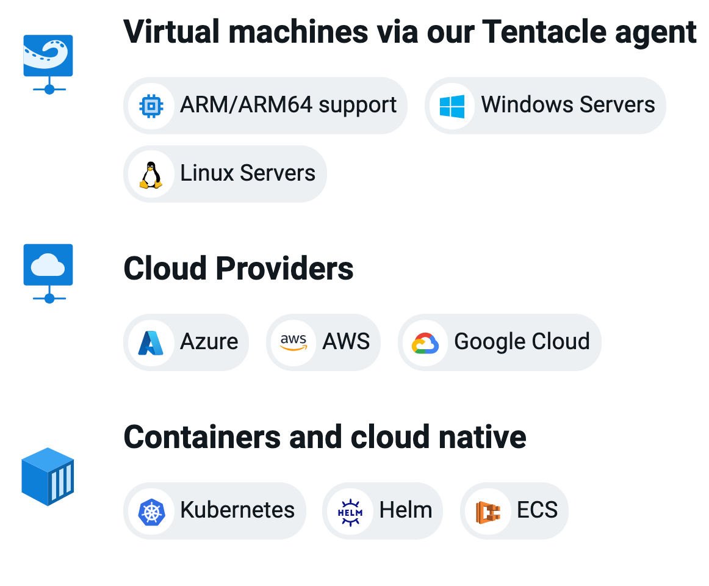
Run on any infrastructure
Support for legacy to modern infrastructure from virtual machines to containers
Cloud agnostic with built-in functionality for Azure, AWS, and Google Cloud
Support for all major CI servers with native plugins including Jenkins, GitHub Actions, Jetbrains TeamCity, Azure DevOps and more

Slide 11
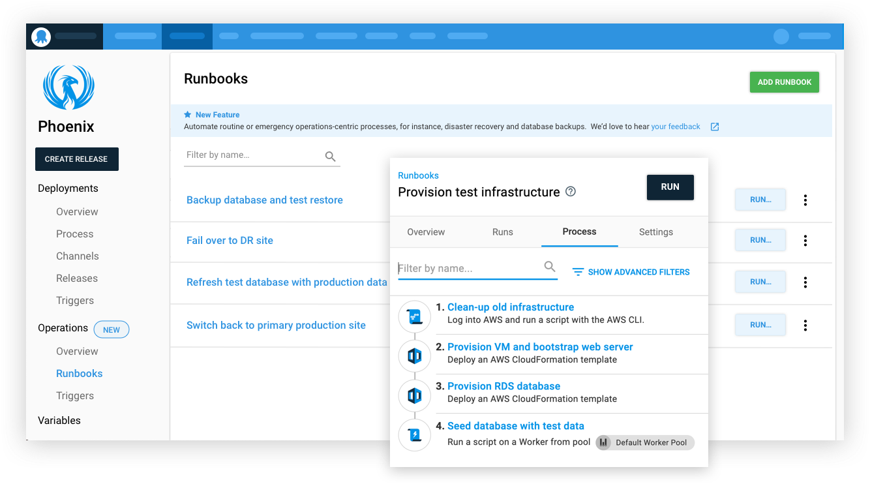
Runbooks
Runbooks allow teams to automate routine maintenance and incident management (emergency) operations tasks

Slide 12
DEMO

Slide 13
























Next Steps

Slide 14
What did we cover?
What is Azure Bicep
Deploying an Azure Bicep template with PowerShell
What is Octopus Deploy
Deploying an Azure Bicep template with Octopus Deploy

Slide 15

Sign up for a free trial
https://octopus.com/start

Slide 16

Thank you! Resources: https://g.octopushq.com/bicepoctopus
Sarah Lean
Senior Solutions Architect
@Techielass
www.techielass.com

