Slide 1
Internal Presenter Notes: What Attendees Should Take Away
Content creators: Write 3 things an attendee should take away from the presentation. This will help presenters home in on the main points.
1. Learn about Octopus Deploy
2. Learn how to integrate Octopus Deploy with Azure DevOps
3.

Slide 2

When super powers combine
Sarah Lean
Senior Solutions Architect @Techielass

Slide 3



Who am I?
Blog at www.techielass.com
@Techielass
Founder of the Glasgow Azure User Group
STEM Ambassador
17+ years in the IT industry
IT Pro

Slide 4


Slide 5


Do you know what Octopus Deploy is?
ⓘ Start presenting to display the poll results on this slide.

Slide 6

OctoPetShop
Their online shop isn’t stable
They want a test environment
They don’t want the server inside their pet shop anymore

Slide 7
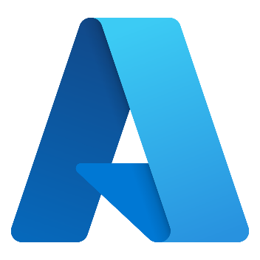

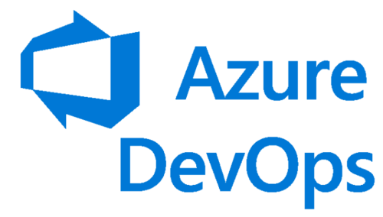
Plan

Slide 8




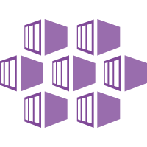

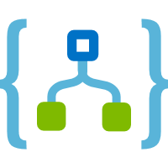

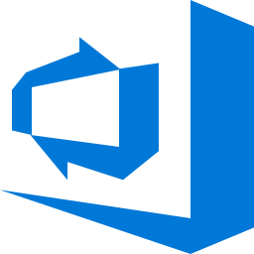

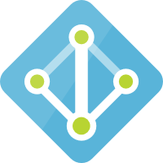

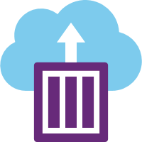
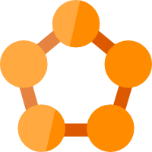
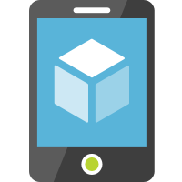



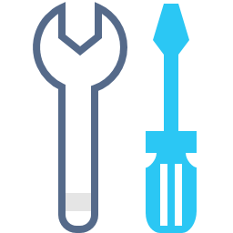

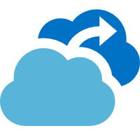


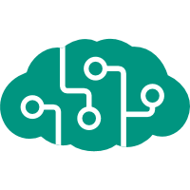
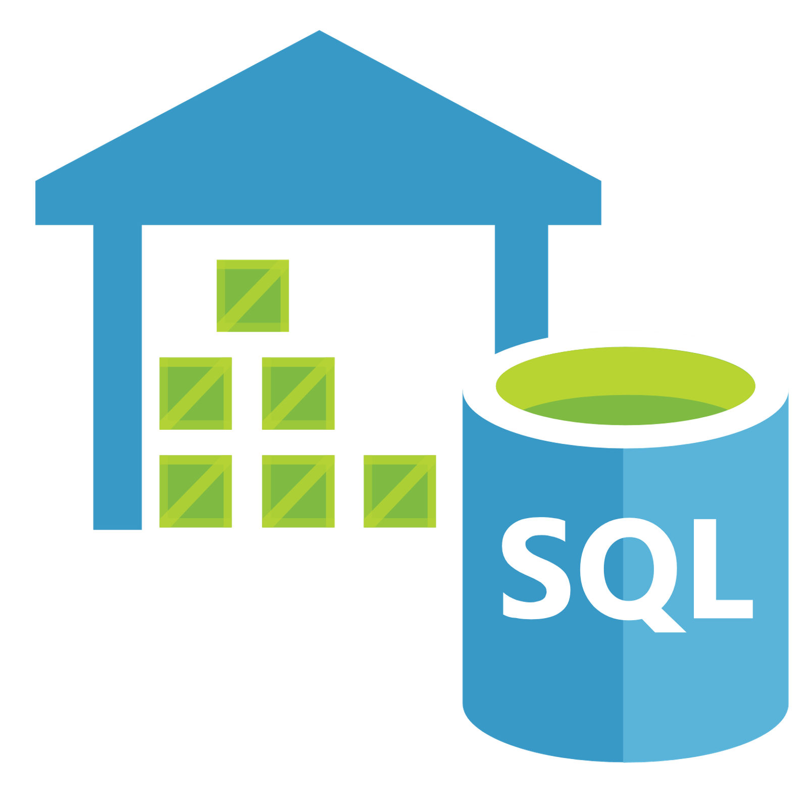
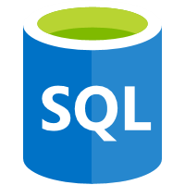

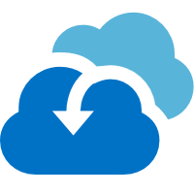

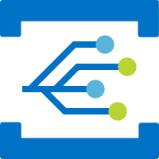



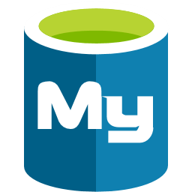


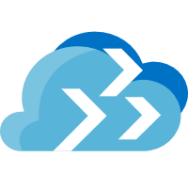








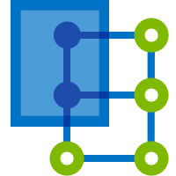







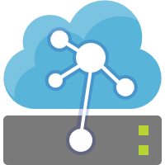





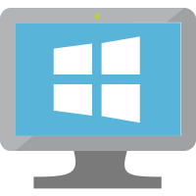

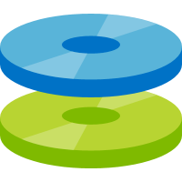
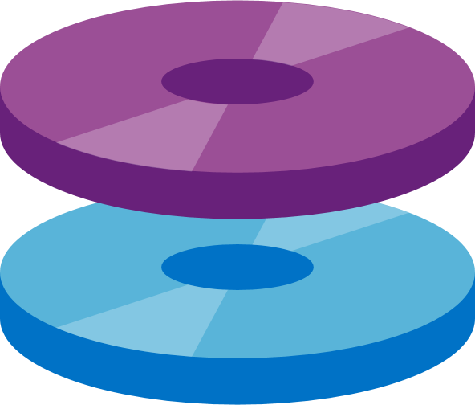
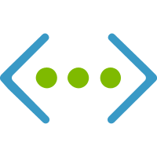

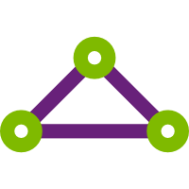

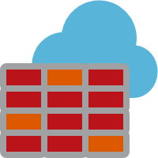
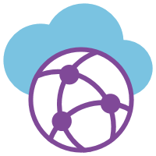


What is Azure?
Management
Platform as a Services (PaaS)
Security
Azure
Monitor
Compute/Containers
Web/Mobile
DevOps/Developer
Security
Center
Log
Analytics
Functions
Kubernetes
Service
Web Apps
Logic Apps
API Apps
Azure DevOps
Lab
Services
Azure AD
Azure
Policy
Container
Instance
Service Fabric
Mobile Apps
Notification
Hubs
SignalR
Service
Application
Insights
SDK
Azure AD for
Domain Services
Azure
Bluepirnts
Integration
IoT
AI
Analytics
Data Services
Azure AD
B2C
Azure
Backup
API
Management
Logic Apps
IoT Hub
Cognitive
Services
SQL Data
Warehouse
SQL
Database
SQL Data
Warehouse
DDoS
Protection
Site
Recovery
Service Bus
Event Grid
IoT Central
Machine
Learning Studio
Azure
Databricks
Database for
MySQL
Cosmos DB
Key Vault
Azure
Migrate
Media/CDN
Time Series
Insights
Machine
Learning Service
Apache Spark
Database for
PostgreSQL
Data Factory
Multi-Factor
Authentication
Databox
Family
Media Services
Content
Protection
Azure
Digital Twins
Bot
Services
Stream
Analytics
Database for
MariaDB
Azure Cache
for Redis
Azure ATP
Cost
Management
Video Indexer
Content Delivery
Network
IoT Edge
Azure
Search
Data Lake
Storage Gen2
Database
Migration Service
Table
Storage
Role- based
access control
Infrastructure as a Services (IaaS)
Compute
Storage
Networking
Virtual
Machine Scale Sets
Linux
Virtual
Machine
Disk Storage
Managed
Disks
Virtual
Network
VPN
Gateway
Express
Route
Load
Balancer
Azure
Firewall
Virtual
WAN
Network
Watcher
Azure Datacenter Infrastructure

Slide 9





What is Azure DevOps?
Azure Boards
Azure Pipelines
Azure Repos
Deliver value to your users faster using proven agile tools to plan, track, and discuss work across your teams.
Build, test, and deploy with CI/CD that works with any language, platform, and cloud. Connect to GitHub or any other Git provider and deploy continuously.
Get unlimited, cloud-hosted private Git repos and collaborate to build better code with pull requests and advanced file management.
➔
Azure Test Plans
Azure Artifacts
Test and ship with confidence using manual and exploratory testing tools.
Create, host, and share packages with your team, and add artifacts to your CI/CD pipelines with a single click.
https://azure.com/devops

Slide 10
Integration with Octopus

Slide 11
Do you know what Octopus Deploy is?
ⓘ Start presenting to display the poll results on this slide.

Slide 12
What is Octopus Deploy?

Slide 13
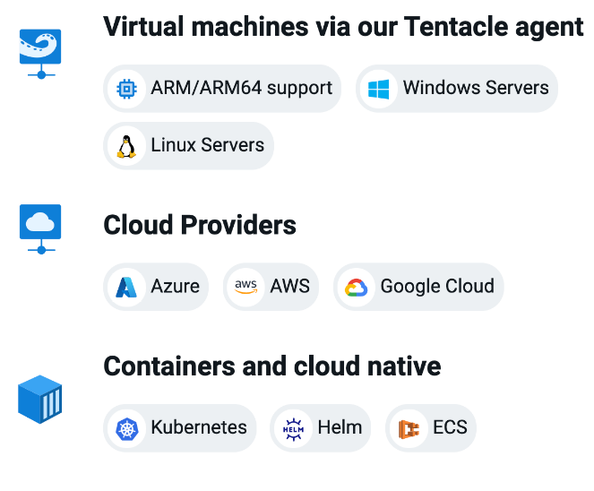
Run on any infrastructure
Support for legacy to modern infrastructure from virtual machines to containers
Cloud agnostic with built-in functionality for Azure, AWS, and Google Cloud
Support for all major CI servers with native plugins including Jenkins, GitHub Actions, Jetbrains TeamCity, Azure DevOps and more

Slide 14
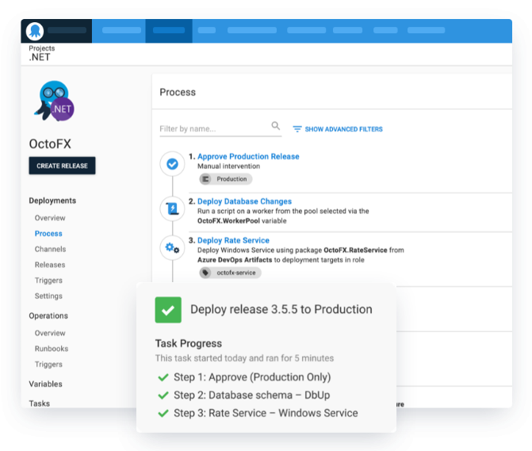
Define your deployment process once
Differences are handled via variables and scoping steps to specific environments
Releases snapshot your deployment configuration and build artifacts for repeatable and reliable deployments
Advanced deployment patterns including rolling, blue-green, canary deployments and multi-tenancy

Slide 15
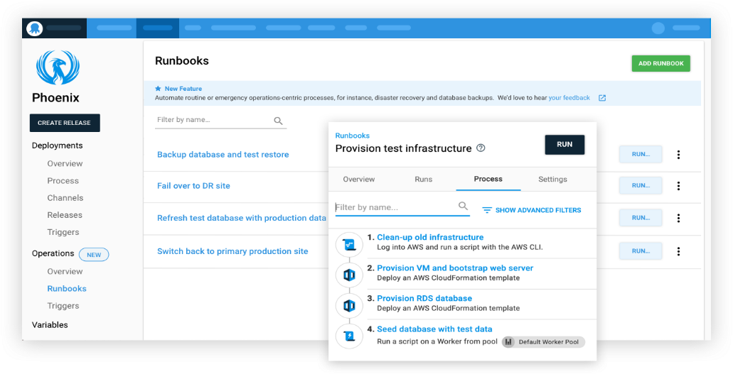
Runbooks
Runbooks allow teams to automate routine maintenance and incident management (emergency) operations tasks

Slide 16
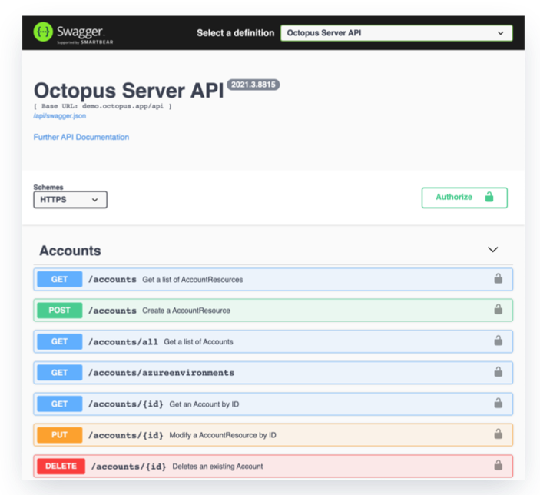
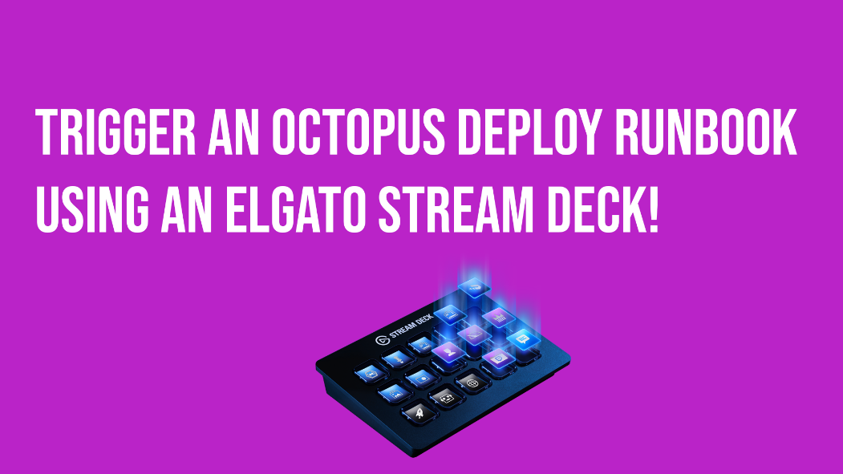
API-first architecture
API-first architecture for automation, customization and flexibility
Cross-platform integrations that suit your team. Octopus CLI, RESTful client, C# API client, Java SDK, Golang API client, and TypeScript API client

Slide 17

















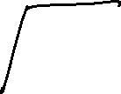















CI/CD Pipeline

Slide 18
DEMO

Slide 19
What did we do?
Introduced new infrastructure hosted in Azure
Introduced a test environment
Introduced source control
Introduced a CI/CD pipeline with Azure DevOps & Octopus Deploy
Introduced a stable, repeatable, cost effective solution

Slide 20
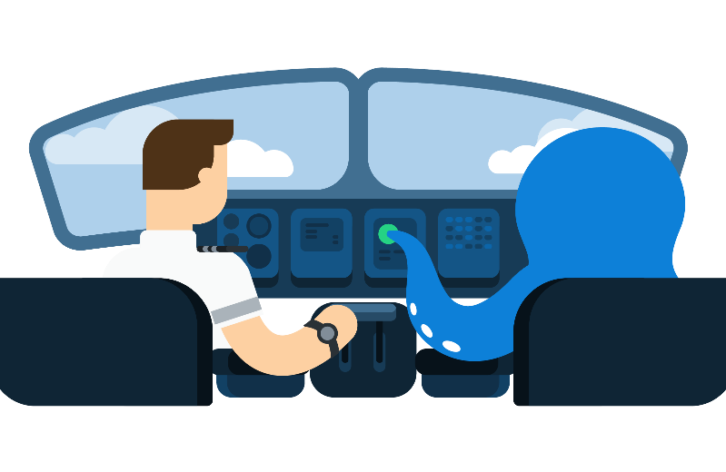
Sign up for a trial
https://octopus.com/start

Slide 21
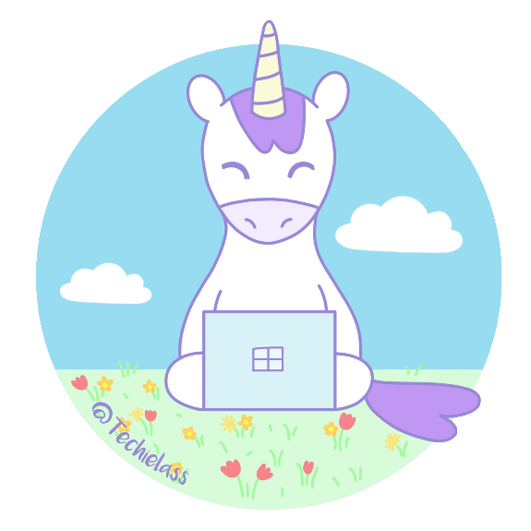
Thank you! Resources: https://g.octopushq.com/superpowers
Sarah Lean
Senior Solutions Architect
@Techielass
www.techielass.com

