Slide 1
RVC Homework Presentation
Robotics and control
Marchiotto Nicola – A.A. 20-21

Slide 2
1 Joint Space Polynomial Trajectory
Considerations:
single actuator taken into account, not considered any dynamic model
analyzed trajectories described by polynomial functions

Slide 3
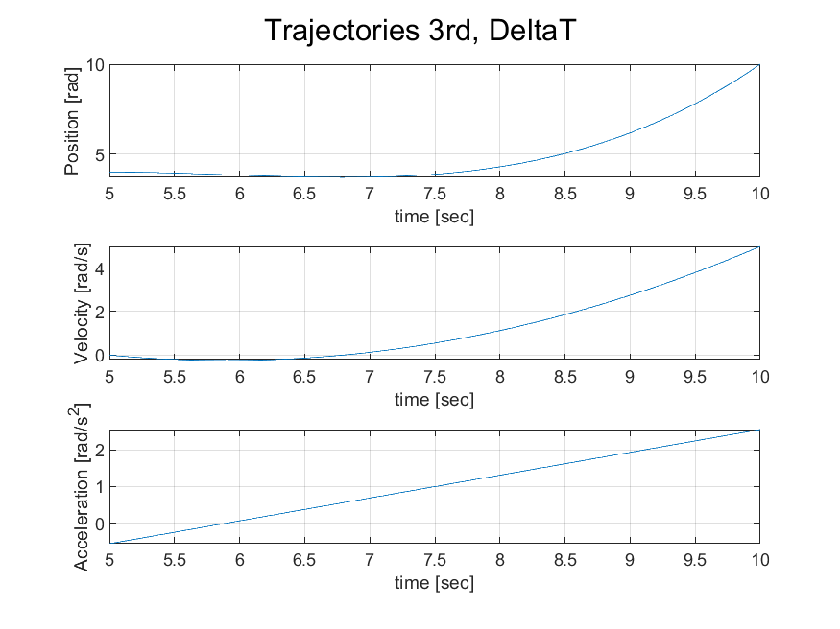
3° Degree Polynomial: ∆T
Trajectories with continuos velocity but discontinuos acceleration
∆T Formulation
Inital and final conditions:
qi=4; qf=10;
dqi=0; dqf=5;
ti=5; tf=10

Slide 4
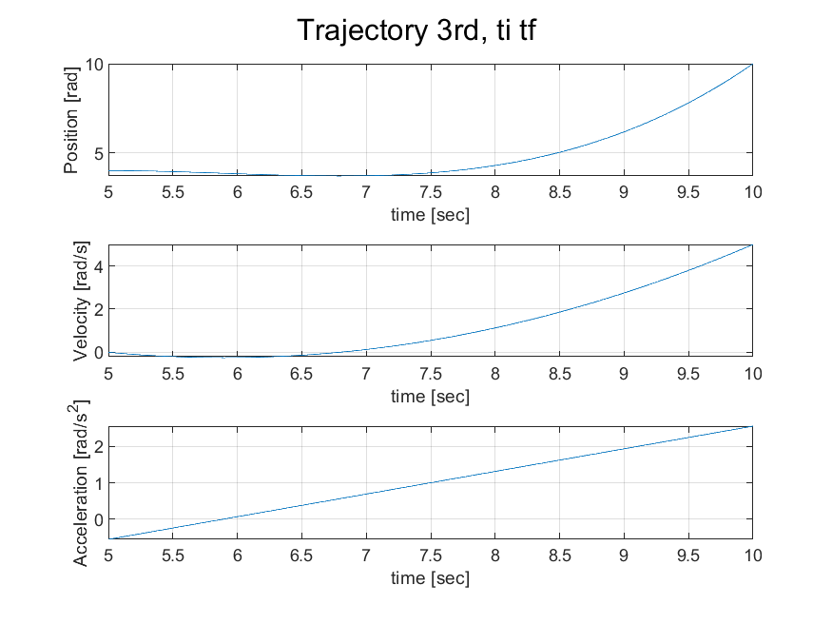
3° Degree Polynomial: ti-tf
Trajectories with continuos velocity but discontinuos acceleration
ti-tf Formulation
Inital and final conditions:
qi=4; qf=10;
dqi=0; dqf=5;
ti=5; tf=10

Slide 5
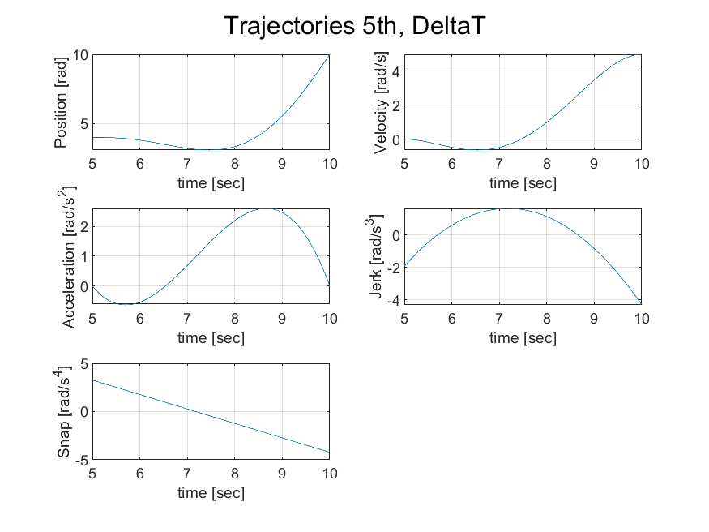
5° Degree Polynomial: ∆T
Trajectories with continuos velocity and acceleration but discontinuos jerk
∆T Formulation
Inital and final conditions:
qi=4; qf=10;
dqi=0; dqf=5;
ddqi=0; ddqf=0;
ti=5; tf=10

Slide 6
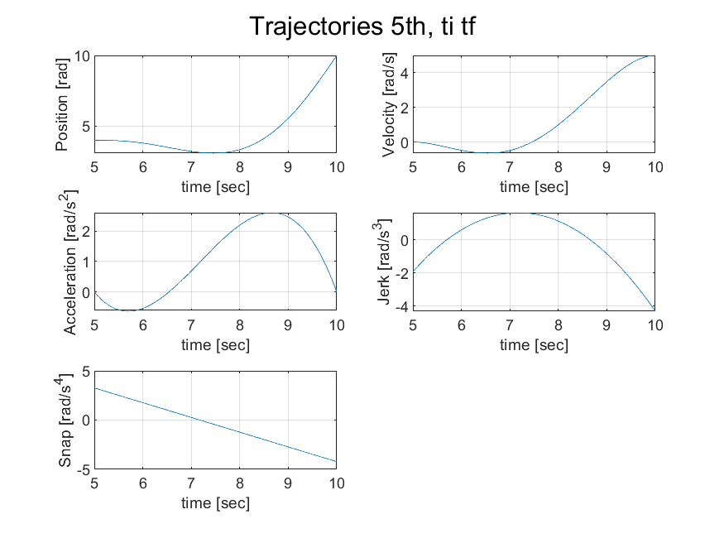
5° Degree Polynomial: ti-tf
Trajectories with continuos velocity and acceleration but discontinuos jerk
ti-tf Formulation
Inital and final conditions:
qi=4; qf=10;
dqi=0; dqf=5;
ddqi=0; ddqf=0;
ti=5; tf=10

Slide 7
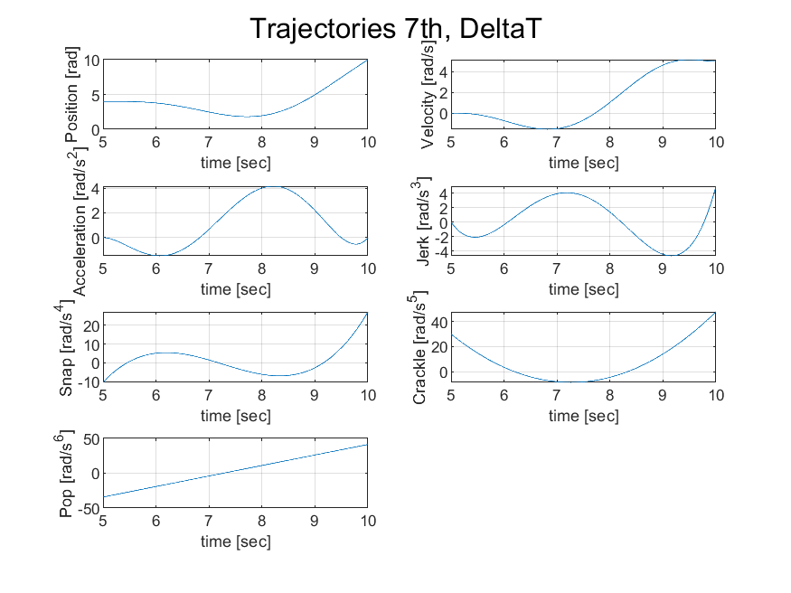
7° Degree Polynomial: ∆T
Trajectories with continuos velocity, acceleration and jerk
∆T Formulation
Inital and final conditions:
qi=4; qf=10;
dqi=0; dqf=5;
ddqi=0; ddqf=0;
ddqi=0; ddqf=5;
ti=5; tf=10

Slide 8
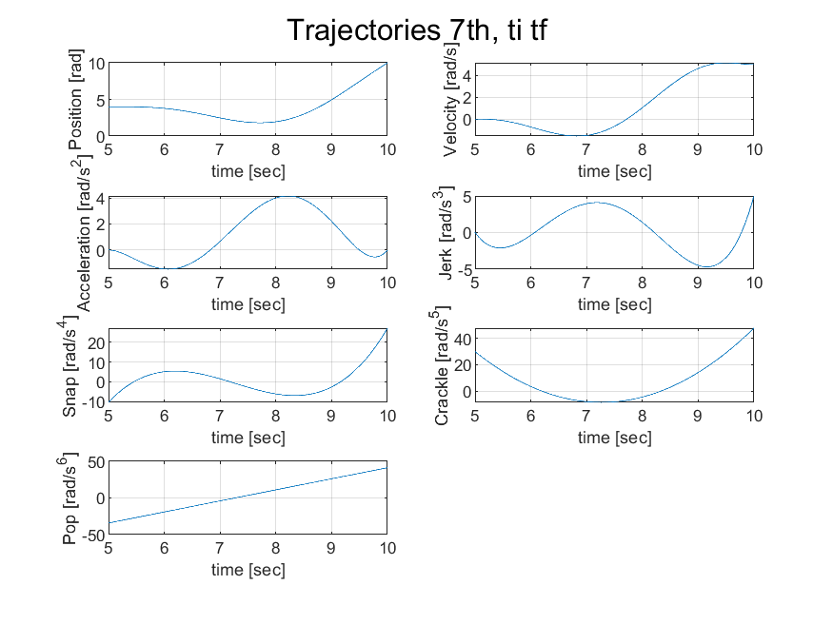
7° Degree Polynomial: ti-tf
Trajectories with continuos velocity, acceleration and jerk
ti-tf Formulation
Inital and final conditions:
qi=4; qf=10;
dqi=0; dqf=5;
ddqi=0; ddqf=0;
ddqi=0; ddqf=5;
ti=5; tf=10

Slide 9
2 Harmonic and Cycloidal Trajectory
Considerations:
Trajectory which exploit trigonometric functions
trigonometric functions have not-null continuos derivatives for any order of derivation in the interval (ti, tf)
May present discontinuoties in ti and tf

Slide 10
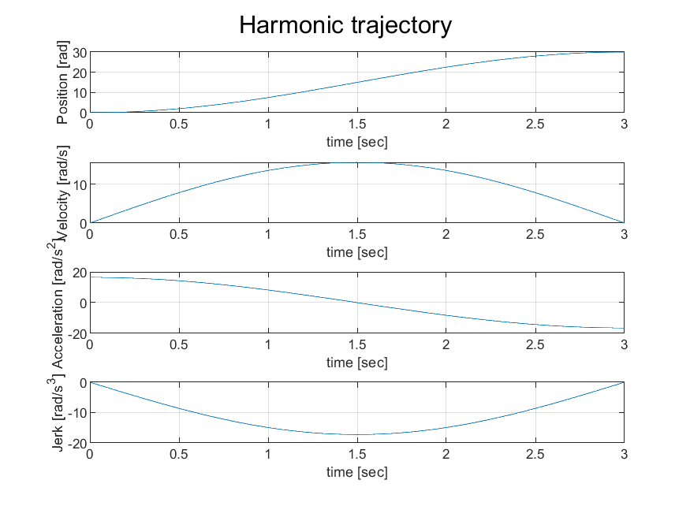
Harmonic Trajectory
Inital and final conditions:
qi=0; qf=30;
ti=0; tf=3

Slide 11
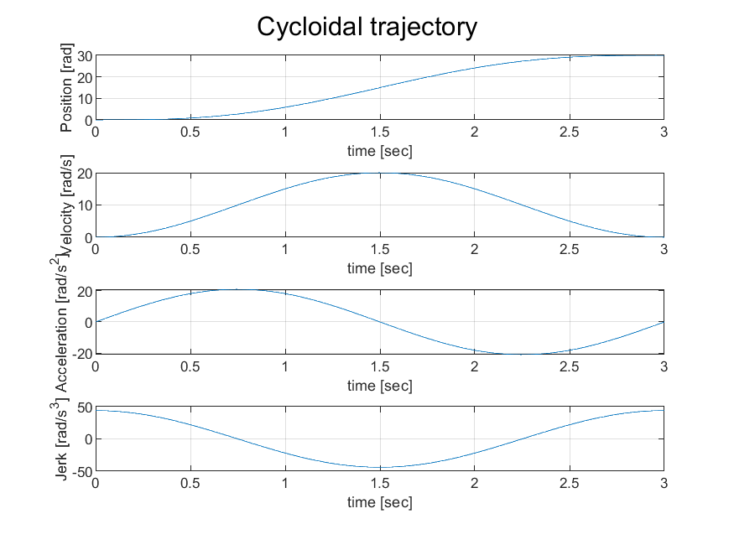
Cycloidal Trajectory
To overcome discontinuous accelerations at ti and tf, we can exploit cycloidal trajectory described by a circle rolling along a line
Inital and final conditions:
qi=0; qf=30;
ti=0; tf=3

Slide 12
3 Trapeizoidal Velocity Trajectory
Considerations:
To obtain trajectories with a continuous velocity profile, linear motions with parabolic blends are used, characterized therefore by the typical trapezoidal velocity profiles, this represent a popular solution in industrial robots.
Trajectories are divided into three parts:
1. constant acceleration in the start phase
2. constant cruise velocity
3. constant deceleration in the arrival phase

Slide 13
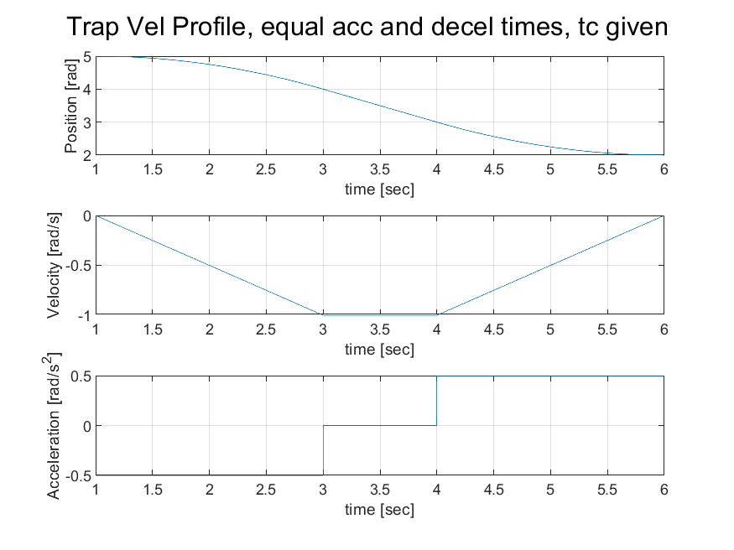
Equal acceleration and decelleration times, tc given
tc represents the duration of the acceleration and decelletation phases
Inital and final conditions:
qi=5; qf=2;
ti=1; tf=6;
tc=2;

Slide 14
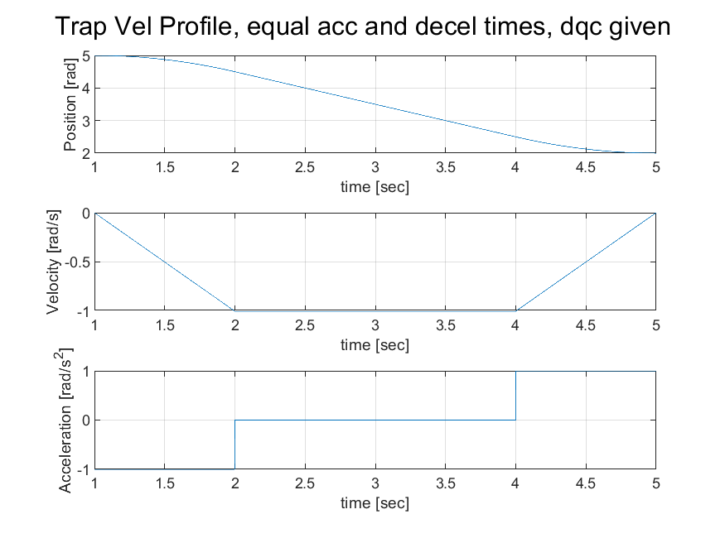
Equal acceleration and decelleration times, dqc given
dqc represents velocity in the costant velocity phase
Inital and final conditions:
qi=5; qf=2;
ti=1; tf=5;
dqc=1;

Slide 15
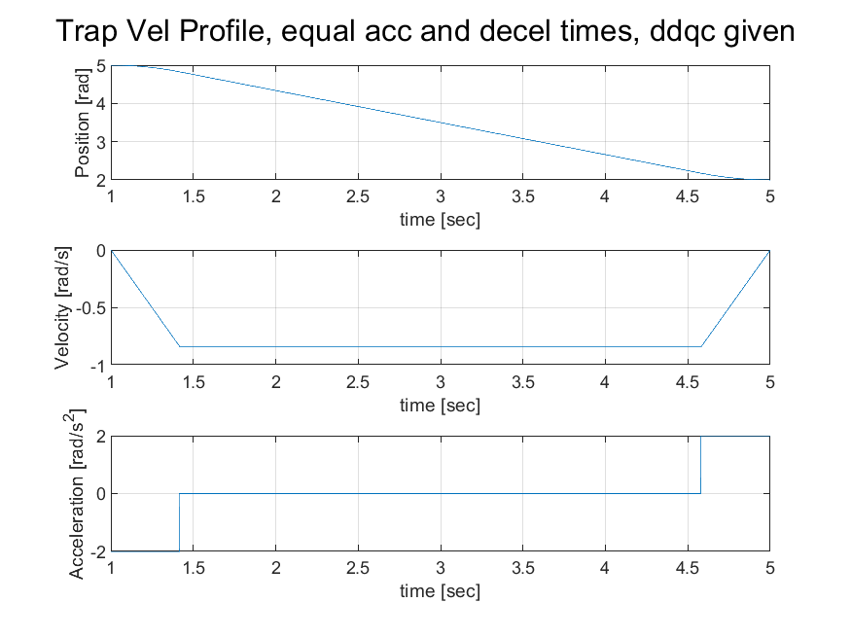
Equal acceleration and decelleration times, ddqc given
ddqc represents the acceleration in the acceleration and decelleration phases
Inital and final conditions:
qi=5; qf=2;
ti=1; tf=5;
ddqc=2;

Slide 16
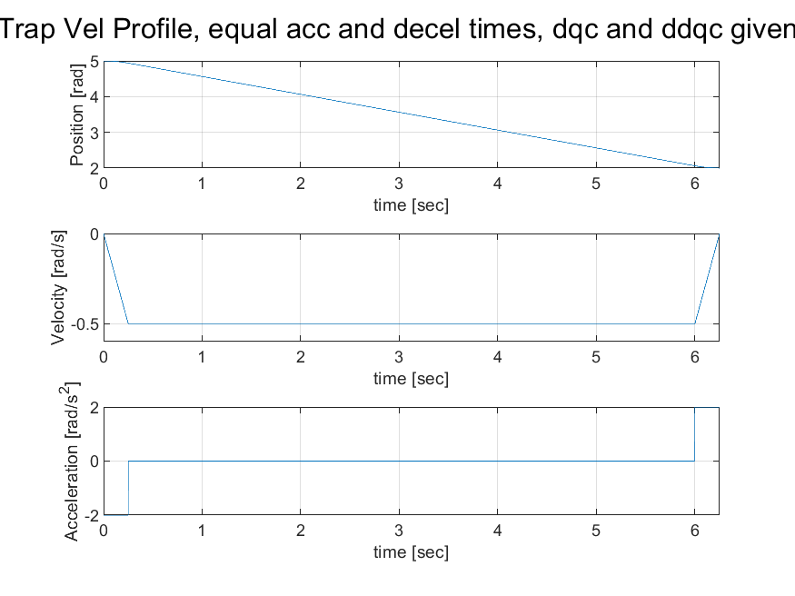
Equal acceleration and decelleration times, ddqc given
dqc represents the velocity in the costant velocity phase
ddqc represents the acceleration in the acceleration and decelleration phases
Inital and final conditions:
qi=5; qf=2;
dqc=0.5; ddqc=2;

Slide 17
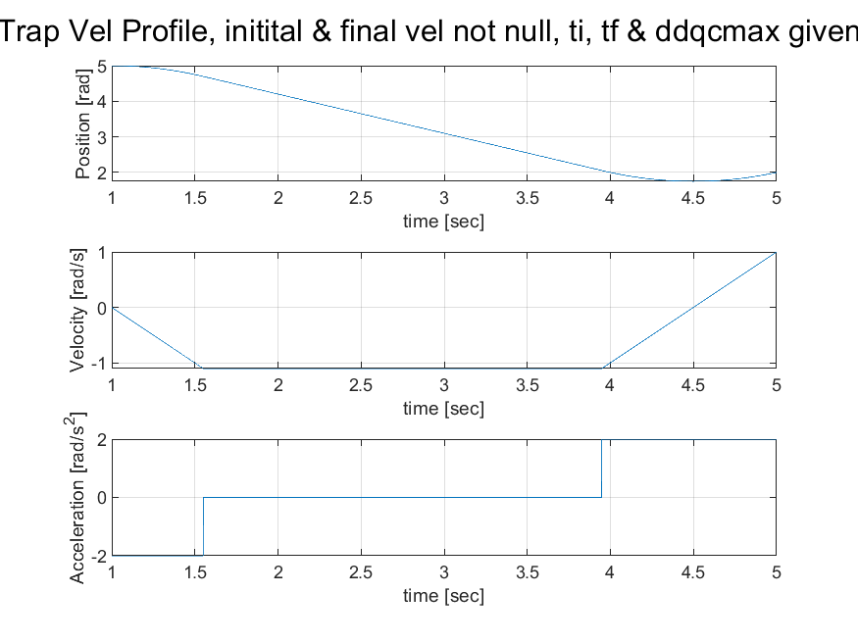
Initial and final velocities can be not null, preassigned duration and ddqcmax
ddqcmax represents the preassigned maximum acceleration in the acc/decc phases
Inital and final conditions:
qi=5; qf=2;
dqi=0; dqf=1;
ddqcmax=2;
ti=1; tf=5;

Slide 18
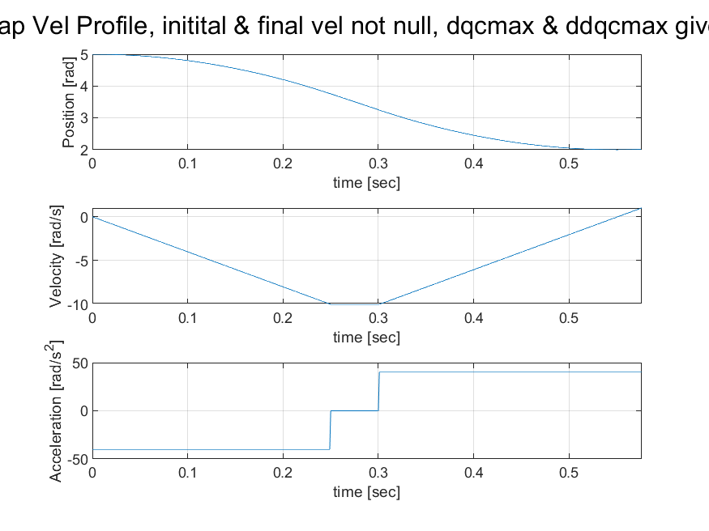
Initial and final velocities can be not null, preassigned dqcmax and ddqcmax
dqcmax represents the preassigned maximum velocity in the acc/decc phases
ddqcmax represents the preassigned maximum velocity in the costant velocity phase
Inital and final conditions:
qi=5; qf=2;
dqi=0; dqf=1;
dqcmax=10
ddqcmax=40;

Slide 19
4 Double S Trajectory
Considerations:
The trapezoidal velocity motion profile presents a discontinuous acceleration
A smoother motion profile could be defined by adopting a continuous, linear piece-wise, acceleration profile
The Double S velocity profile is is composed by linear segments connected by parabolic blends
The jerk is characterized by a step profile instead of by an impulsive jerk profile as in the trapezoidal velocity motion.
Assumptions
dqmax=dqmin, -ddqmax=-ddqmin, dddqmax=-dddqmin, ddqi=ddqf=0
The values max and min are the preassigned max and min values assumed by the various splines

Slide 20
4 Double S Trajectory
We can distinguish 3 phases
Acceleration phase [0,ta]
Maximum velocity phase [ta,ta+tv]
Deceleration phase [ta+tv,tf]
Notation
Tj1=time interval in which the jerk is constant during the acceleration phase
Tj2=time interval in which the jerk is constant during the deceleration phase
Possible cases:
Let dqlim=max(dq(t))
1: dqlim = dqmax → maximum imposed velocity is reached
2: dqlim < dqmax → maximum imposed velocity is not reached
Analogously ddqlim=max(ddq(t))

Slide 21
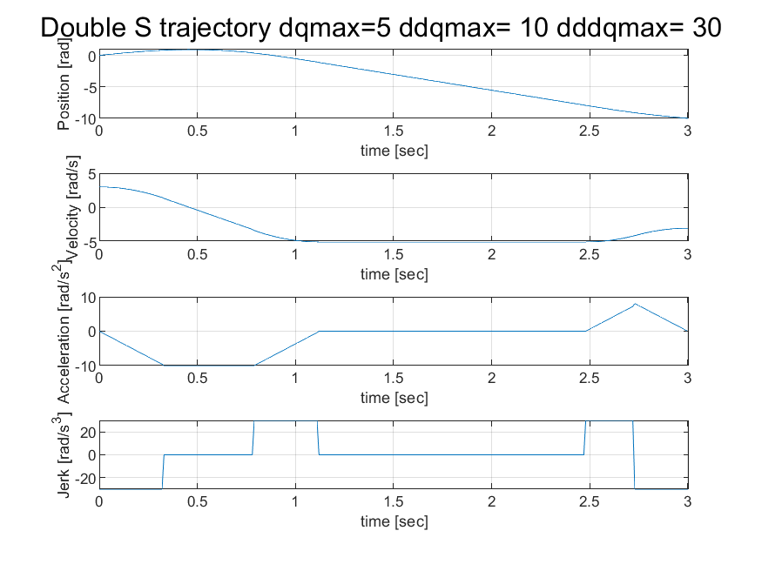
Double S Trajectory given dqmax ddqmax dddqmax
Inital and final conditions:
qi=0; qf=-10;
dqi=3; dqf=-3;
dqmax=5;
ddqmax=10;
dddqmax=30;
ti=0;
Results
ta: 1.13
tv: 1.36
td: 0.52
Tj1: 0.33 Tj2: 0.26
dqlim: 5.0
ddqdlim: -7.74
ddqalim: 10.00

Slide 22
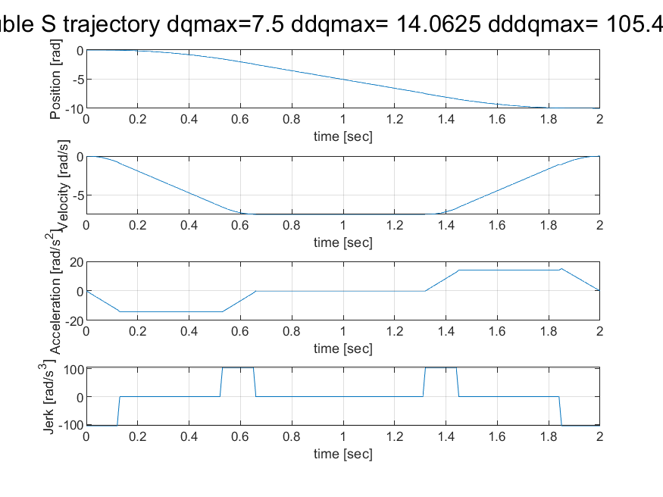
Double S Trajectory with preassigned duration
Inital and final conditions:
qi=0; qf=-10;
∆T=2;
α=1/3 β=1/2
Results
ta=td: 0,67
tv: 0,67
Tj1=Tj2: 0.14
dqmax: 7.50
ddqmax: 14.06
dddqmax: 105.47
dqlim: 7.50
ddqdlim: - 14.06
ddqalim: 14.06

Slide 23
5 Joint Space - Multipoint Trajectories
Trajectories through a sequence of points, considered interpolation and approximation problems
INTERPOLATION: Given n + 1 pairs (qk ; tk ), design a trajectory such that the end-effector passes by each point qk (path points, via points) at a specific instant of time tk.
Implemented solution: a suitable number of low-order interpolating polynomials (motion primitives) continuous at the path points, cubic polynomial chosen for the problem.

Slide 24
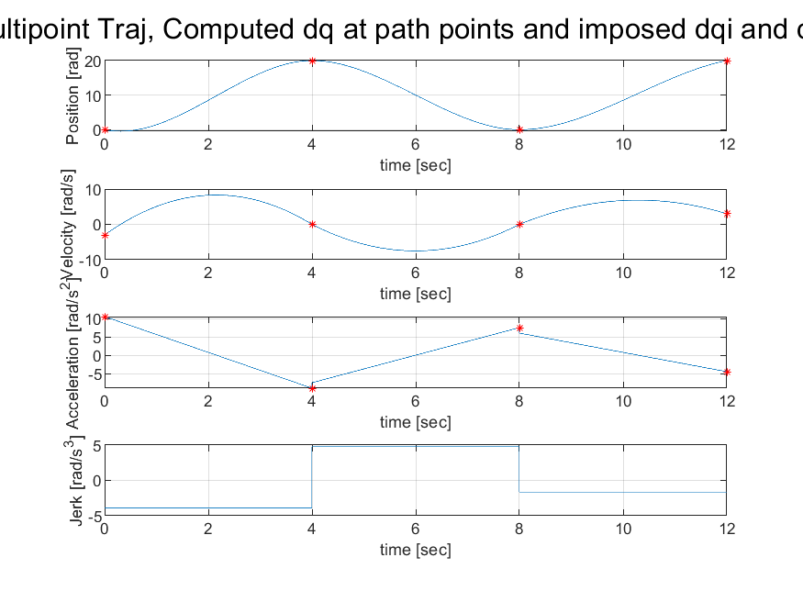
Multipoint Interpolation: computed velocities at path points and imposed dqi and dqf
Continuos velocity profile but discontinuities in the acceration may be present
Input :
qk=[0 20 0 20];
tk=[0 4 8 12];
dqi=-3; dqf=3;

Slide 25
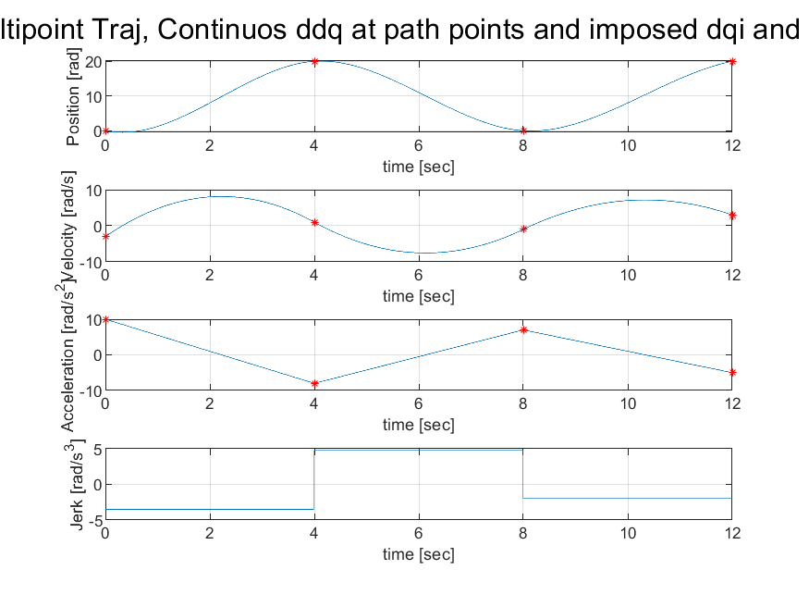
Multipoint Interpolation: continuos accelerations at path points and imposed dqi and dqf
Input :
qk=[0 20 0 20];
tk=[0 4 8 12];
dqi=-3; dqf=3;

Slide 26
6 Joint Space - Multipoint Trajectories
Trajectories through a sequence of points, considered interpolation and approximation problems
INTERPOLATION: Given n + 1 pairs (qk ; tk ), design a trajectory such that the end-effector passes by each point qk (path points, via points) at a specific instant of time tk.
Implemented solution: a suitable number of low-order interpolating polynomials (motion primitives) continuous at the path points, cubic polynomial chosen for the problem.

Slide 27
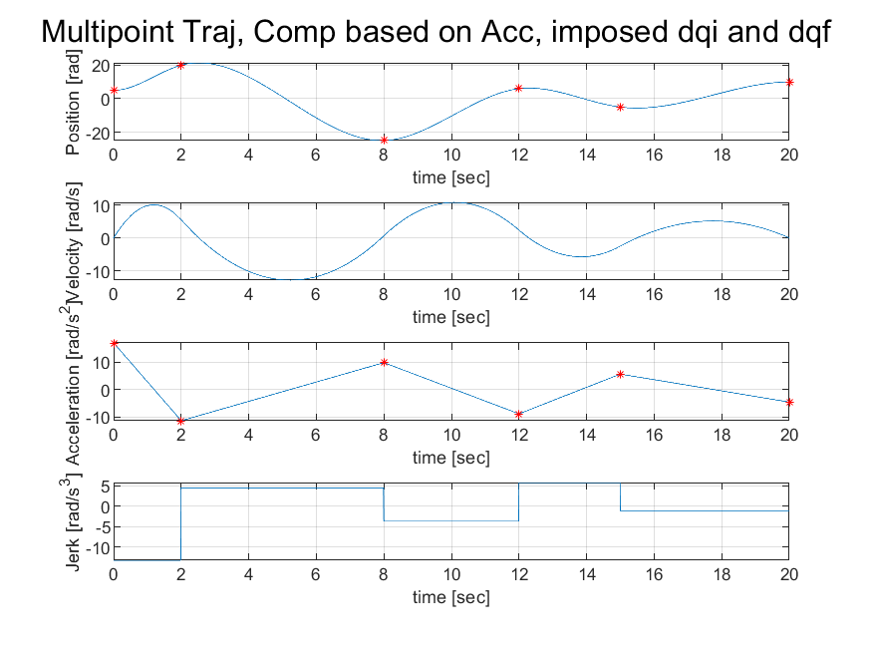
Multipoint Interpolation: continuos accelerations at path points and imposed dqi and dqf, computation based on acceleration
Input :
qk=[5 20 -25 6 -5 10];
tk=[0 2 8 12 15 20]
dqi=0; dqf=0;

Slide 28
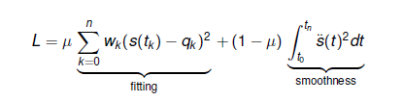
6 Joint Space - Multipoint Trajectories
APPROXIMATION: Smoothing cubic splines are designed to approximate and not interpolate a set of given points, the approzimated trajectory is the solution of a minimization problem which metric L is a tradeoff between two opposite goals:
The fitting of the given via points
The smoothness of the resultant trajectory
μ ∈ [0; 1] weights the trade-off between the two conflicting goals
wk are parameters which can be arbitrarily chosen in order to modify the weight of the k-th quadratic error on the global optimization problem
If wk=0, the smoothed polynomial will pass exactly through the qk point, as wk increase more margin will be allowed

Slide 29
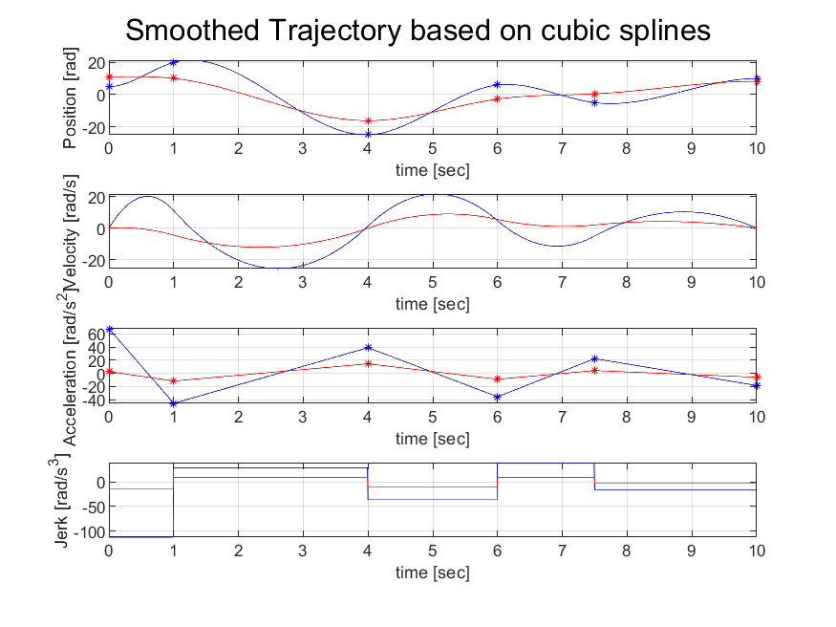
Smoothing Cubic Splines
Blue splines: Interpolated
Red splines: Smoothed
Input:
qk=[5 20 -25 6 -5 10];
tk=[0 1 4 6 7.5 10];
mu=0.7;
w_vec=[1 1 1 1 1 1];

Slide 30
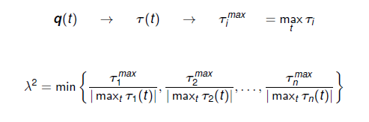
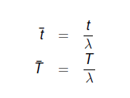
7 Joint Space - Multipoint Trajectories Model Based Trajectory Planning
SCALING IN TIME: The scaling in time is usefull when we have to satisy the following constraints:
Kinematic saturation: limits on velocity and acceleration, abs(dq(t))<=max(dq(t))
Dynamic saturaton: limits on the torques requested by the motors, abs(τ(t))<=max(τ(t))
DYNAMIC COSTRAINT
Let q(t) be the planned trajectory. The scaling factor λ can be used to increase (λ< 1) or decrease (λ > 1) the duration in order to allow for at least to one torque to be equal to the maximum value.

Slide 31
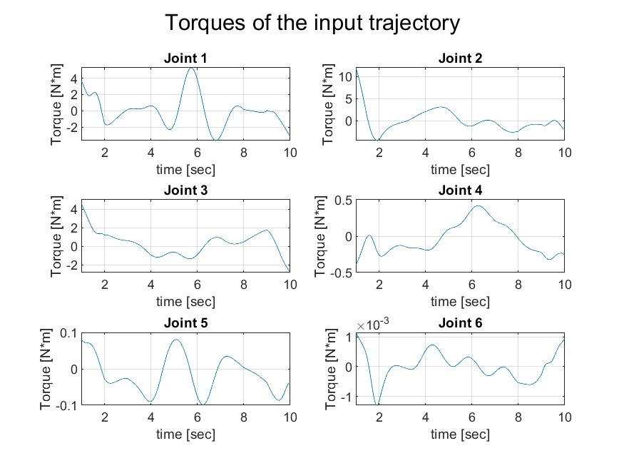
Model based trajectory planning
Initial trajectory computed with computation based on acceleration, used the same trajectory for all 6 joints
Torques computed with inv_dyn_recursive_NewtonEulero
Inputs:
qk=[1 2 3 4 5 6 7 8 9 10];
tk=[1 2 3 4 5 6 7 8 9 10];
∆T=9; dqi=0; dqf=0;

Slide 32
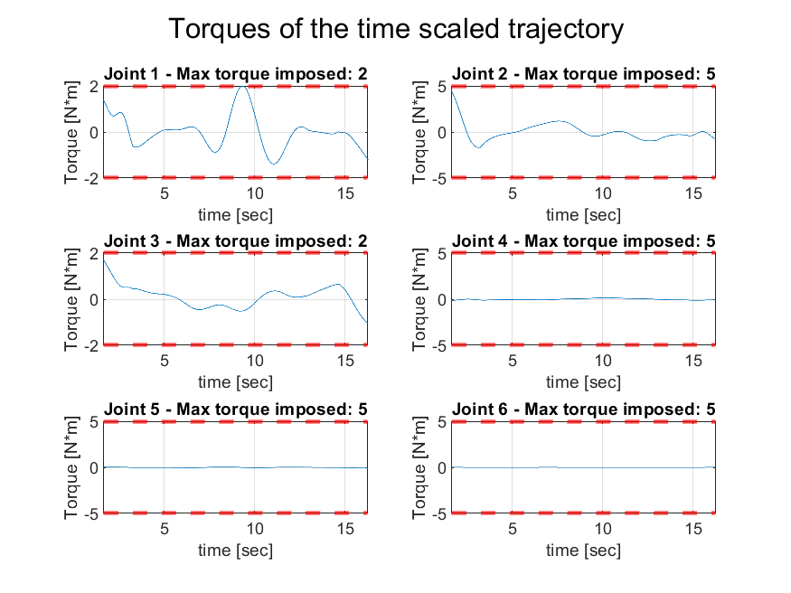
Model based trajectory planning
Inputs:
tau1_max=2;
tau2_max=5;
tau3_max=2;
tau4_max=5;
tau5_max=5;
tau6_max=5;
Results
λ = 0.6153;
∆T = 14.6275

Slide 33
8 Operational Space Trajectories Motion Primitives
In 3D Trajectory planning we have to take care of the geometry of the trajectory, the path p(u), and the motion timing law t=u(t)
Let p ∈ R³ be a Cartesian point given by p =f (u) where u ∈ [u_{i} ; u_{f} ] is the parameter of the function f. p(u) is the parametric representation on the path with
pi := p(u_{i}) = f(u_{i}) initial point
pf := p(u_{f}) = f(u_{f}) final point
We will refer to motion primitives for the geometric features of the path and to time primitives for the timing law on the path itself.
This assignment present a path composed by rectilinear and circular sub-path

Slide 34
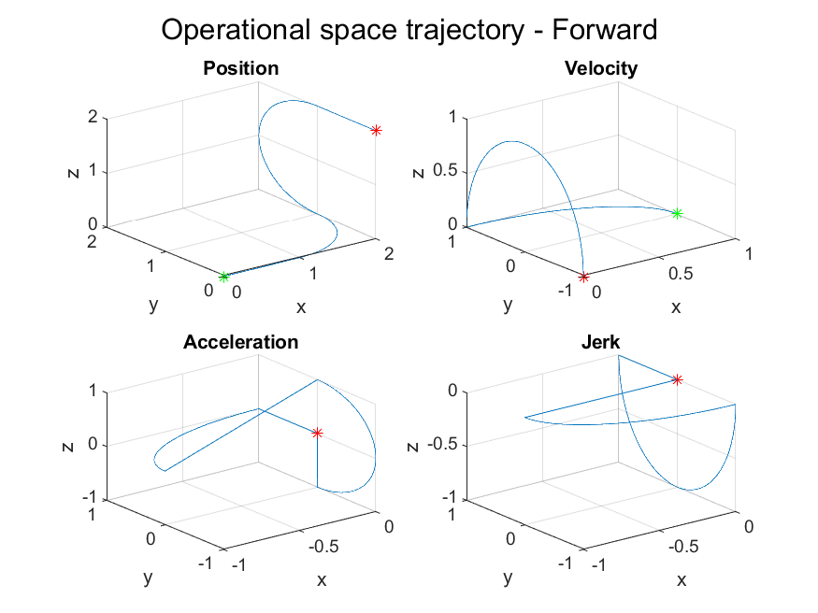
Trajectory composed by motion primitives
Forward path
Inputs: Via points
[0 0 0]
[1 0 0]
[2 1 0]
[2 1 2]
[2 0 2]

Slide 35
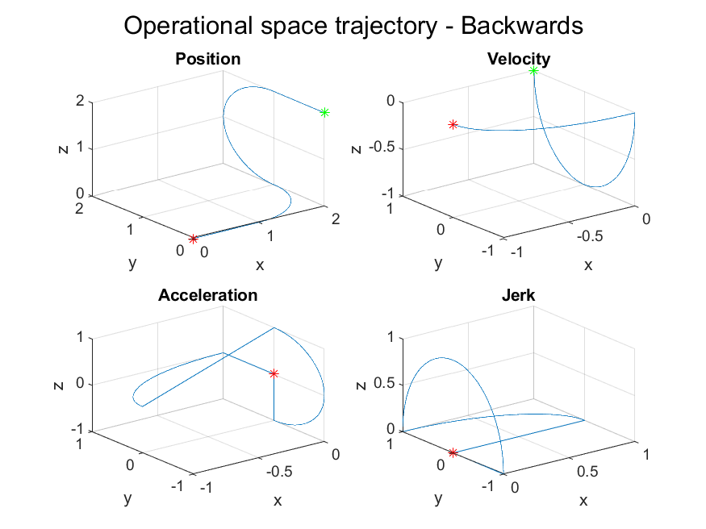
Trajectory composed by motion primitives
Backward path
Inputs: Via points
[2 0 2]
[2 1 2]
[2 1 0]
[1 0 0]
[0 0 0]

Slide 36
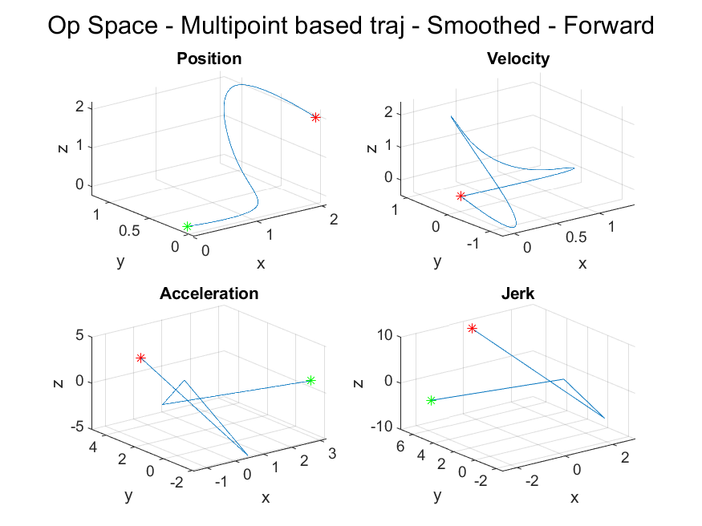
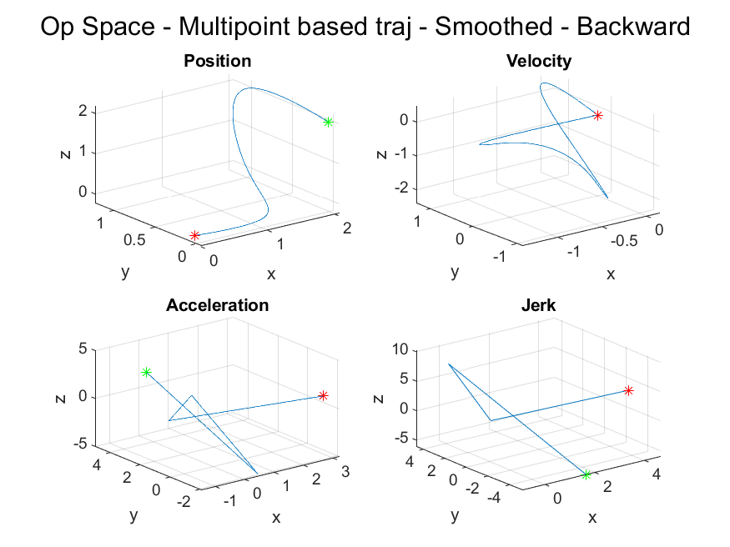
Multipoint Trajectory vs Motion Primitives
Trajectory computed using the smoothed cubic splines trajectory with the same via points, component by component and imposing interpolation conditions at the same time instants

Slide 37
9 Shortest Trajectory connecting 3 points on a sphere
Let p1, p2, p3 three points on a sphere of center p0 and radius R. Design the trajectory such that
The EE will pass through the three points along the shortest path,
the z axis of the EE is always orthogonal to the sphere.
The assignment has been performed by composing a path as followed:
Given 3 points on the sphere, find the pair whose circular segment connecting the two is larger w.r.t. the other pairs of points, discard this pair and compose a path composed by 2 circular segment with centre the origin of the sphere and extremes the points of the remaining 2 pairs, the resultant path will be called sphere_path.
Compute a rectilinear path from the UR5 default start position to the closer point between the starting and ending point of the sphere_path, if the closer point is the last of the sphere_path, flip this latter.
The overall path will be rectilinear_path + sphere_path
The trajectory is obtained using 5th_order_polynomials connecting the first and the last point of each path segment with initial and final velocity and acceleration equal to 0

Slide 38
9 Shortest Trajectory connecting 3 points on a sphere
The orientation of the EE has been computed by analyzing the Frenet Frame of each section of the path and retrieving the corresponding Euler angles
The trajectory related to the orientation has been computed in the rectilinear segment using as initial orientation the default UR5 start orientation and as final the one given by the first point of first circular segment of the sphere_path, whose normal is perpendicular to the sphere.
The circular segments orientation has been computed using as initial orientation the orientation of the first point the circular segment in cosideration, computed by the corresponding Frenet frame, and as final orientation the one given by the last point of the circular segment, always computed by the corresponding Frenet frame.
The Trajectory related to the orientation has been computed using 5th_order_polynomials to obtain initial and final angular velocity and acceleration in each segment.

Slide 39
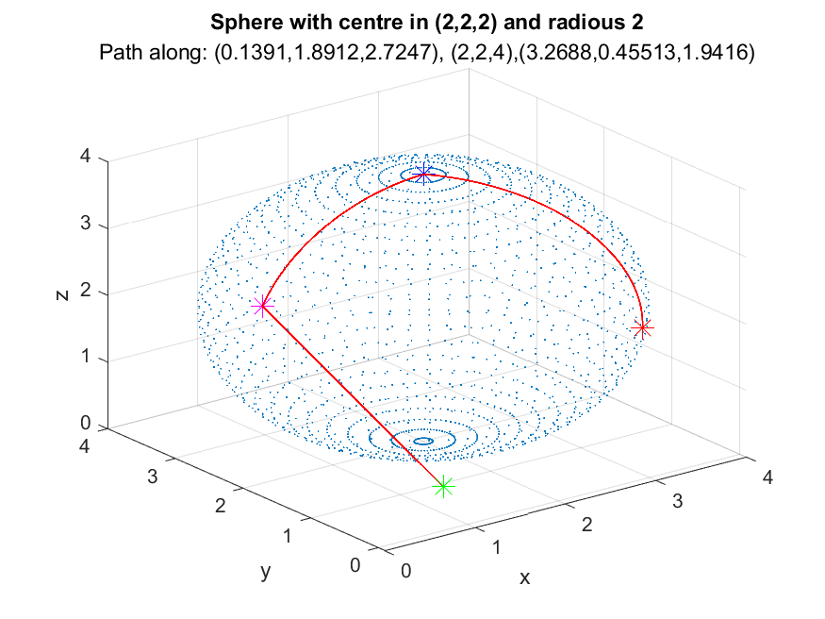

Slide 40
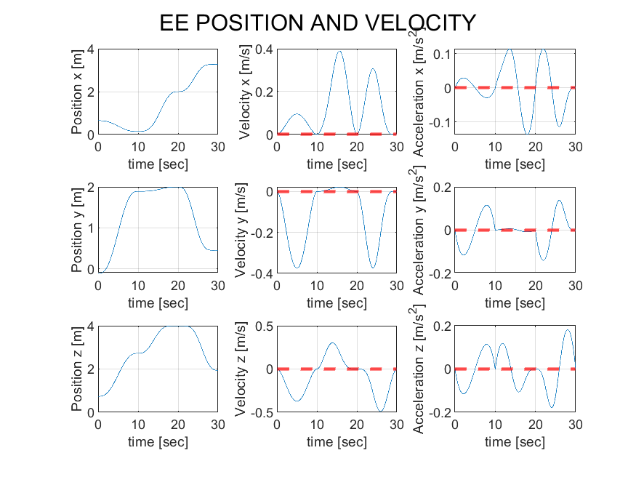

Slide 41
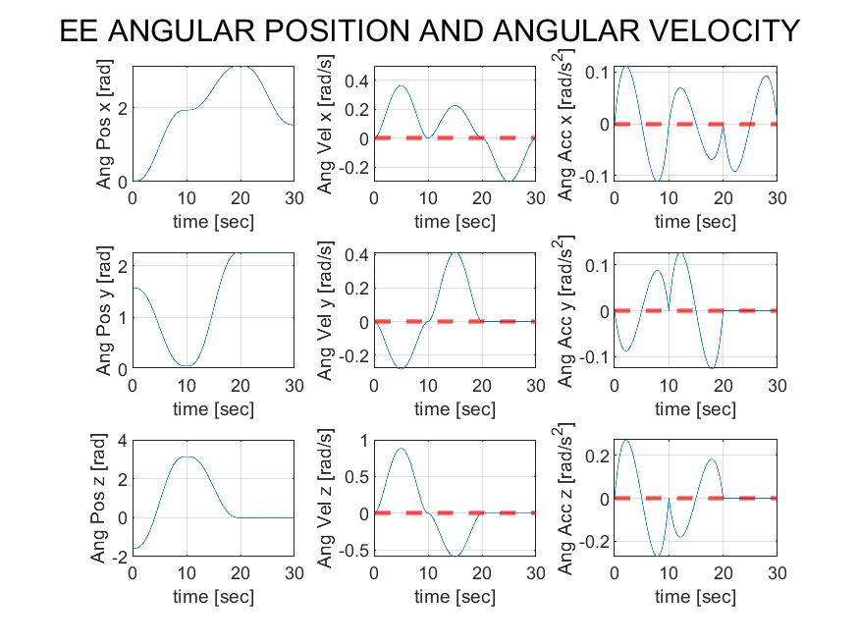

Slide 42
RVC Homework Presentation
Vision
Marchiotto Nicola – A.A. 20-21

Slide 43
1.1: Find a public dataset of range images from different acquisition systems
The dataset contains cropped RGB images and depth data (collected from a Microsoft Kinect) of ASL (American Sign Language) handshapes corresponding to 24 letters of the English alphabet, "X" and "Z" are excluded since they rely on movements.
https://www.kaggle.com/mrgeislinger/asl-rgb-depth-fingerspelling-spelling-it-out

Slide 44
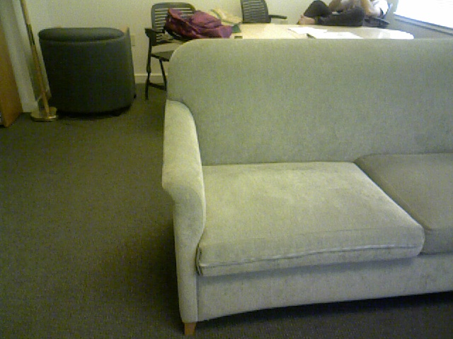
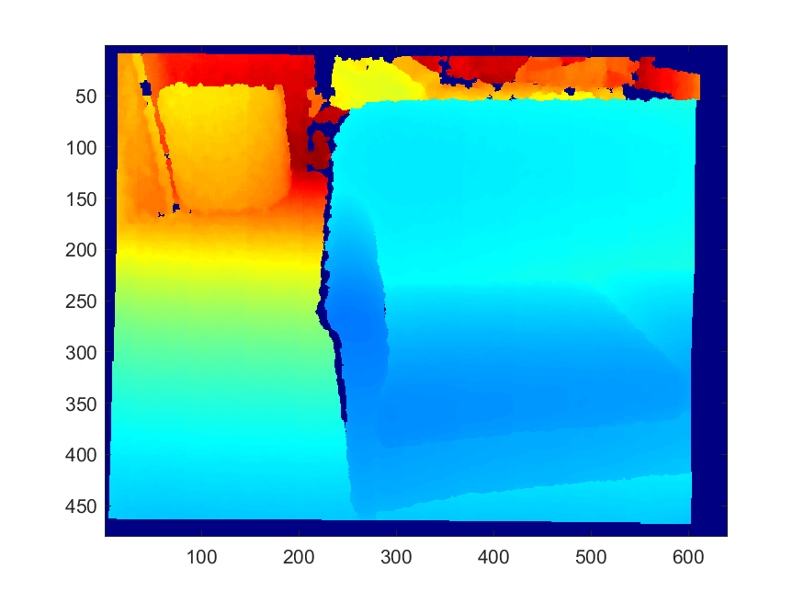
Starting image, RGB and depth version

Slide 45
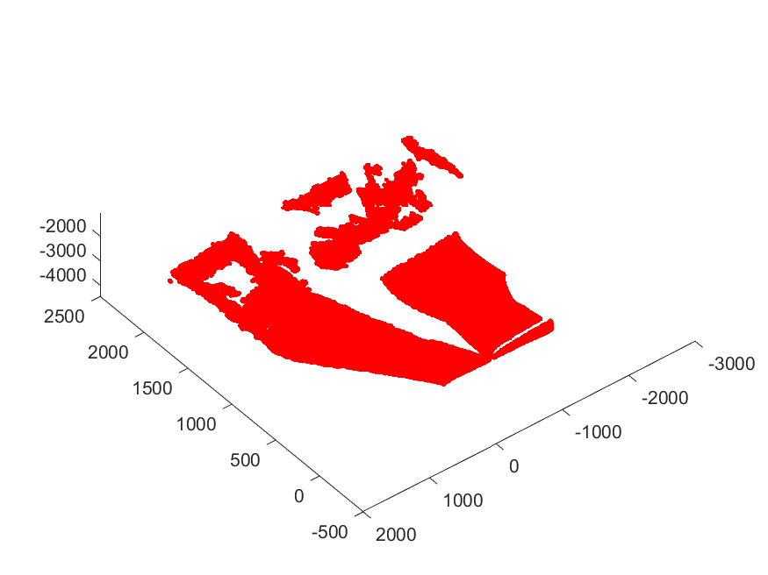
1.2: Create a 3D cloud of points from a range image

Slide 46
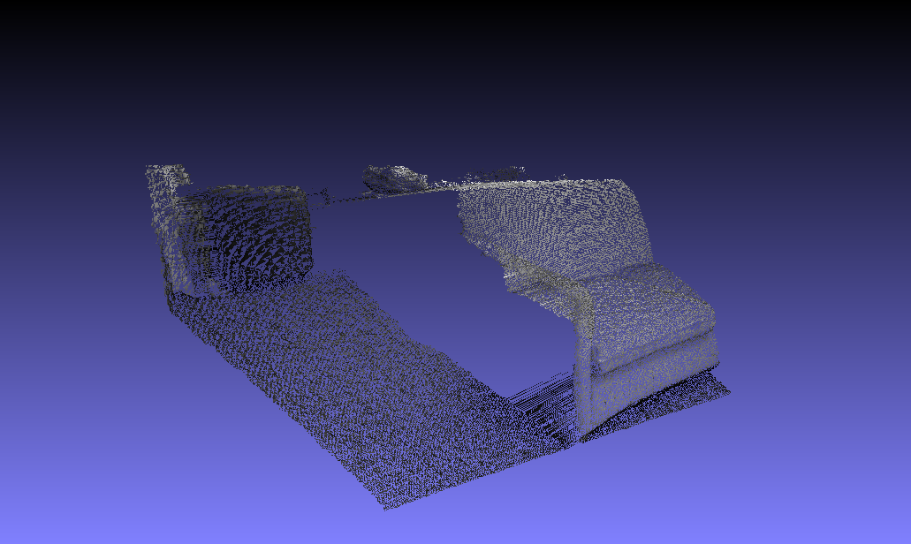
1.3: Mesh reconstruction from range image

Slide 47
2: Image analysis
Goal: Recognize in the proposed images various obejct using the tecniques seen in the lectures related to Image Analysis.
The cited tecniques involve morphological operations like binarization, opening, or closing. The concepts of regions, connected components, bounding box, elongation, eccentricity and others have been also used to obtain the objectives of the assignments.

Slide 48
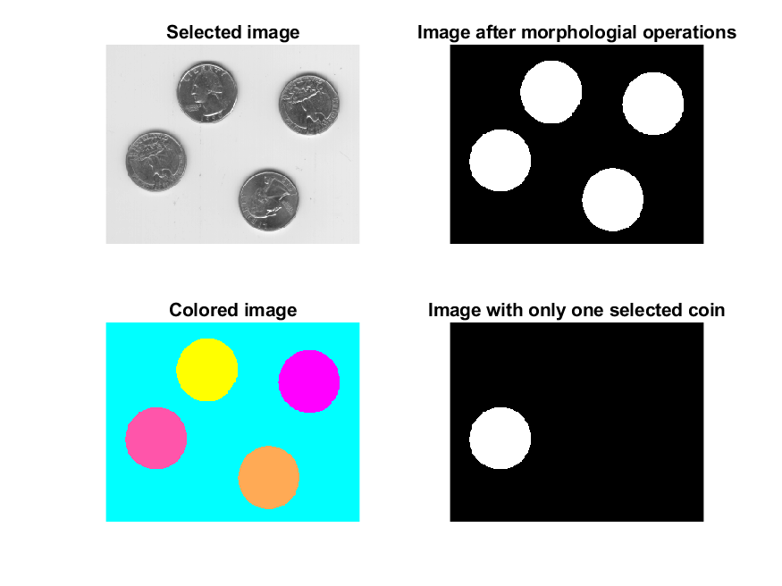
Image Analysis: HW 1
Obtain same results of exercise 1 (not reported here) with coins image

Slide 49
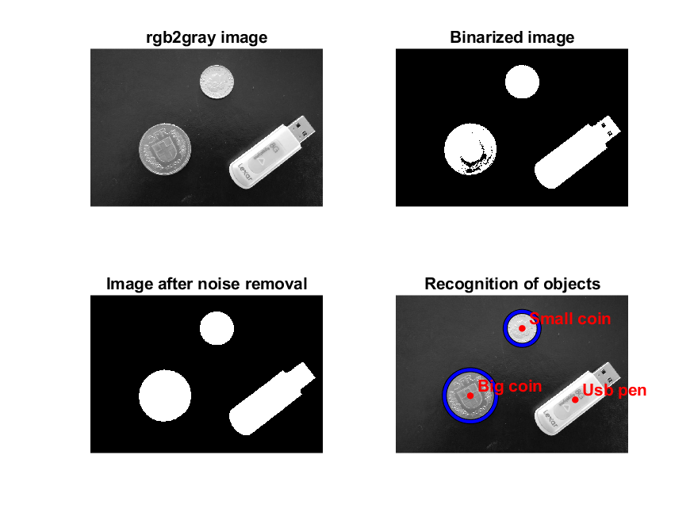
Image Analysis: HW 2
Use morphological operators and region properties to infer information about shape and size of objects in the image

Slide 50
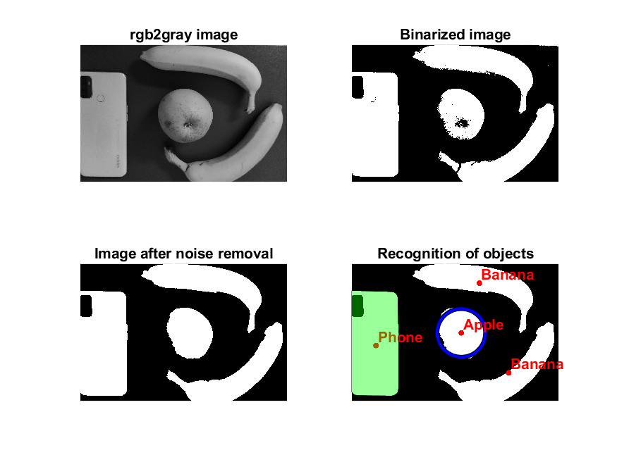
Image Analysis: HW 3
Use morphological operators and region properties to infer information about shape and size of objects in an image of our choice

Slide 51
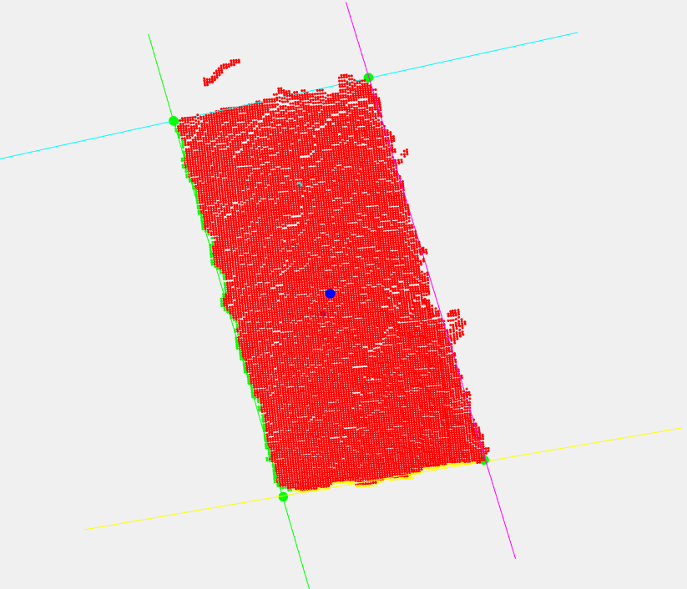
3: 3D Analysis
Implement the following methods to achieve the result seen in the lecture
Plane Fitting
Point to plane distance computation
Point to plane projection
Line fitting
Point to line projection
Angle between two lines
Two lines intersection
Robust line fitting

Slide 52
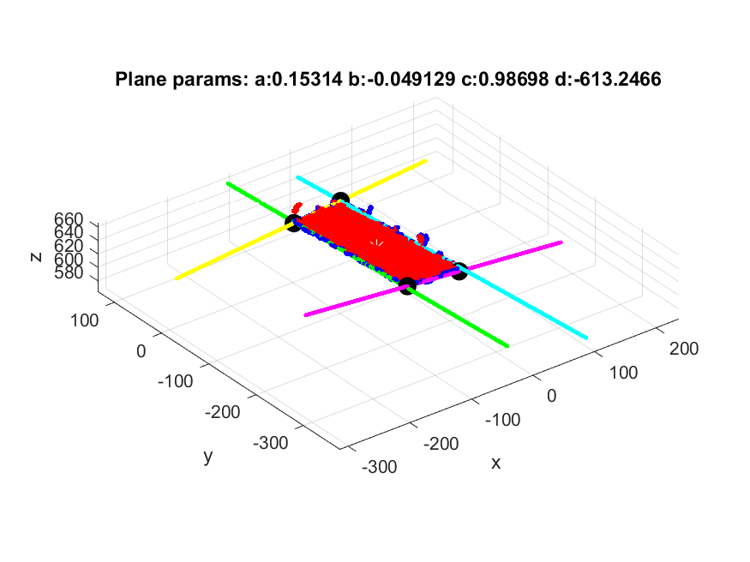

Slide 53
