Slide 1

PLAN4ARI

Slide 2
The RATIONALE
Plan4ARI identifies four levels at which AI can dramatically improve the use of robots in an industrial context.
A robot is intelligent if the user can describe the task to be tackled instead of coding
A robot is intelligent if it can autonomously solve how to tackle a task, considering other agents (robots or humans) inside the operative scene
A robot is intelligent if it can plan its movement considering the context and preserving safety under all the operative conditions
A robot is intelligent if it can move and react appropriately during the execution of tasks according to the scene evolution
Notes:
2

Slide 3
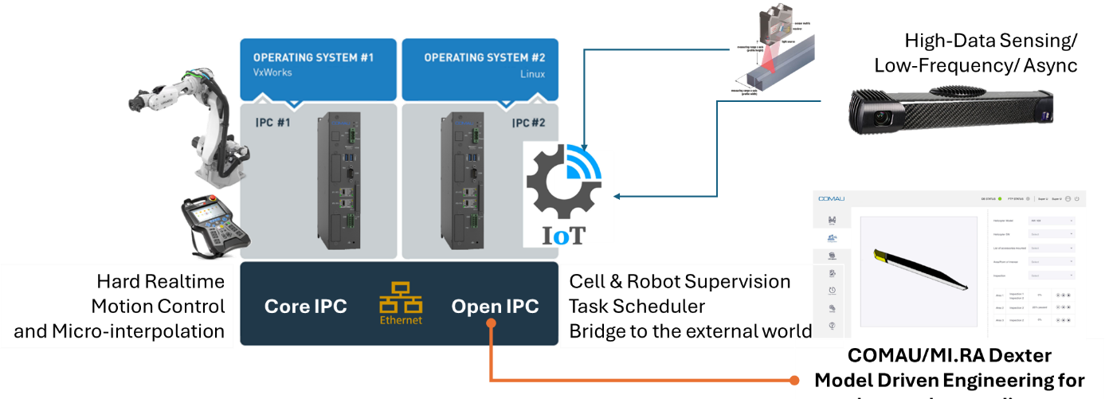
AI = IPC + Add-ons
The idea was to extend the COMAU’s new controller with a set of tools to expand the controller abilities

Slide 4
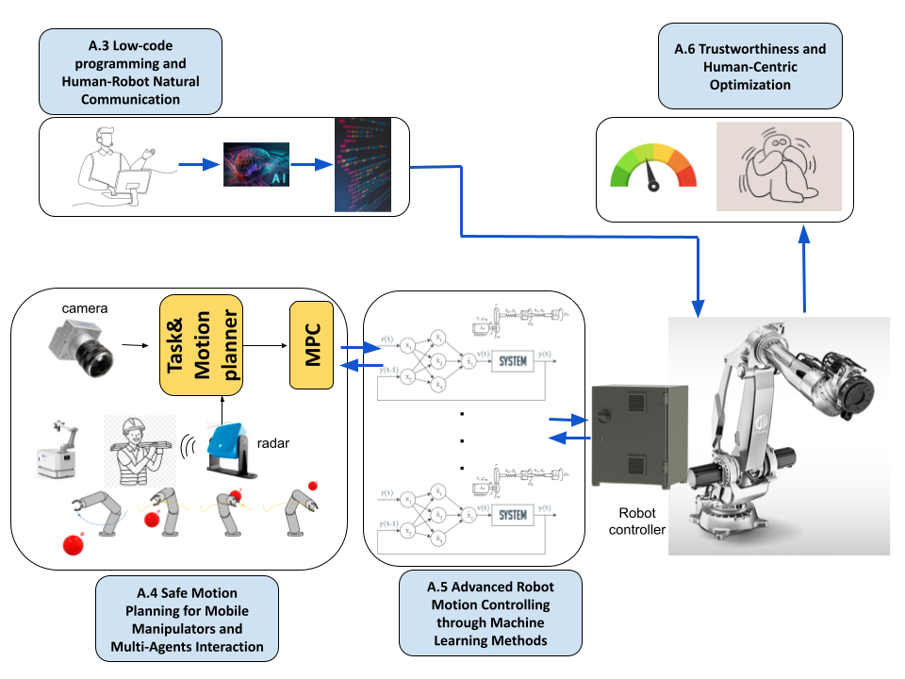
AI = IPC + Add-ons
The idea was to extend the COMAU’s new controller with a set of tools to expand the controller abilities

Slide 5
GANTT
1 Management Work Package
5 Technical Work Packages
1 Demonstrative Work Package
1 Dissemination Work Package

Slide 6
Low-Code
A2

Slide 7
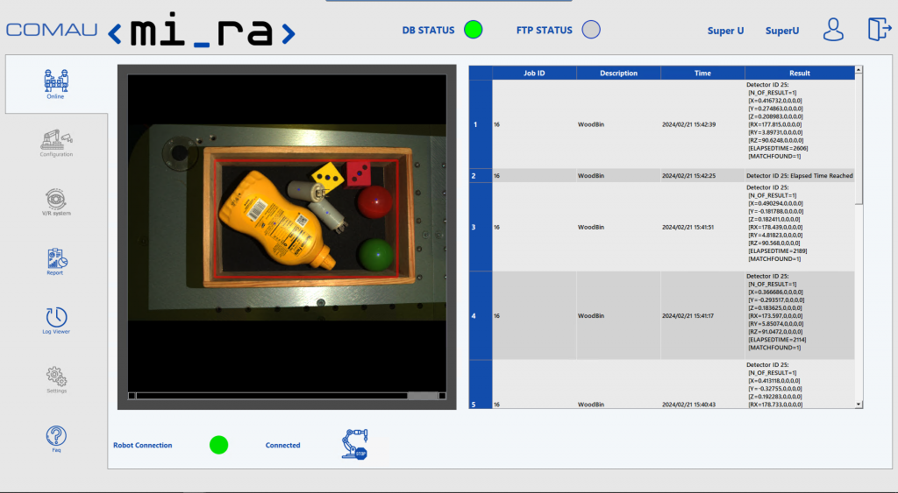
LOW-CODE
From Low-Code to AI Agents
Integration with MI.RA/Dexter
LLM for generating a Knowledge Base
LLM for generating the Problem description (PDDL)
Deterministic Solvers (and heuristic for durative actions with variance)
Integrating Behaviour Trees for execution/expand MI.RA Dexter to integrate BT

Slide 8
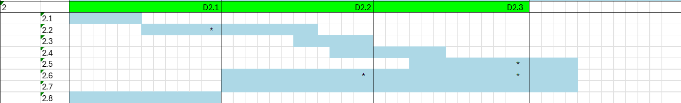
A2 - Activities
Task 2.1 Update of the scientific plan with the last state-of-the-art methodologies and tools [Fundamental Research]
Task 2.2 PDDL2 Generation for Robotic Tasks with Lightweight LLM from Natural Language [Fundamental Research]
Task 2.3 PDDL2 to Behavior Tree Generation with time-variance modeling to integrate variability [Industrial Research]
Task 2.4 Task and Motion Planning Optimization in Digital Twin Environment [Industrial Research]
Task 2.5 Optimal BehaviorTree Execution and Online Replanning [Industrial Research]
Task 2.6 Integration of the Task Planning Framework inside MI.RA/Dexter low-code [Industrial Research]
Task 2.7 Continuous Integration [Industrial Research]
Task 2.8 Benchmarking and Evaluation [Industrial Research]

Slide 9
A.2 Roles
      PI Role
The PI will coordinate the activity and be part of the team that designs the methodology, its deployment, implementation, and testing.
The full team will have a one-week touch point focused on presenting the results to the PI and the Host Institution Responsible for the MI.RA/Dexter platform.
      Research Organization
The research organisation will invest more than 30% of the budget. The team will be composed of a Senior Researcher and a fellow.
They will define the methodology and implement it using the first ad-hoc platform and then (from half-project to the end) inside MI.RA/Dexter.
      Host Institution
The Host Institution will invest about 35% of the budget. The team will comprise the top figures responsible for the cognitive platform development, the development team, and the innovation team.
The innovation team will lead the project's goal, and it will lead the development of a use case that will verify the quality of the outcomes.

Slide 10
Sensing for Context Awareness
A3

Slide 11
Sensing for Context Awareness
Deep learning techniques for autonomous robot registration LLM for generating the Problem description (PDDL)
The integration of radar sensors to track the human inside the scene.
Sensor fusion (camera & radar)
Connection between KB and tools for the scene understanding

Slide 12
A3 - Activities
Task 3.1 Update of the scientific plan with the last state-of-the-art methodologies and tools [Fundamental Research]
Task 3.2 Radar sensor integration for scene monitoring [Industrial Research]
Task 3.3 Fusion of radar sensor data and camera data [Industrial Research]
Task 3.4 Semantic Segmentation [Industrial Research]

Slide 13
Local and Global Autonomous Motion Planning
A4

Slide 14
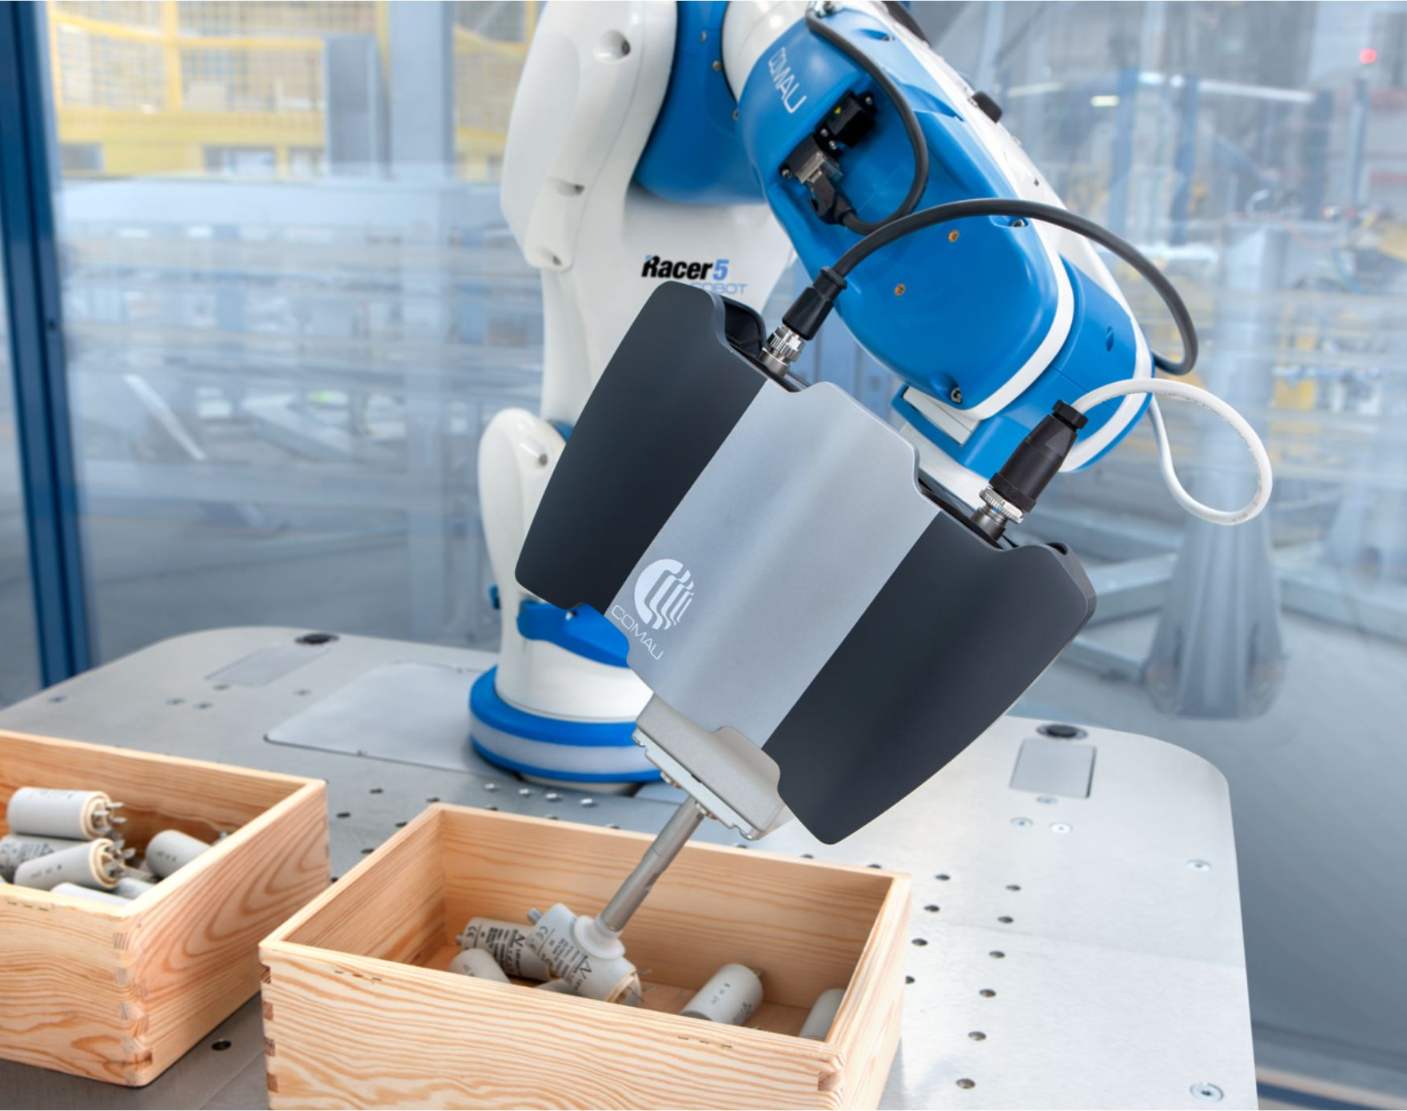
Local and Global Autonomous Motion Planning
Multi-path replanning algorithm.
Motion planning according to the time variability of uncontrollable concurrent tasks
fast replanning strategies
Safety-aware cost function based on ISO/TS 15066
Model Predictive Control for path planning

Slide 15

A4 - Activities
Task 4.1 Update of the Scientific Plan with the latest State-of-the-Art Methodologies and Tools for Motion Planning
Task 4.2 Informed Sample-Based Optimal Motion Planning for teams of mobile manipulators in dynamic environments
Task 4.3 Model Predictive Control for Optimal Adaptive Micro-interpolation
Task 4.4 Integration of the Motion Planning Framework inside MI.RA/Dexter
Task 4.5 Integration of the MPC trajectory micro-interpolator inside the COMAU Core IPC
Task 4.6 Continuous Integration
Task 4.7 Benchmarking and Evaluation

Slide 16
A.3 & A.4 Roles
      PI Role
      The PI will coordinate the activity and be part of the team that designs the methodology, its deployment, implantation, and testing.
      The team will have a one-week touch point focused on presenting the results to the PI, the Host Institution Responsible for the MI.RA/Dexter platform and the Host Institution are Responsible for the low-level control.
      Research Organization
      The research organisation will invest about 35% of the budget in this topic. The team will comprise two fellow researchers directly, followed by the PI.
      They will define and implement the methodology using the ad-hoc platform and then (from half-project to the end) inside MI.RA/Dexter (for the offline/online motion planner) and the Core IPC (for the Model predictive controller).
      A.4.3.3 Host Institution
      The Host Institution will invest about 35% of the budget to integrate. Different top figures will be engaged: the responsible for the cognitive platform development, the responsible for the low-level controller development, and the responsible department of the vision systems.
      A working team will mainly focus on developing innovative methodologies for scene update, registration, and semantic segmentation. The second working team will integrate the offline/online motion planner with the MI.RA/Dexter platform. The third working team will put effort into deploying the Core IPC controller with a double goal. First, the MPC must be integrated into the Core IPC. Second, to create a powerful async communication channel with the MI.RA/Dexter platform for safe continuous streaming of reference trajectories for the robot.

Slide 17
Advanced Robot Motion Controlling through Machine Learning Methods
A5

Slide 18
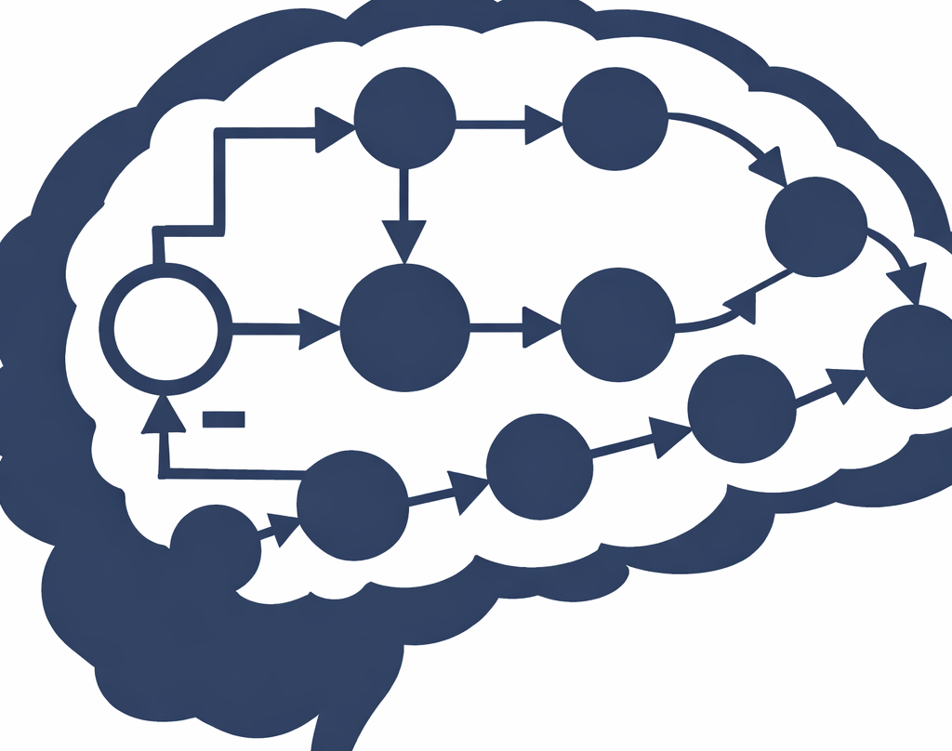
Advanced Robot Motion Controlling through Machine Learning Methods
To innovate in deploying controllers that guarantee performance even under actuator faults and motion constraints.
To innovate in deploying controllers considering elasticity inside the industrial robot joints.
To innovate in the robustness and reliability of neural controllers
Neural Controllers integrated with Model Based methodologies

Slide 19
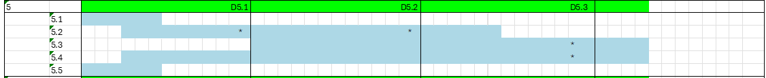
A4 - Activities
Task 5.1 Update of the scientific plan with the last state-of-the-art methodologies and tools
Task 5.2 Design of the neural controller with prescribed performance constraint architecture
Task 5.3 Integration of the Motion Planning Framework inside the Open IPC
Task 5.4 Continuous Integration
Task 5.5 Benchmarking and Evaluation.

Slide 20
A.5 Roles
      PI Role
The PI will coordinate the activity, and he will be part of the team for the design of the methodology, its deployment, implementation, and testing.
The full team will have a one-week touch point, focused on presenting the results to the PI, the Host Institution Responsible for the low-level control.
      Research Organization
The research organisation will invest about the 25% of the budget in this topic.
They will define the methodology and implement it using the first ad-hoc platform and then (from the halfway point to the end) inside the Core IPC.
      Host Institution
The Host Institution will invest about 27.5% of the budget to integrate
Two working teams will be engaged. First, a working team will mainly focus on supporting the research organization in developing a realistic digital twin of COMAU robots that can be exploited in the development phase. Furthermore, such a team will support the research organization in defining the evaluation metrics, designing the experiments, and measuring the performance. The second working team will put effort into integrating the control strategies inside a prototype of a robot controller.

Slide 21
Human-Robot Trustiness Evaluation and Assessment
A6

Slide 22
Activity 6 (a6)
Finalità di A6:
Costruire una scala per la valutazione della "fiducia" degli operatori nei cobots / nel lavorare con i cobots
La scala di valutazione sarà un questionario con domande a risposta chiusa
Fornisce un indice della fiducia degli operatori (HRC industriale e cobots)
Rivolta all'industria; recluta i soggetti (lavoratori) del campo industriale reale
Rimanere nel campo reale: no "pseudo-robot", no ambienti controllati / laboratori di ricerca, no soggetti fuori contesto (per es. colleghi ricercatori, laureandi, etc.)
La realizzazione della scala coinvolge:
Tecnologie attuali
Soggetti (lavoratori) del campo reale
Contesto del campo reale
Notes:
22

Slide 23
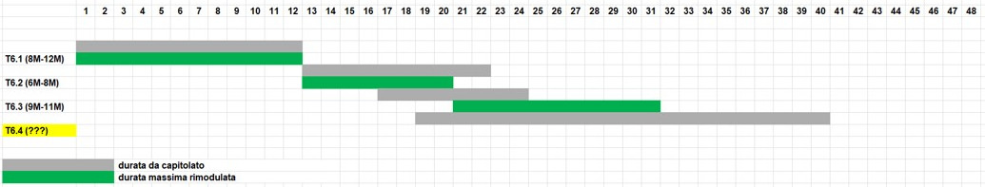
A6 - Tasks
T6.1 Design of the Questionnaire
T6.2 Questionnaire Validation
T6.3 Questionnaire Deployment
T6.4 Evaluation Campaign, dataset creation synthesis
Affinamento delle azioni nei task e rimodulazione delle relative durate
Notes:
23

Slide 24
t6.1 design of the questionnaire
Analisi e progettazione del questionario iniziale (Q1):
Cosa si vuole indagare
Definizione delle caratteristiche dei soggetti
Definizione e stesura delle items di Q1
T6.1 definisce il cuore dell'indagine,
i task successivi –anche loro pure importanti- sono più orientati alla realizzazione
Durata:
Originale: M1 – M12 (lunghezza 12M)
Rimodulata: M1 + lunghezza 8M / 12M
Notes:
24

Slide 25
t6.2 questionnaire validation
Implementazione di Q1 e del protocollo sperimentale:
Definizione del protocollo di sperimentazione
Stesura e invio della documentazione della sperimentazione al Comitato Etico CNR (include il GDPR)
→Dopo l'invio non si può cambiare, nella sostanza, il protocollo
Attesa dell'ok dal Comitato Etico CNR (1 – 3 mesi)
Implementazione software di Q1 (durante l'attesa)
Reclutamento dei soggetti (durante l'attesa)
Durata:
Originale: M13 – M22 (lunghezza 10M)
Rimodulata: lunghezza 6M / 8M
Notes:
25

Slide 26
t6.3 questionnaire deployment
Sperimentazione e analisi:
Messa online di Q1 ed esecuzione della sperimentazione
Analisi dei risultati (analisi fattoriale esplorativa)
Eliminazione da Q1 delle items poco significative: questionario Qfinal (scala trust )
Considerazioni sul significato dei fattori estratti
Durata:
Originale: M17 – M24 (lunghezza 8M)
Rimodulata: lunghezza 9M / 11M
Notes:
26

Slide 27
t6.4 To be redefined
Durata:
Originale: M19 – M40 (lunghezza 22M)
Rimodulata: ???
Notes:
27

Slide 28
Next Steps
Teaming and responsabilities
Touch Point: When & Who
Objectives: We can revise the entire project. We just should justify it
Milestone: 6 Months – Documents with the implementation guidelines of the project

Slide 29
Grazie
Notes:
29

