Slide 1
Stance classification
Nicola Poggialini – NLP Project Work

Slide 2
Task description and outline
Stance classification is the task of automatically identifying the position of the author of a document towards a certain target
Outline of the presentation:
Background – Transformers, BERT, BERTweet
Dataset – SemEval 2016 (task 6)
Architecture – Original model and experiments
Experimental setup
Results – Best model found and final evaluation

Slide 3
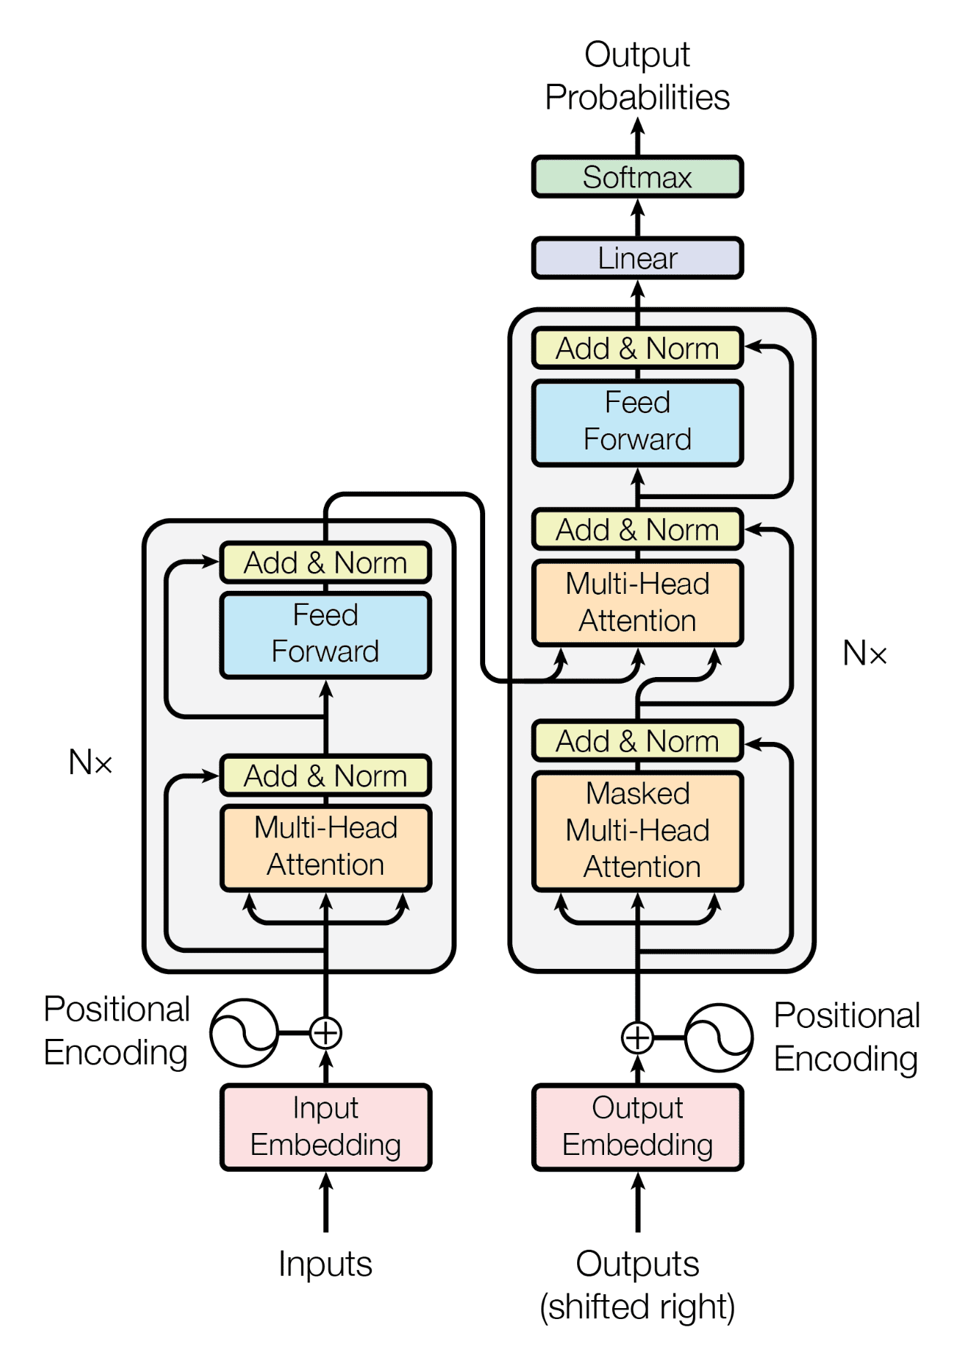
Background
Waswani et al., 2017: “Attention is all you need”
Introduced the Transformer model
Encoder-decoder model based on attention
Instead of processing texts in a sequential way (as RNNs), it’s able to proces it altogether
Uses positional encodings to not lose position information
Transformer model architecture

Slide 4
Background
Devlin et al., 2019: “BERT: Pre-training of Deep Bidirectional Transformers for Language Understanding”
Based on Transformer’s encoders
Masked Languange Modeling (MLM) and Next Sentence Prediction (NSP)
Its embeddings exploited in many tasks to obtain SOTA results
Nguyen et al., 2020: “BERTweet: A pre-trained language model for English Tweets”
Same architecture as BERT
Trained with the same process of RoBERTa (which is an optimized BERT’s pre-training)

Slide 5
Dataset - SemEval-2016 (task 6)
Features:
Tweet: contains the raw text of the tweet
Target – possible values: Hillary Clinton, Feminist Movement, Legalization of Abortion, Atheism, Climate Change is a Real Concern
Stance – possible values: Againts, Favor, None
Sets:
Training (2914 instances)
Test – Task A (1249) – targets seen during training
Test – Task B (707) – new, unseen target

Slide 6
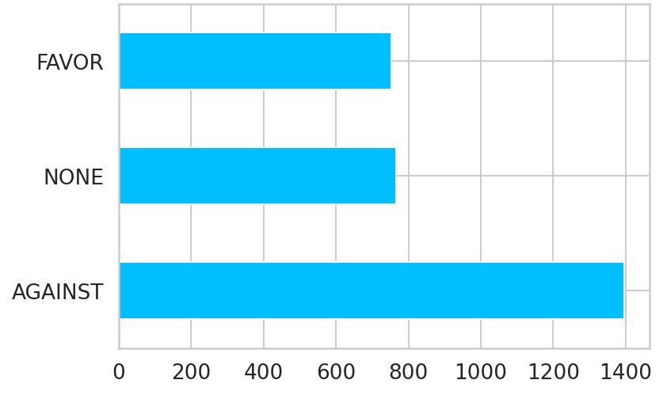
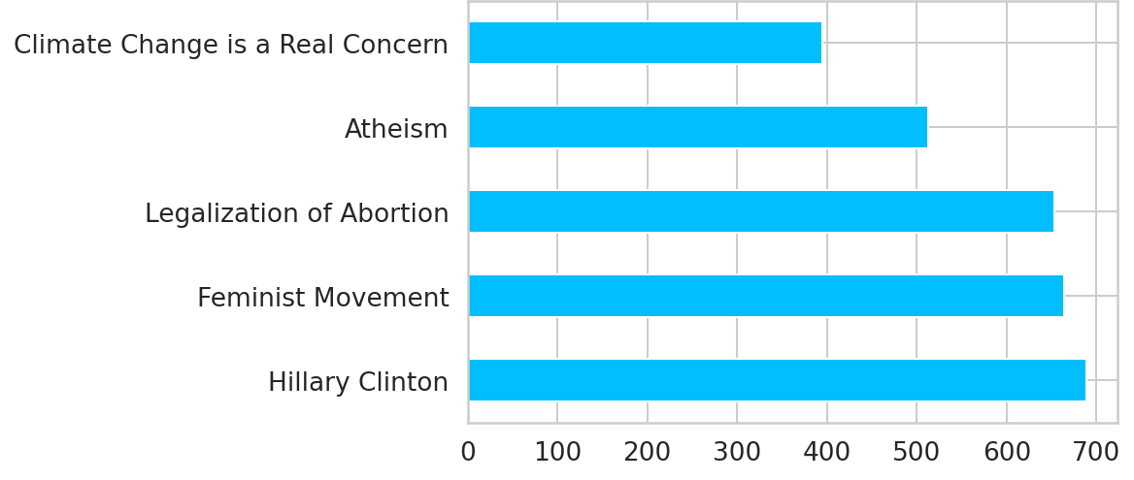
Training data exploration
The data are imbalanced with respect to the variable Stance
There are more represented and less represented targets
Stances distribution
Targets distribution

Slide 7
Pre-processing
BERTweet’s authors provided a function (called normalizeTweet) to pre-process tweets as they did in their experiments
Pre-processing with normalizeTweet:
Tokens are extracted from Tweets using TweetTokenizer from the NLTK
Emojis are translated into text strings
Tweets are normalized by converting user mentions and web/url links into special tokens @USER and HTTPURL, respectively

Slide 8
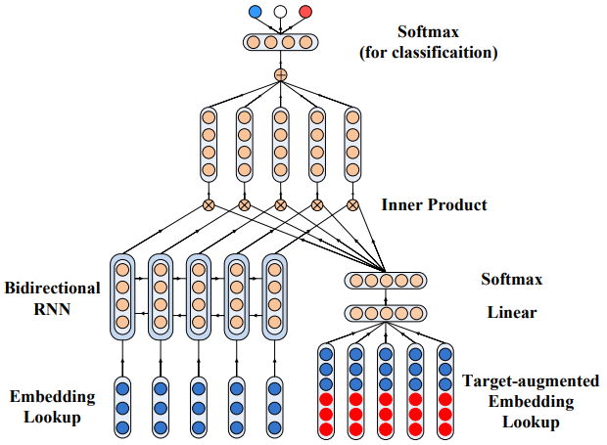
Original architecture - Target-specific Attentional Network
Target-specific Attentional Network (TAN) workflow:
Embedding layer: Word2Vec
Tweet side: bi-LSTM (hidden dimension = 100)
Target side: target-augmented embeddings + attention scores with linear layer and softmax
Product between attention scores and bi-LSTM output
Resulting word vectors are combined with a mean
Linear layer and softmax for classification
Du et al., 2017: “Stance Classification with Target-specific Neural Attention”

Slide 9
Model proposed
The model proposed uses BERTweet’s embeddings instead of Word2Vec ones
BERT-based embeddings are dynamically informed about the context, Word2Vec embeddings are static
BERTweet produces vectors with a dimensionality much higher (768) with respect to Word2Vec (300)
Considering the hidden dimension used by the following bi-LSTM in the architecture (100*2), this abrupt change in dimensionality could lead to some information loss

Slide 10
Experiments
Increase the hidden dimension of the bi-LSTM to 200
Less abrupt change
Increase the number of layers in the bi-LSTM to 2 and use the best dimension found in the first experiment
More processing of the embeddings, which could result in less information loss
Use 2 bi-LSTMs but with different hidden dimensions, the first bigger (300) and the second smaller (100)
More gentle change of dimension

Slide 11
Experimental setup
Train set split: 0.9
Loss: Cross-Entropy loss
Optimizer: AdamW
Batch size: 32
Learning Rate: fixed 1e-5
Number of epochs: 50
Input length - Tweet: 50
Input length - Target: 8

Slide 12
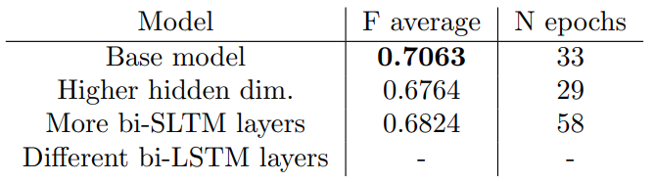
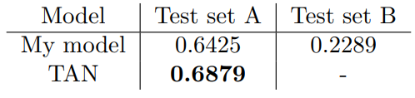

Results
The metric used is the mean of the F1 score for the ‘Against’ and ‘Favor’ classes:
F average on the validation set
F average on the test set

Slide 13
Conclusions
Comparable results, but worse than the original model
TAN results were obtained using 5 models, each one trained on a specific target
Future work:
The target side of the architecture was left fixed, while changing only the tweet side
Some possible experiments could be about processing the target-augmented embeddings more before the attention layer

