Slide 1
Santander Customer Transaction Prediction
Nicola Poggialini – ML project work

Slide 2
Task description
The task is about predicting the future behaviour of customers
We’re interested in whether a transaction will be made, regardless of the amount of money involved
Binary classification problem
0: the customer won’t make a transaction
1: the customer will make a transaction

Slide 3
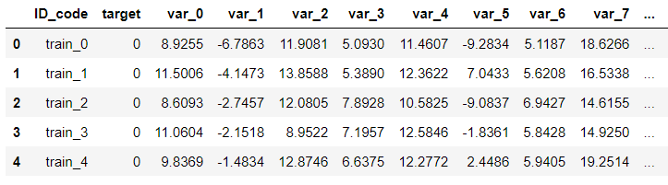
Data exploration
Dataset provided:
200000 instances
202 features
ID code: identifies the transaction (not used in the solution)
Target: binary variable that we want to predict
200 anonymous features: predictors
First rows and columns of the dataset

Slide 4
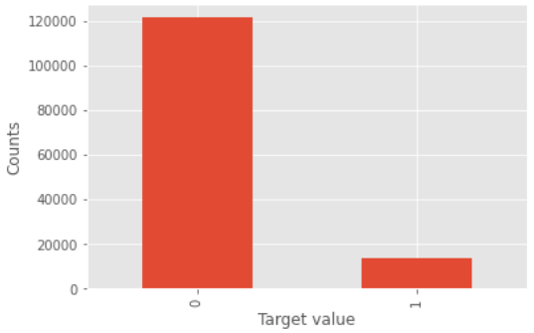
Data exploration
A brief analysis showed that there are no relevant correlations between the predictiors
Then, it was noticed that the data are also imbalanced with respect to the target variable
Distribution of the target values

Slide 5
Methods – Approach overview
The approach followed to tackle the problem was the following:
Find a good ‘configuration’ of the dataset
The data are imbalanced and present a high dimensionality, both factors that can impact negatively the performances of a model
To do that, I’ve started with a simple model (Logistic regression) to test the different approaches
Find the best model
Once the right configuration is found, I’ll tune and test different models on it

Slide 6
Methods – Techniques
Baseline
Logistic regression with adjusted weights for unbalanced data
High dimensionality
Feature selection
ANOVA
Mutual information
Random Forests
Dimensionality reduction
PCA

Slide 7
Methods – Techniques
Unbalanced data
Undersampling: delete instances from the over-represented class
Near Miss algorithm: selects examples from the majority class that have the smallest average distance to the three closest examples from the minority class
Oversampling: add copies of instances from the under-represented class
SMOTE algorithm: it works randomly picking a point from the minority class and computing the k-nearest neighbors for this point. The synthetic points are added between the chosen point and its neighbours
Since these approaches could suffer from the curse of dimensionality, they are also tested with less/reduced features

Slide 8
Methods – Techniques
Classifiers:
Decision Tree and Random Forests
Nayve Bayes
SVM
Alternative approach
One class classification
Approach used in anomaly detection
Tested using the one class version of SVM

Slide 9
Operating environment
Language used:
Python (Jupyter notebook)
Hardware:
Local CPU
Accelaration (GPU/TPU): None
Principal libraries:
sklearn
imblearn (for implementing the algorithms for unbalanced data)

Slide 10
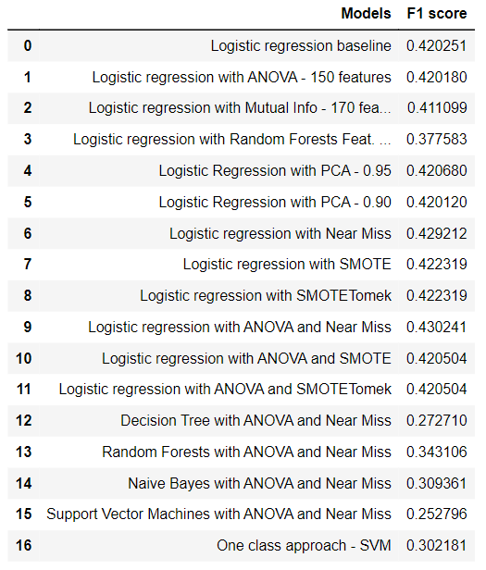
Results – Comparison on validation set
Metric
F1 score for the less-represented class
The best score was obtained with the Logistic regression when combined with ANOVA and Near Miss
Scores on the validation set

Slide 11
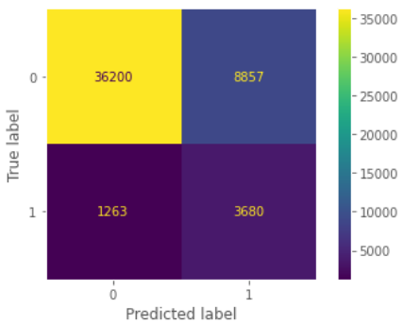
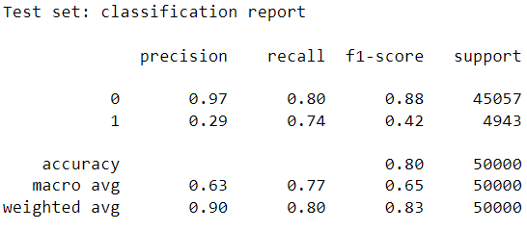
Results – Test set
Classification report on the test set
Confusion matrix on the test set

Slide 12
Conclusions
Overall good score (0.83), but still under 0.5 for the less representative class
Future improvements
Better technique to tackle the imbalance problem
With Near Miss, in the training set, the number of instances of the more-represented class goes from ~120.000 to ~13.000
More complex classifier (e.g. a well-tuned neural network)

