Slide 1
Multi-Domain Conversational Agents based on Semantic Parsing and Retrieval of External Knowledge
Department of Computer Science and Engineering
Artificial Intelligence
Academic Year 2022-2023
Supervisor
Prof. Gianluca Moro
Co-supervisor
Dott. Giacomo Frisoni
Candidate
Nicola Poggialini

Slide 2
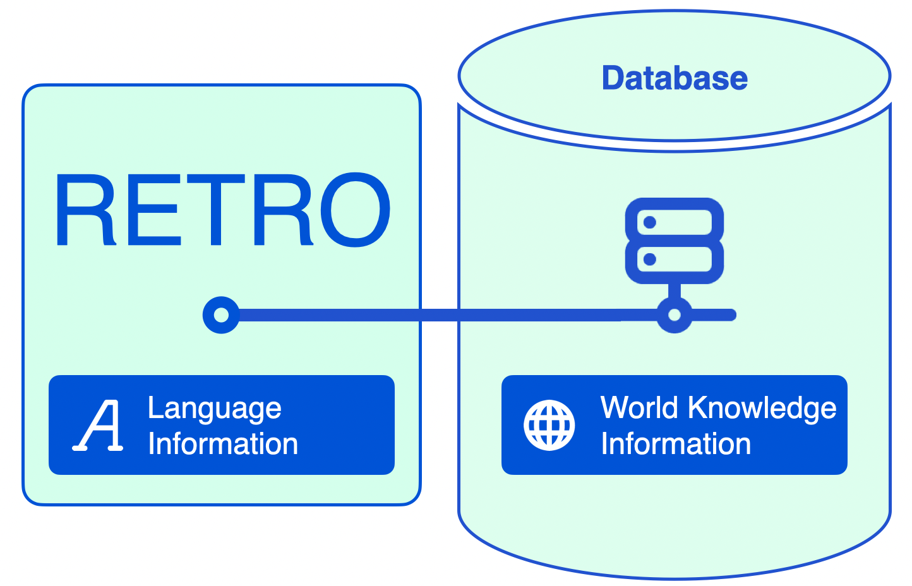
Problem - Limits of Large Language Models (i)
Conversational agents are artificial intelligence systems capable of holding a natural dialogue with users
Large Language Models (LLMs) have been adopted to create SOTA methods
LLMs store all the knowledge within their weights
Significant resources to train and store the models
Re-training needed for knowledge updating
Solution: Retrieval-enhanced language models (e.g. RETRO [Borgeaud et al., 2021])
source

Slide 3
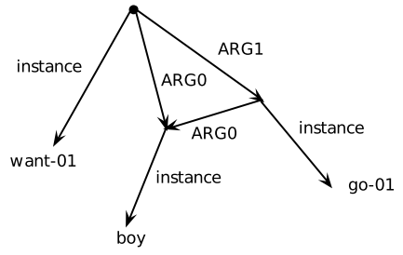
Problem - Limits of Large Language Models (ii)
LLMs take the input text in its raw form, which can be ambiguous
Solution: Semantic Parsing
Process of converting a natural language sentence into a formal meaning representation
A possible way to do semantic parsing is by using Abstract Meaning Representation (AMR) graphs [Banarescu et al., 2013]
Directed, labeled graphs that capture the relationships between concepts and their roles in a sentence
AMR representation of
‘The boy wants to go’

Slide 4
Objectives
Developing a conversational agent based on both retrieval technologies and AMRs
To the extent of our knowledge, this combined approach has never been explored before
Finding the best configuration through ablation studies
Testing our proposal in generating responses for multi-domain dialogues
Comparing our model with the reference baseline: EKo-DoC [Lai et al., 2023]

Slide 5
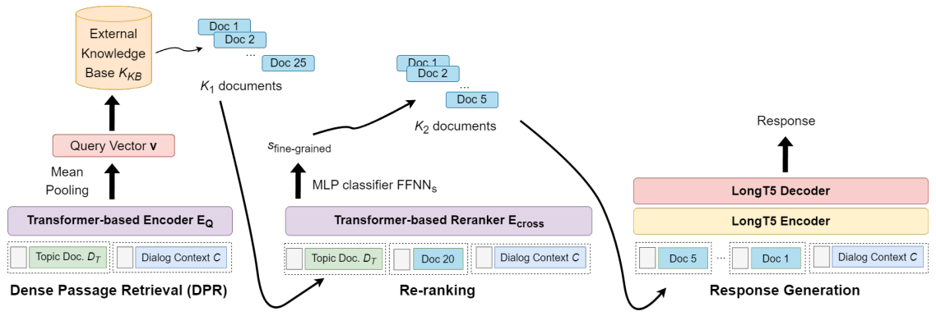
Reference Model – Architecture

Slide 6
Reference Model – Architecture (ii)
Dense Passage Retrieval (DPR)
Sentence Transformer [Reimers et al., 2019] (all-mpnet-base-v2)
FAISS [Johnson et al., 2017]
Re-ranking (RR)
RoBERTa [Liu et al., 2019]
Response Generation
LongT5 [Guo et al., 2022] (large version)

Slide 7
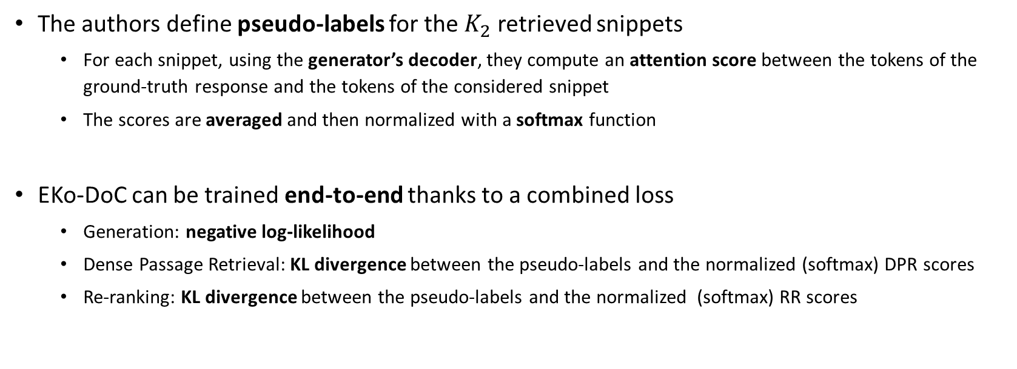
Reference Model – Training method
The authors define pseudo-labels for the $K_{2}$ retrieved snippets
For each snippet, using the generator’s decoder, they compute an attention score between the tokens of the ground-truth response and the tokens of the considered snippet
The scores are averaged and then normalized with a softmax function
EKo-DoC can be trained end-to-end thanks to a combined loss
Generation: negative log-likelihood
Dense Passage Retrieval: KL divergence between the pseudo-labels and the normalized (softmax) DPR scores
Re-ranking: KL divergence between the pseudo-labels and the normalized (softmax) RR scores

Slide 8
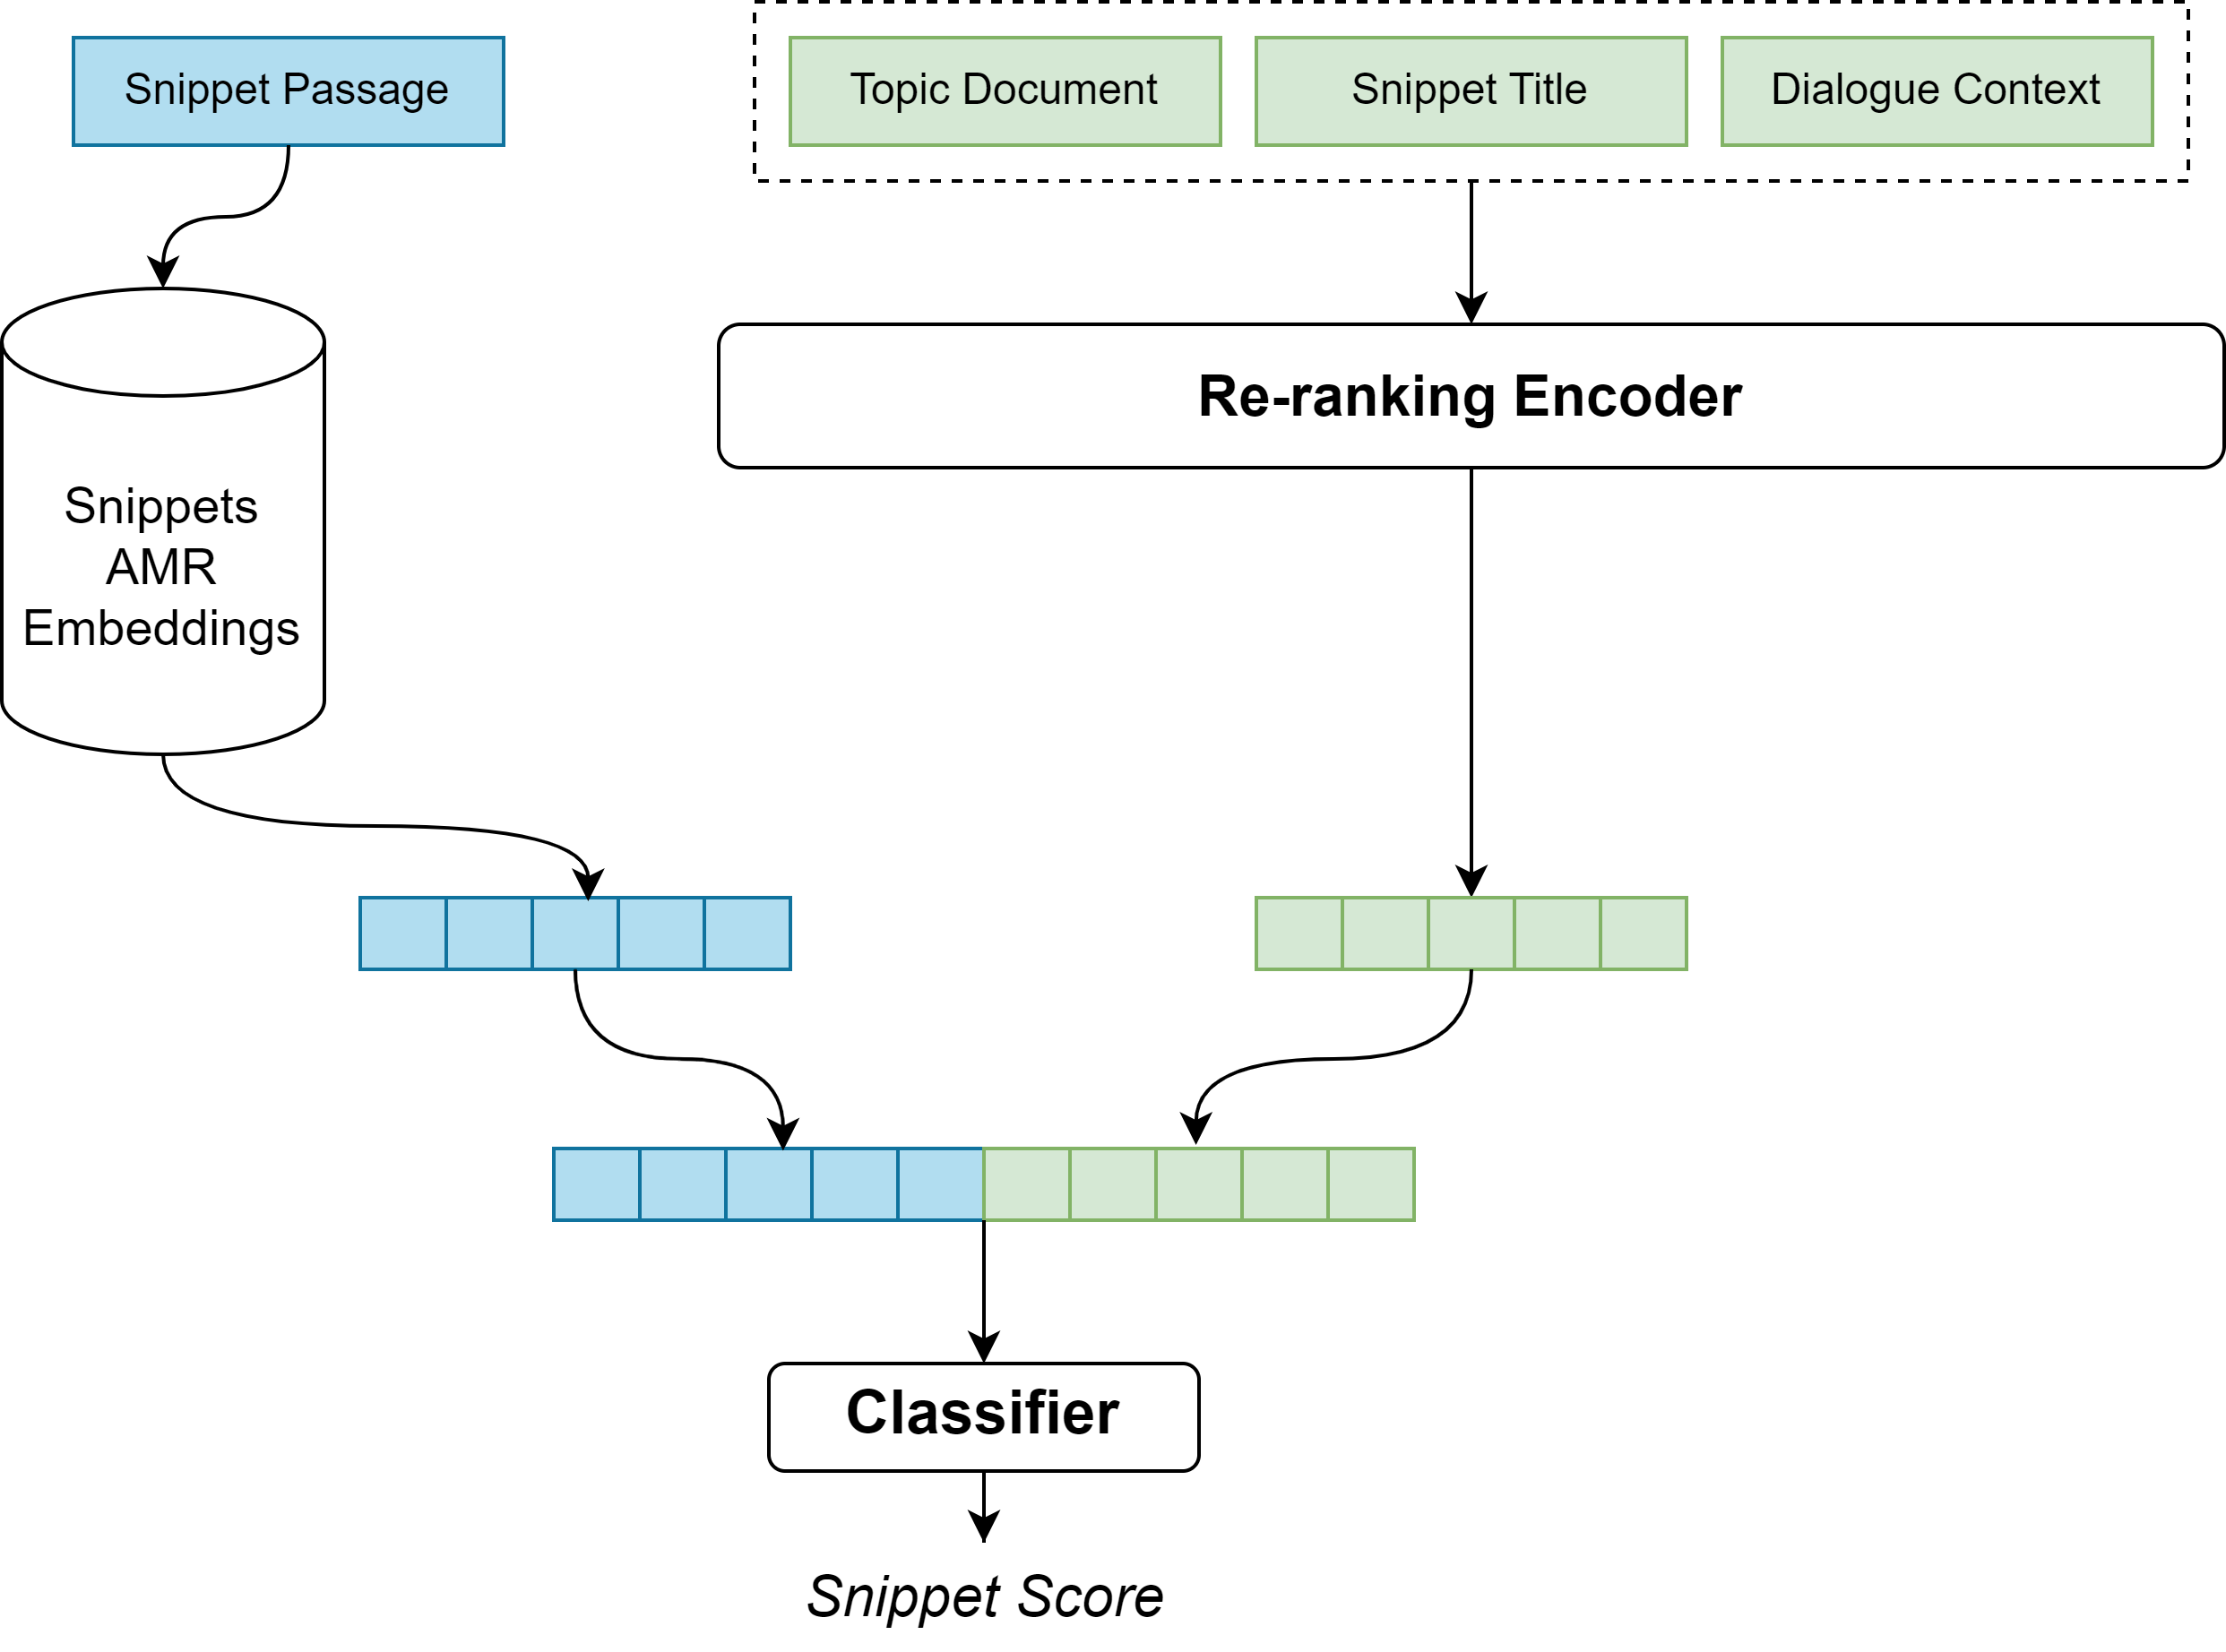
AMR augmentation
We propose to incorporate AMR graphs in the re-ranking module
The classifier receives two vectors concatenated
RoBERTa [Liu et al., 2019] embedding of the dialogue context, snippet title, topic document string
Snippet embedding of the snippet passage through AMR
AMR embeddings are computed offline

Slide 9
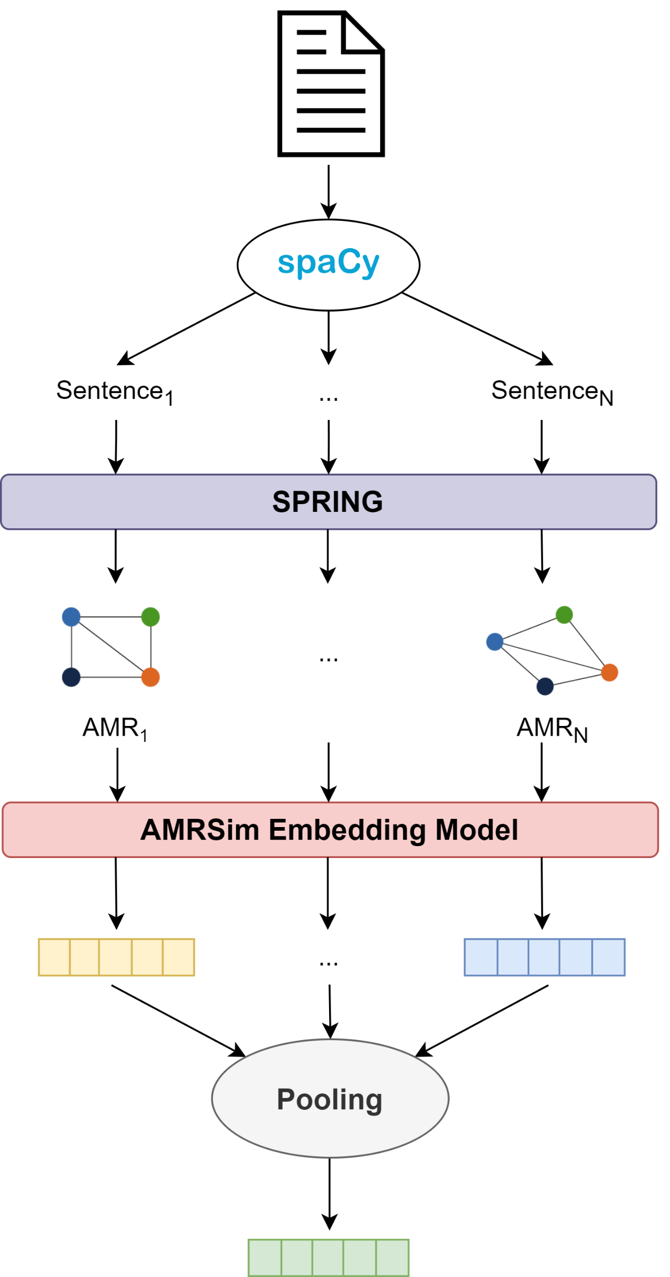
Text-to-AMR and AMR embeddings
The document text is split into sentences using spaCy
Each sentence is converted into its AMR representation with SPRING [Bevilacqua et al., 2021]
AMR graphs are encoded using the embedding model proposed in AMRSim [Shou and Lin, 2023]
The sentence-level embeddings are pooled to obtain the document-level encoding

Slide 10
Dataset
MultiDoc2Dial is a recent conversational dataset [Feng et al., 2021]
Presents a set of dialogues and an external knowledge base composed of a few hundred documents (divided into passages)
Each dialogue and each external document belong to one of 4 different domains

Slide 11
Dataset (i)
MultiDoc2Dial is a recent conversational dataset [Feng et al., 2021]
Presents a set of dialogues and an external knowledge base composed of a few hundred documents (divided into passages)
Each dialogue and each external document belong to one of 4 different domains
Consequent turns in the same dialogue can be grounded in different documents

Slide 12
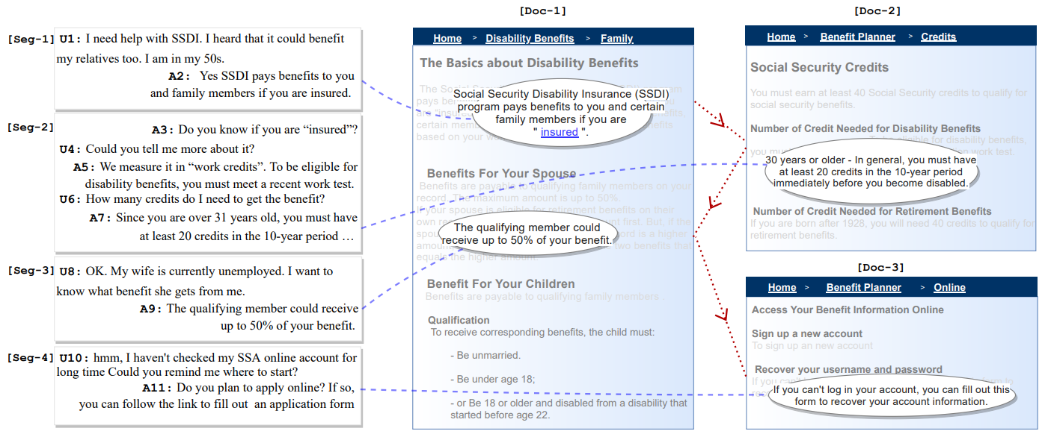
Dataset (ii)

Slide 13
Experiments on our architecture
Re-ranking classifier: 1-, 2-, 3-layers neural network
Pooling operation for AMR embeddings: Mean, Max, Sum
Re-ranking text embedding alternative: UAE-Large-V1 [Li and Li, 2023]
Chosen from the Massive Text Embedding Benchmark (MTEB) Leaderboard [Muennighoff et al., 2022]
Good balance between size and overall performances on re-ranking task
Without Topic Document
Defined as the first passage of the first grounded document of each dialogue by EKo-DoC’s authors
Not realistic: users should provide it in addition to the utterance

Slide 14
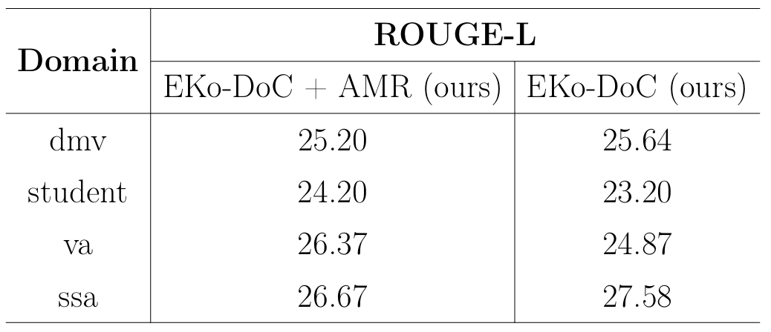
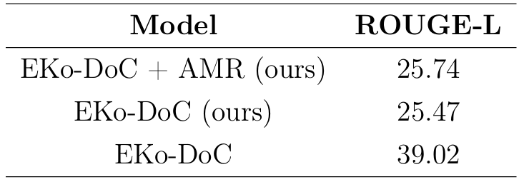
Results (i)
Domain-specific results
Overall results

Slide 15
Results (i)
Overall results

Slide 16
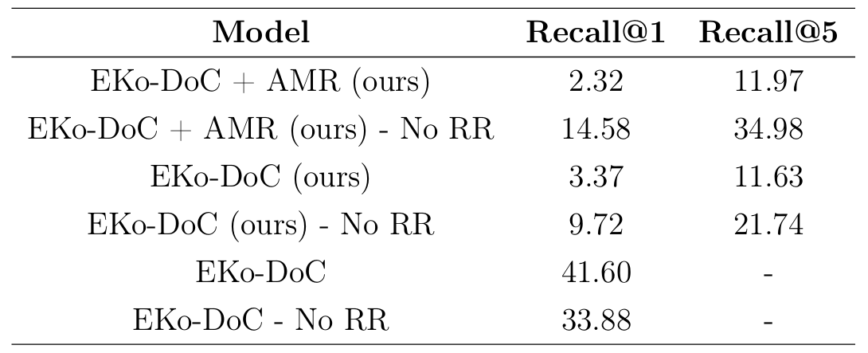
Results (ii)
Retrieval evaluation

Slide 17
Conclusions and Future Work
Conclusions
Future Work
AMRs brought a small improvement in the final performances
The positive impact is heavily limited by the re-ranker’s abilities
Strong improvements are expected once the flaws observed are resolved
Reach the original results of our baseline
Keep exploring the AMR augmentation once the desired base performance is found
Try different generation models

Slide 18
Thank you for your attention

