Slide 1


Slide 2

Access your data
Anywhere
At any time
With any device

Slide 3
With Streamit one can either
Download documents
Stream music and videos
Share files
Upload pictures

Slide 4




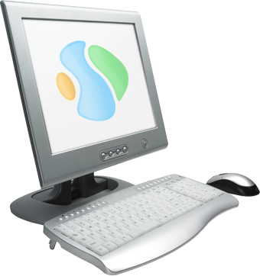
















Slide 5
Why choose Streamit ?
Easy to use
No third party in the middle
Multiple OS and Devices
Remote administration

Slide 6
