Slide 1



AGATA DUBIŃSKA
KATARZYNA MAKOWSKA
MARIA SZCZERBIŃSKA
PCRpal
Python CLI tool for batch validation and analysis of PCR primers
GIT
Page 01

Slide 2
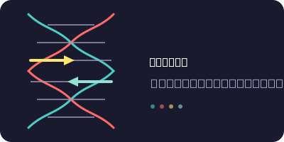
Page 02

Slide 3
MOTIVATION
PCR primer design is one of the most common steps in molecular biology workflows. Existing tools (Primer3, OligoCalc) require manual input of sequences one by one. PCRpal allows batch validation of multiple primers at once from a single input file, saving time and reducing human error.
Page 03

Slide 4
HOW DOES IT WORK?
PCRpal is a Python CLI tool that takes a CSV or FASTA file with primer sequences and returns a full validation report including:
Melting temperature (Tm)
GC content
Sequence length validation
Self-complementarity check
Primer dimer detection
CSV report generation
Multi-dataset comparison with plots
Page 04

Slide 5
PCRpal consists of:
main.py → orchestrates the pipeline, CLI interface
parser.py → reads input file, validates sequences
calc.py → calculates Tm, GC content, flags out-of-range values
dimers.py → checks self-complementarity and primer dimers
report.py → generates CSV report and plots
Page 05

Slide 6
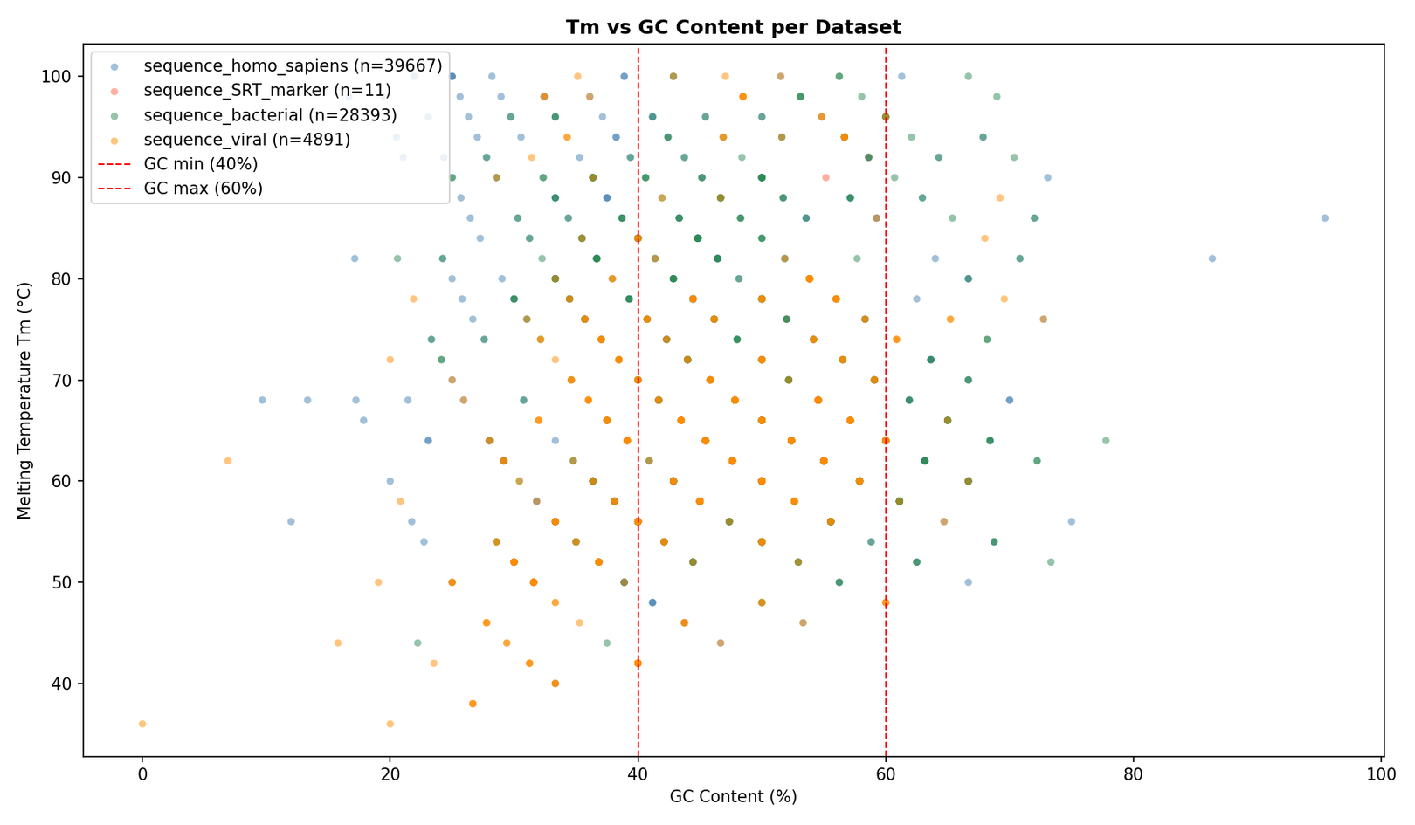
RESULTS
Page 06

Slide 7
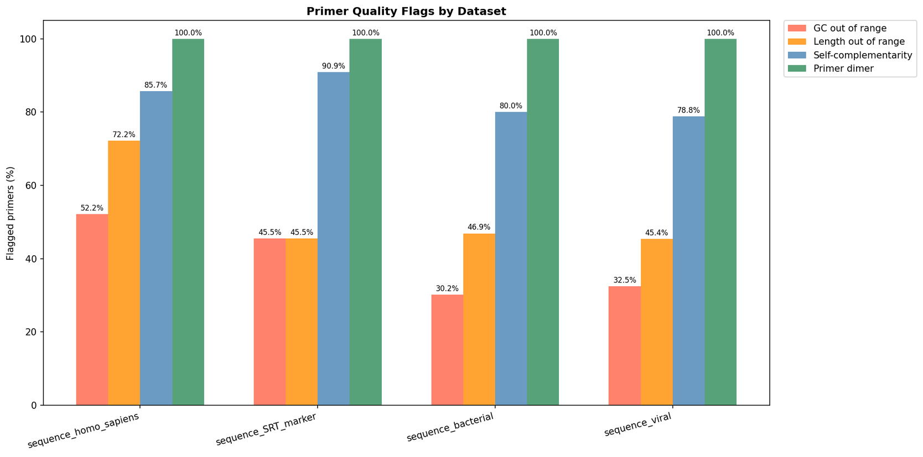
RESULTS
Bacterial dataset: lowest GC out-of-range rate (30.2%)
Homo sapiens: highest proportion of length outliers (72.2%)
Primer dimer risk high across all datasets (79–100%)
Page 07

Slide 8
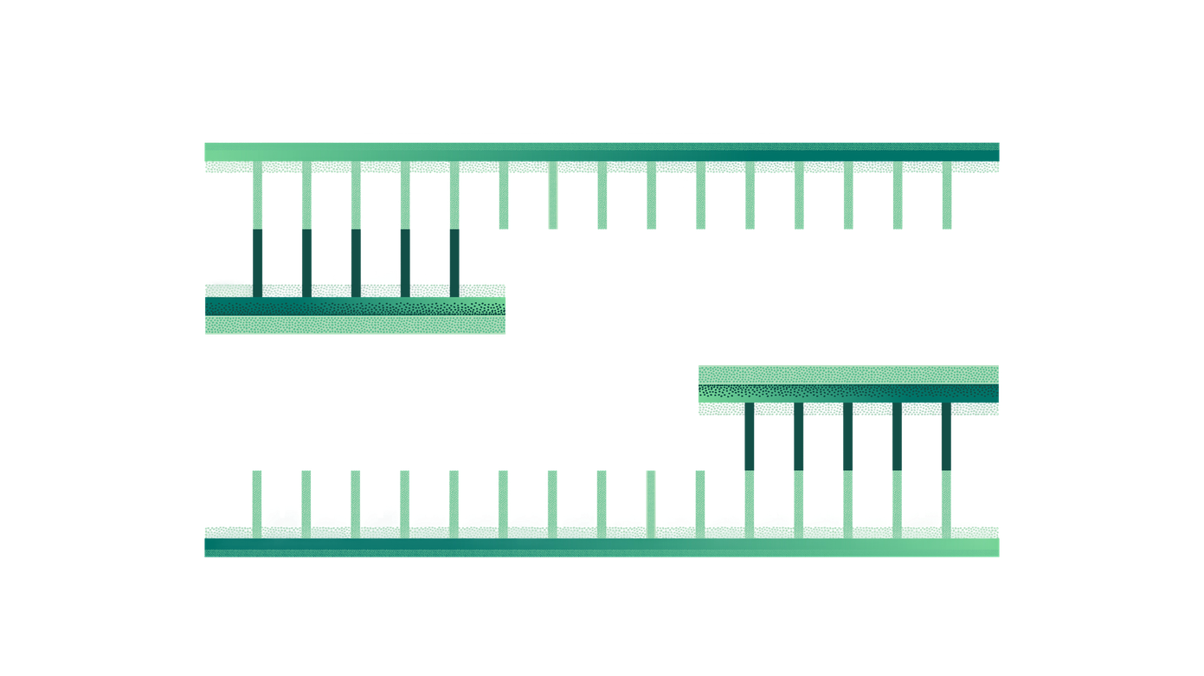
FUTURE PLANS
Integration with Biopython Bio.SeqUtils.MeltingTemp for more accurate Tm calculations
Support for target sequence input and binding site visualization
BLAST integration for off-target binding check
GUI via Streamlit
Page 08

Slide 9
BIBLIOGRAPHY
Untergasser et al. (2012) → Primer3—new capabilities and interfaces https://doi.org/10.1093/nar/gks596
Kibbe (2007) → OligoCalc: an online oligonucleotide properties calculator https://doi.org/10.1093/nar/gkm234
Wallace R.B. et al. (1979) → Hybridization of synthetic oligodeoxyribonucleotides to φX 174 DNA: the effect of single base pair mismatch https://doi.org/10.1093/nar/6.11.3543
Brownie J. et al. (1997) → The elimination of primer-dimer accumulation in PCR https://doi.org/10.1093/nar/25.16.3235
Rychlik W., Rhoads R.E. (1989) → A computer program for choosing optimal oligonucleotides for filter hybridization, sequencing and in vitro amplification of DNA https://doi.org/10.1093/nar/17.21.8543
Page 09

Slide 10
Thank you for your attention!
Page 10

