Slide 1
AKKA – FIRST APPROACH
Tran, tan dung

Slide 2
OVERVIEW
Basically, AKKA is an open source, combining many libs for building highly concurrent, distributed, and fault tolerant applications on the JVM.
AKKA Actor is the core of AKKA
AKKA Stream and AKKA HTTP, which can help the project

Slide 3
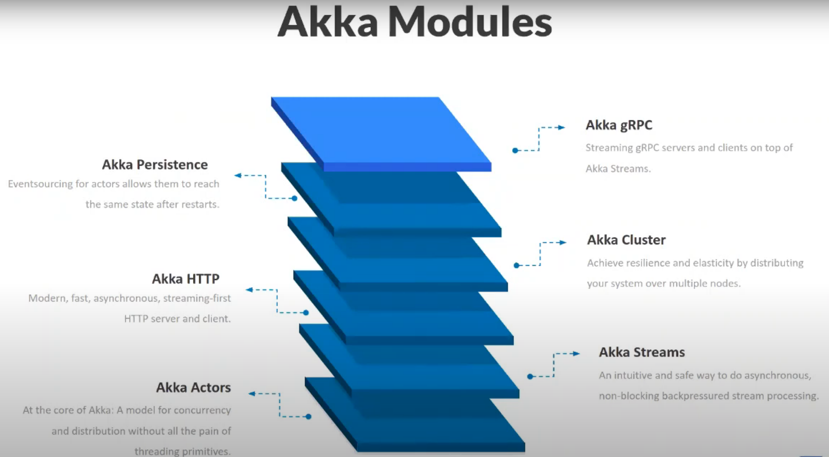
OSS LIBRARIES

Slide 4
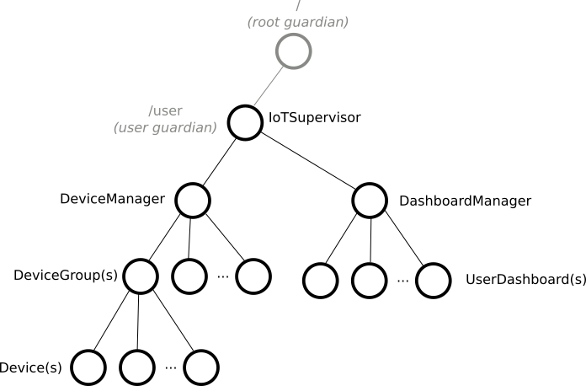
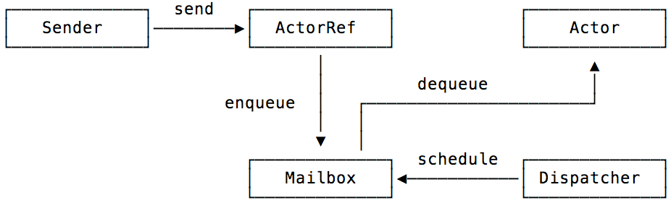
AKKA ACTORS
A model for concurrency and distribution without all the pain of threading primitives.
Hierarchical model
Process in Actors
fault-torelance & scalability
Notes:
– Sử dụng message thay vì method call cho phép sender không bị tạm dừng để đợi return value từ receiver. – Chúng ta không cần quan tâm đến vấn đề synchronization trong môi trường multi-thread vì các message được xử lý theo thứ tự First In First Out (theo dạng queue). – Việc quản lý Actor theo dạng Hierarchy giúp thuận tiện trong Error Handling. Các Actor sẽ thông báo về Parent của chúng khi xảy ra lỗi và các Parents sẽ quyết định cách xử lý lỗi cho các Child Actors.

Slide 5
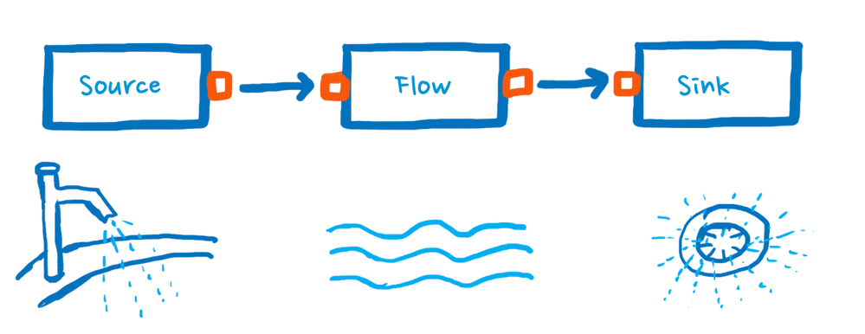
AKKA STREAMS
An intuitive and safe way to do asynchronous, non-blocking back pressured stream processing.
val sourceProducingElements:
Source[Int, NotUsed] = Source(1 to 100)
val sinkPrintingElements: Sink[Int, Future[Done]] = Sink.foreach[Int](println(_))
val flowTransformingData: Flow[Int, Int, NotUsed] = Flow[Int].filter(_ % 2 == 0).map(_ * 2)
Notes:
Avoid blocking and Back pressure
it is possible to express a chain (or as we see later, graphs) of processing entities. Each of these entities executes independently (and possibly concurrently) from the others while only buffering a limited number of elements at any given time
StreamAn active process that involves moving and transforming data.
GraphA description of a stream processing topology, defining the pathways through which elements shall flow when the stream is running.

Slide 6
AKKA HTTP
The AKKA HTTP modules implement a full server and client side HTTP stack in top of AKKA Actor and AKKA Stream.
It's not a frame work but rather a more general toolkit for providing and consuming HTTP-based services.
It has 02 layers:
Http-core (low level) handles:
Connection management.
Parsing and rendering of message and header.
Timeout management (requests and connections).
Response ordering.
High-level Server-Side API
Route
Directive
Rejections
Exception Handling
Testing

Slide 7
SPECIFICATIONS
Event-driven: With Actors, requests can be done asynchronously and non-blocking operations exclusively.
Scalable: By message passing and location transparency, adding nodes without having to modify the code is possible.
Resilient: Akka fault tolerance is to encounter errors a self-healing system.
Responsive: Akka’s non-blocking, message-based strategy helps to give quick feedback to request.

Slide 8



EDITOR & BUILD TOOL
VS Code (Editor)
Metals
(Extension supports Scala)
Build/Command tool

Slide 9
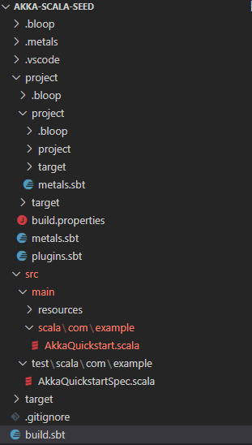
AKKA Project Layout
project, sbt and scala version definitions
app code goes here, in a subdirectory indicating the code’s language
like src/main, but for tests
the jar files your project depends on

Slide 10
PLAN
No. | Task | Timeline
1 | Approach AKKA & Scala | 21/4 – 5/5 (2 weeks)
2 | Setup Project Implement basic WebSocket (Server) | 6/5 – 15/5 (1.5 weeks)
3 | Implement functions & Utilities for Broker Core | 16/5 – 16/6 (4 weeks)
4 | Test core functions – Draft 1st report | 17/6 – 30/6 (2 weeks)
5 | Implement User functions | 1/7 – 28/7 (4 weeks)
6 | Test user functions – Draft 2nd report | 29/7 – 11/8 (2 weeks)
7 | Make up User Interface | 12/8 – 1/9 (3 weeks)
8 | Test all – Draft 3rd report | 1/9 – 15/9 (2 weeks)
9 | Final report | 16/9 – 6/10 (4 weeks)
Meeting to review every 02 week

Slide 11
THANK YOU!

