Slide 1


DEVELOPING MQTT DASHBOARD WITH SCALA & AKKA
Student : tran tan dung - 81182
First Examiner : prof. DR. ThorSten Leize
Second Examiner: prof. Dr. Thomas westermann

Slide 2
Objectives
Understanding about MQTT Protocol and MQTT Broker
Understanding about Actor Model and AKKA Toolkit
Developing MQTT Broker Program by using AKKA Toolkit
Developing a Dashboard for MQTT Broker Program by using Play framework

Slide 3
Agenda
Motivation & Objectives of Thesis
MQTT Protocol & MQTT Broker
Actor Model and AKKA Toolkit
Play framework
Results
Ideas for Improvement

Slide 4
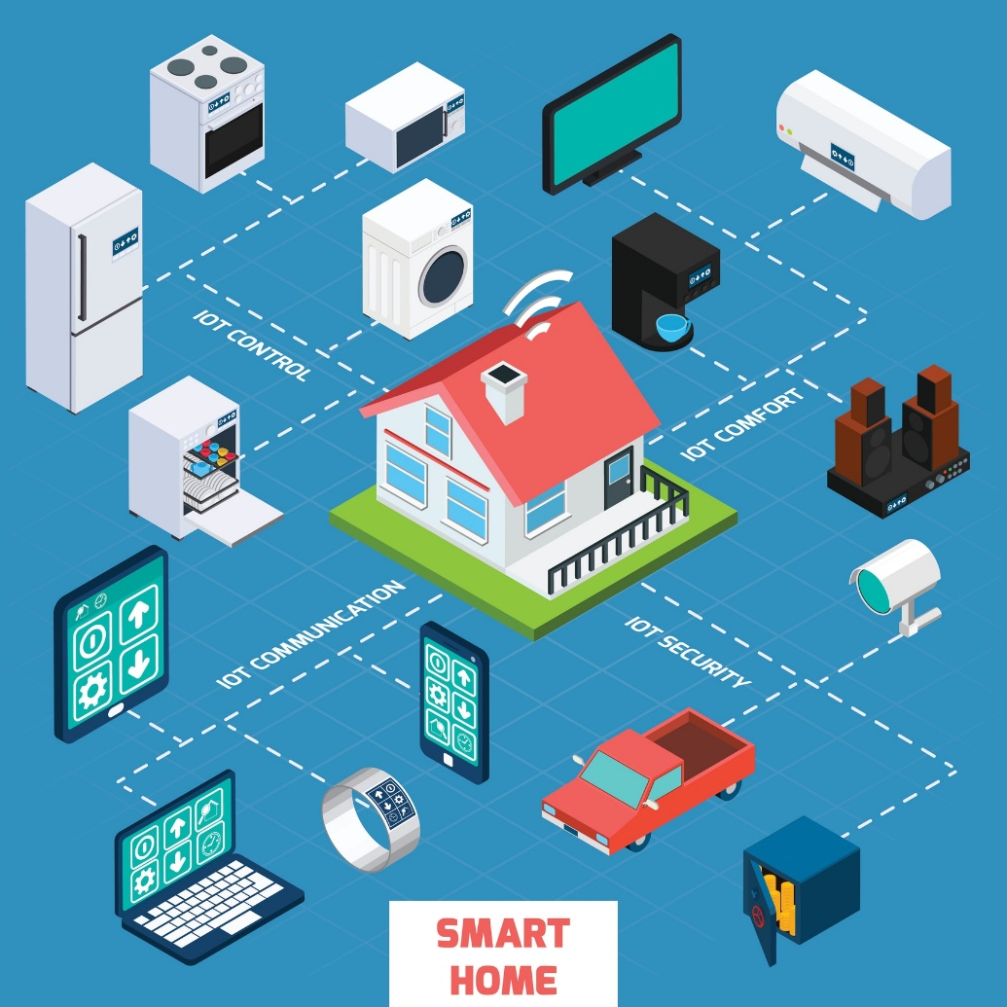
Introduction
Notes:
Separate with Content

Slide 5
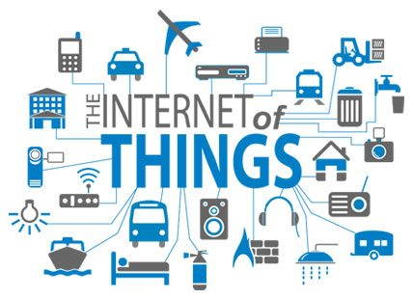
Motivation
Time is changing, the most powerful transformation that comes from the information revolution.
Especially, IoT is a concept mentioned many times, its application creeps to all fields from information, manufacturing, services, healthcare...
Information now is not only transmitted between people and people, people with complexities, but also between devices and people and between devices.
Notes:
Time is changing, the most powerful transformation that comes from the information revolution.
In particular, IoT is a concept mentioned many times, its application creeps to all fields from information, manufacturing, services, healthcare...
From now on, the exchange of information is not only between people and people, people with complexities, but also between simple devices and people and between simple devices.

Slide 6
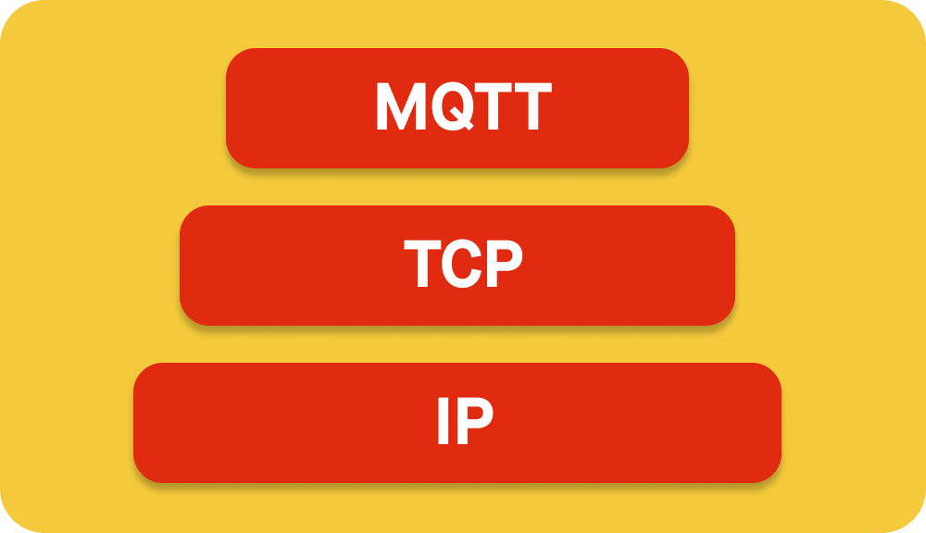
Motivation
Based on an available TCP/IP, MQTT has been developed as a lightweight protocol, following the publish - subscribe model to solve that problems.
Simple implementation
Quality of Service data delivery
Lightweight and bandwidth efficient
Data agnostic
Continuous session awareness
[5]

Slide 7
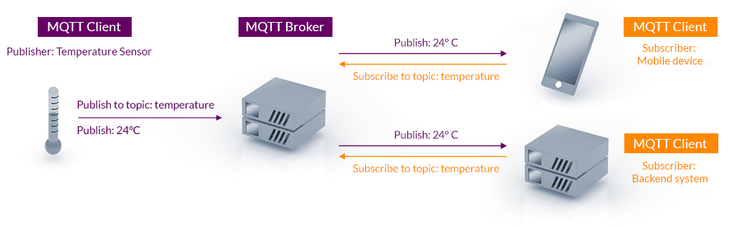
MQTT Protocol
MQTT Publish – Subscribe Model
[3]
Notes:
Pub-sub model

Slide 8
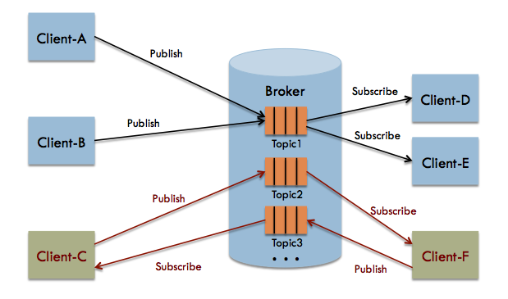
MQTT Broker
Managing connections with various clients.
Receiving numerous messages concurrently.
Filtering and processing messages.
Navigating/Stroring messages.
Etc.

Slide 9

Methods
Notes:
Separate with Content

Slide 10
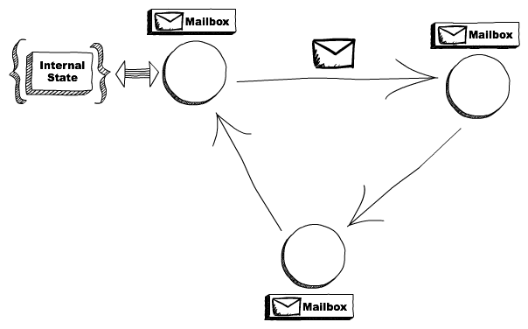
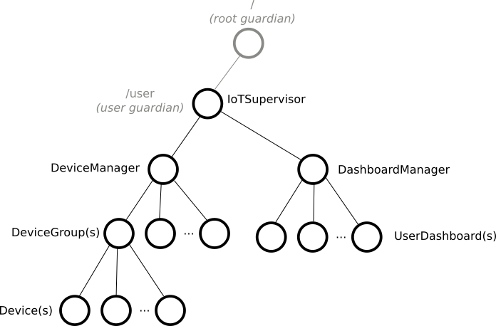
Actor Model
Node communication
Hierarchical model
Notes:
Tell
Ask

Slide 11
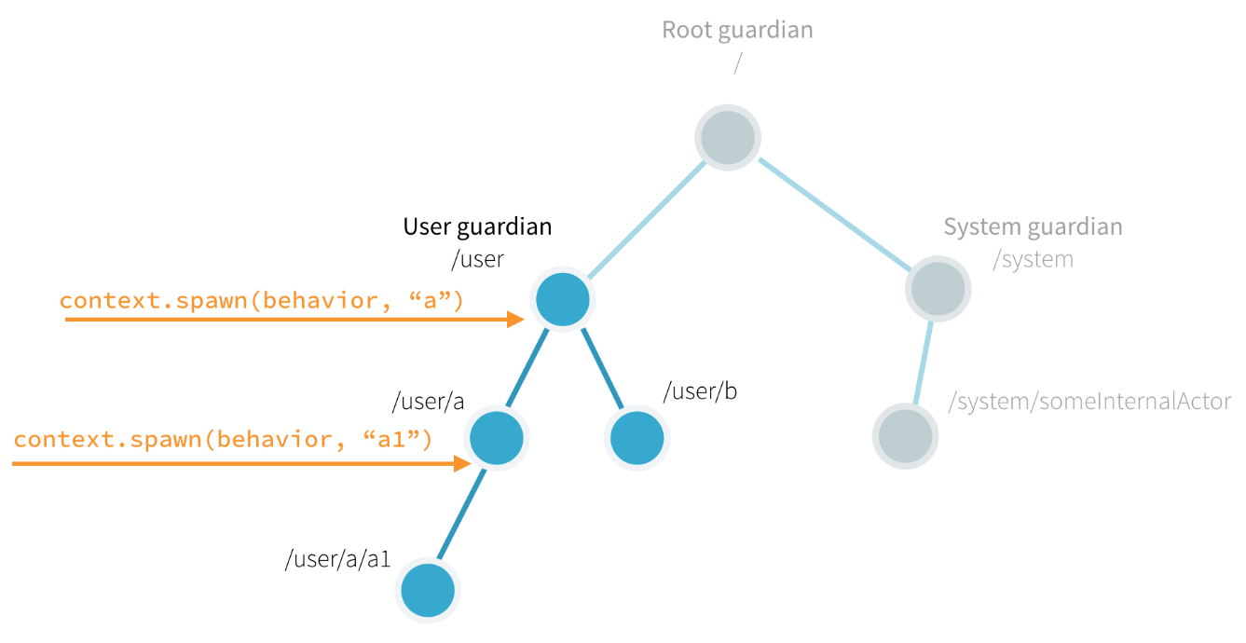
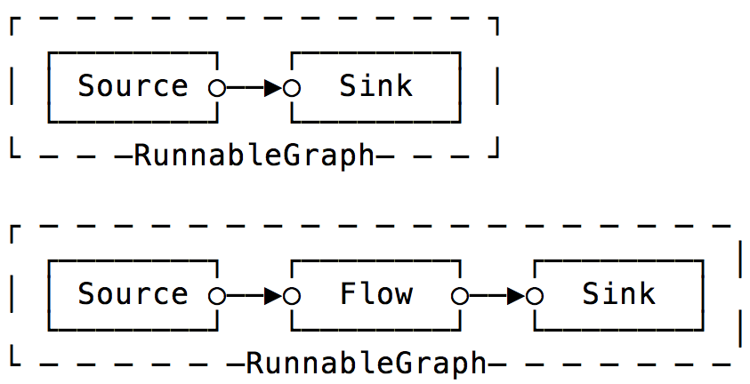
AKKA Toolkit
AKKA Actor
AKKA Stream
Notes:
My platform must be a broker

Slide 12
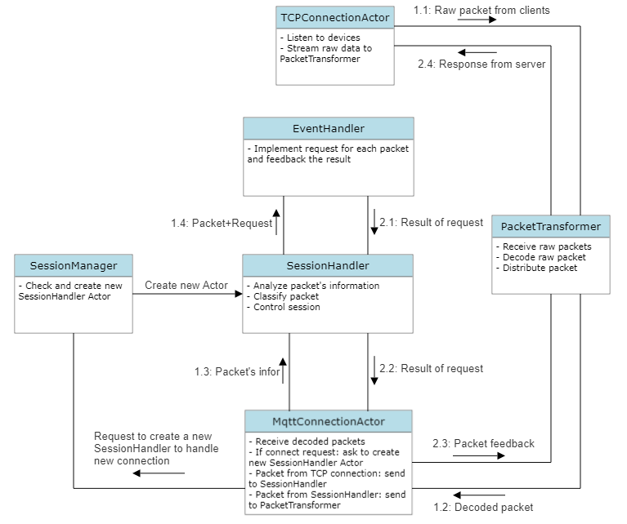
Actor Model in Broker Program

Slide 13
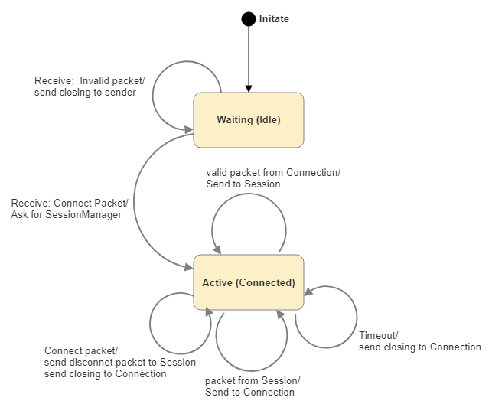
FSM
State(S) × Event(E) → Actions (A), State(S’)
MqttConnection Actor FSM

Slide 14
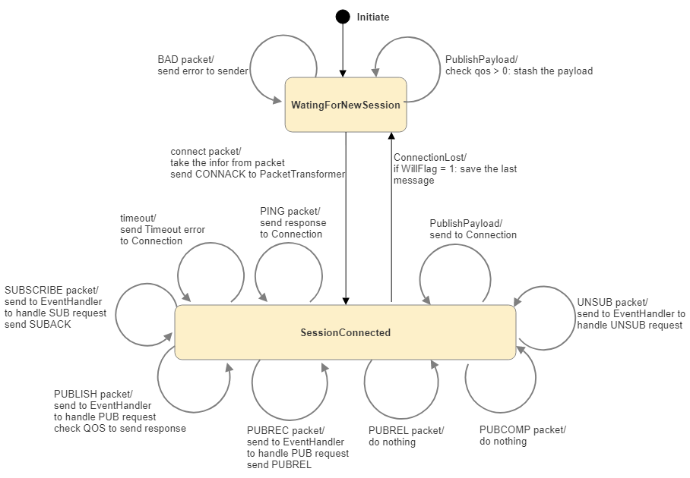
FSM
FSM SessionHandler Actor

Slide 15
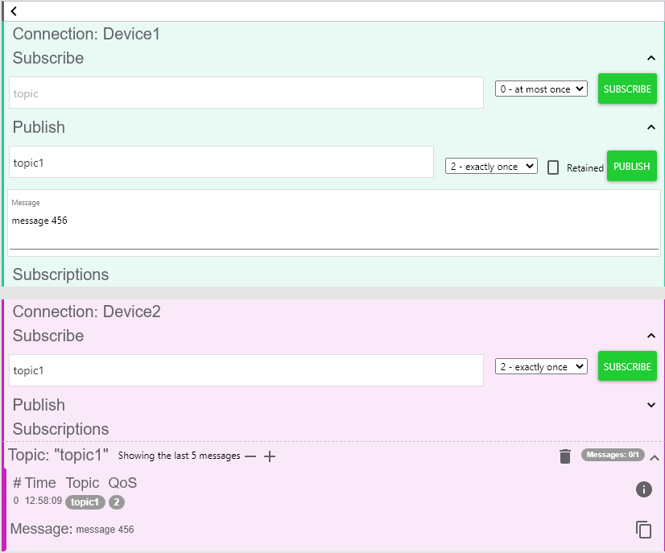
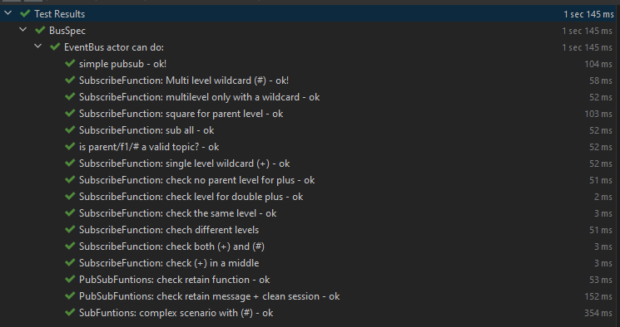
Testing
Unit Test
Intergration Test

Slide 16
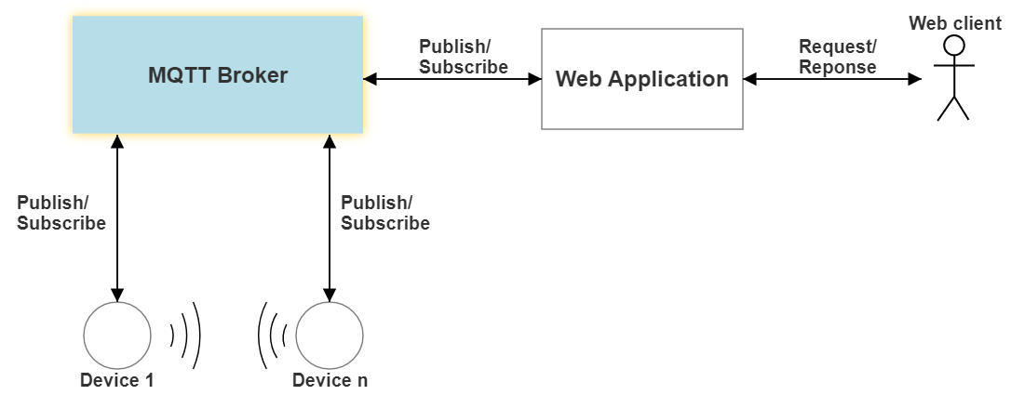
Dashboard Idea
Illustrating of Project Architecture

Slide 17
MVC Model
Model Define data structure
View Display implementing
Controller Contains control logic

Slide 18
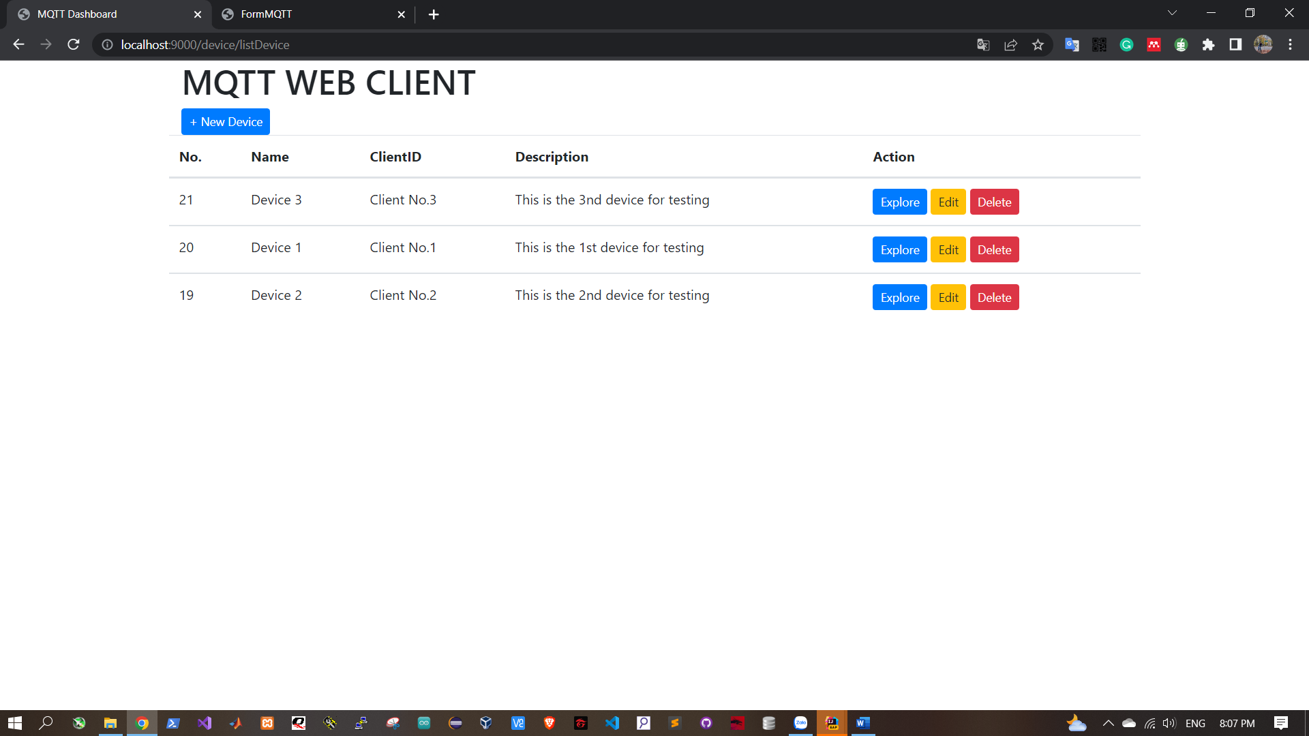
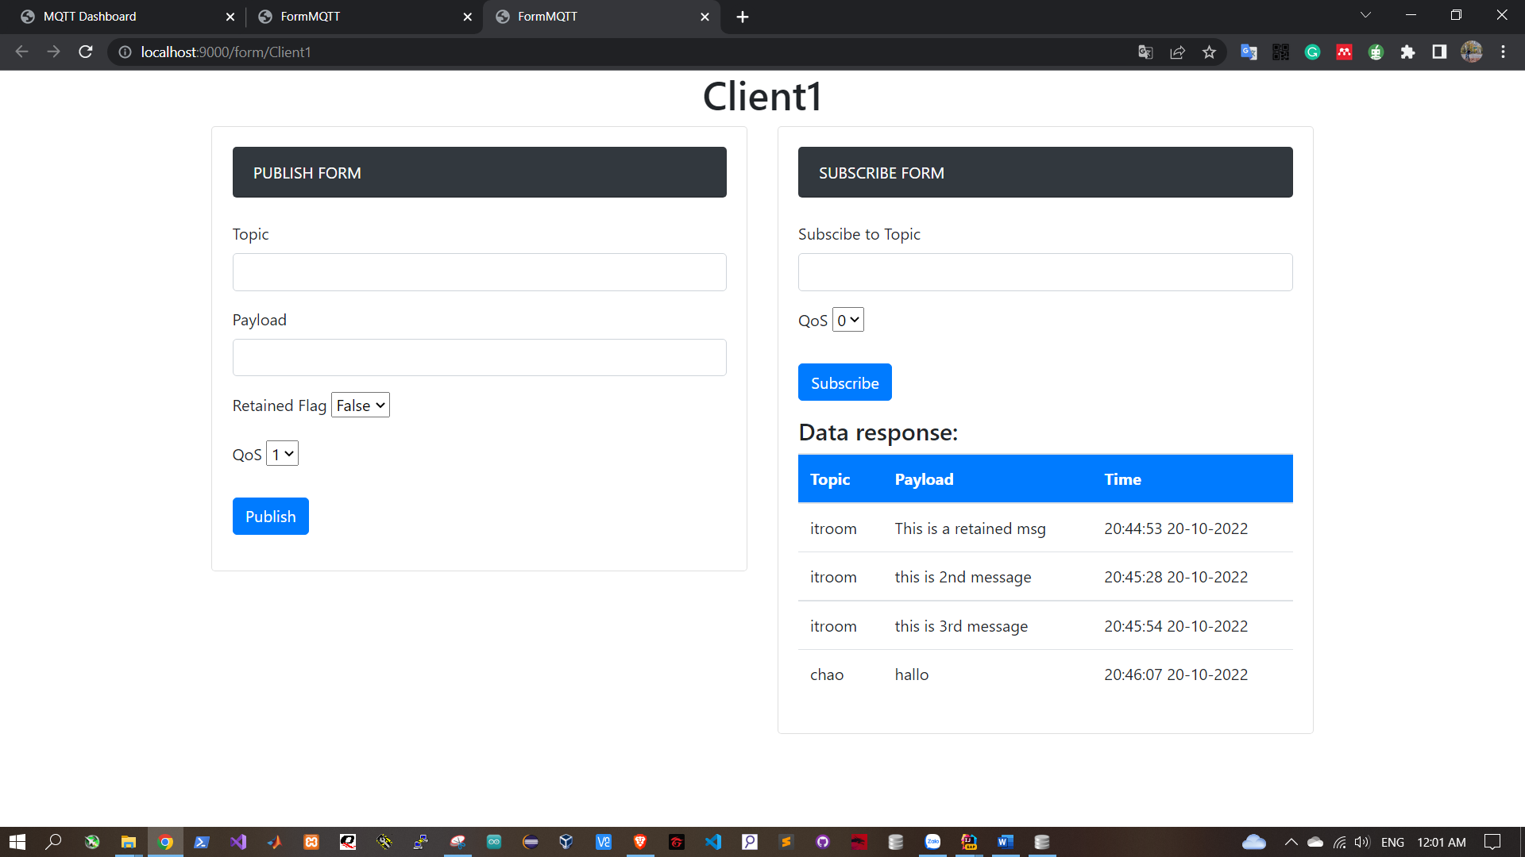
User Interface

Slide 19
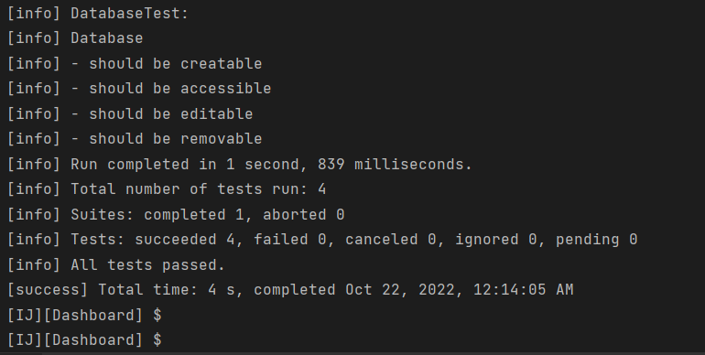
Testing
Test with Browser
Routing Test
Rendering Test
Services Test
Database Test
All tests passed!

Slide 20
Results

Slide 21
Achievements
Being clear about MQTT Protocol & MQTT Broker.
Being clear about Actor Model & AKKA Toolkit.
Successfully implemented a MQTT Broker Program using Actor Model.
Successfully implemented a Dashboard to use MQTT Broker.
All tests passed.
Notes:
Phần website và giao diện người dùng:
- ....

Slide 22
Ideas for Improvement
Applying security features in MQTT Broker: adding TLS, setting rules in network, etc…
Applying HTTPS in Web.
Visualizing data by chart, trend, more user tabs, etc…
Adding user management.
To be updated.
Notes:
Phần website và giao diện người dùng:
- ....

Slide 23
THANK YOU!

Slide 24
References
[1] B. Singh, "How Internet of Things (IoT) Are Going To Impact Your Business?," 15 June 2016. [Online]. Available: https://www.business2community.com/big-data/internet-things-iot-going-impact-business-01572401. [Accessed 19 February 2022].
[2] M. D. Penna, "How the Internet of Things changes everything," 21 August 2017. [Online]. Available: https://martech.org/internet-things-changes-everything/. [Accessed 19 February 2022].
[3] "MQTT: The Standard for IoT Messaging," [Online]. Available: https://mqtt.org/. [Accessed 19 February 2022].
[4] Steve, "Understanding the MQTT Protocol Packet Structure," 28 January 2021. [Online]. Available: http://www.steves-internet-guide.com/mqtt-protocol-messages-overview/. [Accessed 19 February 2022].
[5] A. Leibbrandt, "What is MQTT and why it is important for the Internet of Things," 16 November 2021. [Online]. Available: https://akenza.io/blog/what-is-mqtt. [Accessed 19 February 2022].
[6] T. H. Team, "MQTT Publish, Subscribe & Unsubscribe - MQTT Essentials: Part 4," 02 February 2015. [Online]. Available: https://www.hivemq.com/blog/mqtt-essentials-part-4-mqtt-publish-subscribe-unsubscribe/. [Accessed 19 February 2022].
[7] "The Internet of Things with ESP32," 08 December 2017. [Online]. Available: http://esp32.net/. [Accessed 19 February 2022].
Notes:
Phần website và giao diện người dùng:
- ....

Slide 25
Introduction
The problem now is there are billions of devices in our connection.
Almost of devices are simple and do not have many powerful specifications, so we need a communication method which is simple, flexible, reliable and economical. bandwidth/power.
[2]
Notes:
The problem now is there are billions of devices in our connection.
Almost of devices are simple and do not have many powerful specifications, so we need a communication method which is simple, flexible, reliable and economical. bandwidth/power.

Slide 26
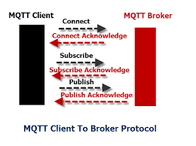
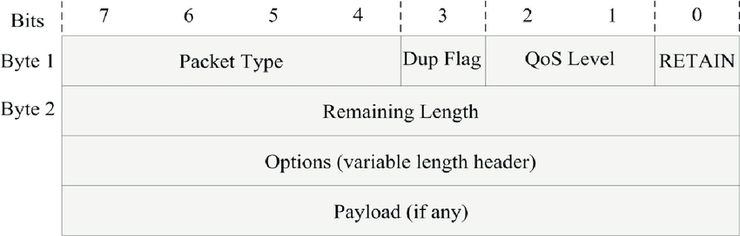
MQTT Protocol
MQTT Frame
Delivery diagram
[4]
Notes:
Pub-sub model

