Slide 1
Evaluation of a non-linear function to represent subsurface outflow and tile drainage.
Nicolas Velasquez, Ricardo Mantilla, Felipe Quintero, Morgan Fonley, Witek Krajewsky,

Slide 2
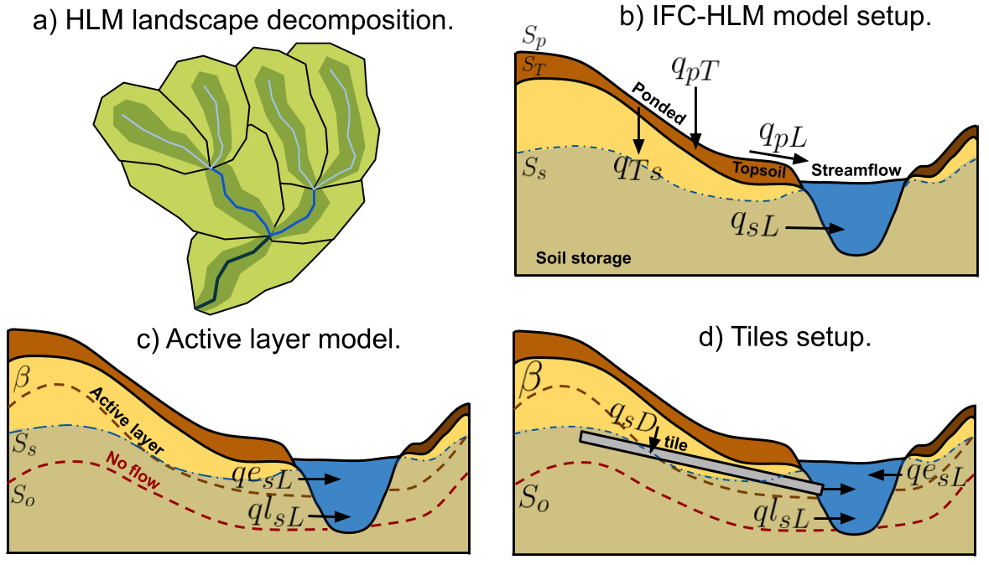
For the evaluation we use a version of the HLM model that has an active layer on the subsurface, and the option to include tile drainage.

Slide 3
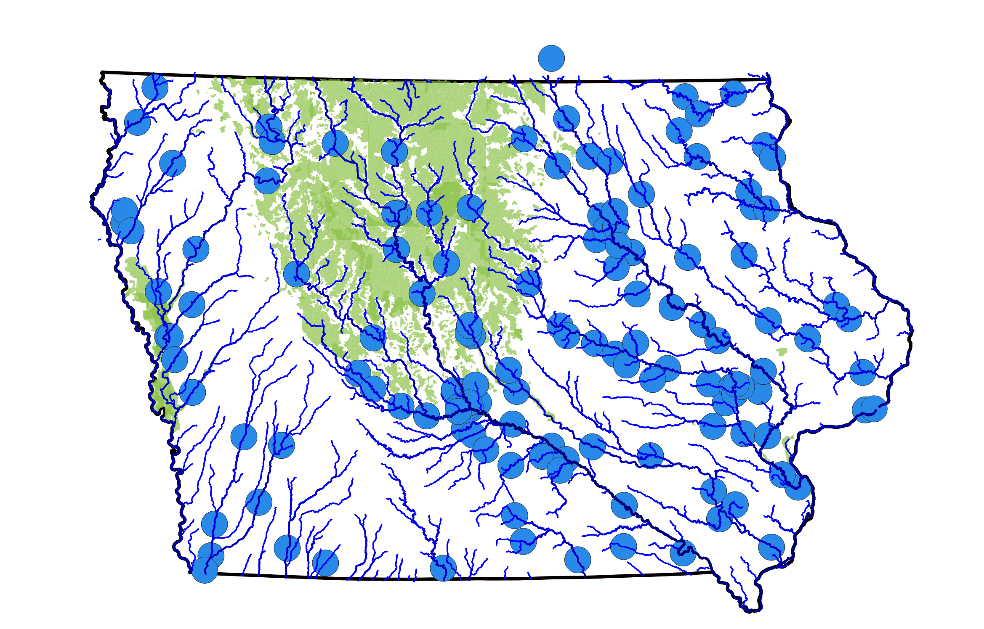
With the new model, we consider three new scenarios between 2002 and 2018: active layer (undrained), tiled (drained), and distributed drained (green).

Slide 4
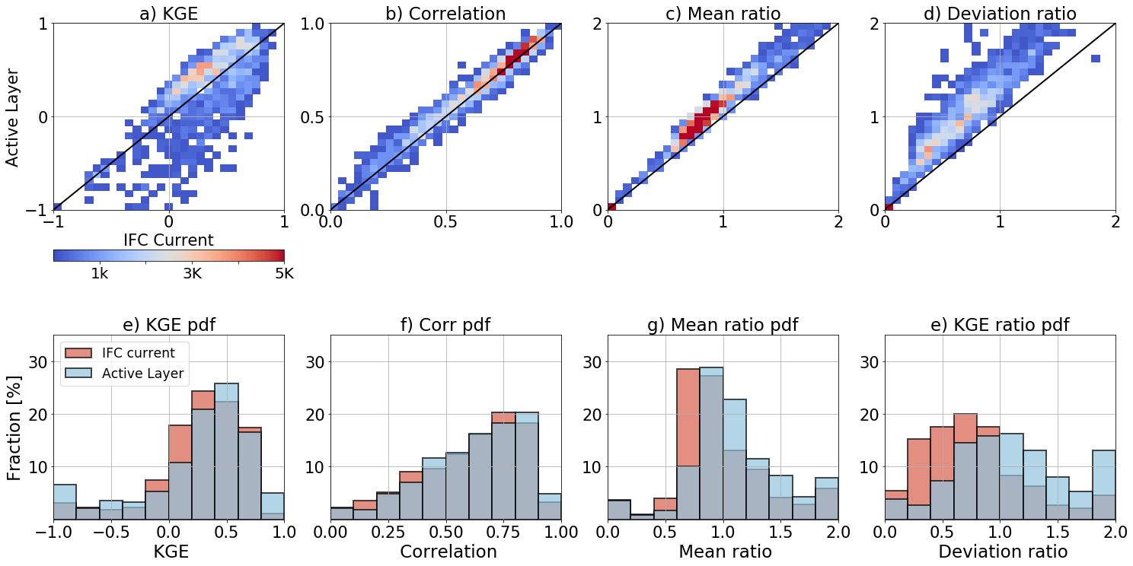
With the new model, we consider three new scenarios between 2002 and 2018: active layer (undrained), tiled (drained), and distributed drained (green).

Slide 5
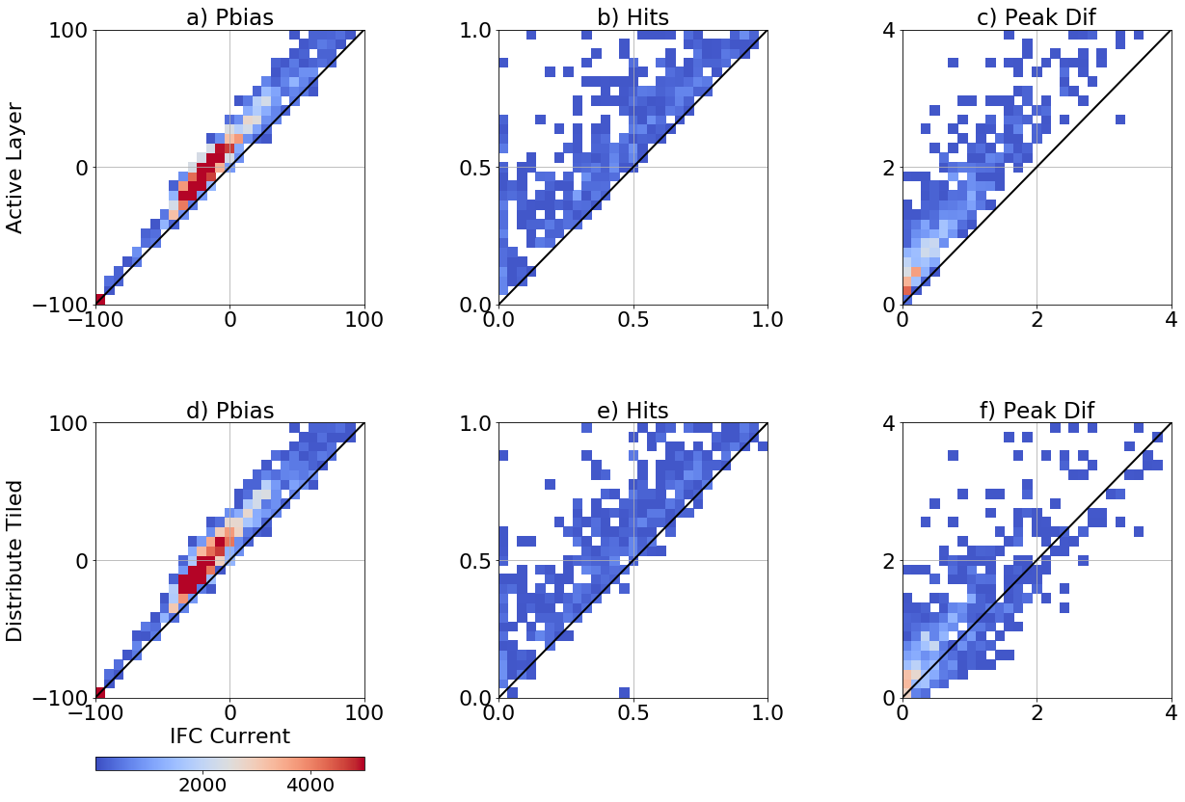
With the new model, we consider three new scenarios between 2002 and 2018: active layer (undrained), tiled (drained), and distributed drained (green).

Slide 6
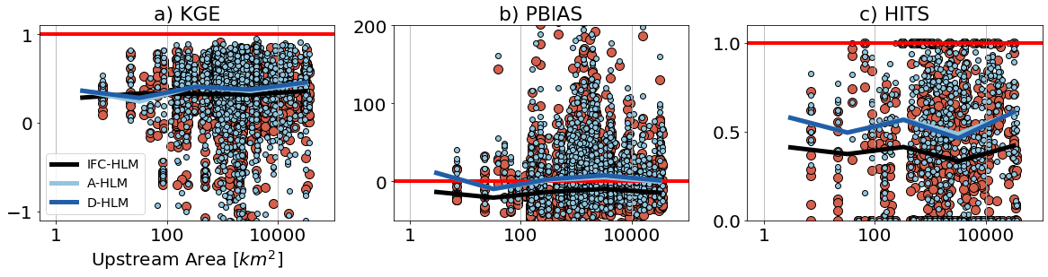
With the new model, we consider three new scenarios between 2002 and 2018: active layer (undrained), tiled (drained), and distributed drained (green).

Slide 7
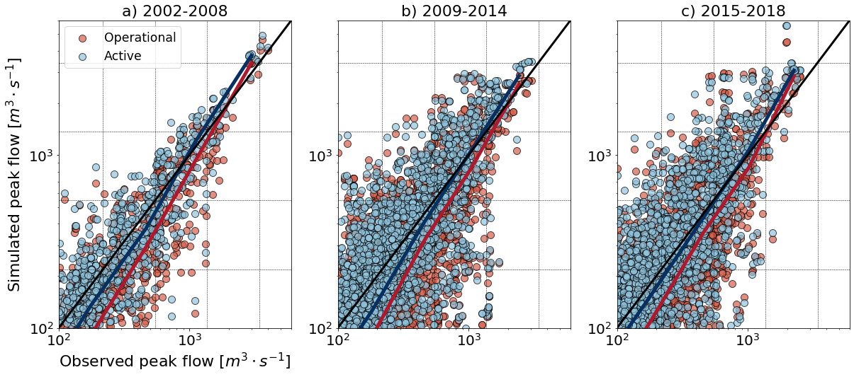
With the new model, we consider three new scenarios between 2002 and 2018: active layer (undrained), tiled (drained), and distributed drained (green).

Slide 8
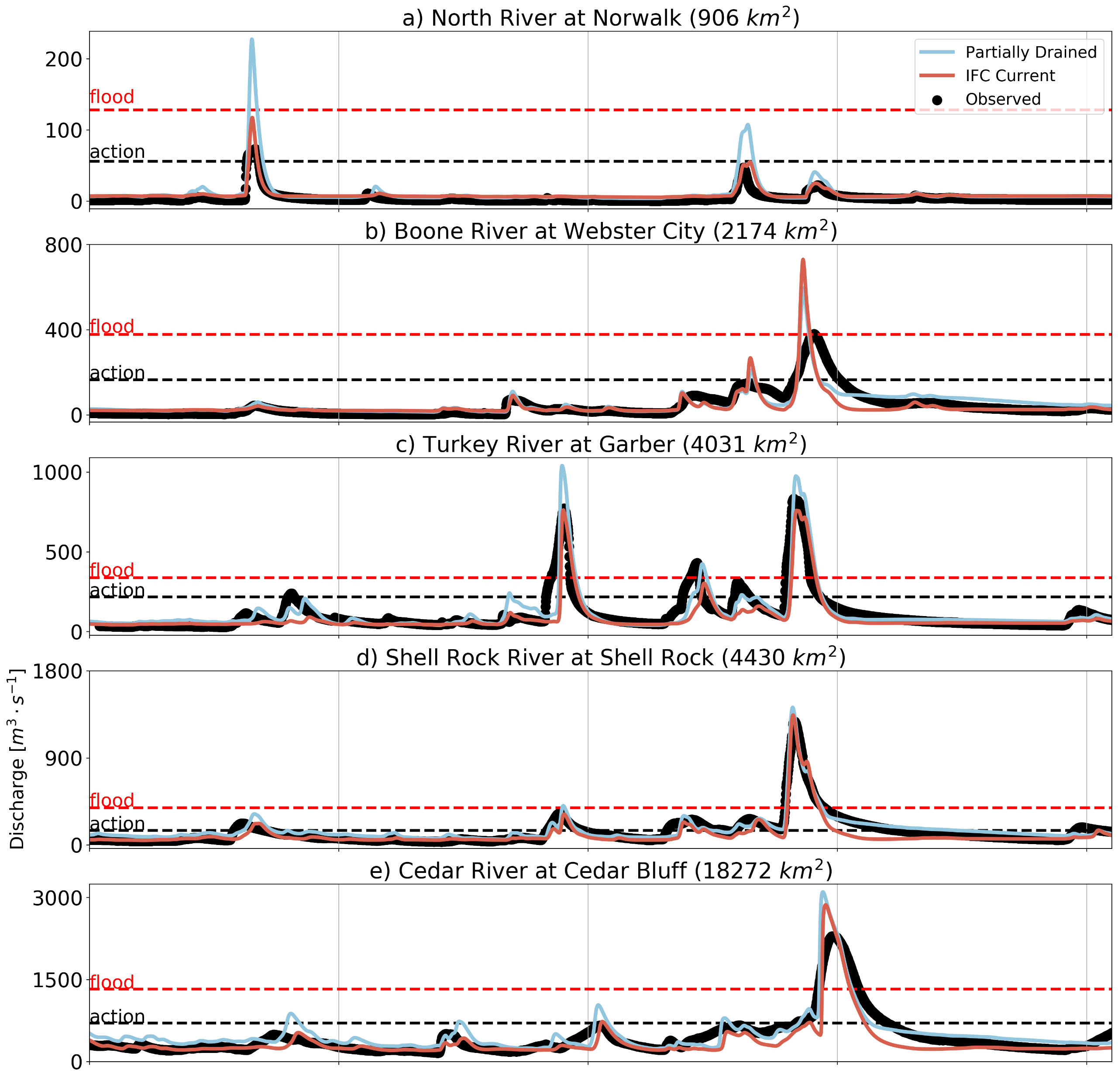
With the new model, we consider three new scenarios between 2002 and 2018: active layer (undrained), tiled (drained), and distributed drained (green).

