Slide 2
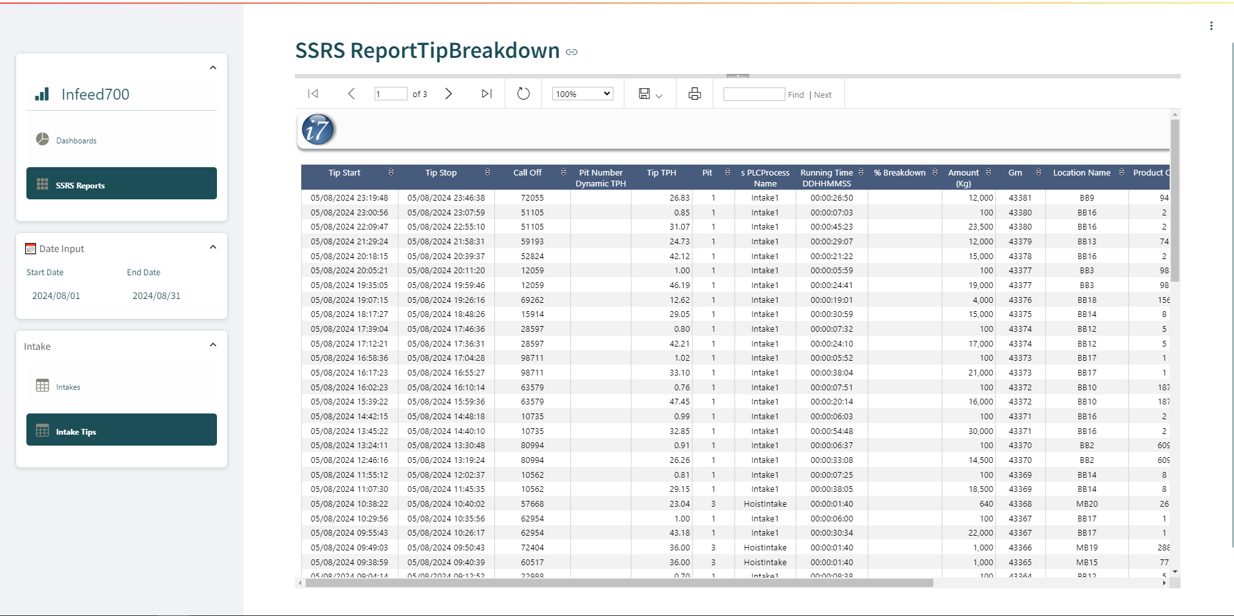

Slide 7





Infeed700
Dashboards
SSRS Reports
Start Date
End Date
2024/08/01
2024/08/31
Intake
Intakes
Intakes Tips

Slide 9




Infeed700
Dashboards
SSRS Reports
Start Date
End Date
2024/08/01
2024/08/31
Intake
Intakes
Intakes Tips

Slide 11



Infeed700
Dashboards
SSRS Reports
Start Date
End Date
2024/08/01
2024/08/31
Intake
Intakes
Intakes Tips

Slide 12
Infeed700
Dashboards
SSRS Reports
Start Date
End Date
2024/08/01
2024/08/31
Intake
Intakes
Intakes Tips

Slide 14
#BBC0C6

