Slide 1


Final Internship Defense
Société Générale
March 2016 – September 2016
Nicolas SOARES
soares_n

Slide 2
Sommaire
Context
Grid computing
GridAudit & GridSupervisor
Conclusion

Slide 3

Société Générale
150 years of expertise
150k collaborators – 76 countries
GNP 2015 : 23,5B €
3 pillars
Retail Banking
SG CIB
IBFS
Notes:
Main oldest french multinational banking & financial services company
First french banking group
150 years of expertise
150k collaborator
76 countries
Gross national product 2015 23,5B€
Pillars: retail banking 3000 agencies 12 millions individual clients
Online banking trading prestations boursorama bank
Boursorame website economical financial infos
Corporate & investment banking
3rd european investment bank
Market of shares, rates, exchanges
Advise merger/acquisition act commercial bank
Interationnal banking & financial service
Retail & investment expertise internationaly all continent
Operate effeciently need resources

Slide 4
SG resources organisation
RESG
ACH
GTS
IMM
INO
RET
MKT
EUS
IBF
MDM
APS
SSB
CLD
ENG
BKP
GRD
SUP
Notes:
Tree provide specific resource to bunisess partners in pillars
Global technology service, main biggest european computing infra service
85% computing infra of SG, workstations computing center computing telecom network
Counsel assists business lines functional divisions for implement° of projects
Market division, ensure proper functioning comput infra & client relationship business partner CIB
Server storage backup service
Assure admin maintenance backup market infra, handle sev projects ensure proper functioning of prod
Grid team, handle monitore grid comp plat & infra

Slide 5
The Grid team
Applications
ITEC
Informations & technology of Gobal Business Service
Grid
middleware
GTS Grid
OSs
Hardwares
GTS
Windows/Unix Team
Notes:
Middleware iTEC dep info & techno oof global business service of CIB pillar wich provide their own business partner application compute on grid plat
Gts deps handling hardw & OS of grid provide best env itec app work efficiently
Even composed different hardwaare running Oss, ITEc application run like one big supercomp no worry hardw OS compat

Slide 6


What is grid computing ?
Affordable
Fast
Robust
Scalable
Notes:
Collection heterogeneous affordable comput resource from multiple location
Reach common goal rquire intensive comput split goal small fractionsspread each node
Comput require large time &supercomputer achieved quickly cheaply, robust & scalable env
seti@home university california example instal software,participate analisis radio signal search sign extraterrestrial inteligence

Slide 7


The Grid platform
Grid platform
Desktop
scavenging
Middlewares
Symphony
LSF
Datacenters
Notes:
Detail
Composed various resources, servers ut also use desktop scavenging
Classic desktop comp of SG made part of grid when not used, night, minimal computing power, put together substantial computing power
Glued toogether by middlewares, distribute & viirtualize compute intensive appl service & process runned on many nodes composing grid
Symphony, high performance computing software system focus financial service industry<
Run several OS win linux solaris
Designed deliver scalability & enhance performance for comouter intensive risk and analytical app
3 quarter whole runned by
Platform load sharing facility, workload management platform & job scheduler distributed HPC
Execute jobs on etworked unix & win with different archi

Slide 8
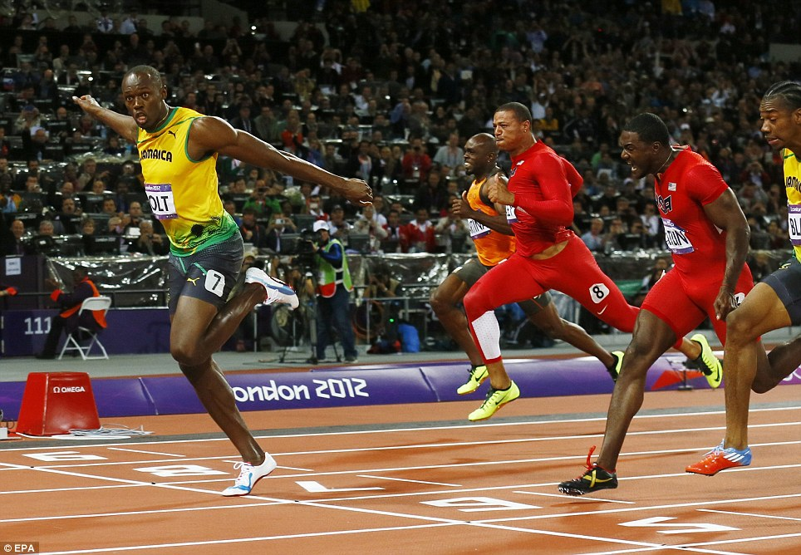
Why grid computing ?
Highly competitive environment
Need to be quick and accurate
  30 clusters
    6 000 servers
      90 000 cores
Critical business core
Business support
  1000 MKT collaborators – 24/7 – 3 continents
Monitoring
First = Winner
Notes:
Simple concept
Win when first
Highly competitive banking world
Ability quickly accuratle compute financ datas (financ risk, pricing) give meaningful advantage leader marketplace
Determinant factor success or fail trading transaction
To be competitive SG put in place largest grid compu plat banking env
30 cluster, 6000 servers, 90 000 cores
Xtreme criticality financial computation + need comput quick accurate
Can’t afford let grid down 1 second any issue identified fixed so no issue propagated end user
Project i worked come in

Slide 9
GridAudit & GridSupervisor
other monitoring projects
Computing Grid
DBs - APIs
Grid DB
GridHome
website
GridAudit
Consistency checks
GridSupervisor
Compliance checks
Notes:
Several tool constantly monitore nodes, gather enormous datas available databses api
Gridaudit
Request DB & API and directly requests nodes WMI request, windows interface provide info & control tools on systems
Detect store grid DB inconsistencies among source of infos
Then run postcheck detect inconsistencies outdated datas from previous check results alerts directly human mail
Gridsupeervisor looks compliance error on nodes
Alerts when error detected can also directly act on node like closing + maintenance
.net projects, , 3,5 4,5 adapt evolution .net 1 EVOL grid infra & tools
Gridaudit implement request of various API from deffirent services,, several checks process datas of api
Supervisor new compliance checks modified way compli alert raised, instad alerting direct mail, poluting mail & ard & long process
Modificed whole project & way alerts were created & formated to store alert o, DB alert monitored from gridhome platform
Website help dev & admin manage grid
Significantly reduce amount mail by day automated part of grid reporting saving precioustime increase work efectiveness

Slide 10
Conclusion
Technical
.NET / windows dev.
Grid computing
Personnal
Banking world
  Security
  Processes
  Criticality
Professional vision enlarged
Notes:
Technical
Highly imporved skill .net dev, windows dev
Detail inner working biggest comput grid
Personnal
Work practices & env massive company banking world
Fundamentalsecurity side
Secu main word define everything from process, require valid & cross valid each step any action done on infra
Ddefine diffeerent hierarchi layers ensure no mistake error propagate end user
Gigantic group, specially banking company new, previous pro exp startup small companies, enlarge vision professional world

Slide 11
Conclusion
Fulfilment of the Epitech curriculum
Technical skills and experiences
Teamwork mentality
Quick learning & versatility
Notes:
Peerfect conclusion epitech curriculum
Fulfilled every skill acqquired define epitech education
Technical skills & experience
Build teamwork mentality
Quick learning& versatility abilities

Slide 12
Questions ?

