Slide 1


Final internship defense
Société Générale
March 2016 – September 2016
Nicolas SOARES
soares_n

Slide 2
Sommaire
Context
Grid computing
GridAudit & GridSupervisor
Conclusion

Slide 3
Context
RESG
GTS
MKT
SSB
GRD
Ressources & innovations
Global Technologie Service
Wholesale bank division
Server Storage & Backup
Grid team
Application
ITEC (Informations & technology of Gobal Business Service)
Grid
middleware
GTS Grid
OS
Hardware
GTS
Windows/Unix Team

Slide 4


What is grid computing ?
Affordable
Fast
Robust
Scalable

Slide 5
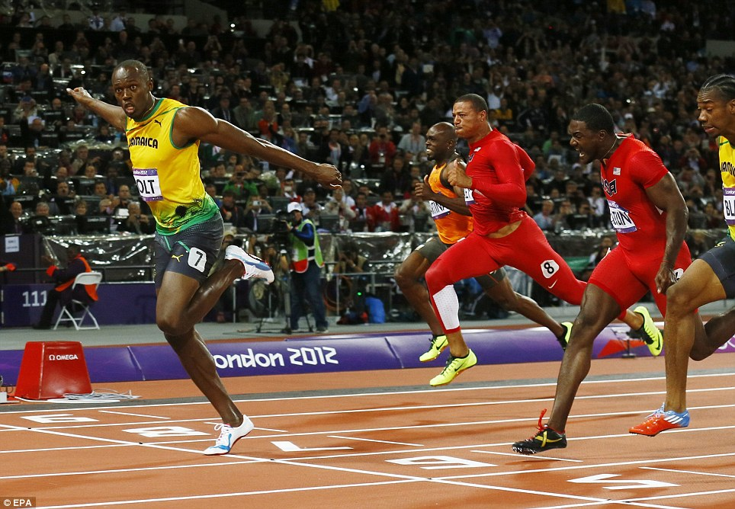
Why grid computing ?
First = Winner

Slide 6
GridAudit & GridSupervisor
other monitoring projects
Computing Grid
DBs - APIs
Grid DB
GridAudit
GridSupervisor

Slide 7
Conclusion
Technical
.NET / windows dev.
Grid computing
Personnal
Banking world
  Security
  Processes
  Criticality

Slide 8
Versatility
noun
1. Capacity of doing many things competently
2. Having varied uses or serving many functions

Slide 9
Questions ?

