Slide 1
Traffic Accidents Hotspots in Zürich City
Statistical Analysis of the Spatial Distribution of Traffic Accidents and their Categorical Subsamples in the City of Zürich from 2011 to 2019
Nicolas Beglinger / Nicolas Schmidheiny

Slide 2
Table of Contents
Research Problem
Data
Preliminary Results
Next Steps

Slide 3
Research Problem
Are there any hotspots or “especially dangerous spots” in the street network of Zürich City regarding traffic accidents? If yes, where are they located?
Do these hotspots spatially differ among different traffic participants involved (eg. cyclists, pedestrians, motorcyclists) or are they located at the same locations?

Slide 4
Data
The Project is based on a single dataset provided by Open Data Stadt Zürich containing all traffic accidents registered by the police in the City of Zürich between 2011 and 2019.
The dataset is structured in different attributes like for example the involvement of pedestrians and cyclists, but also the severity of the accident, the road type on which the accident occurred, the accident type (e.g. parking), as well as spatio-temporal information.

Slide 5
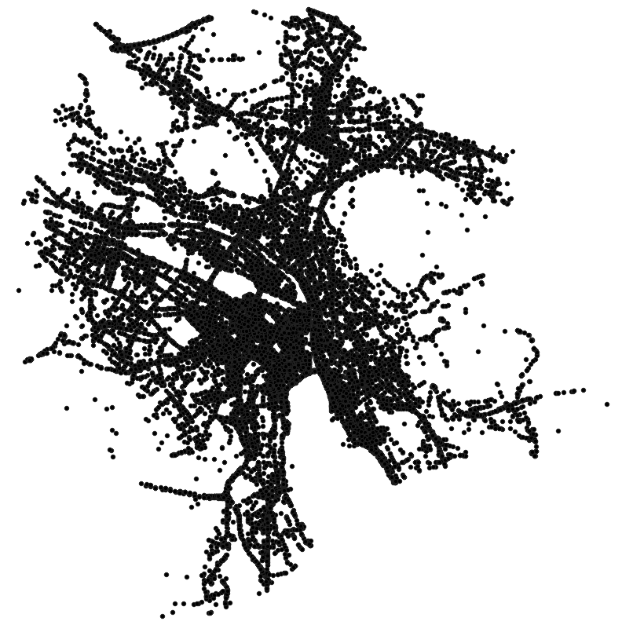
Preliminary Results

Slide 6
Next Steps
Elaborate a significance-test for the hotspots
Find a way to take the severity of the accidents into account
Provide a priority-list with the most dangerous locations in the city of Zürich for every traffic participants-category, by which traffic planners could make decisions about how to improve safety on these spots

Slide 7
References
Traffic Accidents Data: https://data.stadt-zuerich.ch/dataset/sid_dav_strassenverkehrsunfallorte

