Slide 1
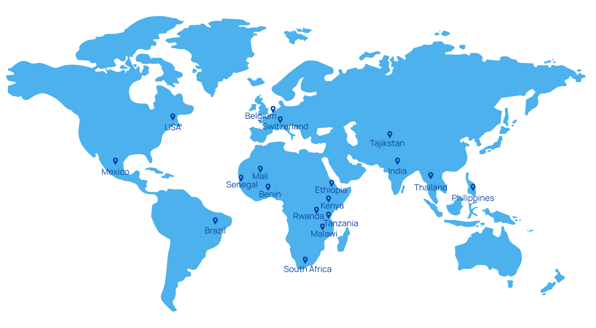

STUDENT PRESENTATION
EPFL
Global Health
Dataset Catalog
Web application for dataset discovery, validation and cataloguing
Nicolas Berlin
Supervised by: David Sasu, Aurélien Macé
September 2026
1
Notes:
Introduce the project as a web application and data-engineering MVP, not as a scientific dataset analysis project.

Slide 2

OVERVIEW
Presentation outline
01
Context & problem
Project focus
02
Project objective
A metadata-first catalogue that helps users find dataset pages and inspect validated access links.
03
System architecture
04
Workflows & implementation
05
Current status & future work
2
Notes:
Set expectations: this is a software project focused on search, collection, validation and cataloguing.

Slide 3
CONTEXT & PROBLEM
Why this application is needed
01
02
03
Heterogeneous sources
Manual checks
No unified workflow
Dataset pages are spread across repository metadata, open-data portals, APIs and regular websites.
Users still need to verify relevance, dataset-page identity, download links and API availability.
Search, classification, validation and persistence are often handled as separate steps.
The project addresses the workflow around dataset metadata. It does not perform scientific analysis of the datasets.
3
Notes:
Use this slide to avoid over-claiming: the issue is not a new medical discovery, it is a discovery and cataloguing workflow problem.

Slide 4
PROBLEM STATEMENT
Technical users need one workflow to discover, classify, validate and catalogue global health dataset pages.
FROM A DATA ENGINEERING / SOFTWARE ENGINEERING PERSPECTIVE
Scope: the application stores metadata and access links; it does not download or retain full dataset files.
4
Notes:
This is the concise problem statement to say aloud. It is deliberately focused on users and workflow.

Slide 5
PROJECT OBJECTIVE
Project objective and scope
How can one application discover and catalogue global health datasets across heterogeneous sources?
1
2
3
Search & discover
Classify & validate
Catalogue & inspect
Search local PostgreSQL first and fall back to external repository metadata when needed.
Use EPFL RCP to classify candidates and validate candidate download/API links.
Persist datasets that pass page classification and distribution validation.
5
Notes:
Frame the objective as an application objective, not a research hypothesis.

Slide 6
SYSTEM ARCHITECTURE
React, FastAPI, services and PostgreSQL
Repository search
DataCite + RCP relevance
React/Vite
frontend
FastAPI
backend
PostgreSQL
sources, jobs and catalogue
Collector pipeline
Discovery + page RCP
+ link validation
FastAPI orchestrates search and collection. PostgreSQL supports local lookup, job state and validated persistence.
6
Notes:
Walk through the main components and emphasize separation of concerns.

Slide 7
WORKFLOW 1
Repository search and automatic collection
No local match
Accepted
User
query
PostgreSQL
search
DataCite
fallback
RCP relevance
check
Reserve or reuse
collection job
PostgreSQL
persistence
Local match
Return immediately
Rejected
No collection
Page RCP +
link validation
Valid only
Accepted includes relevant and somewhat relevant. External repository metadata is never copied directly into the catalogue.
7
Notes:
Explain the two-stage logic: search produces candidates; automatic collection validates before saving.

Slide 8
WORKFLOW 2
Source collection pipeline
Configured
source
Discover source
through an adapter
Metadata +
distribution extraction
RCP page
classification
Download / API
validation
PostgreSQL
Accepted repository
candidate
Open candidate
landing page only
Discovery families for configured sources
CKAN
Socrata
data.json / DCAT
Generic websites
The catalogue retains only datasets accepted by the page classifier and backed by at least one valid distribution.
8
Notes:
Show how manual source collection and automatic candidate collection share the same downstream gates.

Slide 9
IMPLEMENTATION
Technology stack and API contracts
React/Vite
FastAPI
PostgreSQL
Frontend interface, progressive status and result display
HTTP validation, routes and job orchestration
Search, sources, jobs, datasets and distributions
Python collector
EPFL RCP
Discovery, extraction, classification and validation
LLM-based relevance and page classification
Main API entry points
Search and fallback POST /collector/search-datasets
Classify + reserve POST /collector/classify-repository-result
Track collection GET /collector/collection-jobs/{id}
Inspect catalogue GET /collector/collected-datasets
9
Notes:
Mention that the API contract can also be inspected through Swagger during local development.

Slide 10
CURRENT STATUS
Implemented capabilities in the MVP
Search previously collected datasets in PostgreSQL
Discover pages from CKAN, Socrata, data.json/DCAT and websites
Fall back to DataCite when no local result is found
Classify dataset pages and validate download/API links
Classify external candidates and automatically collect accepted results
Persist only datasets that pass every validation gate
Status: under active development; current catalogue contains seeded official sources but does not yet guarantee source officiality for every collected dataset.
10
Notes:
This slide summarizes what currently exists. Keep wording careful around source officiality.

Slide 11
QUALITY GATES
Validation and bounded execution
A
B
C
Page classification
Distribution validation
Network safety
The page classifier checks whether a discovered page is an individual health-relevant dataset record.
HEAD requests and bounded partial GETs verify link availability and avoid retaining HTML as data files.
Public HTTP guards reject private/local destinations and re-check redirect targets.
Design principle: fail visibly rather than silently accepting uncertain or malformed results.
11
Notes:
Use this to show the project is not just a simple CRUD app; it contains validation gates and safety controls.

Slide 12
LIMITATIONS & FUTURE WORK
What remains to be improved
Current limitations
Next steps
• Source authority and licensing policies are not fully enforced
• One repository provider and one RCP voter
• Deduplication relies on the normalized dataset URL
• Background jobs are process-local
• No authentication, monitoring or human review workflow
• Evaluate additional repository providers and independent models
• Strengthen official-source and licensing checks
• Add a durable worker queue and retry policy
• Improve deduplication by DOI, title and version
• Harden production deployment and add a review interface
12
Notes:
Position future work as natural engineering hardening rather than failure of the current MVP.

Slide 13
Key takeaway
The catalogue turns scattered dataset pages into searchable metadata.
Every saved record passes automated classification and link validation.
React frontend
FastAPI + collector
PostgreSQL catalog
13
Notes:
Finish by repeating the core pipeline and software value.

