Slide 1
Data Management, Winter 2026/27 · Group project
From raw race results to a FAIR, quality-assured knowledge graph
Formula 1 World Championship results 1950–2025
Student A
FAIR assessment and metadata design
Chirag Adhikari
Student B
Data quality and profiling
Manohar Zalki
Student C
Data cleaning and pipeline
Nicolas Bonilla
1 / 17
Notes:
Good morning, we are Chirag Adhikari, Manohar Zalki and Nicolas Bonilla. We take 75 years of Formula 1 results from raw files to a FAIR, quality-assured dataset and a knowledge graph. I start with the dataset and FAIR, Manohar Zalki covers quality, Nicolas Bonilla the cleaning, and we close with the graph.

Slide 2
76 seasons of F1 results with real quality issues
Why this dataset
25,907
1,149
Relational: one fact table and four reference tables
Genuine issues from 76 seasons of rule changes and file exports
A natural network of drivers, teams, circuits and countries
race results (one row per car per race)
championship Grands Prix
817
77
drivers and 203 constructor entries
circuits in 34 countries
Source: Ergast database via the Jolpica-F1 API (also mirrored on Kaggle). Sprint races are out of scope.
Presenter: Student A · Chirag Adhikari
2 / 17
Notes:
Our dataset is the Ergast Formula 1 database, which the group downloaded from its successor, the Jolpica API. The core table has 25,907 race results: one row for every car in every championship Grand Prix since 1950, 1,149 races in total, linked to tables of races, circuits, drivers and constructors. We chose it for three reasons. It is relational, so joins and keys matter. Its quality problems are real: they come from 76 seasons of changing rules and from how the files were exported, not from planted errors. And drivers, teams and circuits form a natural network, which is ideal for graph modelling.

Slide 3
One command rebuilds every deliverable
Step 0
B
C
A
Graph
Web
Extract
Profile
Clean
Describe
Model
Show
25,907
29
55/55
54→93%
30,141
7
raw rows, values unchanged
issues in 7 quality dimensions
validation gates passed
RDA FAIR maturity
typed relationships
dashboard views, live
python run_all.py --from-scratch
Deterministic: two runs give byte-identical files · 14 automated tests · no network needed
Presenter: Student C · Nicolas Bonilla
3 / 17
Notes:
Everything you will see comes from one pipeline. Step zero only flattens the raw archive into CSV files and records checksums; it never changes a value. Component B profiles those files and writes an issue register with 29 entries. Component C resolves every issue and only publishes data that passes all 55 validation gates. Component A describes the clean package with standard metadata, and the graph is built from validated output only. A single command rebuilds every file in about a minute, and two independent runs give byte-identical results, so every number in our report is reproducible.

Slide 4
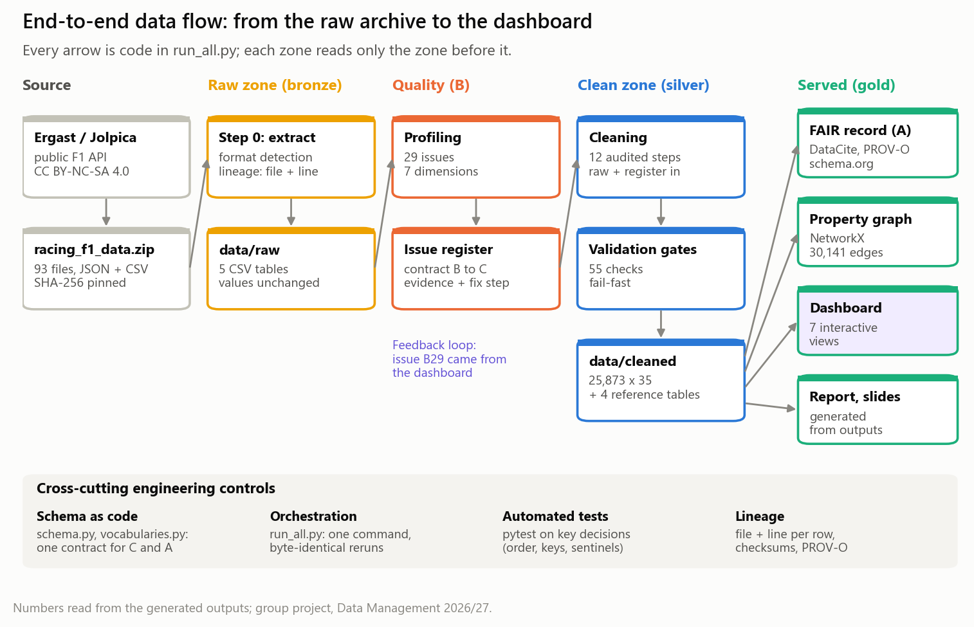
Data engineering: zones, contracts and controls
Presenter: Student A · Chirag Adhikari
4 / 17
Notes:
Here is the architecture behind it. Data move through zones: an immutable raw zone that keeps the source values and their lineage, a clean zone that is only written when every validation gate passes, and served products: the FAIR record, the graph, the dashboard and the report. Underneath are four engineering controls: one schema contract shared by cleaning and metadata, one orchestrated command, automated tests, and lineage down to the source line.

Slide 5
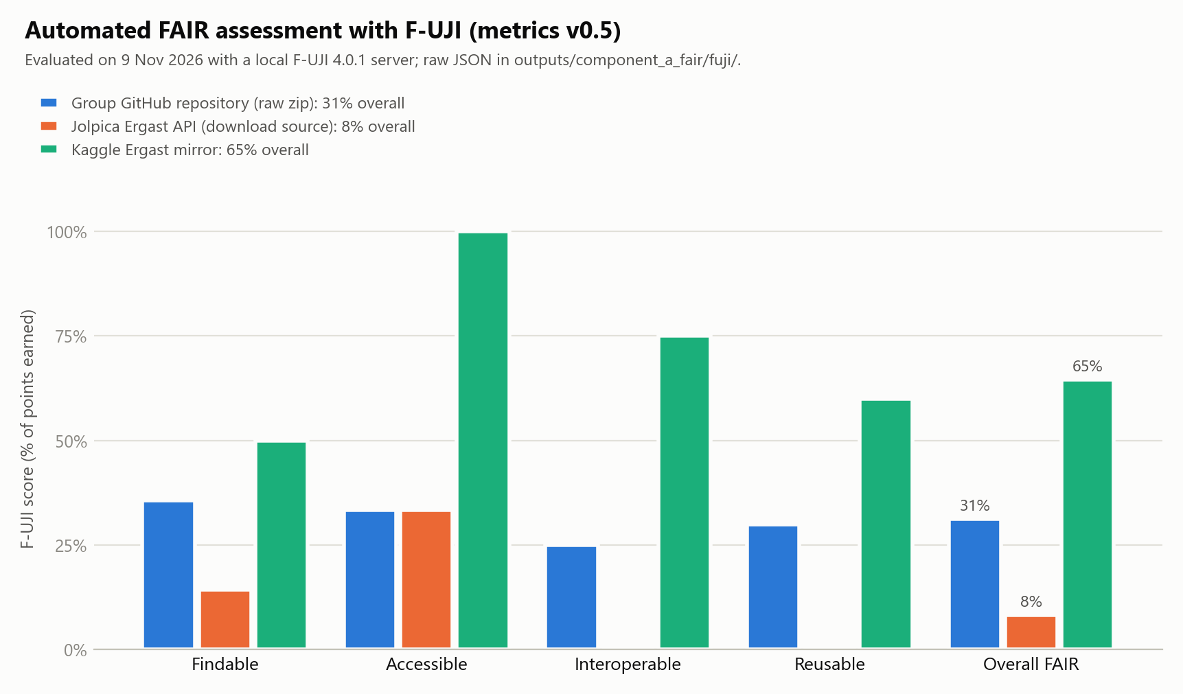
As obtained, the data is hard to find and reuse
54% → 93%
RDA maturity, 41 indicators: as obtained → our package
6/20 → 12/20
essential indicators met
Findable stays at level 0 until a DOI is actually minted.
Presenter: Student A · Chirag Adhikari
5 / 17
Notes:
We measured FAIRness twice. First automatically with F-UJI, run on a local server against the three places where the data lives. The Jolpica API we downloaded from scores only 8 percent, our own GitHub repository 31 percent, and the Kaggle mirror 65 percent. Because F-UJI only sees what is online, we also scored all 41 indicators of the RDA maturity model with written evidence. Our curated package lifts maturity from 54 to 93 percent. Findable honestly stays at level zero until the DOI is minted.

Slide 6
Biggest gaps: no identifier, conflicting licences
Who says what about the licence?
What our package adds
98.7%
of drivers linked to Wikidata IDs (circuits 100%)
Ergast (original source)
Non-commercial use only
Jolpica-F1 (our download)
CC BY-NC-SA 4.0
DataCite 4.5
record validated against the official XSD
Kaggle mirror
Claims CC0, public domain
Our GitHub repository
MIT licence for everything
ISO + PROV
ISO 3166 country codes, W3C provenance, checksums
DOI
via Zenodo: reserved now, minted on deposit
Fix: data under CC BY-NC-SA 4.0, code under MIT, with attribution
Presenter: Student A · Chirag Adhikari
6 / 17
Notes:
We documented 7 concrete FAIR gaps, each with indicator, evidence and remedy. Two stand out. First, there is no persistent identifier: the data is only reachable through URLs that can change. Second, the licences contradict each other. Ergast allowed only non-commercial use and Jolpica licenses the data CC BY-NC-SA, yet the Kaggle mirror claims public domain and our own repository says MIT for everything. We fixed what we can: a clear licence split, a DataCite record that validates against the official schema, ISO country codes, provenance, and Wikidata identifiers for 98.7 percent of drivers. The DOI is reserved and minted on deposit.

Slide 7
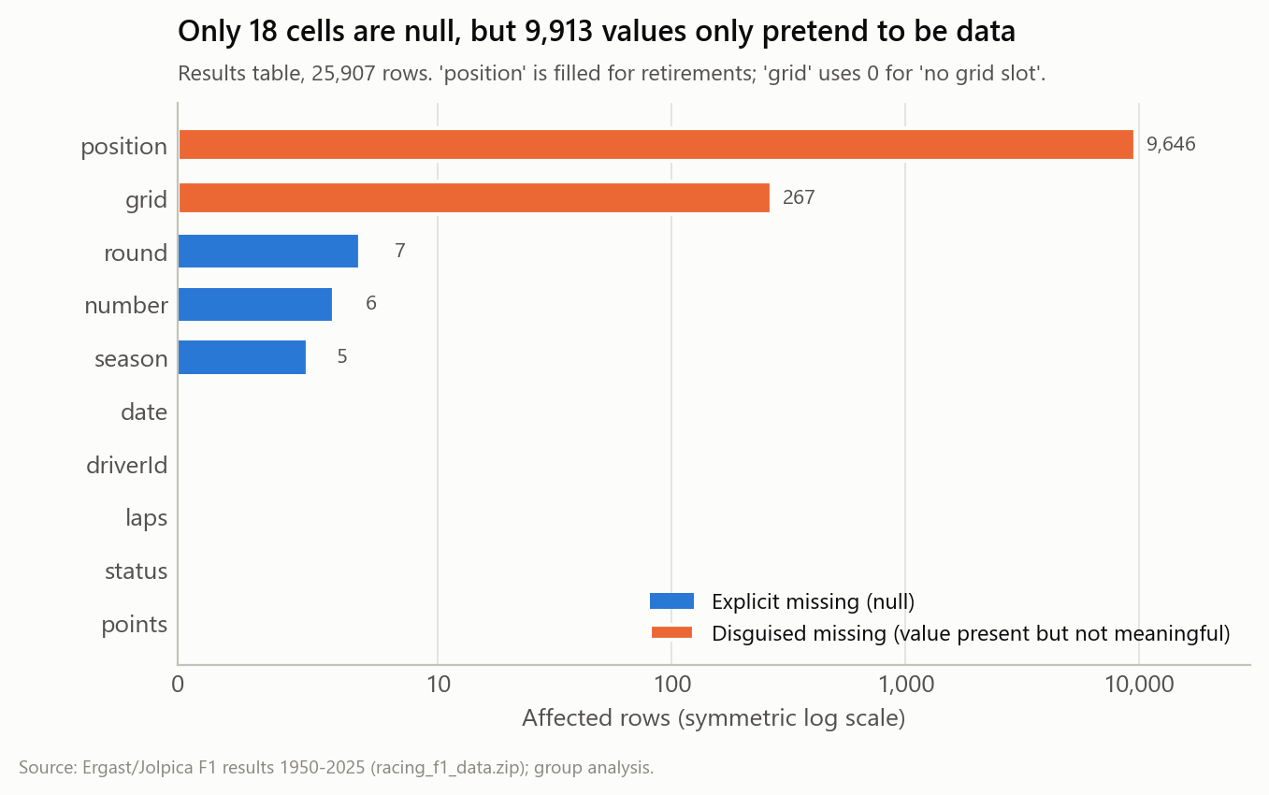
Completeness is deceptive: 9,913 hidden gaps
18
explicit nulls: the table looks 99.9% complete
9,646
'positions' that are really retirements
267
cars on a fictitious 'grid slot 0'
Presenter: Student B · Manohar Zalki
7 / 17
Notes:
I profiled every column of all five tables and ran 29 quality rules. The first lesson: completeness is deceptive. Only 18 cells are empty, so the table looks almost perfect. But 9,913 values only pretend to be data. The position column is filled for 9,646 drivers who retired, withdrew or were disqualified, and 267 cars start from grid slot zero, which does not exist. A model that predicts results from grid positions would learn from a retirement ranked eighteenth and from a fictitious pole-better-than-pole.

Slide 8
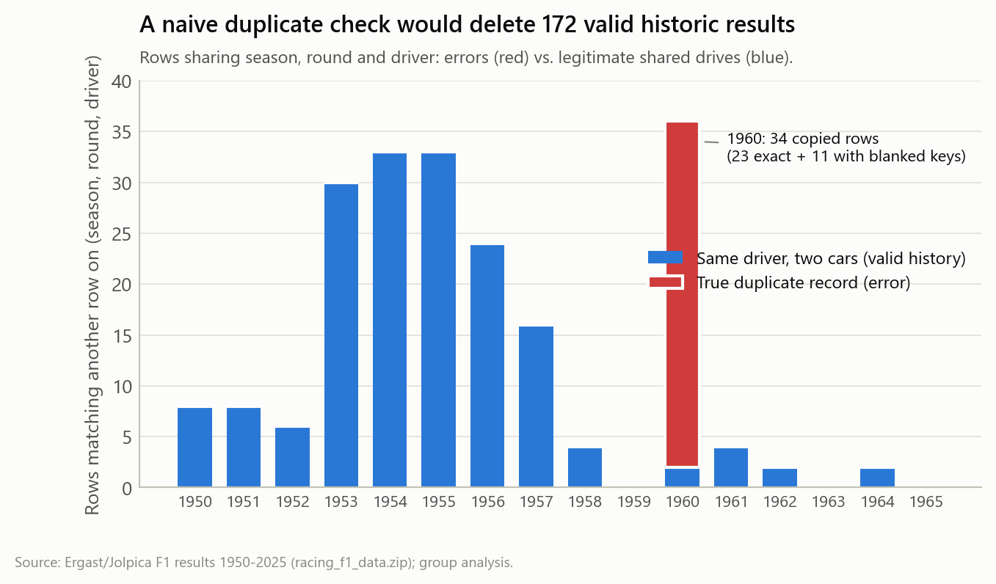
A naive duplicate check deletes real history
34
true duplicates, all from 1960
11
of them hidden behind blanked keys
172
valid rows: one driver, two cars in a race
Correct key: season, round, driver and car number
Presenter: Student B · Manohar Zalki
8 / 17
Notes:
Uniqueness needs domain knowledge. 23 rows of the 1960 United States Grand Prix were appended twice, and 11 rows of the 1960 Italian Grand Prix are copies whose season and round were blanked, so they only look like duplicates after the keys are restored. The red bar is the real problem. The blue bars are not: 172 rows share season, round and driver because in the 1950s a driver could take over a team-mate's car and be classified twice. A naive duplicate check would delete that history. The correct key includes the car number.

Slide 9
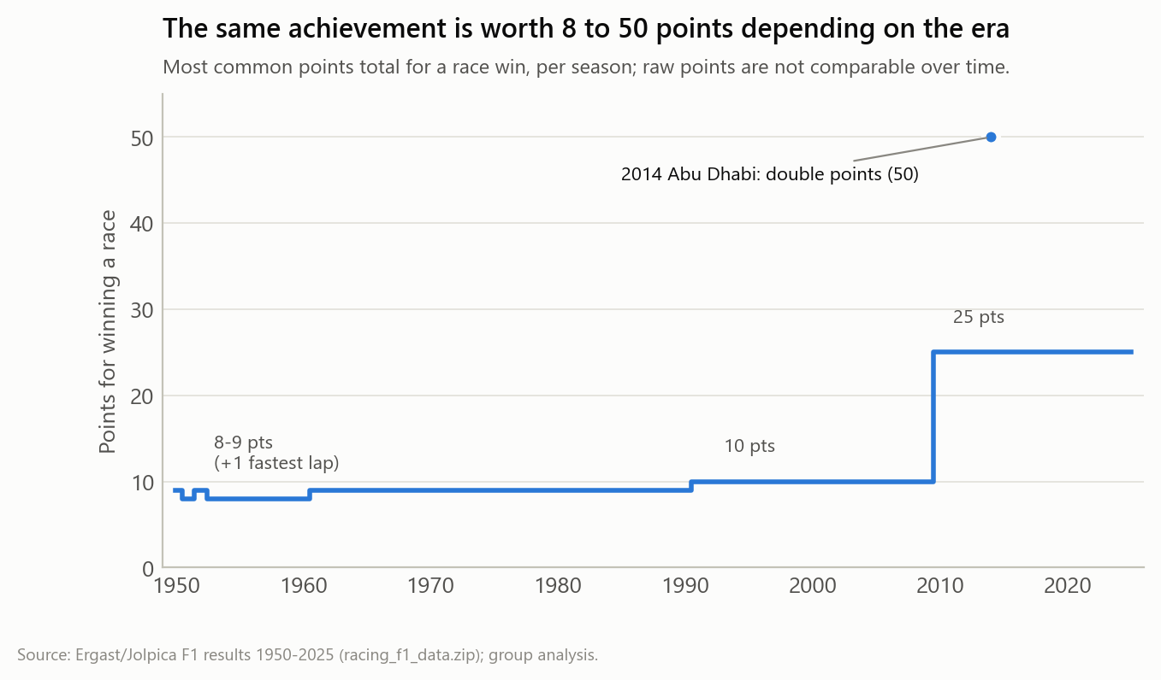
Valid history can look like bad data
8–50
points for the same achievement: winning a race
270
lap 'outliers', all valid Indianapolis 500 results: flag, never delete
Impact on data science and AI
Inflated wins from duplicated rows
Biased targets: a retirement as '18th'
Era bias in all-time rankings
Presenter: Student B · Manohar Zalki
9 / 17
Notes:
Some issues are not errors at all, but they still break analyses. A race win was worth 8, 9, 10, 25 or even 50 points depending on the era, so raw points are not comparable over time. All 270 statistical outliers in laps are valid Indianapolis 500 results, so we flag them instead of deleting them. The root causes are export artefacts, undocumented source semantics and genuine historical change. For data science the impact is concrete: inflated win counts, biased prediction targets, sparse features from 136 free-text statuses, and train-test leakage through duplicated rows.

Slide 10
Order matters: repair keys, then de-duplicate
Naive order
Our order (steps C02 → C03)
1. Remove exact duplicates
2. Repair missing keys
1. Restore season (5) and round (7) by exact lookup
2. Remove exact duplicates
11
34
duplicates survive, hidden by the blanked keys
duplicates removed, none left; a unit test locks this in
No invented values
Grid 0 becomes missing plus a flag (267 rows); no statistical imputation anywhere
Keys come only from deterministic lookups: the file name and races.csv
Presenter: Student C · Nicolas Bonilla
10 / 17
Notes:
The most important design decision was the order of operations. If you remove duplicates first and repair keys afterwards, 11 duplicates survive, because their season and round were blanked. So step C02 restores the missing season from the file name and the missing round by an exact lookup in the races table, and only then does step C03 remove all 34 copies. A unit test documents both orders. We also never invent values: no statistical imputation is used. Grid zero becomes missing with a flag, and withdrawn cars keep a missing number because none ever existed.

Slide 11
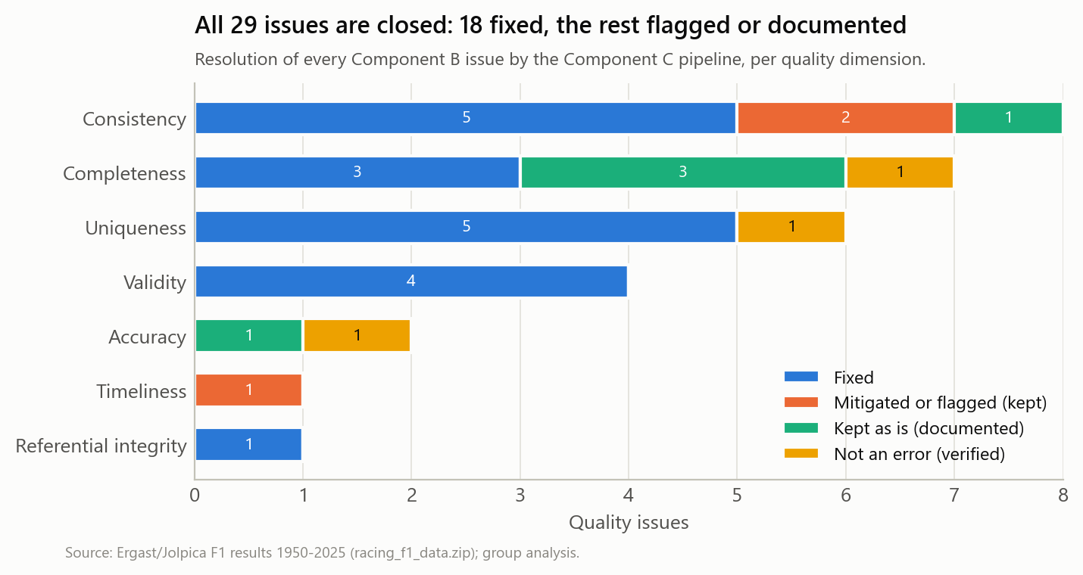
Every issue closed, every output validated
55/55
validation gates passed; one failure blocks publishing
18 of 29
issues fixed, the rest flagged, kept or verified
25,873
clean rows, 35 documented columns, an audit record per step
Flag, don't delete: Indy 500 rows, shared drives and status conflicts stay, with flags
Presenter: Student C · Nicolas Bonilla
11 / 17
Notes:
Every one of the 29 issues is now closed: 18 are fixed, 3 are mitigated or flagged, 5 are kept and documented, and 3 were verified as non-errors. Our rule is flag, don't delete: Indianapolis 500 rows and shared drives stay in the data with flags. Status went from 136 free-text values to 8 groups. Every step writes an audit record, and 55 validation gates check schema, keys, foreign keys and vocabularies. If a single gate fails, nothing is published as clean. The final table has 25,873 rows and 35 documented columns.

Slide 12
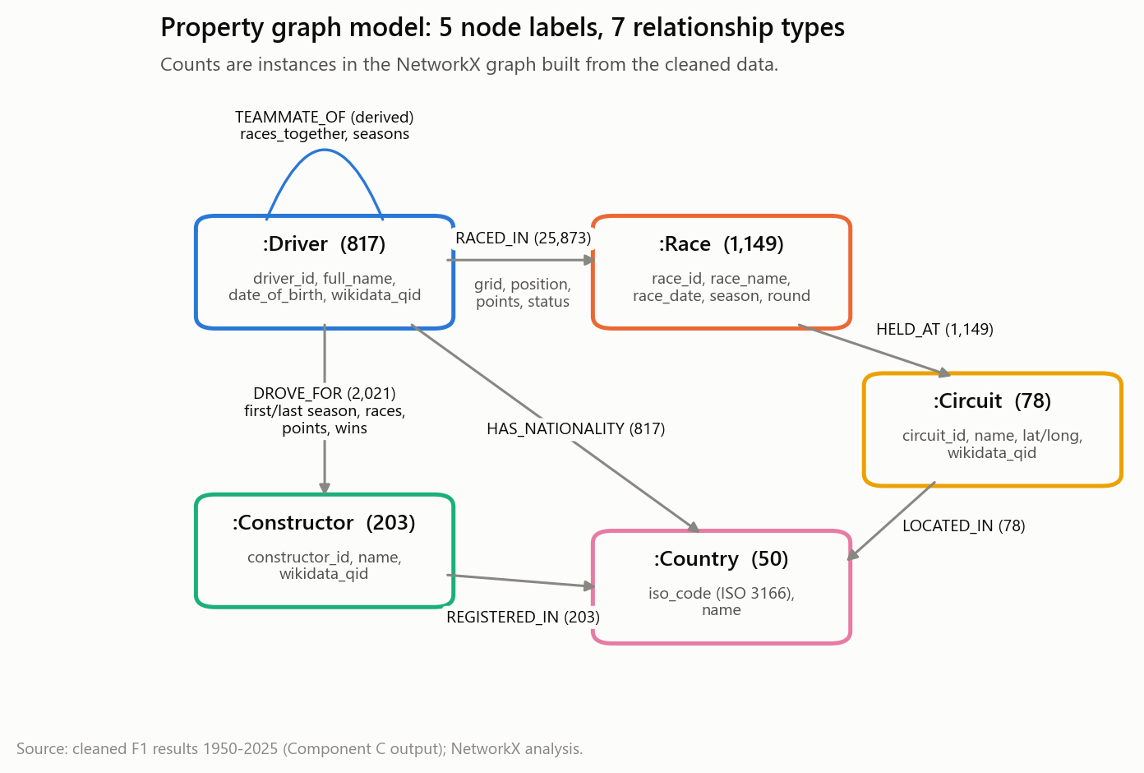
75 years of F1 form a small world
0.41
4.8
clustering (random graph: 0.014)
team-mate links between two drivers on average
Fangio → Verstappen in 8 steps
Fangio → Bonnier → Andretti → Giacomelli → de Cesaris → Barrichello → Button → Pérez → Verstappen
NetworkX MultiDiGraph: 2,297 nodes, 30,141 typed edges, exported to GEXF for Gephi
Presenter: Student B · Manohar Zalki
12 / 17
Notes:
For the graph we modelled the cleaned data as a property graph: drivers, races, constructors, circuits and countries, with results stored as properties on RACED_IN edges, and a derived TEAMMATE_OF relationship. Indianapolis 500 rounds are excluded from the team-mate projection, a direct consequence of the quality analysis. The result is a small world: clustering is 0.41 against 0.014 for a random graph, yet two drivers are on average only 4.8 links apart. Juan Manuel Fangio reaches Max Verstappen in 8 steps, through long careers such as de Cesaris and Barrichello.

Slide 13
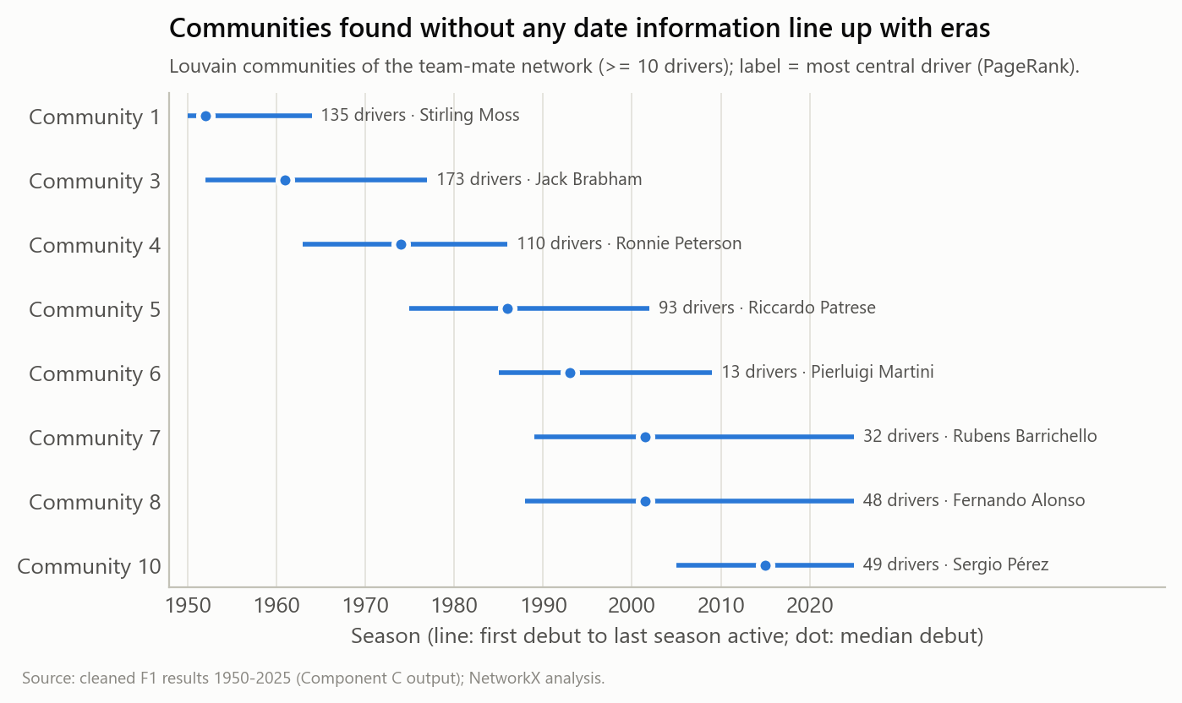
Communities rediscover the eras by themselves
11
Louvain communities, modularity 0.70
0.15
highest betweenness; top bridges: Bonnier, Brabham, de Cesaris
Caveat
Before the 1970s 'constructor' means the chassis make that private entrants shared, which inflates early drivers' degree.
Presenter: Student A · Chirag Adhikari
13 / 17
Notes:
Louvain community detection finds 11 communities with a modularity of 0.70. The algorithm never sees a date, yet the large communities line up with eras, from the fifties around Stirling Moss and the sixties around Jack Brabham to the present grid around Sergio Pérez. Betweenness highlights bridges between eras such as Jo Bonnier and Andrea de Cesaris. One caveat links back to data quality: before the seventies the constructor field records the chassis make shared by private entrants, so early drivers look more connected than they were.

Slide 14
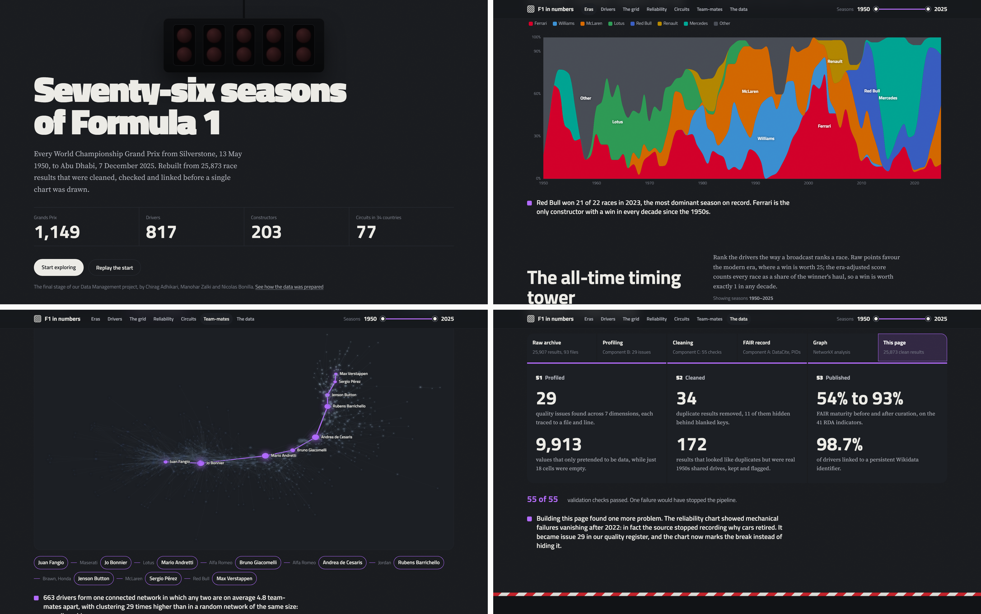
The project, live: our interactive dashboard
Built only from validated outputs
build_web_data.py reads the clean tables, graph metrics, issue register and FAIR scores
run_all.py rebuilds it as its last step
It found issue B29: retirement causes not recorded from 2023
Live demo
streamlit run app.py
then localhost:8501
Presenter: Student C · Nicolas Bonilla
14 / 17
Notes:
Everything we showed ends here, in an interactive dashboard that the group can open with one command. It reads only validated outputs: the clean tables, the graph metrics, the issue register and the FAIR scores, and run_all rebuilds it as its last step. It also paid back: the reliability view showed mechanical failures vanishing after 2022, which turned out to be the source no longer recording why cars retired. That became issue B29. If time allows, we open it live.

Slide 15
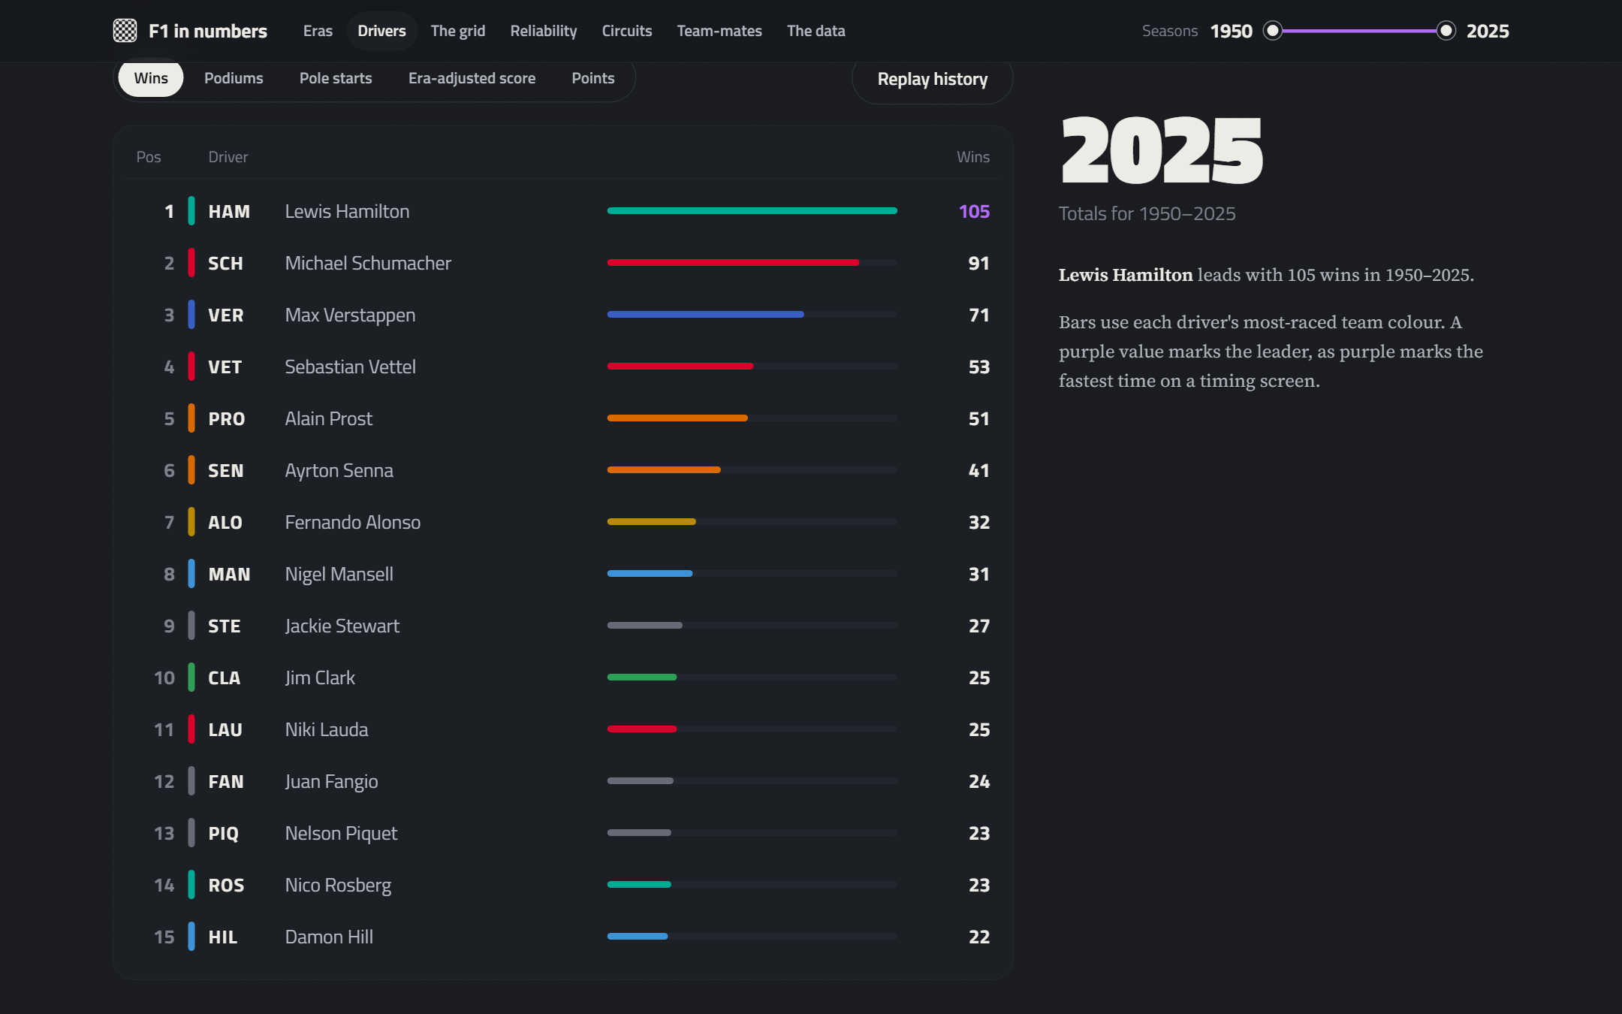
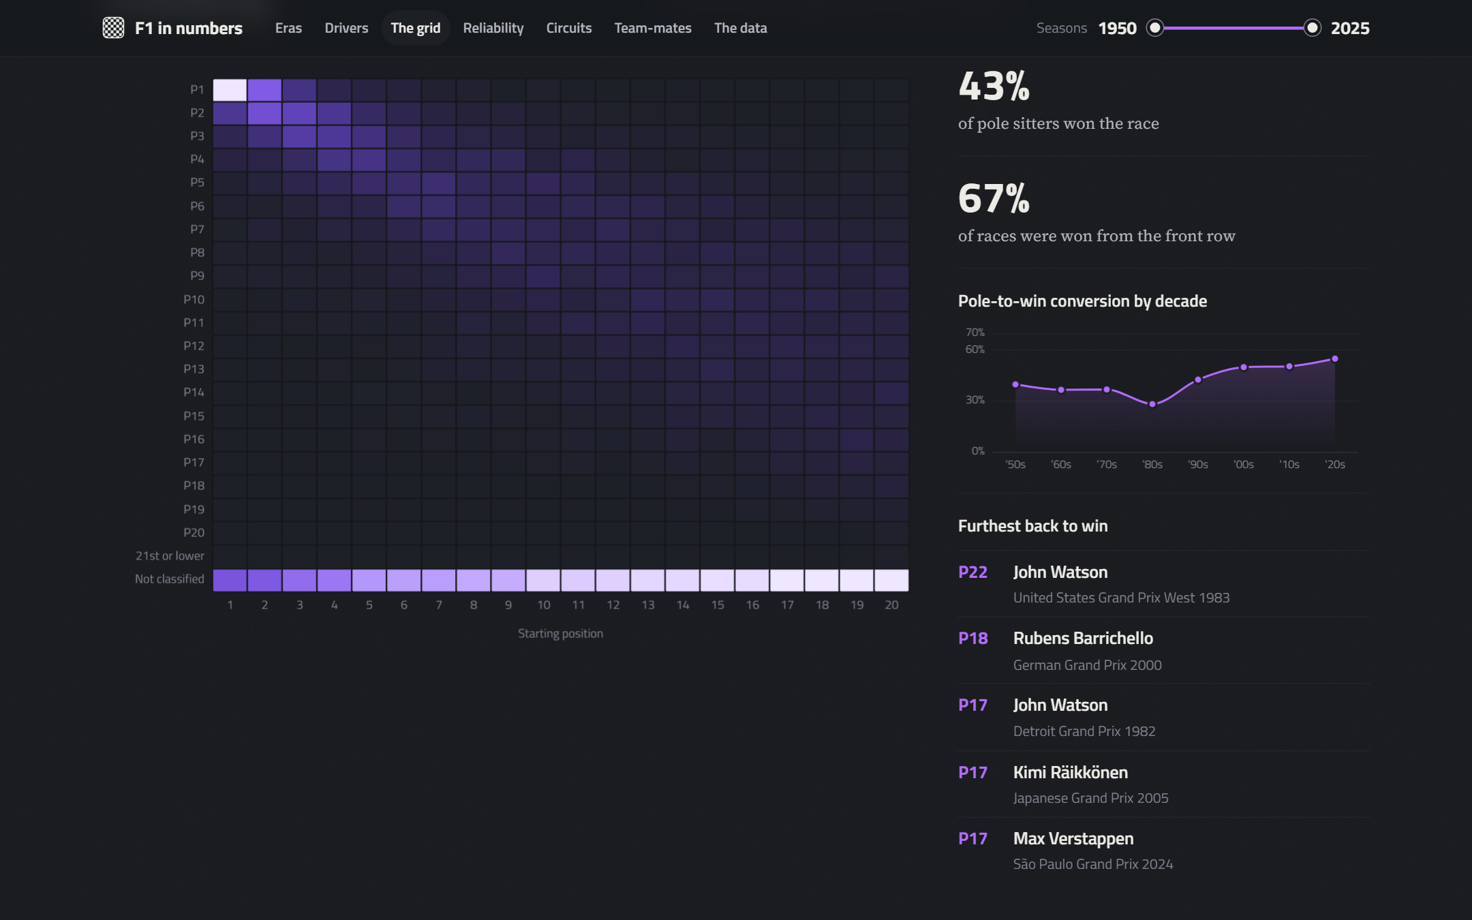
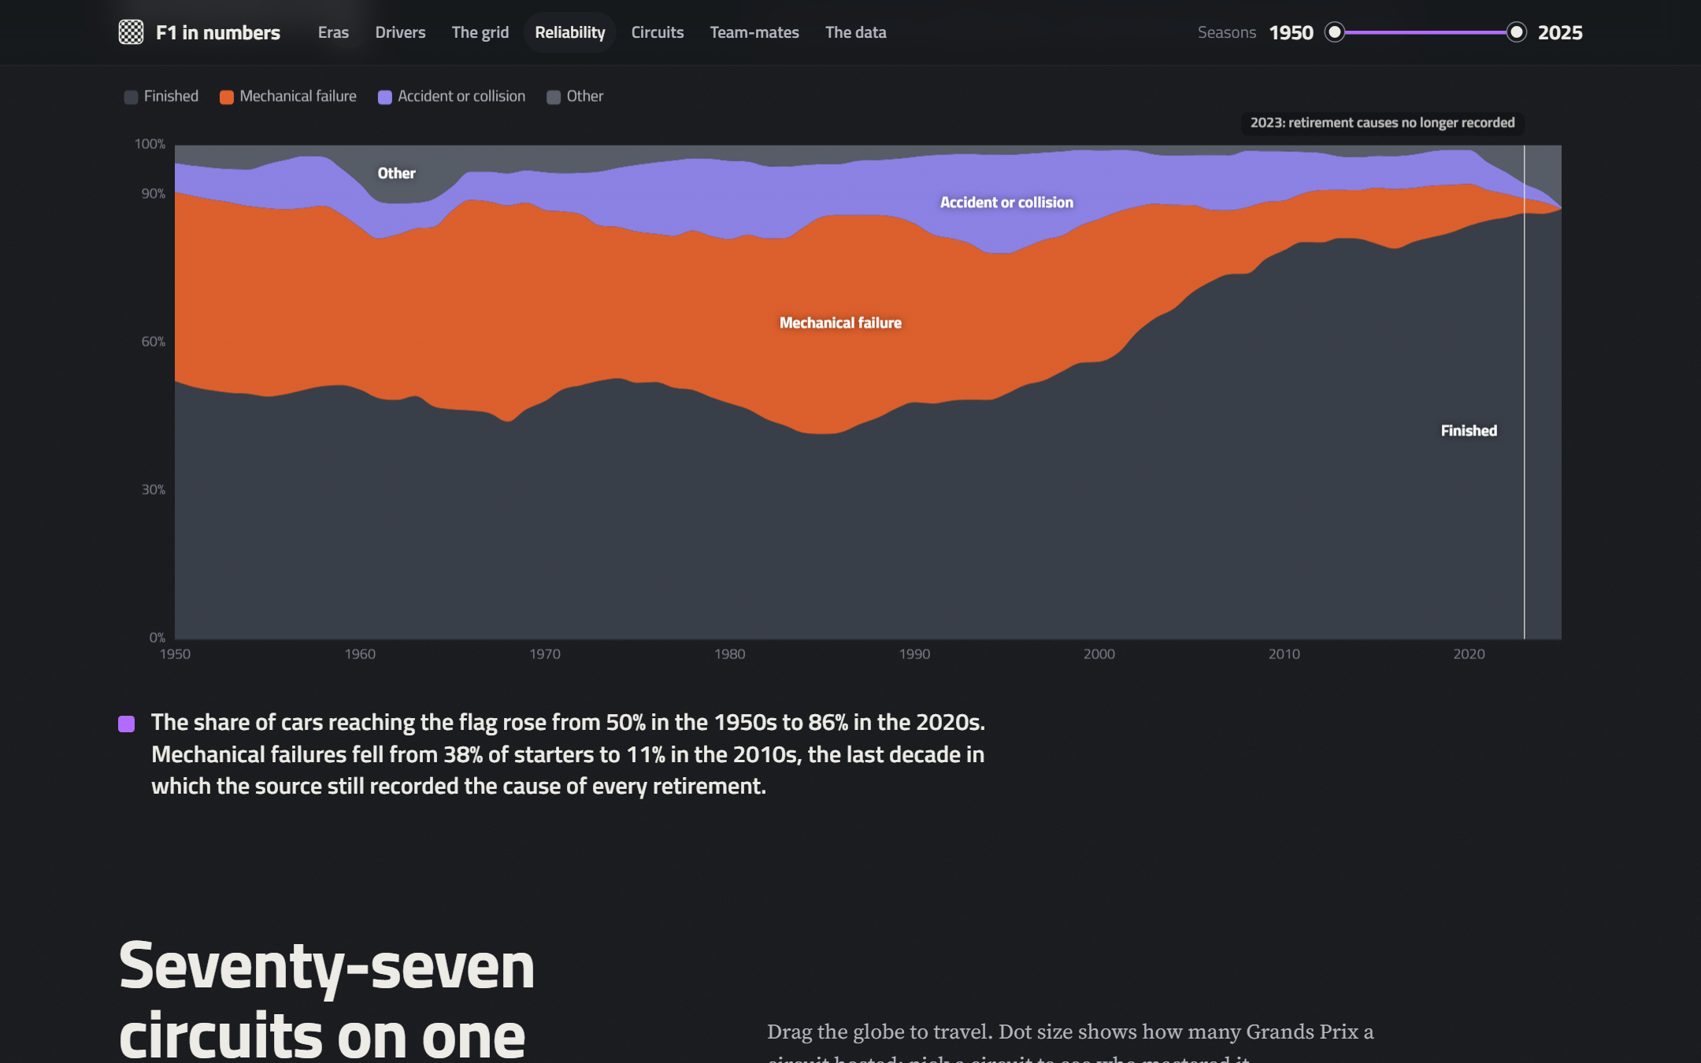
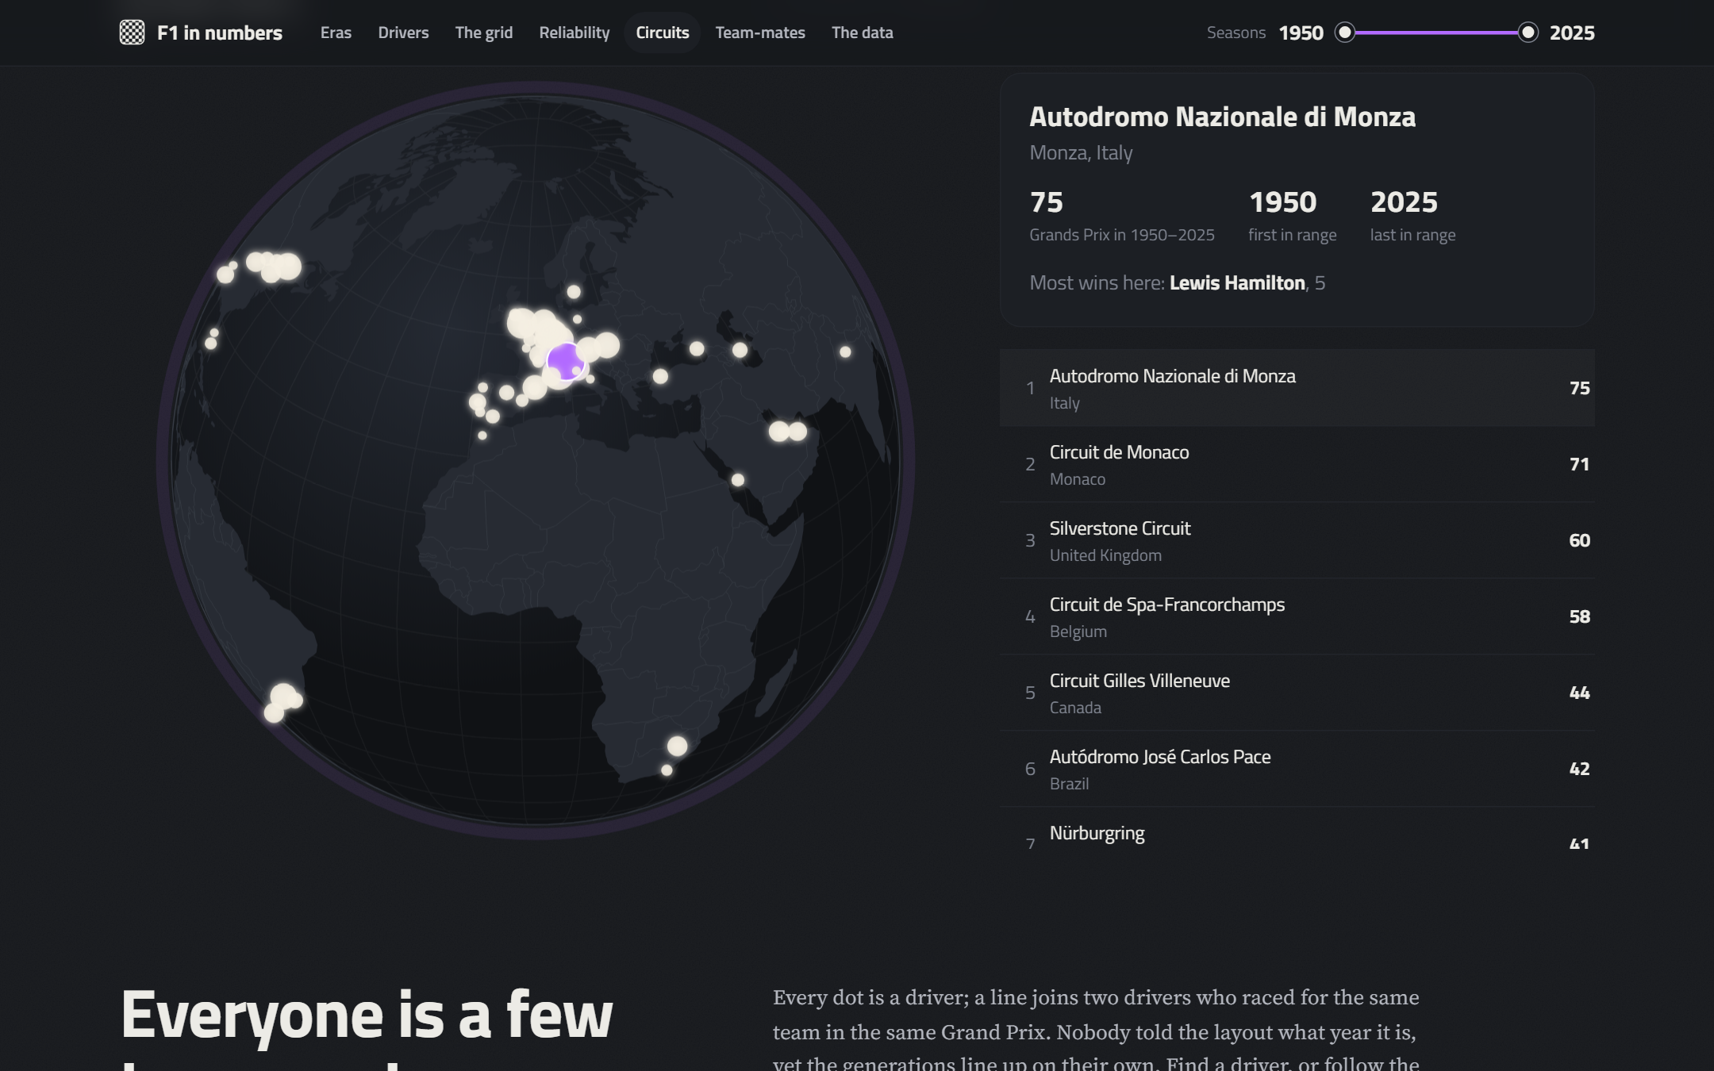
Inside the dashboard: every chart reads validated data
Timing tower: wins, podiums, era-adjusted score
Grid to finish, pole conversion, furthest-back wins
Reliability, with the 2023 break (B29) marked
77 circuits on a rotating globe
Presenter: Student B · Manohar Zalki
15 / 17
Notes:
Four more views. The timing tower ranks drivers by wins or by our era-adjusted score. The grid view shows where cars finish from each starting slot, using classified positions only, which is exactly the fix for issue B11. The reliability view marks the 2023 break that became issue B29, and the globe places all seventy-seven circuits.

Slide 16
What we learned
1
Quality is contextual
Outliers, duplicates and short grids were often valid history
2
Order of operations matters
11 duplicates hid behind blanked keys
3
FAIR gaps sit around the values
No DOI, conflicting licences, no provenance
4
Automate the evidence
Audit log, 55 gates, 14 tests, metadata generated from code
Presenter: Student C · Nicolas Bonilla
16 / 17
Notes:
Four lessons. First, quality is contextual: outliers, duplicates and short grids were often valid history, so every automatic rule needed domain checking before deleting anything. Second, the order of operations matters, as the 11 hidden duplicates show. Third, the largest FAIR gaps were around the values: no identifier, conflicting licences and no provenance. Fourth, automating the evidence, with an audit log, validation gates, tests and generated metadata, turns cleaning into something an examiner can verify. Next steps are a Zenodo DOI and reporting the source defects upstream to Jolpica.

Slide 17
Questions?
Code, data, metadata and report: github.com/zalkimanohar/Formula1-Racing-Analytics
Rebuild everything: python run_all.py --from-scratch
Student A · Chirag Adhikari
Student B · Manohar Zalki
Student C · Nicolas Bonilla
17 / 17
Notes:
Thank you. We are happy to take your questions; each of us will answer on our own component.

