Slide 1
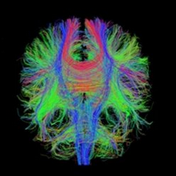
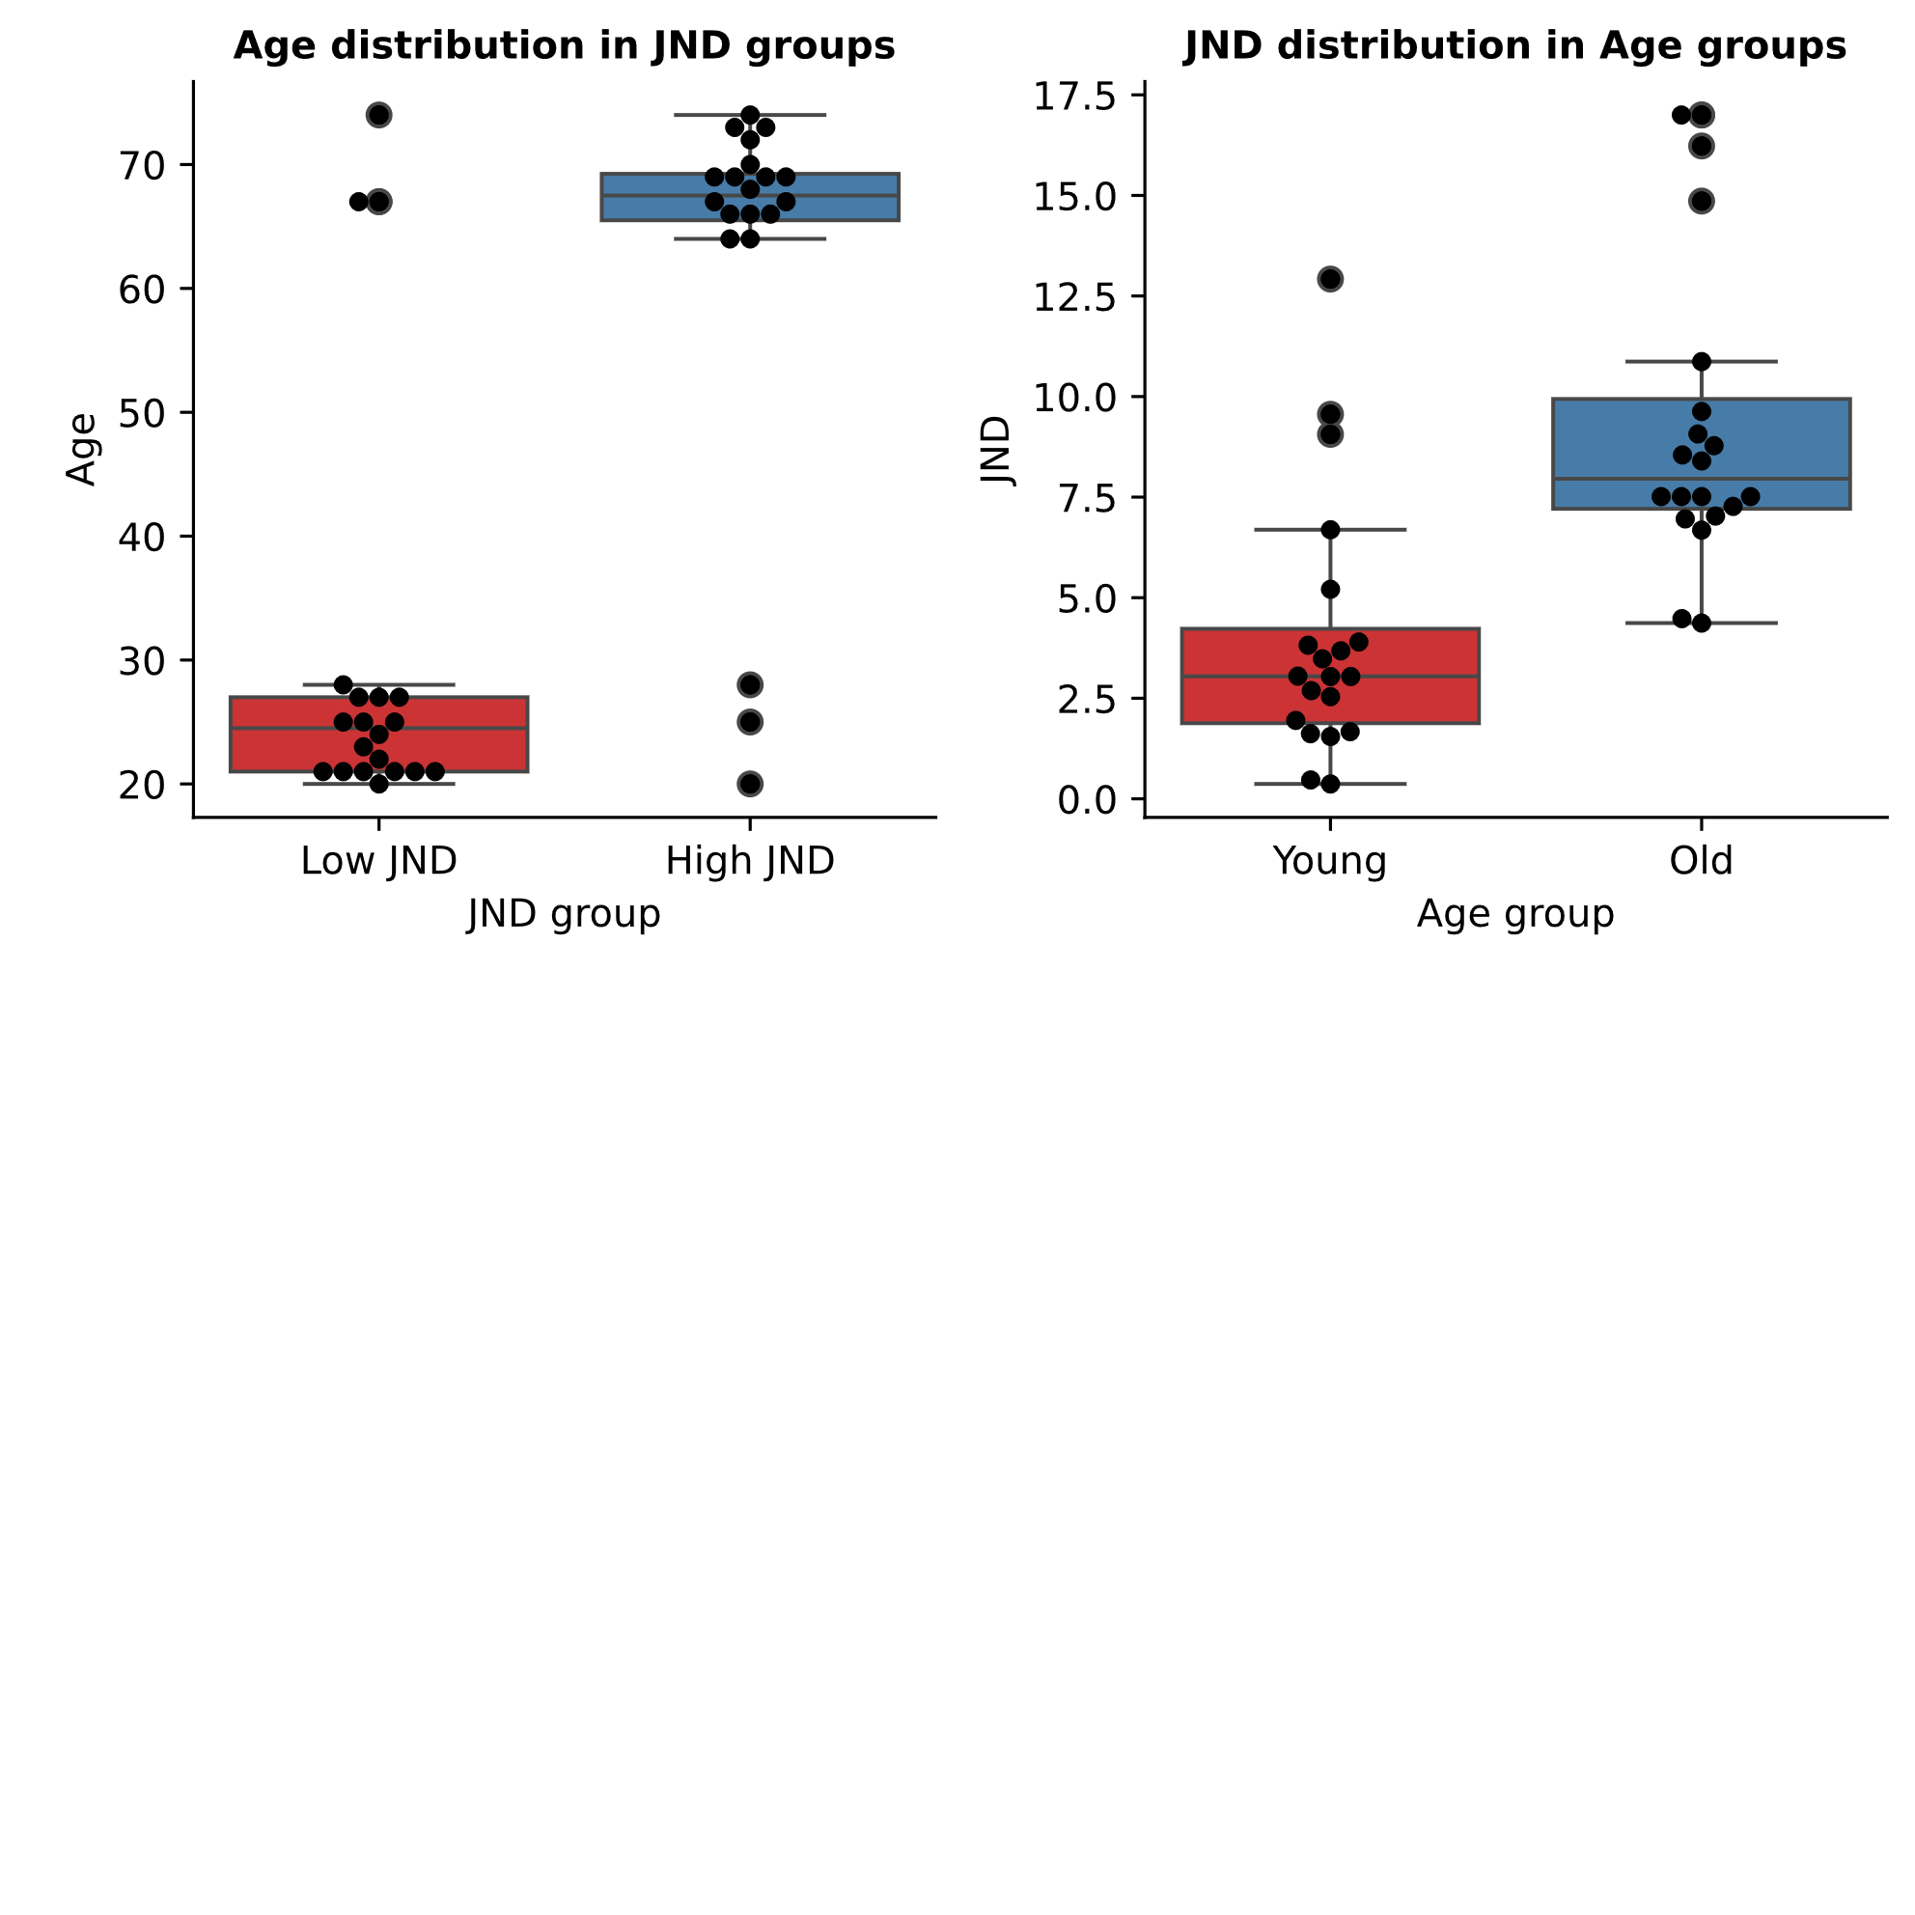

Slide 2
What about an unsupervised approach?
Toward the identification of proprioceptive performance biomarker
Two groups (old vs young)
DTI
Some anatomical differences between groups
Aging impacts anatomy / Behavior
DTI data from 40 subjects of different ages
Different pattern in DTI ?
Could these clusters predict behavior ?
Could these clusters predict age ?

Slide 3
What about unsupervised approach ?
Normalizing (StandartScaler ou RobustScaler), one hot encoding for categorialvariables…feature selection ???
Cleaning / Normalizing / Encoding…
Kmeans and Feature selection using Sequential Features Selector
Kmeans : the clusters
Visualization of cluster for each CC
Subject | Seg.1 | 2 | 3 | 4 | 5 | 6 | .. | .. | 100
1 | 0.29450532281826813 | 0.3123614390540079 | 0.32984540196605133 | 0.34260443111294225 | 0.3506974933578329 | 0.3564999445647938 | … | … | 0.38441289378333776
 | 0.29969420499975064 | 0.3050412796592624 | 0.3113423478629586 | 0.3174059823874761 | 0.32476799445114524 | 0.33958143411035807 | … | … | 0.3720782026328896
2 | 0.30290362344871746 | 0.3139299335902156 | 0.3265514118013284 | 0.33997531558414257 | 0.35392165904898326 | 0.36998791477186294 | … | … | 0.39516617191668
3 | 0.2550646436920872 | 0.26628531489072166 | 0.27803069418657583 | 0.29126747958751453 | 0.2986099692324162 | 0.3091664531363234 | … | … | 0.3588663517853628
4 | 0.2606969516994714 | 0.2771857784799971 | 0.29450957145568846 | 0.31358434020253473 | 0.32338791363225333 | 0.33199115932319406 | … | … | 0.3560638425477553
.. | 0.2112370463304045 | 0.22027267323474467 | 0.2287878814792557 | 0.24034408157308057 | 0.25382553001418706 | 0.2661320133426597 | … | … | 0.29299858222465885

Slide 4
What about unsupervised approach ?
Clustering Kmeans
Cleaning / Normalizing / Encoding…
Kmeans and Feature selection using Sequential Features Selector
Kmeans : the clusters
Visualization of cluster for each CC
K Means ? How do it work ? How can we find pertinent clusters with such a high number of features ?

Slide 5
Supervised learning
Unsupervised learning
Systems are able to predict future outcomes based on past data
Requires both an input and an output to be given to the model for it to be trained
Systems are able to identify hidden patterns from the input data provided
By making the data more readable and organized, similarities or anomalies become more évident

Slide 6
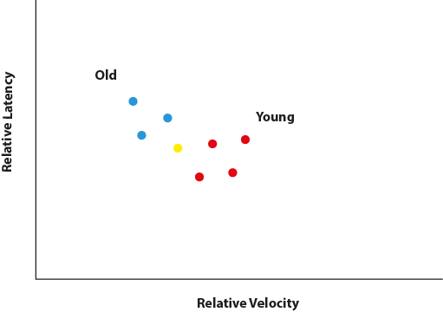
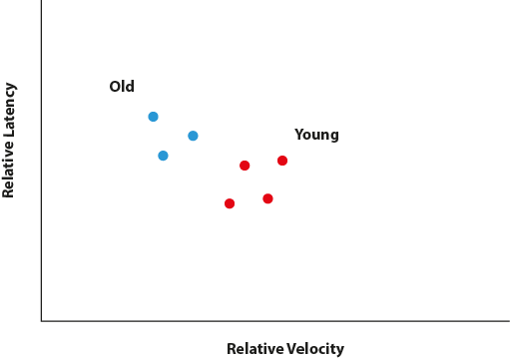
Supervised learning
Systems are able to predict future outcomes based on past data
Requires both an input and an output to be given to the model for it to be trained
Les données sont labellisées (old or young)

Slide 7
Supervised learning
Systems are able to predict future outcomes based on past data
Requires both an input and an output to be given to the model for it to be trained
Le sujet jaune est-il « old » ou « young »

Slide 8
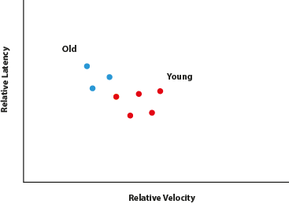
Supervised learning
Systems are able to predict future outcomes based on past data
Requires both an input and an output to be given to the model for it to be trained
Le sujet jaune est-il « old » ou « young » ? Si votre algo vous dit « young », a-t-il raison ?
On peut donc en répétant cela avec plein de données test, tester les performances de prédiction. Nombre de prédictions correctes vs nombre d’erreur.

Slide 9
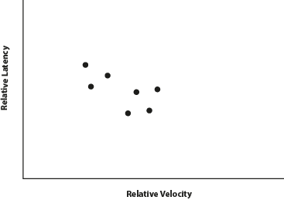
Unsupervised learning
Systems are able to identify hidden patterns from the input data provided
By making the data more readable and organized, similarities or anomalies become more évident
Mais si nous n’avons pas de labels.
Pouvons nous séparer les données en 2 classes ?

Slide 10
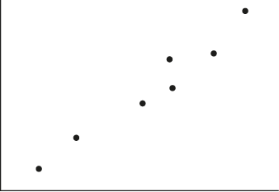
Unsupervised learning
Systems are able to identify hidden patterns from the input data provided
By making the data more readable and organized, similarities or anomalies become more évident
Clustering Kmeans

Slide 11
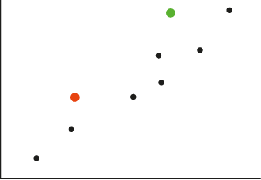
Unsupervised learning
Systems are able to identify hidden patterns from the input data provided
By making the data more readable and organized, similarities or anomalies become more évident
Clustering Kmeans

Slide 12
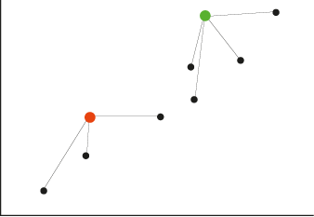
Unsupervised learning
Systems are able to identify hidden patterns from the input data provided
By making the data more readable and organized, similarities or anomalies become more évident
Clustering Kmeans

Slide 13
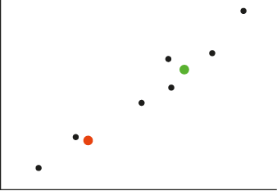
Unsupervised learning
Systems are able to identify hidden patterns from the input data provided
By making the data more readable and organized, similarities or anomalies become more évident
Clustering Kmeans

Slide 14
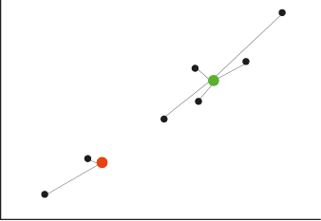
Unsupervised learning
Systems are able to identify hidden patterns from the input data provided
By making the data more readable and organized, similarities or anomalies become more évident
Clustering Kmeans

Slide 15
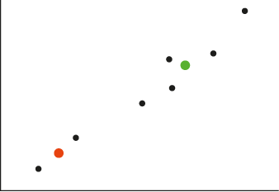
Unsupervised learning
Systems are able to identify hidden patterns from the input data provided
By making the data more readable and organized, similarities or anomalies become more évident
Clustering Kmeans

Slide 16
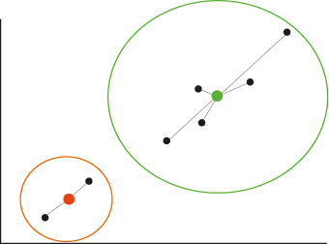
Unsupervised learning
Systems are able to identify hidden patterns from the input data provided
By making the data more readable and organized, similarities or anomalies become more évident
Clustering Kmeans

Slide 17
Unsupervised learning
Systems are able to identify hidden patterns from the input data provided
By making the data more readable and organized, similarities or anomalies become more évident
Clustering Kmeans
Cluster 1
Cluster 2

Slide 18
100 variables pour 40 sujets …..
Cleaning / Normalizing / Encoding…
Kmeans and Feature selection using Sequential Features Selector
Kmeans : the clusters
Visualization of cluster for each CC

Slide 19
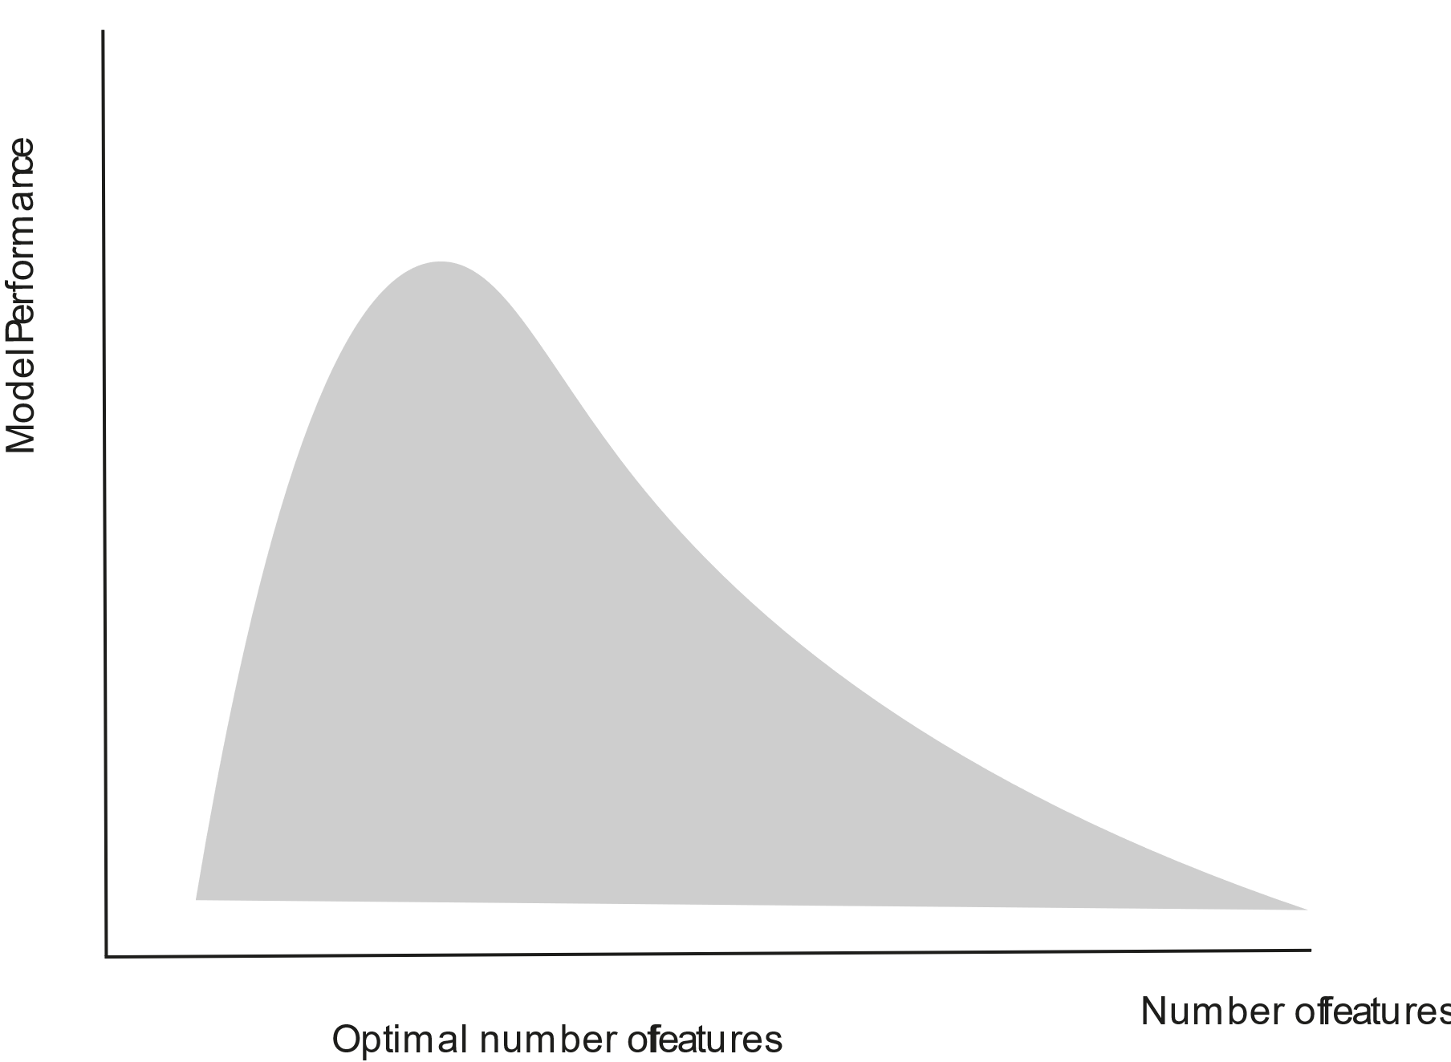
100 variables pour 40 sujets ….. Beaucoup trop de variables
Fléau de la dimension
Cleaning / Normalizing / Encoding…
Kmeans and Feature selection using Sequential Features Selector
Kmeans : the clusters
Visualization of cluster for each CC

Slide 20
SFS : Sequential Feature Selector
De 100 à 5 features. …
Cleaning / Normalizing / Encoding…
Kmeans and Feature selection using Sequential Features Selector
Kmeans : the clusters
Visualization of cluster for each CC
Run Kmeans sur 99 variables 100 fois.
On obtient un score de clusterisation (min. dist. to cluster centers…)

Slide 21
SFS : Sequential Feature Selector
De 100 à 5 features. …
Cleaning / Normalizing / Encoding…
Kmeans and Feature selection using Sequential Features Selector
Kmeans : the clusters
Visualization of cluster for each CC
Run Kmeans sur 99 variables 100 fois.
On obtient un score de clusterisation (min. dist. to cluster centers…)

Slide 22
SFS : Sequential Feature Selector
De 100 à 5 features. …
Cleaning / Normalizing / Encoding…
Kmeans and Feature selection using Sequential Features Selector
Kmeans : the clusters
Visualization of cluster for each CC
Run Kmeans sur 99 variables 100 fois.
On obtient un score de clusterisation (min. dist. to cluster centers…)

Slide 23
SFS : Sequential Feature Selector
De 100 à 5 features. …
Cleaning / Normalizing / Encoding…
Kmeans and Feature selection using Sequential Features Selector
Kmeans : the clusters
Visualization of cluster for each CC
Run Kmeans sur 99 variables 100 fois.
On obtient un score de clusterisation (min. dist. to cluster centers…)

Slide 24
SFS : Sequential Feature Selector
De 100 à 5 features. …
Cleaning / Normalizing / Encoding…
Kmeans and Feature selection using Sequential Features Selector
Kmeans : the clusters
Visualization of cluster for each CC
Run Kmeans sur 99 variables 100 fois.
On obtient un score de clusterisation (min. dist. to cluster centers…) pour chaque run

Slide 25
SFS : Sequential Feature Selector
De 100 à 5 features. …
Cleaning / Normalizing / Encoding…
Kmeans and Feature selection using Sequential Features Selector
Kmeans : the clusters
Visualization of cluster for each CC
Run Kmeans sur 99 variables 100 fois.
On obtient un score de clusterisation (min. dist. to cluster centers…)
Run Kmeans sur 99 variables 100 fois.
On élimine la « feature » qui avait été enlevée lors du run ayant eu le meilleur score. C’est la moins importante pour faire les clusters.
Et on recommence avec 98 variables 99 fois … jusqu’à n’avoir que les X variables les plus importantes.

Slide 26
SFS : Sequential Feature Selector
De 100 à 5 features. …
Cleaning / Normalizing / Encoding…
Kmeans and Feature selection using Sequential Features Selector
Kmeans : the clusters
Visualization of cluster for each CC
Run Kmeans sur 99 variables 100 fois.
On obtient un score de clusterisation (min. dist. to cluster centers…)
Run Kmeans sur 99 variables 100 fois.
On élimine la « feature » qui avait été enlevée lors du run ayant eu le meilleur score. C’est la moins importante pour faire les clusters.
Et on recommence avec 98 variables 99 fois … jusqu’à n’avoir que les X variables les plus importantes.

Slide 27
SFS : Sequential Feature Selector
De 100 à 5 features. …
Cleaning / Normalizing / Encoding…
Kmeans and Feature selection using Sequential Features Selector
Kmeans : the clusters
Visualization of cluster for each CC
Run Kmeans sur 99 variables 100 fois.
On obtient un score de clusterisation (min. dist. to cluster centers…)
Run Kmeans sur 99 variables 100 fois.
On élimine la « feature » qui avait été enlevée lors du run ayant eu le meilleur score. C’est la moins importante pour faire les clusters.
Et on recommence avec 98 variables 99 fois … jusqu’à n’avoir que les X variables les plus importantes.

Slide 28
SFS : Sequential Feature Selector
De 100 à 5 features. …
Cleaning / Normalizing / Encoding…
Kmeans and Feature selection using Sequential Features Selector
Kmeans : the clusters
Visualization of cluster for each CC
Run Kmeans sur 99 variables 100 fois.
On obtient un score de clusterisation (min. dist. to cluster centers…)
Run Kmeans sur 99 variables 100 fois.
On élimine la « feature » qui avait été enlevée lors du run ayant eu le meilleur score. C’est la moins importante pour faire les clusters.
Et on recommence avec 98 variables 99 fois … jusqu’à n’avoir que les X variables les plus importantes.

Slide 29
SFS : Sequential Feature Selector
De 100 à 5 features. …
Cleaning / Normalizing / Encoding…
Kmeans and Feature selection using Sequential Features Selector
Kmeans : the clusters
Visualization of cluster for each CC
Run Kmeans sur 99 variables 100 fois.
On obtient un score de clusterisation (min. dist. to cluster centers…)
Run Kmeans sur 99 variables 100 fois.
On élimine la « feature » qui avait été enlevée lors du run ayant eu le meilleur score. C’est la moins importante pour faire les clusters.
Et on recommence avec 98 variables 99 fois … jusqu’à n’avoir que les X variables les plus importantes.

Slide 30
SFS : Sequential Feature Selector
De 100 à 5 features. …
Cleaning / Normalizing / Encoding…
Kmeans and Feature selection using Sequential Features Selector
Kmeans : the clusters
Visualization of cluster for each CC
Run Kmeans sur 99 variables 100 fois.
On obtient un score de clusterisation (min. dist. to cluster centers…)
On a donc largement réduit le nombre de variables !
On peut maintenant faire cette sélection pour chaque CC

Slide 31
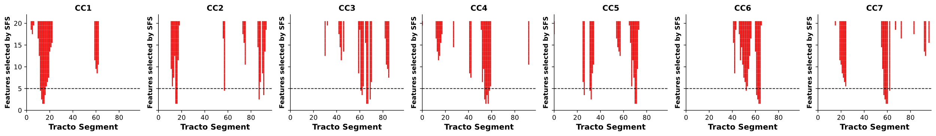
SFS : Sequential Feature Selector
Cleaning / Normalizing / Encoding…
Kmeans and Feature selection using Sequential Features Selector
Kmeans : the clusters
Visualization of cluster for each CC

Slide 32
SFS : Sequential Feature Selector
Cleaning / Normalizing / Encoding…
Kmeans and Feature selection using Sequential Features Selector
Kmeans : the clusters
Visualization of cluster for each CC

Slide 33
SFS : Sequential Feature Selector
Cleaning / Normalizing / Encoding…
Kmeans and Feature selection using Sequential Features Selector
Kmeans : the clusters
Visualization of cluster for each CC

Slide 34
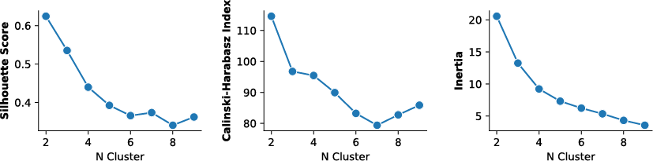
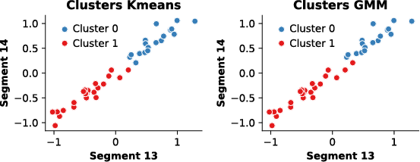
The clusters
CC1 5 features
Cleaning / Normalizing / Encoding…
Kmeans and Feature selection using Sequential Features Selector
Kmeans : the clusters
Visualization of cluster for each CC

Slide 35
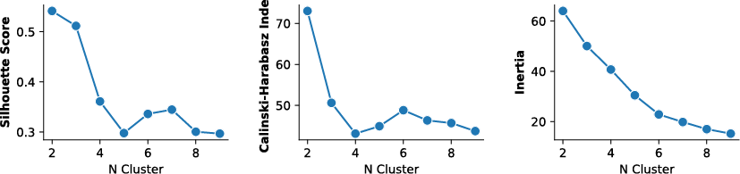
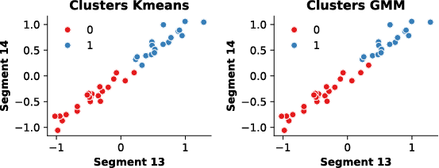
The clusters
CC1 10 features
Cleaning / Normalizing / Encoding…
Kmeans and Feature selection using Sequential Features Selector
Kmeans : the clusters
Visualization of cluster for each CC

Slide 36
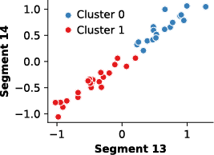
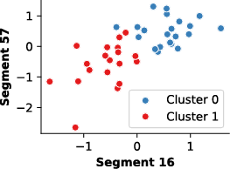
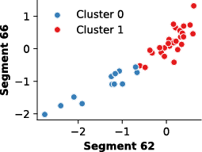
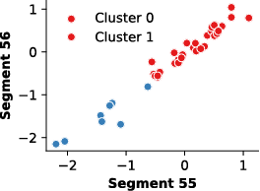
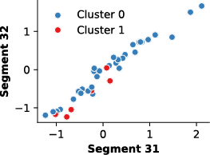
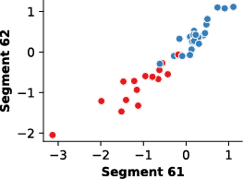
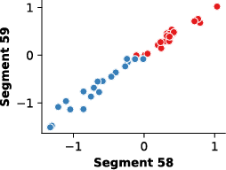
The clusters
CC1 to CC7 - 5 features

Slide 37
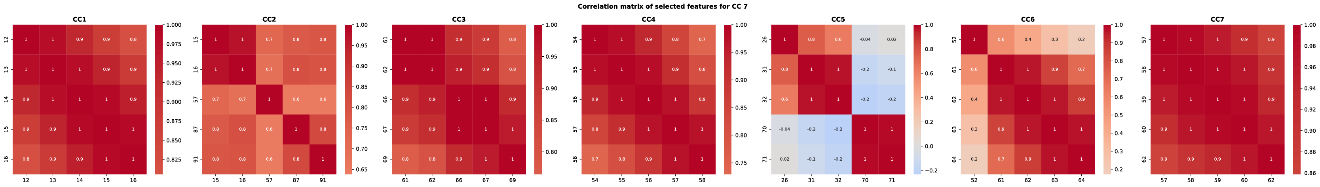
The clusters
Cleaning / Normalizing / Encoding…
Kmeans and Feature selection using Sequential Features Selector
Kmeans : the clusters
Visualization of cluster for each CC

Slide 38
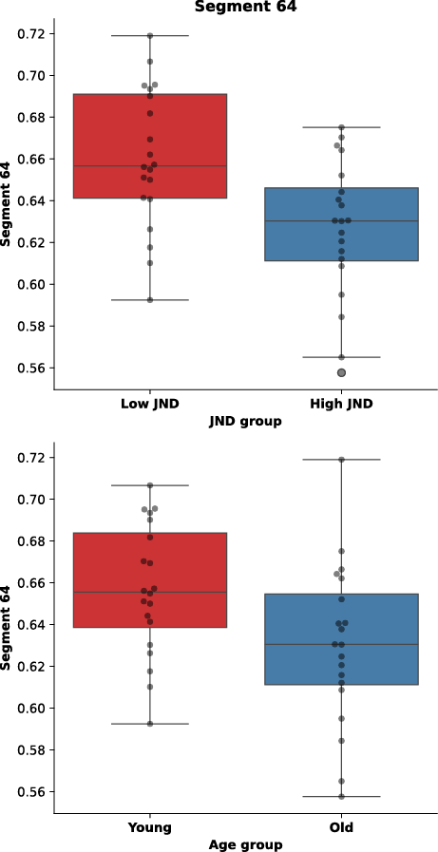
Cleaning / Normalizing / Encoding…
Kmeans and Feature selection using Sequential Features Selector
Kmeans : the clusters
Visualization of cluster for each CC

Slide 39
CC6 segment 64 as example
Cleaning / Normalizing / Encoding…
Kmeans and Feature selection using Sequential Features Selector
Kmeans : the clusters
Visualization of cluster for each CC

Slide 40
CC6 segment 64 as example
Cleaning / Normalizing / Encoding…
Kmeans and Feature selection using Sequential Features Selector
Kmeans : the clusters
Visualization of cluster for each CC

Slide 41
CC6 segment 64 as example
Cleaning / Normalizing / Encoding…
Kmeans and Feature selection using Sequential Features Selector
Kmeans : the clusters
Visualization of cluster for each CC

Slide 42
CC6 segment 64 as example
Cleaning / Normalizing / Encoding…
Kmeans and Feature selection using Sequential Features Selector
Kmeans : the clusters
Visualization of cluster for each CC

Slide 43
CC6 segment 64 as example
Cleaning / Normalizing / Encoding…
Kmeans and Feature selection using Sequential Features Selector
Kmeans : the clusters
Visualization of cluster for each CC

Slide 44
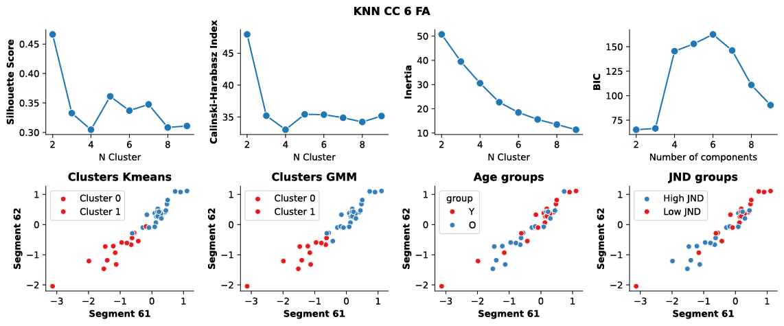
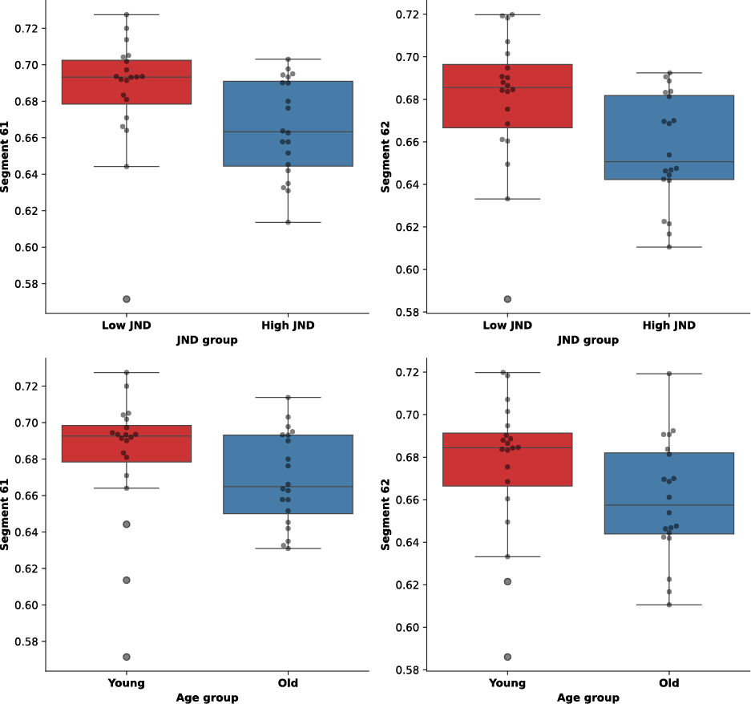
CC6 as example

Slide 45
CC6 as example

Slide 46
CC6 as example

Slide 47
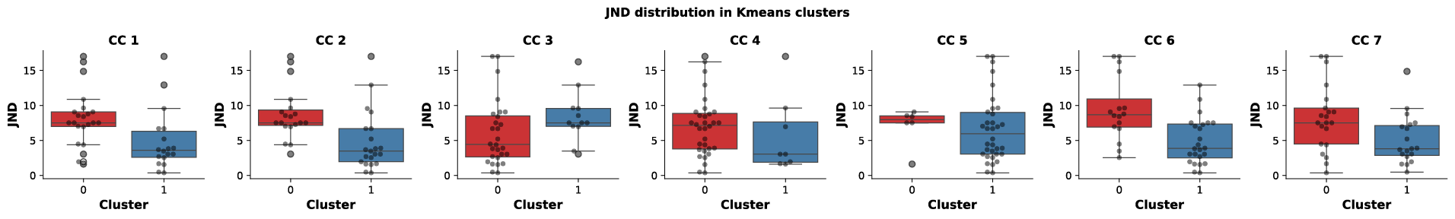
The clusters vs. JND

Slide 48

The clusters vs. JND
Can we predict the JND with DTI data ?
Can we better predict the JND than the age group ?
If yes, then the “Age” is not the variable influencing the proprioceptive performance. The anatomy is.

Slide 49
Supervised classification of JND
The data :
  X : The DTI data (same than used for clustering) / 5 features for each CC
  Y : 3 target variables
  the JND group (low vs high JND)
  the cluster (0 or 1)
  the age group (Y vs O)
The model :
  K-nearest neighbors / Optimized with GridSearch for K, Distance, Weigth
  Classical testing : Kfold CV = 5
  Validation curves and Confusion matrix : Accuracy / Recall / Precision / F1 Score

Slide 50
Supervised classification : K-nearest neighbors

Slide 51
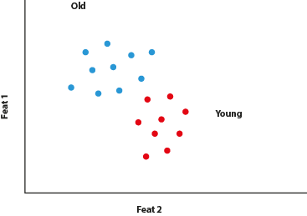
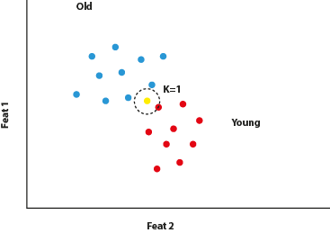

Supervised classification : K-nearest neighbors
Importance of K (number of neighbors) : hyperparameter for KNN

Slide 52
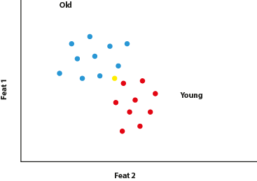
Supervised classification : K-nearest neighbors
Importance of K (number of neighbors) : hyperparameter for KNN

Slide 53
Supervised classification : K-nearest neighbors
Importance of K (number of neighbors) : hyperparameter for KNN

Slide 54
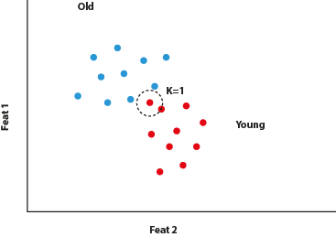
Supervised classification : K-nearest neighbors
Importance of K (number of neighbors) : hyperparameter for KNN

Slide 55
Supervised classification : K-nearest neighbors
Importance of K (number of neighbors) : hyperparameter for KNN

Slide 56
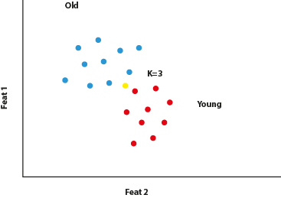
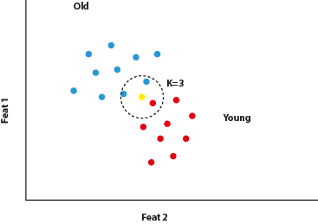
Supervised classification : K-nearest neighbors
Importance of K (number of neighbors) : hyperparameter for KNN

Slide 57
Supervised classification : K-nearest neighbors
Importance of K (number of neighbors) : hyperparameter for KNN

Slide 58
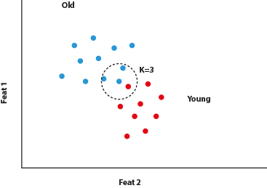
Supervised classification : K-nearest neighbors
Importance of K (number of neighbors) : hyperparameter for KNN

Slide 59
Supervised classification : K-nearest neighbors
Importance of K (number of neighbors) : hyperparameter for KNN

Slide 60
Supervised classification of JND
The data :
  X : The DTI data (same than used for clustering) / 5 features for each CC
  Y : 3 target variables
  the JND group (low vs high JND)
  the cluster (0 or 1)
  the age group (Y vs O)
The model :
  K-nearest neighbors / Optimized with GridSearch for best estimator (K, Distance, Weigth)
  Classical training : Kfold CV = 5
  Validation curves and Confusion matrix : Accuracy / Recall / Precision / F1 Score

Slide 61
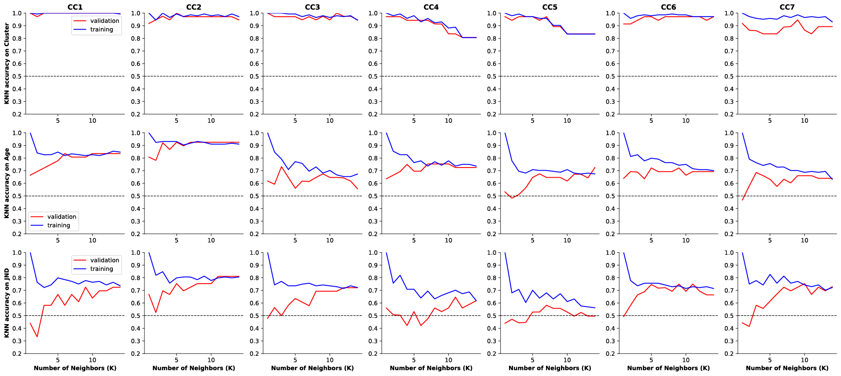
The KNN for JND prediction
Cluster
Age
JND

Slide 62
The KNN for JND prediction
Cluster
Age
JND

Slide 63
The KNN for JND prediction
Cluster
Age
JND

Slide 64
The KNN for JND prediction
Cluster
Age
JND
BAD
BAD
YES
YES
Better than Age
BAD
BAD
Better than Age
YES

Slide 65
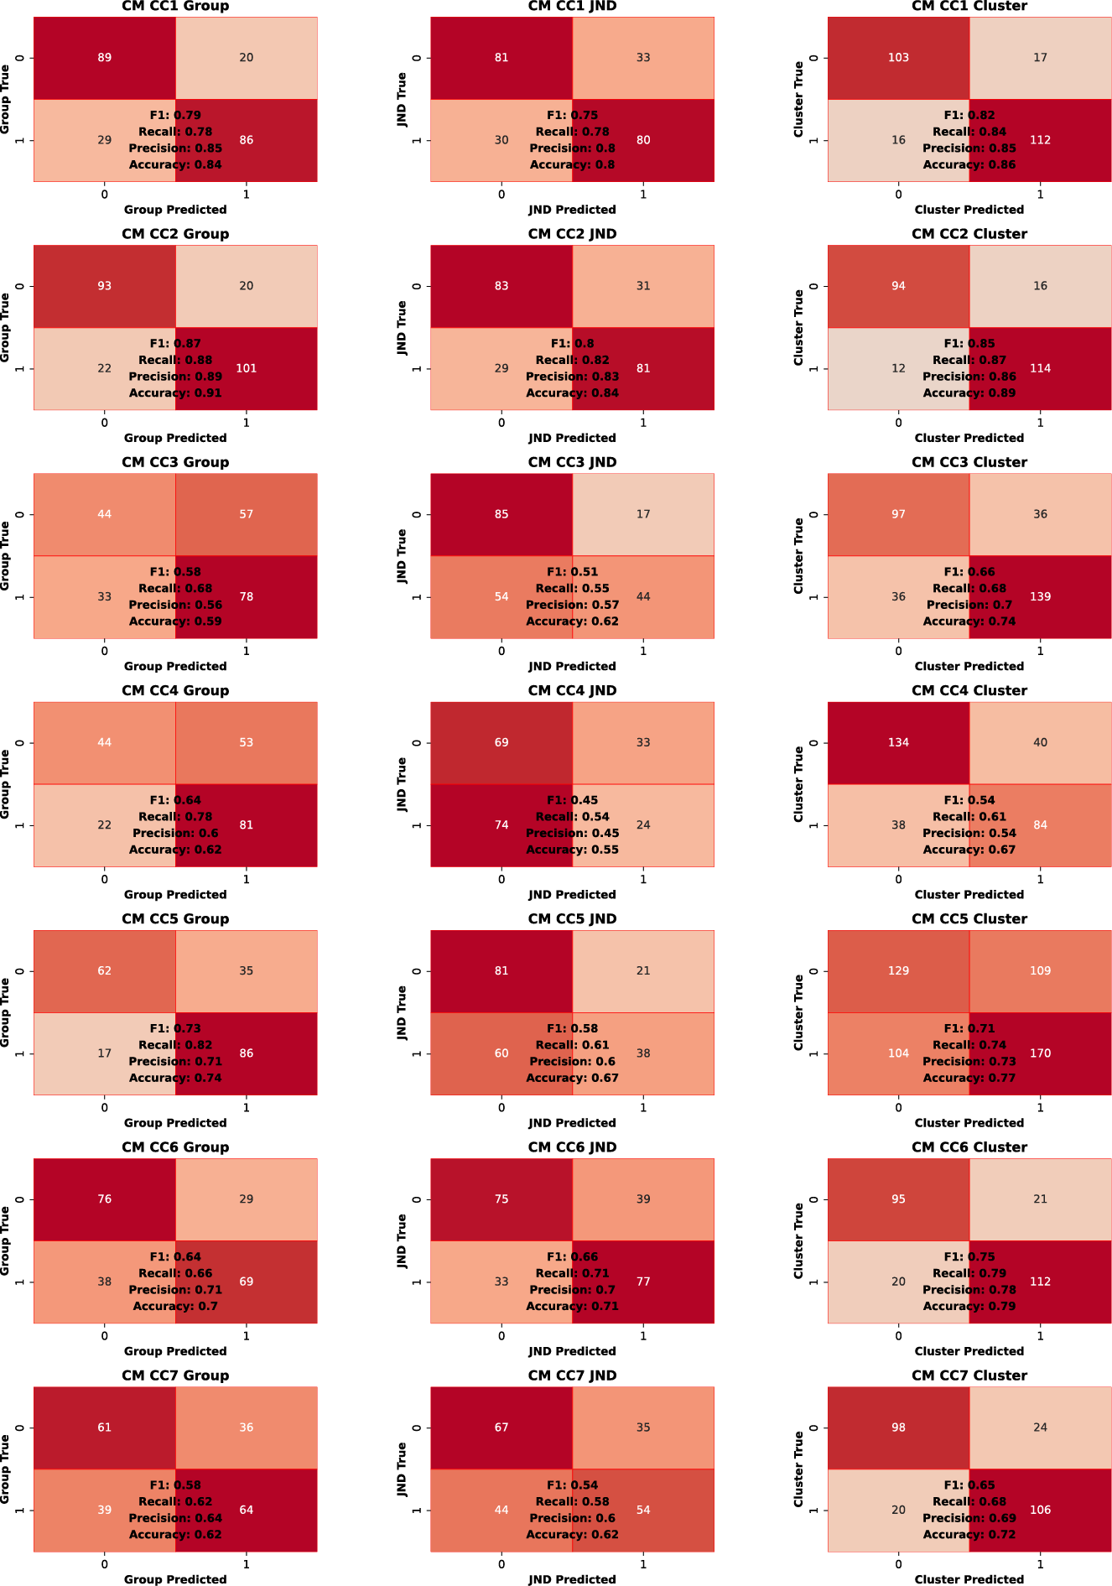
The KNN for JND prediction
Age
Age
Cluster
CC1
CC2
CC3

Slide 66
Age
Age
Cluster
CC4
CC5
CC6
CC7

Slide 67
Conclusion (if you are still alive)
Unsupervised clustering : 2 valid clusters based of raw DTI data
Supervised classification : for some CC JND group is a bettter predictor than the age !!
Analysis of anatomical data based on groups of « age » could be inappropriate.
  Some « youngs » are « old » and some « olds » are young….
  Here we asked : what is the origin of bad performances ?
  The anatomical changes, not the age.
  The changes in DTI values of given segments of the CC could be a biomarker of proprioceptive performance … let’s see ?

Slide 68
Two groups (old vs young)
DTI
Some anatomical differences between groups
Aging impacts anatomy / Behavior
DTI data from 40 subjects of different ages
Different pattern in DTI ?
Could these clusters predict behavior ?
Could these clusters predict age ?

Slide 69
Tractography data (CC1 to CC7 / 100 segments per CC)
Could anatomical differences explain difference in behavior ?
Can we find pattern / clusters in DTI data ?

Slide 70
The Data
Subject | Seg.1 | 2 | 3 | 4 | 5 | 6 | .. | .. | 100
1 | 0.29450532281826813 | 0.3123614390540079 | 0.32984540196605133 | 0.34260443111294225 | 0.3506974933578329 | 0.3564999445647938 | … | … | 0.38441289378333776
 | 0.29969420499975064 | 0.3050412796592624 | 0.3113423478629586 | 0.3174059823874761 | 0.32476799445114524 | 0.33958143411035807 | … | … | 0.3720782026328896
2 | 0.30290362344871746 | 0.3139299335902156 | 0.3265514118013284 | 0.33997531558414257 | 0.35392165904898326 | 0.36998791477186294 | … | … | 0.39516617191668
3 | 0.2550646436920872 | 0.26628531489072166 | 0.27803069418657583 | 0.29126747958751453 | 0.2986099692324162 | 0.3091664531363234 | … | … | 0.3588663517853628
4 | 0.2606969516994714 | 0.2771857784799971 | 0.29450957145568846 | 0.31358434020253473 | 0.32338791363225333 | 0.33199115932319406 | … | … | 0.3560638425477553
.. | 0.2112370463304045 | 0.22027267323474467 | 0.2287878814792557 | 0.24034408157308057 | 0.25382553001418706 | 0.2661320133426597 | … | … | 0.29299858222465885
.. | 0.25604787527412665 | 0.2639338150861601 | 0.27704934359181244 | 0.29030647309106533 | 0.3019633857230773 | 0.31273904516751794 | … | … | 0.35288256971384657
.. | 0.2882732508415677 | 0.2937102121630478 | 0.30259920004014473 | 0.3091726852948311 | 0.3120876354217834 | 0.3126547837635295 | … | … | 0.33630556441735726
.. | 0.27374690129114604 | 0.29069762565610746 | 0.30570647589236005 | 0.31941922878182855 | 0.32736011106459245 | 0.33641111110574023 | … | … | 0.36774273564573334
40 | 0.25883544835330846 | 0.27519453676447003 | 0.28809807520838 | 0.2959893480902339 | 0.2964476244225325 | 0.3005732534153121 | … | … | 0.3719224466424956

