Slide 1
Finding a new location for a Barbershop using Data Science
Nicolas Conley

Slide 2
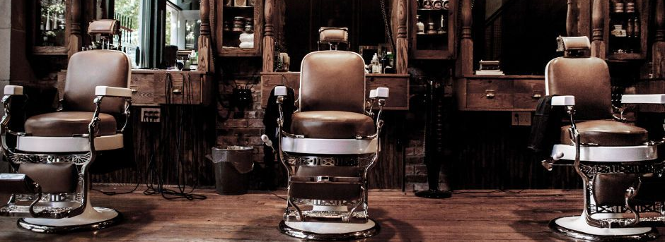
Introduction
What?
Study the best location for a barbershop
Who?
New entrepeneurs that want to start a new Barbershop, but do not know where

Slide 3
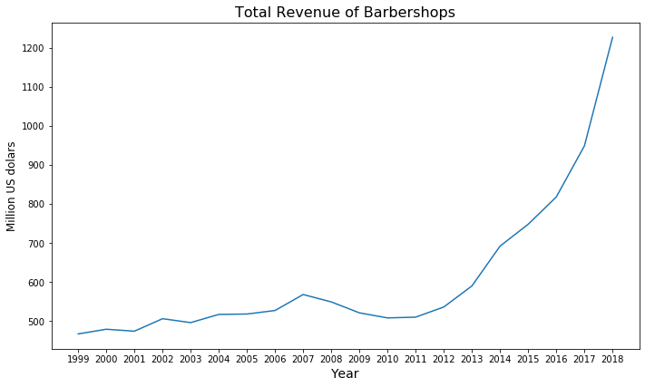
Data

Slide 4
Data
US Census Bureau
Data USA
Foursquare

Slide 5
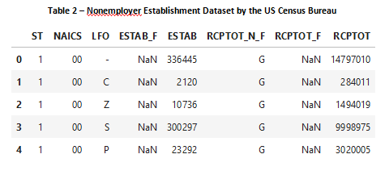
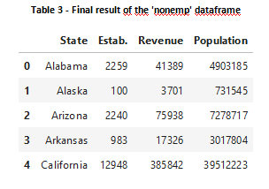
Methodology

Slide 6
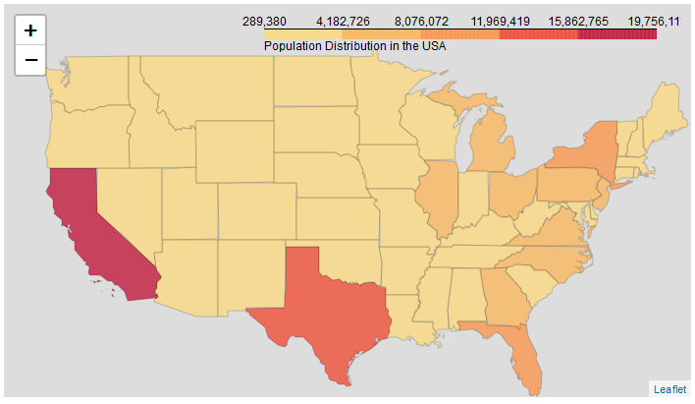
Methodology

Slide 7
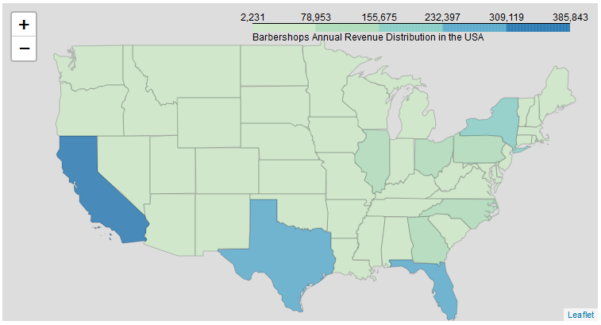
Methodology

Slide 8
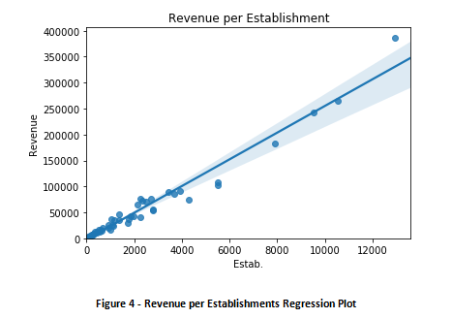
Methodology

Slide 9
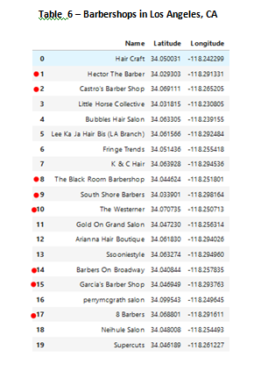
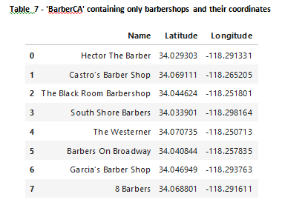
Methodology

Slide 10
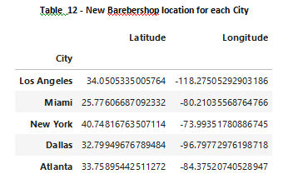
Results
K-mean

Slide 11
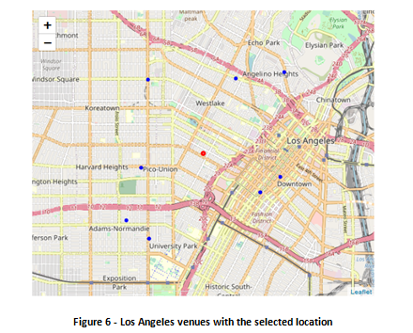
Discusion

Slide 12
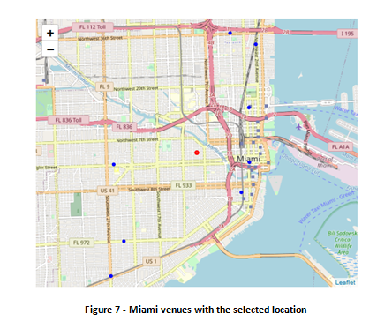
Discusion

Slide 13
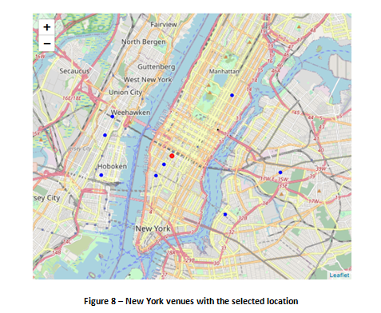
Discusion

Slide 14
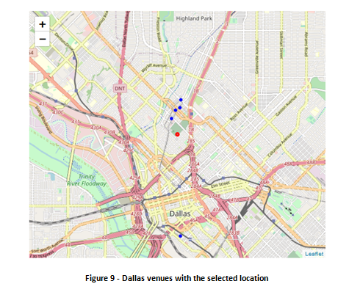
Discusion

Slide 15
Conclusion
This method to place 5 Barbershops around the country, was successful. The Shops were places in the Top 5 most populated states of the US, to catch the larger number of customers as possible.
After getting the Top 5 states (California, Florida, New York, Texas and Georgia), and getting the venues around the very center of the selected cities, a K-means method was used to find the center of the group of shops, this center is the author’s suggestion for the location for the new Barbershop. All addresses were mentioned above in the best location given the data obtained in the beginning of the study.

