Slide 1
TEMAS DE LA COPETENCIA:
Time schedule management
Of the instructors
MIRTHA JULIANARODRIGUEZ GOMEZ
NICOLAS DAVID SANCHEZ BAEZ
JHOAN SANTIAGO MORENO CASTIBLANCO
DEYVITH NICKOLAS ORTIZ TORRES
FICHA:1356742

Slide 2
ABSTRACT
This project has as purpose to create an information system that we will call SIHI which will help to the center of market management, logistics and information technologies to have a better way to manage the schedules of the instructors so that there are no confusions or problems

Slide 3
General objective
Develop an information system for the management of instructors' schedules for the center of markets, logistics and information technologies in the area of ​​articulation

Slide 4
specific objectives
• To analyze the problem through the collection of information.
• To develop the database and the graphical interface.
• To implement the information system.
• To evaluate the functionality of the information system

Slide 5
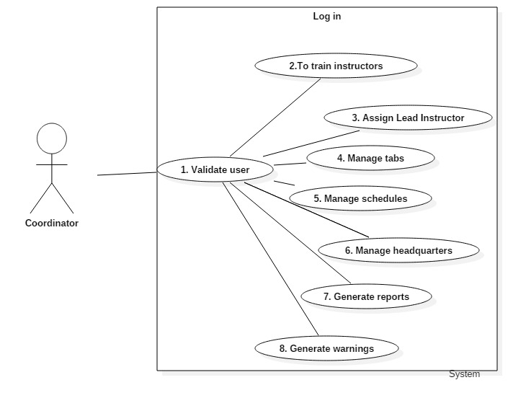
use cases high level

Slide 6
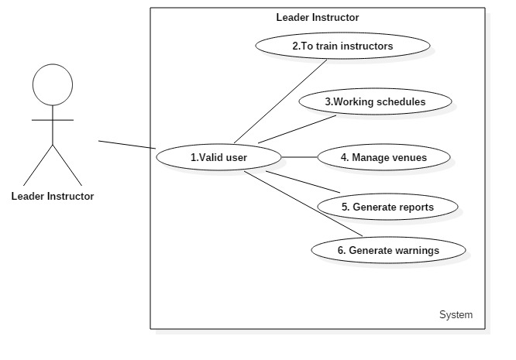

Slide 7
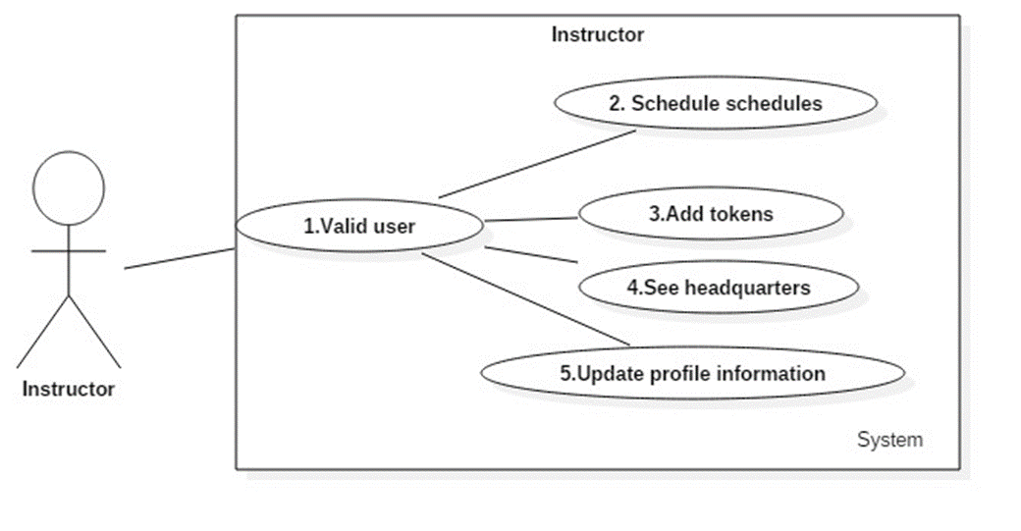

Slide 8
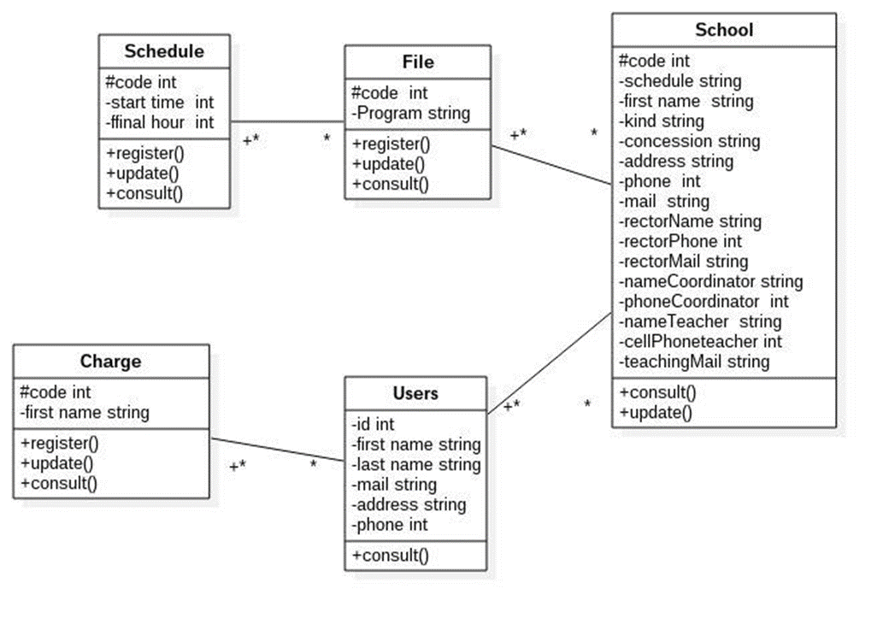
Class diagram

Slide 9
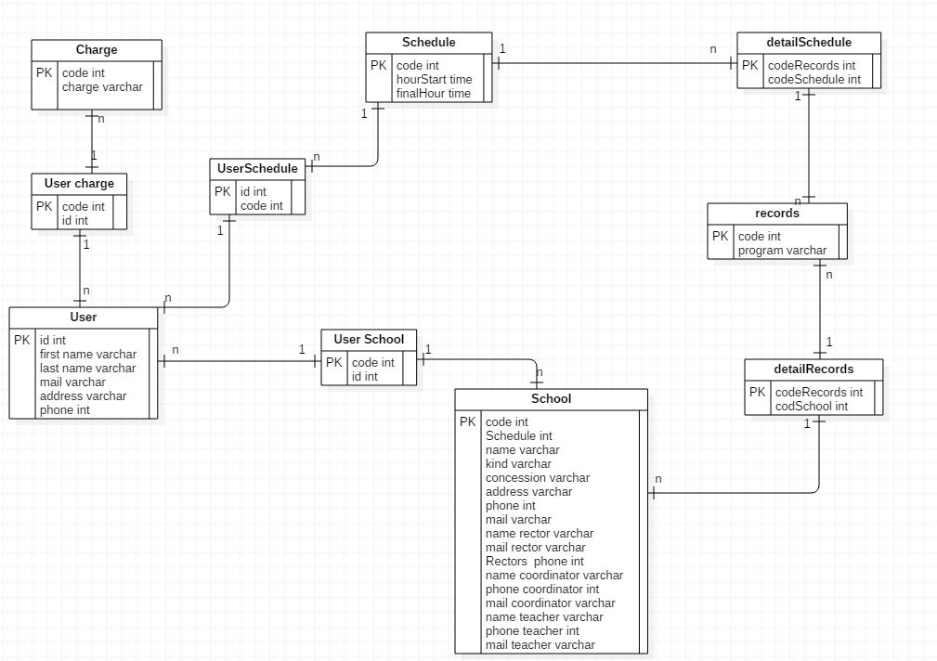
Relational model

Slide 10

GRACIAS

