Slide 1
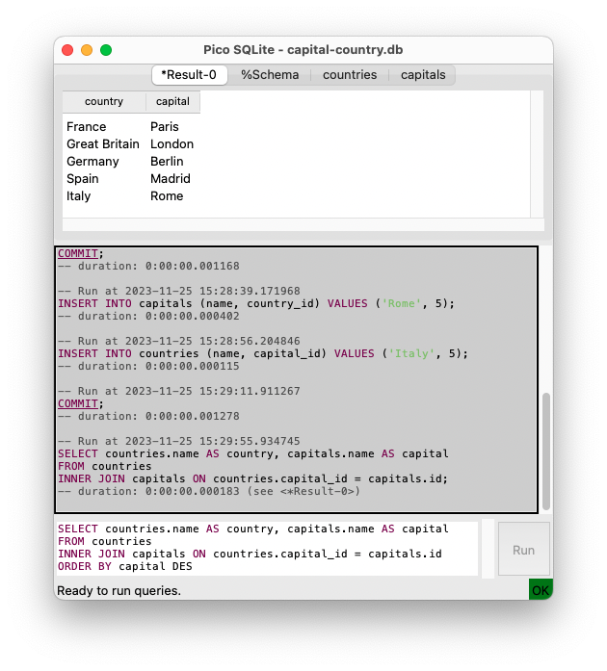
Result, schema and table viewer
Command history
Multiline colored query editor
Active transaction indicator

