Slide 1
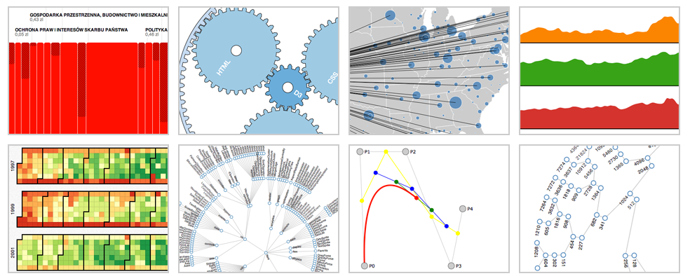
d3js

Slide 2
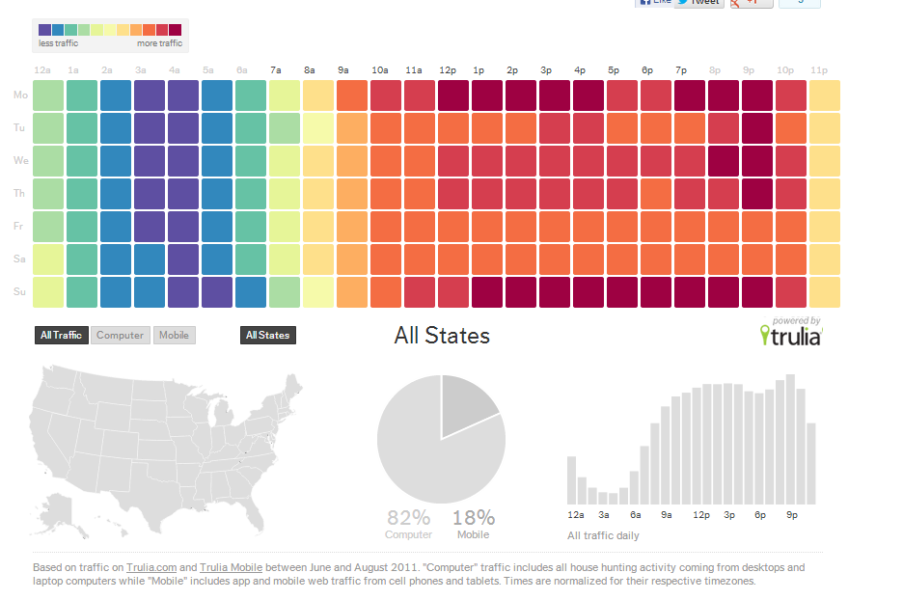
What is it?
D3.js is a JavaScript library for manipulating documents based on data.
Data + d3js = beautiful data
http://trends.truliablog.com/vis/tru247/

Slide 3
Transformation, not representation
VIEW
DATA
d3js
raphaeljs
bonsaijs
…
HTML, SVG and CSS

Slide 4


Selection
Selectors are defined by the W3C Selectors API and supported natively by modern browsers.

Slide 5
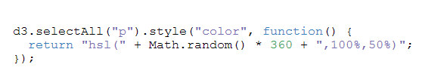

Dynamic property

Slide 6

Data bound

Slide 7

Data enter
5
7
9

Slide 8
Data enter (2)
5
7
9
9

Slide 9

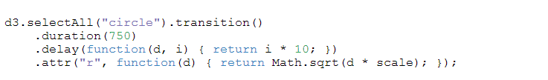
Transition

